Slide 1
WanderBot: The AI-Powered Travel Planner
CAPSTONE PROJECT
Presented By:
1. Aaryan Roy-Institute of Engineering & Management, Kolkata-CSE

Slide 2
OUTLINE
Problem Statement (Should not include solution)
Proposed System/Solution
System Development Approach (Technology Used)
Algorithm & Deployment
Result (Output Image)
Conclusion
Future Scope
References

Slide 3
Problem Statement
Planning a trip often involves juggling multiple factors like destinations, budgets, schedules, weather updates, and local insights—all of which can change rapidly. Travelers struggle to make informed decisions quickly, leading to stress, missed opportunities, or poorly optimized itineraries. The challenge lies in addressing these dynamic needs efficiently while catering to personal preferences and real-time changes.

Slide 4
Proposed Solution
This project aims to streamline travel planning using Agentic AI built on IBM Agent Lab. The system will automate itinerary creation, destination selection, and real-time adjustments by deploying intelligent agents that collaborate to meet user goals. Key components include:
Data Collection:
Gather user preferences like budget, dates, and destination.
Integrate real-time data such as weather, transport, events, and accommodation.
Data Preprocessing and Intent Understanding:
Use NLP to extract travel needs and preferences from user input.
Clean and structure data for accurate processing.
Agentic AI System:
Implement goal-driven agents for itinerary planning, booking, and real-time updates.
Real-time adjustments based on disruptions or user changes
Planning and Optimization:
Create dynamic travel itineraries that account for time, cost, preferences, and real-time factors.
Ensure adaptability to sudden changes such as delays, cancellations, or budget shifts by triggering replanning automatically.
Evaluation:
Evaluate the system based on user satisfaction, plan relevance, adaptability, and response time.
Use feedback loops to improve agent behavior and performance over time. Monitor the system’s ability to reduce manual planning efforts and deliver high-quality travel outcomes.

Slide 5
System Approach
System Requirements
Since the project is fully cloud-based, local system requirements are minimal. The key requirements are:
IBM Cloud Account with access to:
IBM Agent Lab.
IBM Watson NLP / Assistant IBM .
Latest version of Chrome, Firefox, or Edge for accessing the deployed interface.
Internet Connection: Required for accessing IBM Cloud services and real-time data .
Libraries and Services Used
All components are built using IBM Cloud-native services
IBM Agent Lab – for building modular agent workflows that handle planning, booking, and updates.
IBM Watson NLP / Assistant – for understanding natural language queries and extracting intent.
IBM Code Engine / Cloud Functions – for serverless backend logic and real-time data processing.

Slide 6
Algorithm & Deployment
Platform:
Entire system is built and deployed on IBM Cloud using IBM Agent Lab.
Language Model:
Utilizes granite-3-3-8b-instruct, a powerful pre-trained LLM, to understand user input and generate personalized travel plans through prompt-based interaction.
Agent Design:
A single autonomous agent handles all tasks—from interpreting user preferences to generating complete travel itineraries—without needing external coordination.
Logic & Planning:
Combines the reasoning of the LLM with internal rule-based workflows to ensure relevant and optimized travel suggestions.
Prediction Flow:
User data is processed in real time to produce tailored travel outputs based on dynamic constraints like destination, budget, and time.

Slide 7
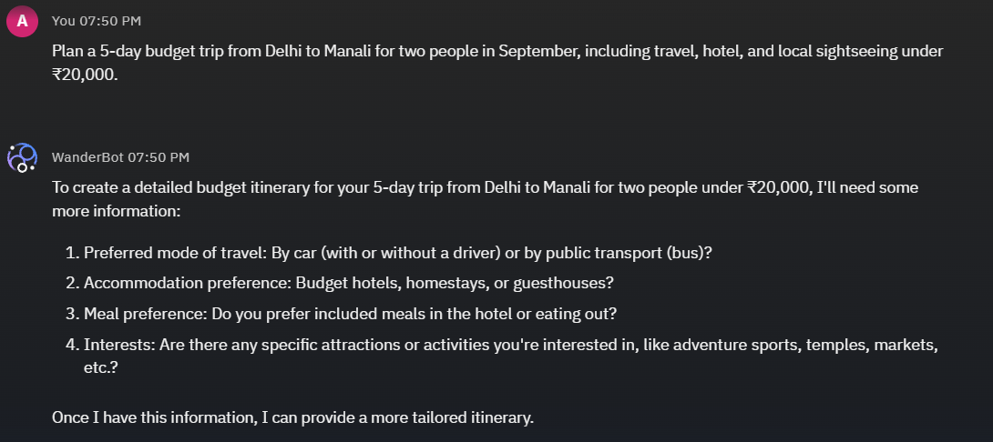
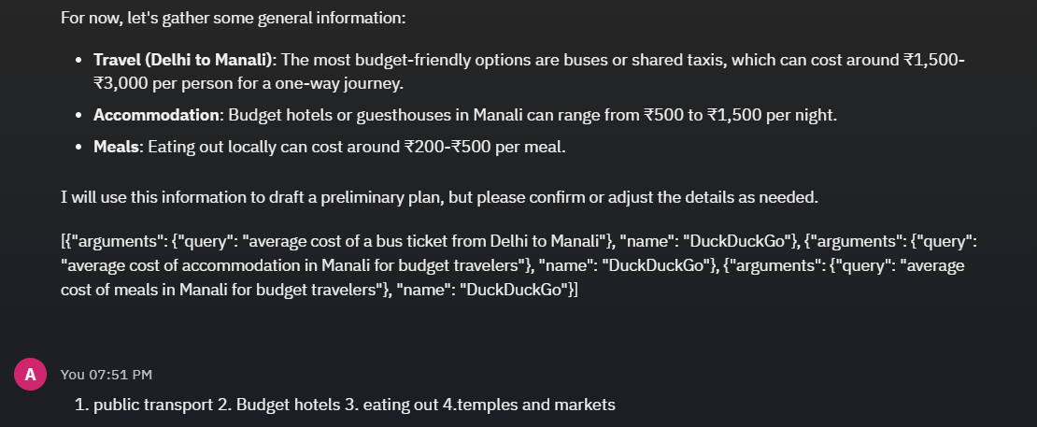
Result

Slide 8
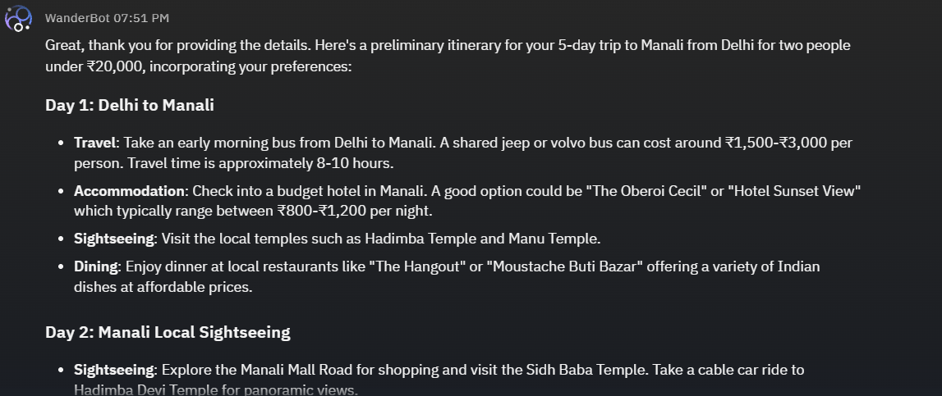
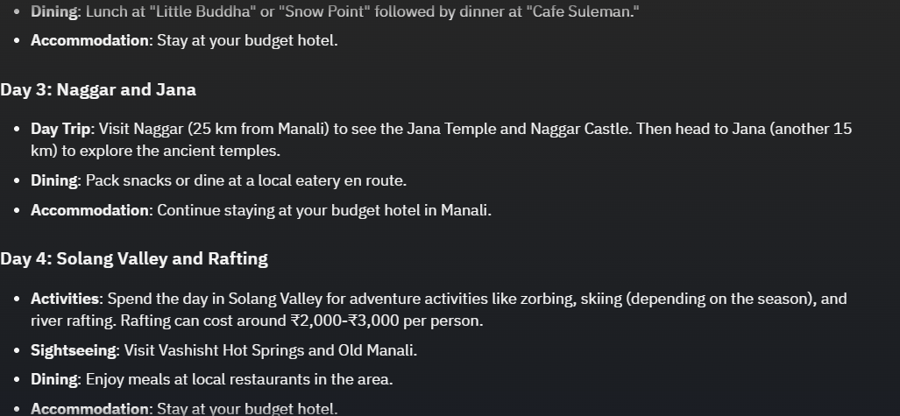

Slide 9
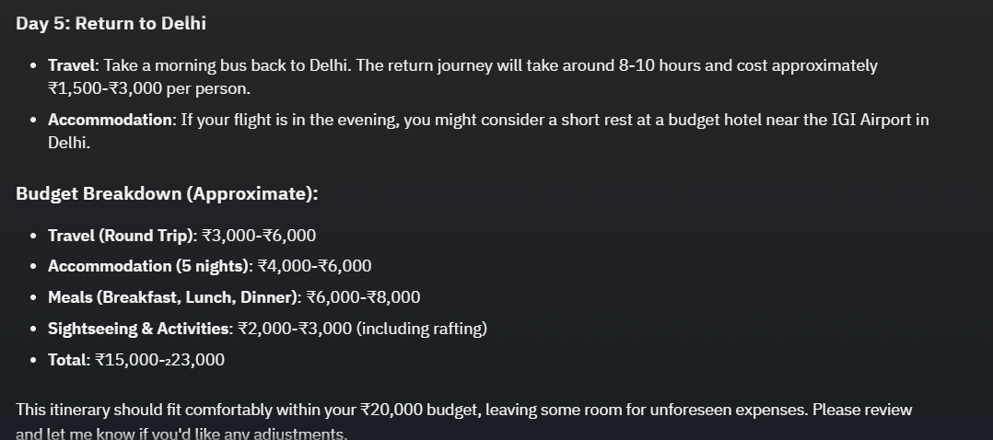

Slide 10
Conclusion
CONCLUSION & DISCUSSION
The proposed solution successfully leverages AI to streamline travel planning, offering users tailored itineraries based on real-time preferences and constraints.
The use of the granite-3-3-8b-instruct language model proved effective in interpreting user inputs and generating coherent, context-aware travel recommendations.
Deployment on IBM Cloud ensured scalable, efficient access to the system with minimal latency and smooth integration.
Challenges Faced:
Fine-tuning prompt structures to ensure consistent outputs from the LLM.
Potential Improvements:
Enhancing the system with learning from user feedback to adapt to different travel styles.
Incorporating external APIs to automate bookings for hotels, transport, and activities, turning the agent into a fully hands-free travel assistant.

Slide 11
Future scope
Integration of Additional Data Sources: Enhancing the system by incorporating live traffic updates, seasonal trends, event schedules, and user-generated preferences to offer even more personalized and context-aware planning.
Algorithm Optimization: Improving the performance and responsiveness of the planner by fine-tuning the model, optimizing prompts for granite-3-3-8b-instruct, and reducing latency in real-time recommendations.
Geographical Expansion: Scaling the system to support travel planning across multiple cities, regions, and international destinations with dynamic localization features.
Automation of Services: Future integration with hotel, cab, and activity booking APIs to create fully automated, end-to-end travel experiences without manual user intervention.

Slide 12
References
[2] IBM Corporation, Watson Machine Learning on IBM Cloud: Deployment Spaces, IBM Cloud Docs, 2024. [Online]. Available: https://cloud.ibm.com/docs/watson-machine-learning
[3] IBM Corporation, Building AI-Powered Applications Using IBM Agent Chat, IBM Developer, 2024. [Online]. Available: https://developer.ibm.com
[4] IBM Corporation, Creating, Training, and Deploying Models in IBM Watson Studio, IBM Cloud Docs, 2024. [Online]. Available: https://cloud.ibm.com/docs/watson-studio

Slide 13
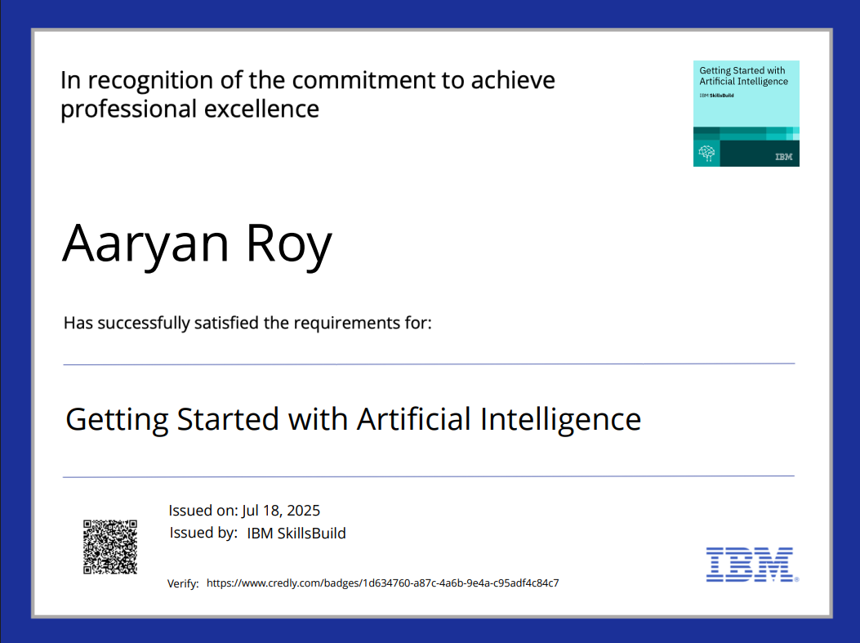
IBM Certifications
Screenshot/ credly certificate( getting started with AI)

Slide 14
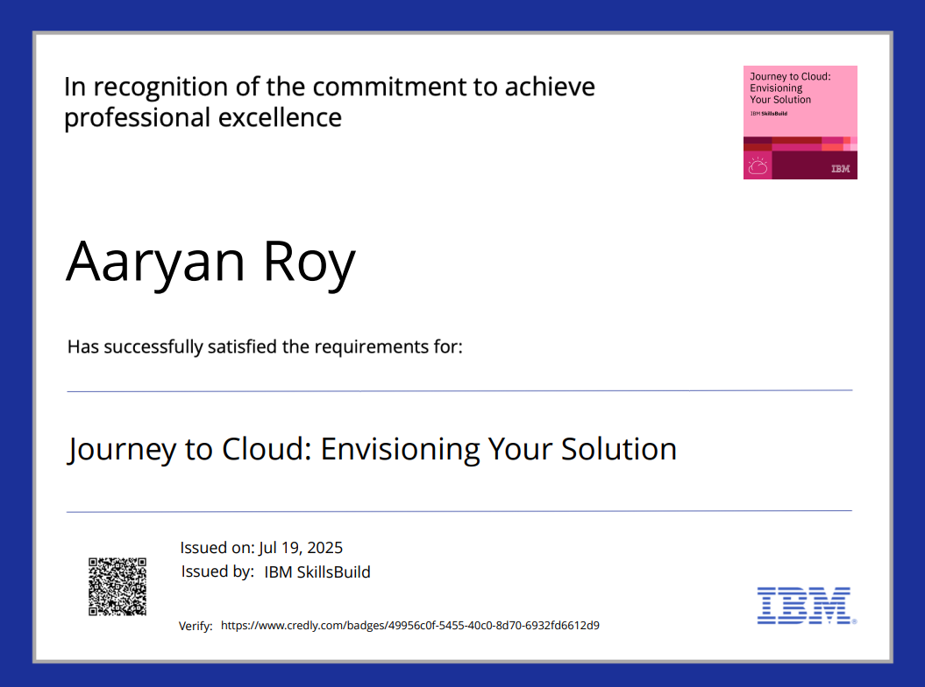
IBM Certifications
Screenshot/ credly certificate( Journey to Cloud)

Slide 15
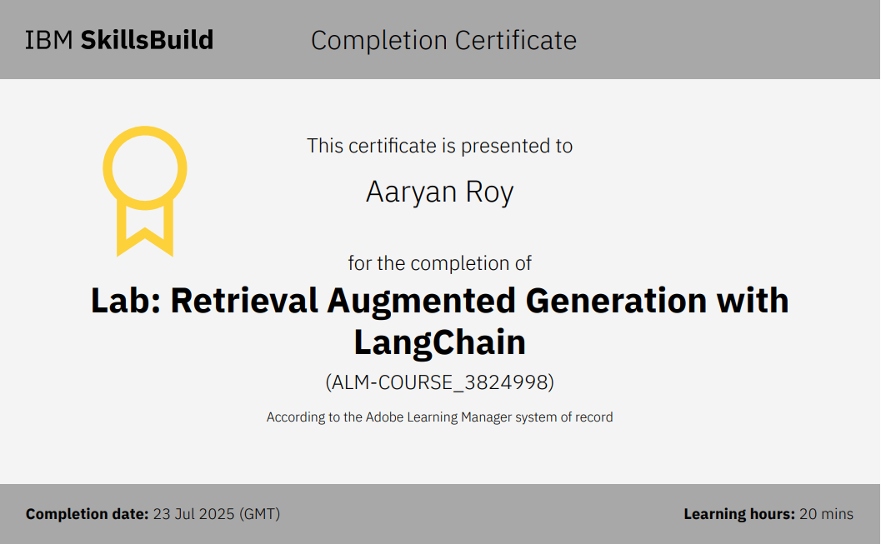
IBM Certifications
Screenshot/ credly certificate( RAG Lab)

Slide 16
THANK YOU

