Slide 1

Project Title:FINE-GRAINED TWO-FACTOR ACCESS CONTROL FOR WEB-BASED CLOUD COMPUTING SERVICES
Under the guidance of
Prof. Srinivas Prasad
Mini project co-ordinators
Dr A. Navya Sree
Dr L. SrinivasaChakravathi
Done by:
Nitin Kundu(121810306003),
R.Siva Sankar Varaprasad(121810306021)
K. Rohit Sai(121810306033)
K. Prithvi Raj(121810306046)
K Balaji(121810306062)

Slide 2

Contents
Abstract
Introduction
What is our Project
Drawbacks of current system
Advantages of proposed system
Architecture
Flow chart
conclusion

Slide 3
ABSTRACT
we introduce a new fine-grained two-factor authentication (2FA) access control system for web-based cloud computing services. Specifically, in our proposed 2FA access control system, an attribute-based access control mechanism is implemented with the necessity of both a user secret key and a lightweight security device. As a user cannot access the system if they do not hold both, the mechanism can enhance the security of the system, especially in those scenarios where many users share the same computer for web-based cloud services. In addition, attribute-based control in the system also enables the cloud server to restrict the access to those users with the same set of attributes while preserving user privacy, i.e., the cloud server only knows that the user fulfills the required predicate, but has no idea on the exact identity of the user. Finally, we also carry out a simulation to demonstrate the practicability of our proposed 2FA system.

Slide 4

Introduction
CLOUD computing is regarded as a prospective com-puting paradigm in which resource is supplied as service over the Internet. It has met the increasing needs of computing resources and storage resources for some enterprises due to its advantages of economy, scalability, and accessibility. Recently, several cloud stor-age services such as Microsoft Azure and Google App Engine were built and can supply users with scalable and dynamic storage. With the increasing of sensitive data outsourced to cloud, cloud storage services are facing many challenges including data security and data access control. To solve those problems, attribute-based encryption (ABE) schemes [1-3] have been applied to cloud storage services. Sahai and Waters [1] first proposed ABE scheme named fuzzy identity-based encryption which is derived from identity-based encryption (IBE) [4]. As a new proposed cryptographic primitive, ABE scheme not only has the advantage of IBE scheme, but also provides the character-istic of “one-to-m any” encryption. Presently, ABE mainly includes two categories called ciphertext -policy ABE (CP-ABE) [2] and key-policy ABE (KP-ABE) [3]. In CP-ABE, ciphertexts are associated with access policies and user’s private keys are associated with attribute sets. A user can decrypt the ciphertext if his attributes satisfy the access policy embedded in the ciphertext.

Slide 5
What is our Project
we propose a fine-grained two-factor access control protocol for web-based cloud computing services, using a lightweight security device. The device has the following properties. It can compute some lightweight algorithms, e.g. hashing and exponentiation; and it is tamper resistant, i.e., it is assumed that no one can break into it to get the secret information stored inside.
With this device, our protocol provides a 2FA security. First the user secret key (which is usually stored inside the computer) is required. In addition, the security device should be also connected to the computer (e.g. through USB) in order to authenticate the user for accessing the cloud. The user can be granted access only if he has both items.
Furthermore, the user cannot use his secret key with another device belonging to others for the access. Our protocol supports fine-grained attribute-based access which provides a great flexibility for the system to set different access policies according to different scenarios. At the same time, the privacy of the user is also preserved. The cloud system only knows that the user possesses some required attribute, but not the real identity of the user. To show the practicality of our system, we simulate the prototype of the protocol.

Slide 6
Drawbacks of current system
Key-insulated cryptosystem requires all users to update their keys in every time period. The key update process requires the security device.
Once the key has been updated, the signing or decryption algorithm does not require the device anymore within the same time period.
The traditional account/password-based authentication is not privacy preserving. However, it is well acknowledged that privacy is an essential feature that must be considered in cloud computing systems.
It is common to share a computer among different people. It may be easy for hackers to install some spyware to learn the login password from the web-browser.
The adversary acts as the role of the cloud server and tries to find out the identity of the user it is interacting with.
Access without Secret Key: The adversary tries to access the system (within its privileges) without any secret key. It can have its own security device.

Slide 7
Advantages of proposed system
Our protocol supports fine-grained attribute-based access which provides a great flexibility for the system to set different access policies according to different scenarios. At the same time, the privacy of the user is also preserved. The cloud system only knows that the user possesses some required attribute, but not the real identity of the user.
To show the practicality of our system, we simulate the prototype of the protocol.
Tamper-resistance. The content stored inside the security device is not accessible nor modifiable once it is initialized. In addition, it will always follow the algorithm specification.
It is capable of evaluation of a hash function. In addition, it can generate random numbers and compute exponentiations of a cyclic group defined over a finite field.
Presented a new 2FA (including both user secret key and a lightweight security device) access control system for web-based cloud computing services.
2FA access control system has been identified to not only enable the cloud server to restrict the access to those users with the same set of attributes but also preserve user privacy.

Slide 8
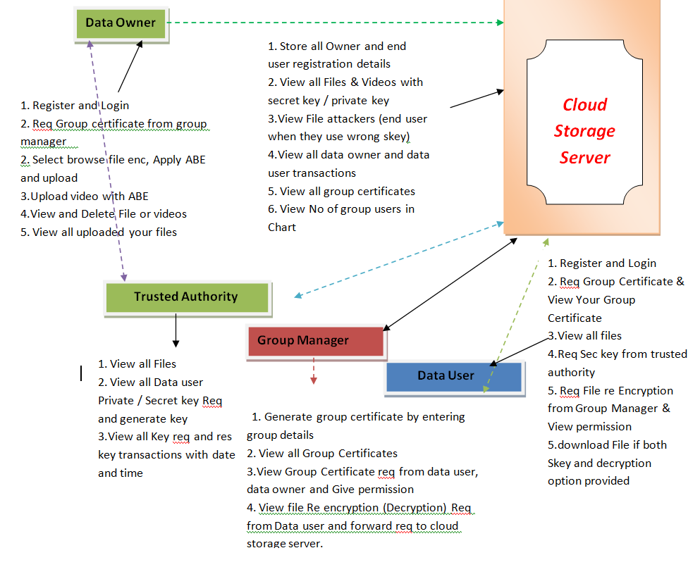
Architecture

Slide 9
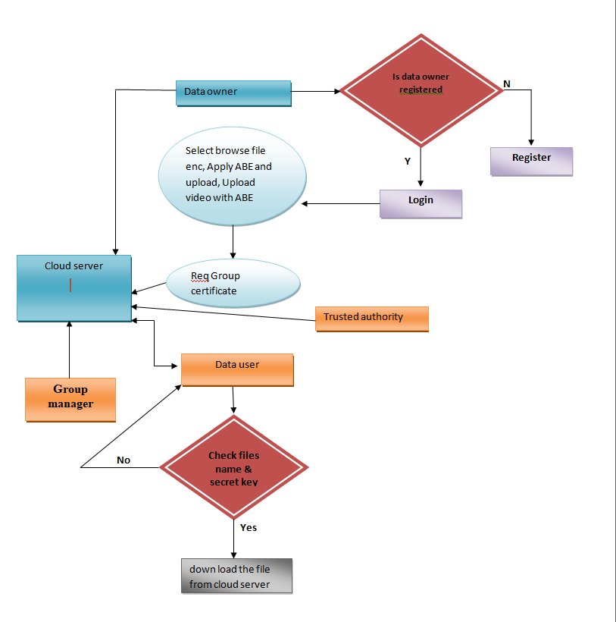
Flow Chart
.

Slide 10
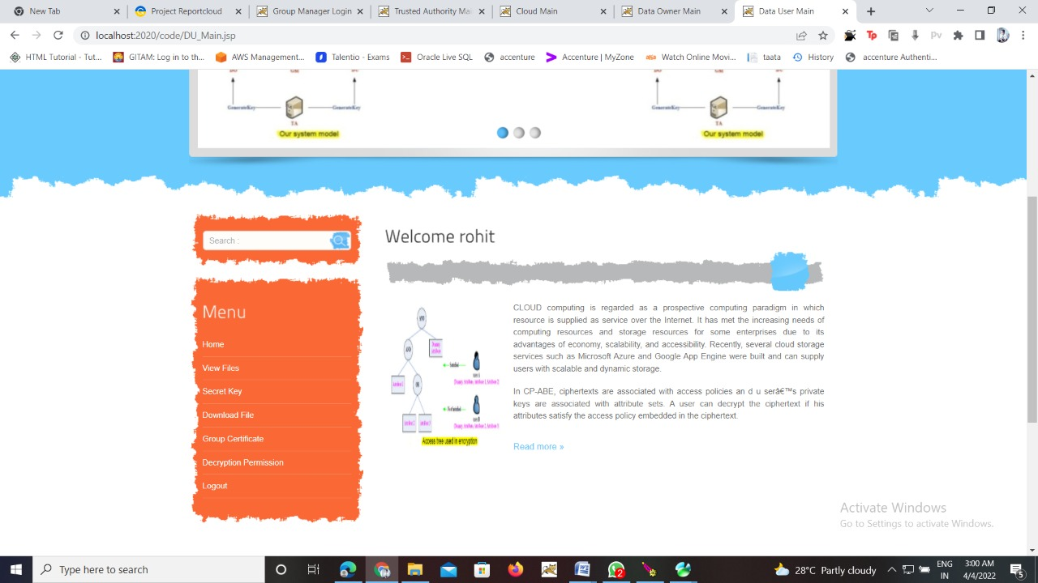
Working

Slide 11
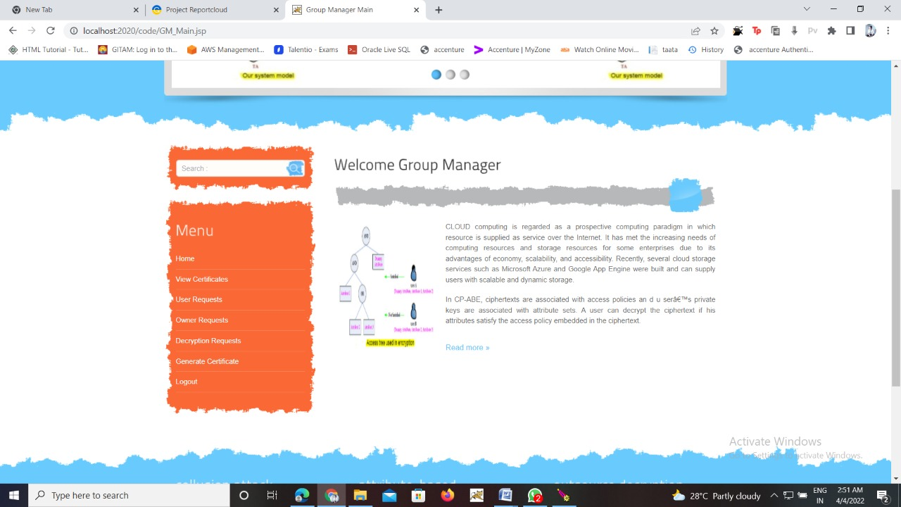

Slide 12
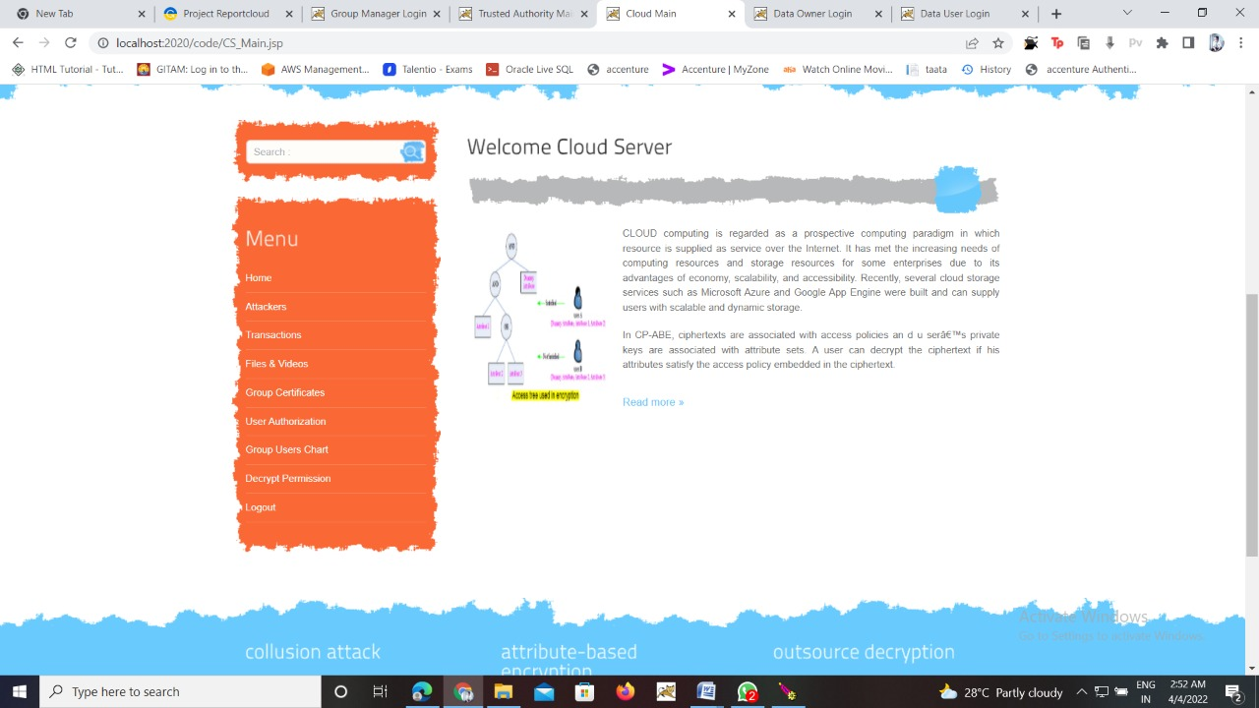

Slide 13
Conclusion
As technology continues to evolve with more focus on the individual user, authentication security will only become more exciting and more important. I foresee a time in which the many wearable and mobile devices we possess will become a core aspect of authentication, with many methods used across two or three factor classes, providing for greater authentication intelligence. 2FA is one of the most effective ways to protect your accounts from unauthorized access and improve data security within your household or business. Today most websites and apps offer some sort of 2FA, and we highly recommend making use of it.

Slide 14
Thank you

