Slide 1
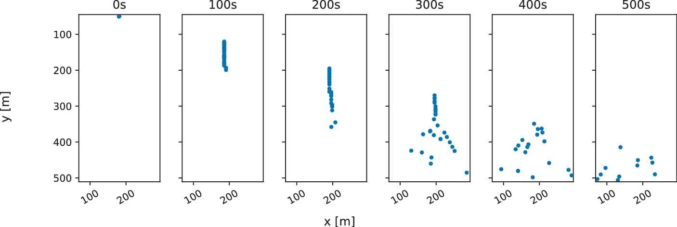
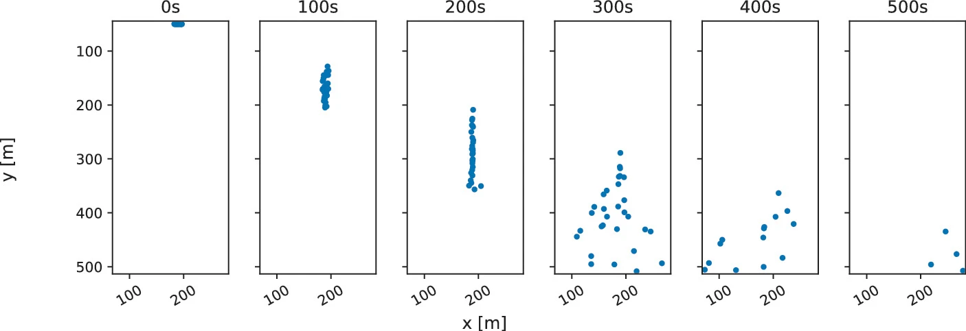

Stripe model SUMO
Optimal Steps Model Vadere
Stripe model SUMO
Optimal Steps Model Vadere
COARSE
EFFORT
Pedestrians move on a 1D stripe.
Pedestrians move in the 2D space.
Define multiple stripes to force 2D movement.
Get realistic 2D movement from the model itself.

Slide 2
