Slide 1
Programming Principles II
Operator Overloading
Dr. Ahmed Awad

Slide 2
What is Operator Overloading?
Function-call notation is cumbersome for certain kind of classes.
      Such as mathematical classes.
      A + B is more convenient that A.add(B)
Operator overloading: Enable default programming language operators to work with objects.
Examples of overloaded operators in C++:
      >>: 1. used for stream insertion.
      2. used for bitwise left shift operation.
      <<: 1. used for stream extraction.
      2. used for bitwise right-sift operation
C++ enables to overload most operators to be sensitive to the context in which they are used.
The jobs performed by overloaded operators can be used by explicit function calls (Not familiar).

Slide 3
Fundamentals of Operator Overloading
Operators provide programmers with a concise notation for expressing manipulations of objects.
C++ does not allow new operators to be created.
C++ does allow existing operators to be overloaded so that it can be used with objects.
Most programmers implicitly use overloaded operators regularly.
    Example: + operator.
    int A=5, B=7; float x=1.2, y=3.7;
    A=A+B ; x=x+y;
Those + operators behave differently.

Slide 4
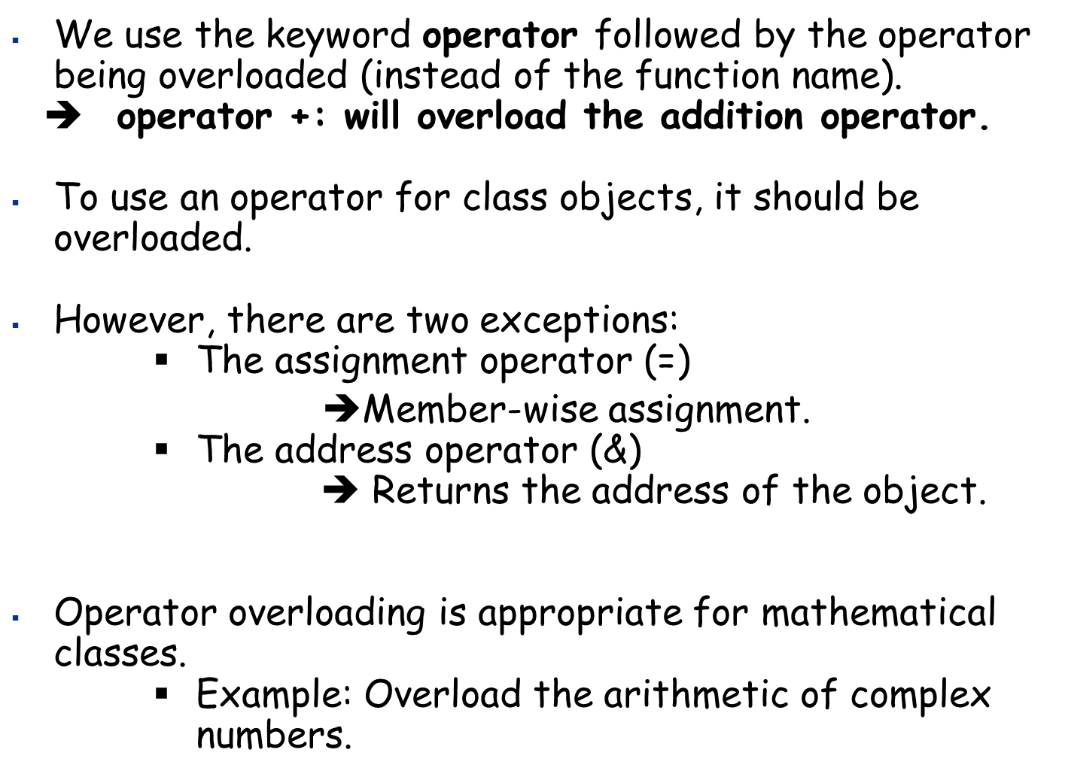
Fundamentals of Operator Overloading (2)

Slide 5
Restrictions on Operator Overloading
The following operators cannot be overloaded:
1) .
2) .*
3) ::
4) ?:
It is not possible to change the arity of an operator.
      Overloaded unary operators remain unary operators.
      Overloaded binary operators remain binary operators.
The meaning of how an operator works on objects of built-in types cannot be changed by operator overloading.
➔ Overloaded operator works only with objects of user-defined types or a mixture of object types and built-in types.
Example: obj2 = obj2+ obj1
We cannot conclude that += has been overloaded
➔ obj2+=obj1 (this is wrong)

Slide 6
Operator Functions: Class Members VS Friend Functions
If the operator function is a member function, then it uses the this pointer implicitly to be the left operand of the operator.
If the operator is non-member function, then both operands of a binary operator must be explicitly listed.
A + B
Operator + function is defined in class X, then, the left operand of the operator + should be an object of type X.
➔ operator+(You only have to list B)
Operator + function is not a member function of X (or any other class), then, both the left and right operands should be explicitly listed.
➔ operator+(list A and B)

Slide 7
What is the Best Implementation for the Operator Function: Member function or friend function?
When an operator function is implemented as a member function, the left most operand must be an object of the operator function class.
If the leftmost operand must be an object different from the class type of the operator class, then the operator function must be non-member function.
Example: cin>>x
It needs to be a friend function if it must access private or protected data members of the class.
It needs to be a friend function to have the operator commutative.

Slide 8
Overloading Stream Insertion and Stream Extraction
Stream Extraction Operator << and stream insertion operator >> are overloaded to process built-in data types, such as char* string.
Stream-insertion and extraction operators can be overloaded to perform input and output user-defined types.
Example: Overload stream insertion and stream extraction operator to input/ouput phone numbers.
Phone number is written the form:
(0972)(0002)123456
code
Area
Telephone

Slide 9
Overloading Stream Insertion and Stream Extraction
class phone {
friend istream& operator >>(istream&, phone&);
friend ostream& operator << (ostream&, phone&);
public:
phone();
void set(const char*, const char*, const char*);
private:
char Tel[7];
char Area[5];
char code[5];
};
phone::phone()
{
set("0000", "0000", "000000");
}
void phone::set(const char* c, const char* a, const char* t)
{
strcpy(Tel, t);
strcpy(Area, a);
strcpy(code, c);
}

Slide 10
Overloading Stream Insertion and Stream Extraction
istream& operator >> (istream& input, phone& p)
{
cout << "Enter the code" << endl;
input >> p.code;
cout << "Enter the area" << endl;
input >> p.Area;
cout << "Enter the telephone" << endl;
input >> p.Tel;
return input;
}
ostream& operator <<(ostream& output, phone& p)
{
output << "(" << p.code << ")" << "(" << p.Area << ")" << p.Tel << endl;
return output;
}

Slide 11
Overloading Stream Insertion and Stream Extraction
void main()
{
phone num;
cout << "Enter phone number in the form (1234)(1112)(123123)" << endl;
cin >> num;
//num.set("1234", "3314", "123123");
cout << num;
}

Slide 12
Array Class- Declaration
class Array {
friend istream& operator>> (istream&, Array&);
friend ostream& operator<< (ostream&, Array&);
public:
Array(int = 10);
Array(Array&);
static int arrayCount();
Array& operator= (Array&);
bool operator==(Array&);
bool operator!=(Array&);
int operator[](int);
int getSum() const;
int getSize() const;
private:
int size;
int* ptr;
static int count;
};

Slide 13
Array Class- Functions Implementation
int Array::count = 0;
int Array::arrayCount()
{
return count;
}
Array::Array(int s)
{
size = (s > 0 ? s : 10);
ptr = new int[size];
for (int i = 0; i < size; i++)
ptr[i] = 0;
count++;
}
Array::Array(Array& A):size(A.size)
{
ptr = new int[size];
for (int i = 0; i < size; i++)
ptr[i] = A.ptr[i];
count++;
}

Slide 14
Array Class- Functions Implementation
int Array::getSum() const
{
int sum = 0;
for (int i = 0; i < size; i++)
sum += ptr[i];
return sum;
}
int Array::getSize() const
{
return size;
}

Slide 15
Array Class- Operator Overloading Friend Functions
istream& operator>>(istream& input, Array& A)
{
for (int i = 0; i < A.size; i++)
input >> A.ptr[i];
return input;
}
ostream& operator<<(ostream& output, Array& A)
{
for (int i = 0; i < A.size; i++)
output << A.ptr[i] << " ";
return output;
}

Slide 16
Array Class- Operator Overloading Member Functions
Array& Array::operator= (Array& R)
{
if (*this != R)
{
delete[] ptr;
size = R.getSize();
ptr = new int[size];
for (int i = 0; i < size; i++)
ptr[i] = R.ptr[i];
}
return *this;
}
bool Array::operator==(Array& R)
{
if (size != R.getSize())
return false;
for (int i = 0; i < size; i++)
{
if (ptr[i] != R.ptr[i])
return false;
}
return true;
}

Slide 17
Array Class- Operator Overloading Member Functions
bool Array::operator!=(Array& R)
{
return !(*this == R);
}
int Array::operator [](int x)
{
return ptr[x];
}

Slide 18
Array Class- Test Program
void main()
{
Array A1, A2(7);
cin >> A1;
cin >> A2;
Array A3(A2);
if (A2 == A3)
cout << "They are equal" << endl;
else
cout << "They are different" << endl;
cout << A1[5] << endl;
}

Slide 19
Overloading Unary Operators
Can be overloaded as:
      Non-member function with one argument
      class X{
      friend bool operator! (X&)
      Non-static member function with no arguments.
      class X{
      public:
      bool operator!();

Slide 20
Converting Between Types
It is often necessary to convert data of one type to data of another type.
      This might be required in assignments, calculations, passing values to functions.
We use cast operators to perform conversion between built-in types.
cout<<(float)x;
float y=5.7;
int x=(int)y;
The compiler cannot know in advance how to convert between user-defined types.
➔ We need conversion (cast) operator

Slide 21
Conversion (Cast) Operator
Used to convert an object of one class into another class or built-in type.
Must be a non-static member function.
Cannot be a friend function.
No return type is specified (
➔Return type is the type to which the object is being converted).
Example:
A:: operator char* () const;
➔ A cast operator to convert an object of user-defined type A to a char* object.
➔ If the compiler sees (char *)s where s is an object of type A, then the cast operator function is called.

Slide 22
Conversion (Cast) Operator
A:: operator int() const;
➔ Overloaded cast operator that can convert an object of user-defined type A to an integer.
A:: operator otherClass() const;
Overloaded cast operator that can convert an object of type A into an object of type otherClass.
The compiler can call the cast operator functions implicitly to create temporary objects.
Example:
cout<<x
If we assume that x is an object of a type that can be cast to (char*), then the compiler will call the proper cast operator to convert x into (char*) type.

