Slide 1



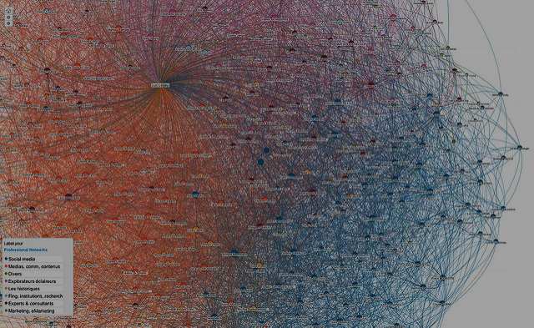
Predicting Short-term Cryptocurrency Volatility using Twitter Data
Jacob Roach
INTRODUCTION
Methodology
BODY TEXT
BODY TEXT
FINDINGS
ADD PHOTOS/VISUALS
TO ENHANCE THE APPEAL
OF YOUR POSTER
CONCLUSION and NEXT STEPS
BODY TEXT
BODY TEXT
ADD PHOTOS/VISUALS
TO ENHANCE THE APPEAL
OF YOUR POSTER
REFERENCES and ACKNOWLEDGEMENTS
ADD PHOTOS/VISUALS
TO ENHANCE THE APPEAL
OF YOUR POSTER
Purdue Undergraduate Research Conference 2022

