Slide 1
Predict Diabetes with Demographics, Behaviors and Health Conditions
Yu Fu, Hao Li, Nina Nguyen

Slide 2
Background
As of 2015, 30.3 million Americans
9.4 percent of the U.S. population have diabetes
Another 84.1 million have prediabetes
Diabetes was the seventh leading cause of death in the U.S. ------National Diabetes Statistics Report 2017
Demographics and daily human behaviors have some correlations with diabetes

Slide 3
Research Goal
Build predictive model using
Demographics
Daily behaviors
Current health conditions
Identify important features in predicting diabetes
Study correlations between diabetes and these features

Slide 4
Data Resources
Behavioral Risk Factor Surveillance System Dataset (BRFSS)
Health-related telephone surveys that collect state data about U.S. residents
50 states
>400,000 adults interviewees
Risk behaviors, chronic health conditions, and use of preventive services

Slide 5
Variables
Target (y) variable: Binary indicator of diabetes status: 0 / 1
Feature (X) variables:
Demographics
Health Status and Conditions
Healthcare Access, Check and Treatments
Behavior: Smoking, Alcohol Consumption, Sleep, Exercise, Drive and Sun Exposure

Slide 6
EDA and Data Cleaning
Cleaning and transforming 176 variables
Continuous, Binary Categorical, Multi Categorical
For binary categorical variables, mapping values to 0 and 1
For multiple categorical variables, apply one-hot encoding
Most of cleaning are easy. Don’t know / Refused / Missing -> NA values
Outlier detection and clipping by IQR. Bound by [Q1 - 1.5IQR, Q3 + 1.5IQR]
Unit Conversion (Example: ALCDAY5, number of drinking days)
101 - 107: 1-7 days per week -> ((X - 100)/ 7 )* 30
201 - 230: 1-30 days per month -> X - 200
Missing data in X variables
Number of variables with NA percentage 50% or higher: 112/176
Plot data distribution before and after cleaning

Slide 7
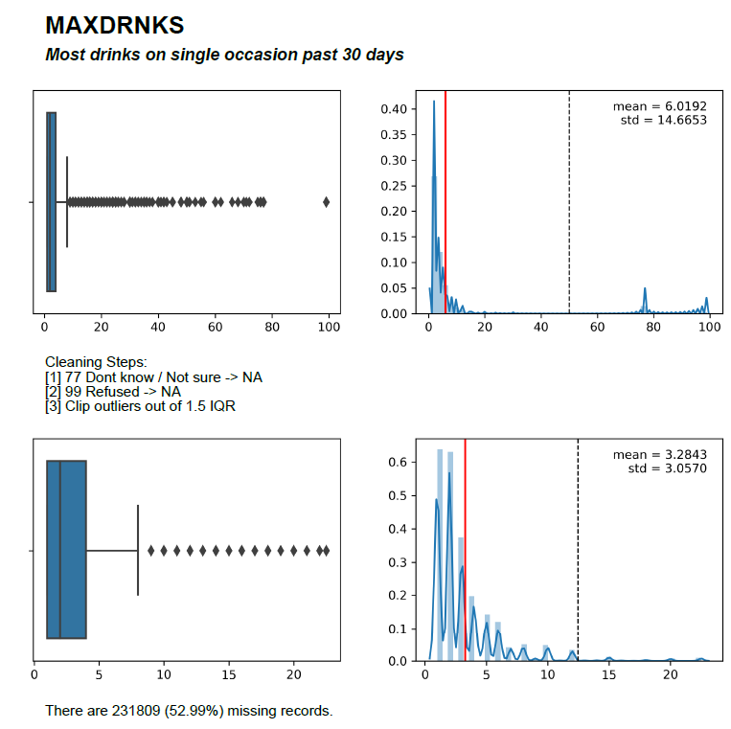
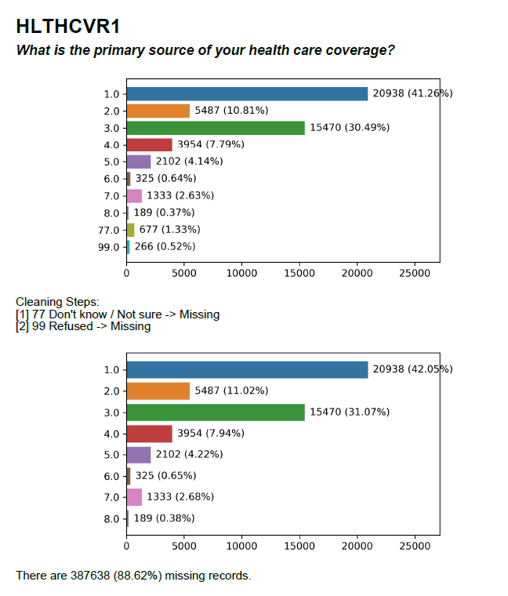
EDA and Data Cleaning

Slide 8
Solutions/Algorithm
Started with Random Forest
Doesn’t handle missing values in predictors
XGBoost
Directions for NA values of each feature is learned
Ensemble by gradient boosting - learn to cover mistakes (residual errors) of previous classifier
Hyperparameter Tuning
Grid search with 5-fold cross validation
Use AUC ROC as metric (F1 is not good, need to consider more thresholds)
Hyperparameters to tune:
Number of trees in ensemble
Max depth of trees
Number of features used in each tree
Learning rate

Slide 9
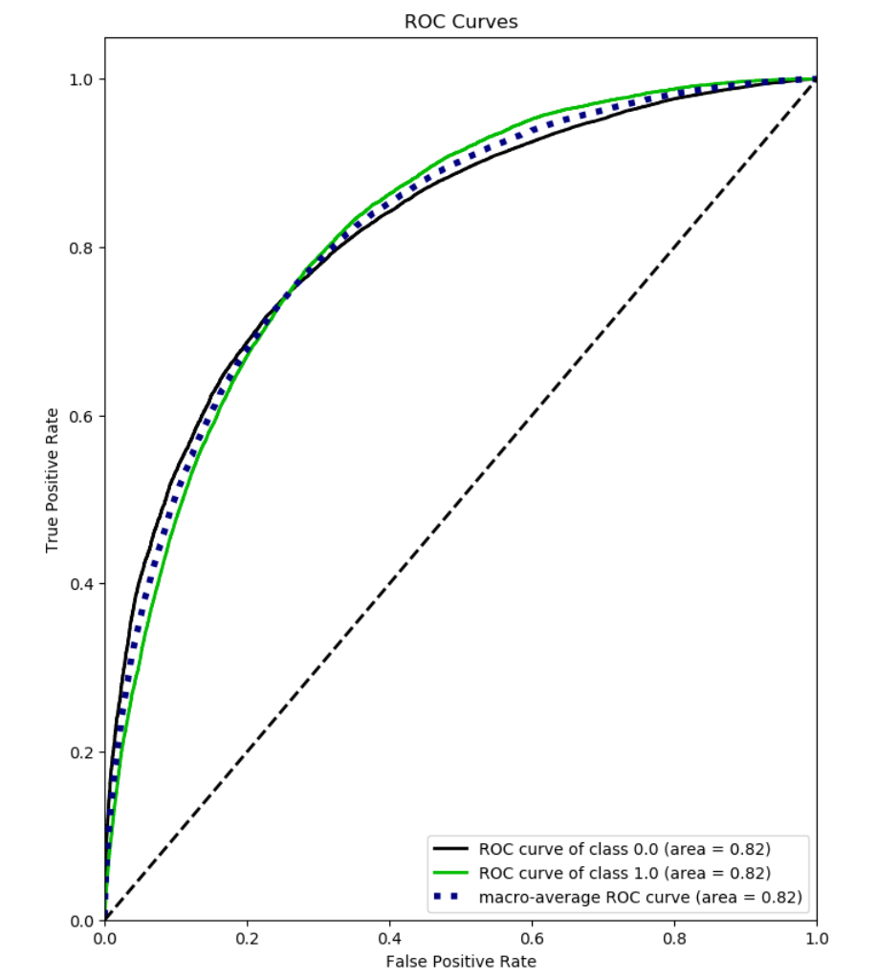
Performance Checking
AUC(Area Under The Curve)
ROC (Receiver Operating Characteristics)
Performance measurement for classification problem
ROC is the curve of sensitivity and specificity on different thresholds
Higher the AUC, better the model is at predicting
Training model has AUC of 0.85 and Test model has AUC of 0.82

Slide 10
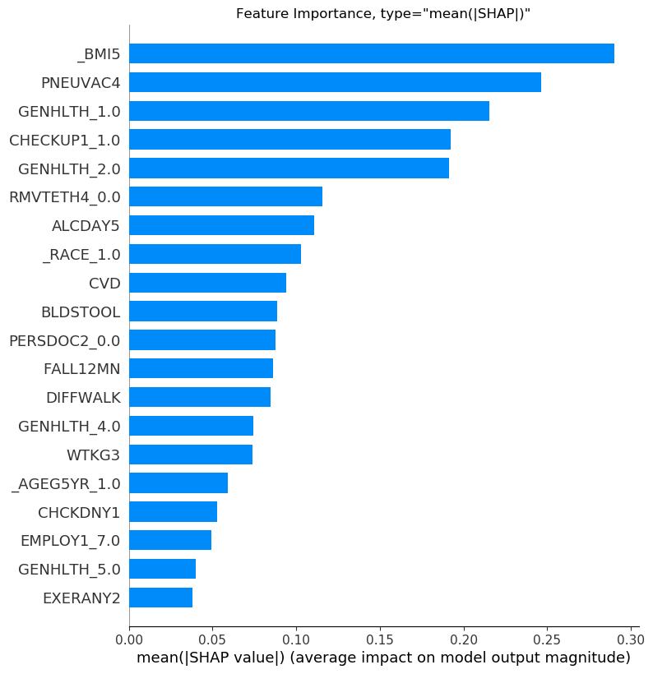
Feature Importance
SHAP Values: A consistent and accuracy feature importance score that gives more explanation
Weight: The number of times a feature is used to split the data across all trees
Gain: The average training loss reduction gained when using a feature for splitting

Slide 11
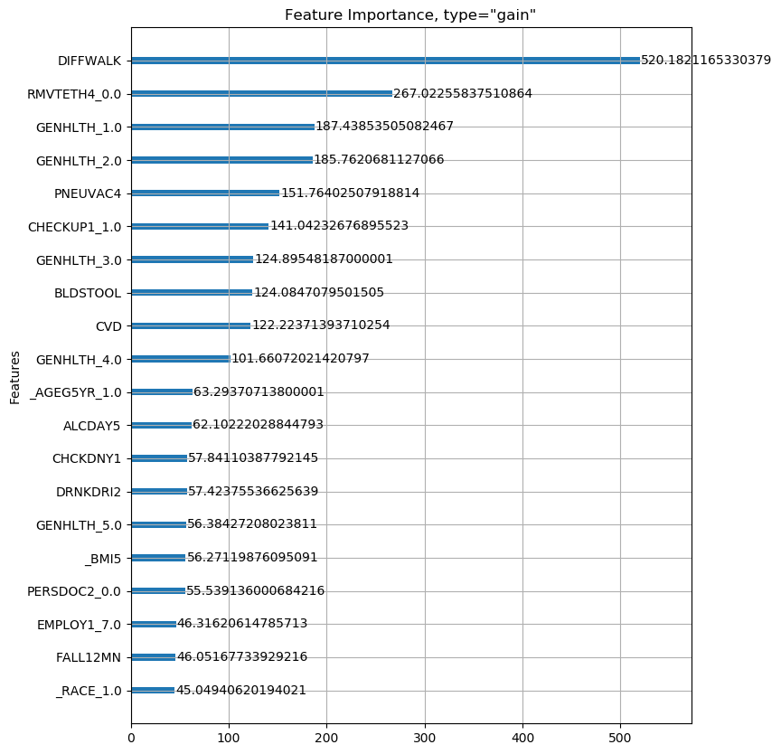
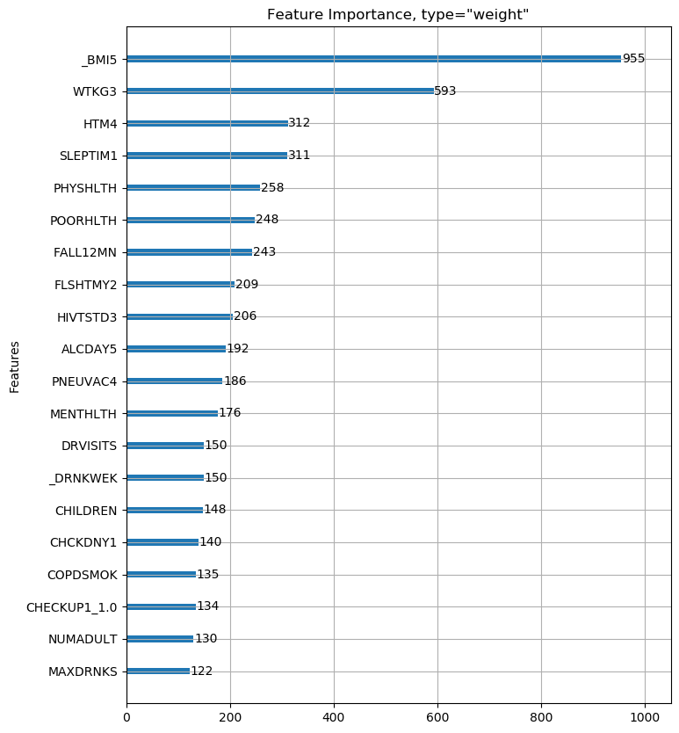

Slide 12
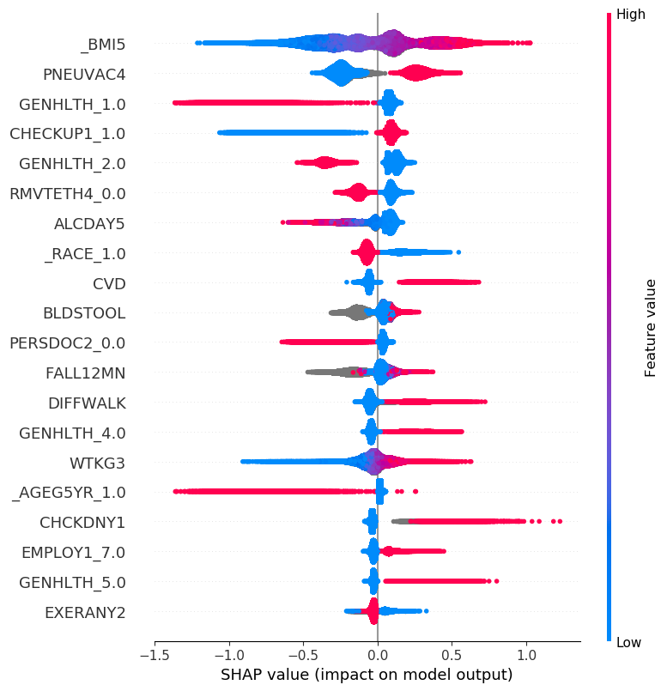
Result Interpretation
High BMI has a strong positive impact of diabetes, while low BMI has a strong negative impact.
Pneumonia (lung infection) vaccination is recommended for diabetes patients. Our model catches the relationship.
People identifying as being good health has a strong negative impact on diabetes. However, identifying as being poor health does not have a strong positive impact on diabetes.
High alcohol consumption seems to have a negative impact on diabetes. Which direction is the causal relationship?

Slide 13
Future Work
Model fine-tuning with more hyperparameters and larger search space
The connection between multiple years of BRFSS survey data
Population segmentation studies by demographics, by behaviors, or by unsupervised clustering
Data collection or augmentation for minority groups.
Experiments to test the causal hypothesis that can be derived from the current predictive model

