Slide 1
ETLBox
It's all in the box! Run all your ETL jobs with this awesome C# class library.

Slide 2


Andreas Lennartz
C# developer since 2001 (.NET 1.1)
~10 years experience with BI systems
~8 years with Microsoft Sql Server
Dived deep into ETL with SSIS ( e.g., see my Github Repos)
Created an SSIS which run sucessful
Programmed my own task
https://github.com/roadrunnerlenny/ssiswaittask
Created packages programatically
https://github.com/roadrunnerlenny/programmingSSIS
Replaced SSIS packages with pure C# code
https://github.com/roadrunnerlenny/etlbox
Author of „Mehr als Clean Code“
www.andreaslennartz.de
Slides and Code of this presentation on GitHub:
https://github.com/roadrunnerlenny/etlbox
https://github.com/roadrunnerlenny/etlboxdemo

Slide 3
ETLBox – what it is
C# library offering some useful classes to the end-user
It has two different “task types”
“Control flow tasks” – basically tasks that fire sql on a db
“Data flow tasks” – a data pipeline processing data row by row in memory
(Terminology leaned on SSIS terms)
The goal is to have an easy-to-use C# library to create complex ETL routines
Alternative to SSIS
Some basic logging functionalities are included (optional to use)

Slide 4
Control Flow Tasks
SqlTask – Execute some sql on the DB
Row count
CRUD a stored procedure
Connection managers (dynamic or static)
More: CreateTableTask, TruncateTableTask, CalculateDatabaseHashTask, CleanUpSchemaTask, CreateIndexTask, GetDatabaseListTask, RestoreDatabaseTask, XmlaTask, DropCubeTask, ProcessCubeTask, AddFileGroupTask, ConnectionManager (Sql, SMO, AdoMD, AS, File), ControlFlow, Package, Sequence, CustomTask, ...
SqlTask.ExecuteNonQuery("Do some sql",$@"EXEC dbo.myProc");
int count = RowCountTask.Count("demo.table1").Value;
CRUDProcedureTask.CreateOrAlter("demo.proc1", "select 1 as test");
ControlFlow.CurrentDbConnection = new SqlConnectionManager(new ConnectionString("...connection string..."));

Slide 5
Control Flow Example
→ Live Coding

Slide 6
Logging
Logging is completely based on NLOG
Every task outputs a log message when executed into table etl.Log
each etl process can store run data in table etl.LoadProcess
Example code :
CreateLogTablesTask.CreateLog();
StartLoadProcessTask.Start("Process 1");
ControlFlow.STAGE = "Staging";
SqlTask.ExecuteNonQuery("some sql", "Select 1 as test");
ControlFlow.STAGE = "DataVault";
Sequence.Execute("some custom code", () => { });
LogTask.Warn("Some warning!");
EndLoadProcessTask.End("Everything successful");

Slide 7
Logging example
→ Live Coding
Demo LogViewer (Preview)

Slide 8
Dataflow task
Create own pipeline:
Define
Link
Execute
Source
Destination
Transformation
Buffer
Buffer
Buffer
Buffer
DBSource<MySimpleRow> source = new DBSource<MySimpleRow>("select * from dbo.Source");
RowTransformation<MySimpleRow, MySimpleRow> trans = new RowTransformation<MySimpleRow, MySimpleRow>(
myRow => { myRow.Value2 += 1;
return myRow;
});
DBDestination<MySimpleRow> dest = new DBDestination<MySimpleRow>("dbo.Destination");
source.LinkTo(trans);
trans.LinkTo(dest);
source.Execute();
dest.Wait();

Slide 9
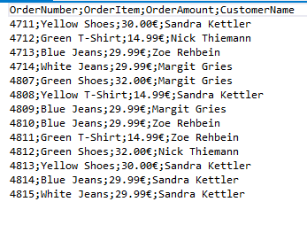
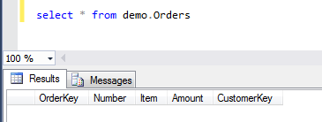
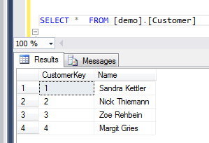
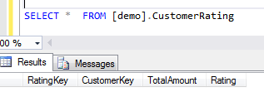
Order
DBDest
CSVSource
String[]
Order
BlockTrans
RateCustomer
Order
Order
Custom Sink
> null
String[]
Order
Rating == null
RowTrans
CSV into Order object
Order
Order
Lookup customer key
Order
Order
Multicast
Order
Order
Rating != null
Order
Customer
RowTrans
OrderIntoRating
Customer
DBSource
Rating
Rating
DBDest

Slide 10
Advantages of ETLBox
Build ETL in C#
Run Locally
Process In-Memory
Code your ETL with a language fittingyour team’s skills and that is coming with a mature toolset
Develop and test your ETL code locally on your desktop using your existing development & debugging tools.
ETLBox comes with dataflow components that allow in-memory processing which is much faster than storing data on disk and processing later.
Know your errors
Manage Change
Embedded or standalone
When exceptions are raised you get the exact line of code where your ETL stopped, including a hands-on description of the error.
Track you changes with git (or other source controls), code review your etl logic, and use your existing CI/CD processes.
(Preview) With .net core and .net standard, etlbox will very likely become a self-deploying toolbol – usable where .net core runs.

Slide 11
Why not SSIS?
SSIS (and most other) ETL tools come with some overhead
SSIS – the unloved child of MS?
Programming API of SSIS is not very good
Own API not really documented (see also https://github.com/roadrunnerlenny/programmingSSIS)
BIML: is build on top of it, and working good, but it’s xml-first
There are probably a lot of use cases where you would like to write you own ETL in C# - but there is no adequate library out there
(please prove me wrong here)
Data Pipeline (in java) has a similar approach
https://northconcepts.com/

Slide 12
Thank you for your attention!

