Slide 1
.NET and Multimedia
Sound, Video and Graphics with C#

Slide 2

.NET and Multimedia?
No(!) build-in classes for audio/video playback or capture
Build-In Classes for Drawing: System.Drawing
But no complex graphics (e.g. 3D)

Slide 3

System.Drawing
Access to GDI+ basic graphics functionality
Advanced functionality with System.Drawing.Drawing2D, System.Drawing.Imaging, and System.Drawing.Text.
Graphics class provides methods for drawing to the display device.
Classes such as Rectangle and Point encapsulate GDI+ primitives.
Pen class is used to draw lines and curves, while classes derrived from the abstract class Brush are used to fill the interiors of shapes.

Slide 4

Managed DirectX
A (Low-Level) API for .NET is needed
Solution: Managed DirectX
Actual Version: Managed DirectX 9.0
Provides nearly same functionality like DirectX 9.0
Designed by Microsoft

Slide 5

Managed DirectX Overview
Set of low-level application programming interfaces (APIs)
for creating high-performance multimedia applications.
Consists of
  Direct3D Graphics
  DirectDraw (Deprecated)
  DirectInput
  DirectPlay (Deprecated)
  DirectSound
  Audio Video Playback

Slide 6

Requirements & Advantages
Requirements
Official: minimum required OS
  Runtime: Windows 98.
  SDK: Windows 2000.
Inofficial: No .NET for 98.
  At least Windows 2000
  but to have fun Win XP
Benefits of Managed Code versus unmanaged
eliminating COM interoperability layer, DirectX improves performance
Managed code reduce volume of code, increase productivity.
Interface is more intuitive, inheriting from.NET Framework
Managed code handles memory management

Slide 7
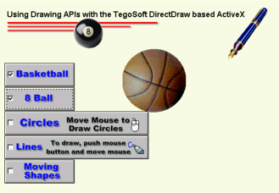
DirectDraw (Deprecated)
low-level API for 2D-Graphics
Decaprecated since DirectX 8.0
All the functionality for 2D is now in the DirectXGraphics Library
DirectDraw API is to directly manipulate display memory, the hardware blitter, hardware overlay support, and flipping surface support, doing all 2D-stuff

Slide 8
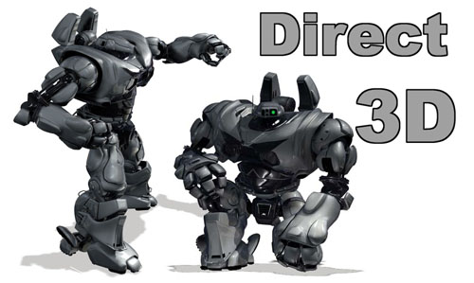
DirectX(3D) Graphics
API to manipulate visual models of 3-dimensional objects
Take advantage of hardware acceleration like video graphics cards.
DirectX Graphics: Support of 2D- and 3D-Graphics
low-level API (Direct3D) and high-level API (Direct3DX)
Low-level API for complex graphics (e.g. 3D-Games), high-level for fast (or faster) development
Direct3DX is based on Direct3D

Slide 9
DirectX(3D) Graphics II
DirectX Graphics directly uses the hardware beside the Graphics Device Interface (GDI) and Display Device Interface (DDI).
Not hardware supported functions will be software emulated by DirectX with HEL.
HEL: Hardware Emulation Layer, using GDI
Support of Flipping, Blitting, Clipping, 3D Z-Puffer, Overlays, direct Control of video data stream from the hardware (Video-Port Manager).

Slide 10
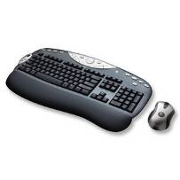


DirectInput
process data from a
  keyboard
  Mouse
  Joystick
  game controller

Slide 11

DirectPlay (Deprecated)
tools to develop multiplayer applications (e.g. games)
Provides layer that isolates application from underlying network.
DirectPlay handles details of network communication.
DirectPlay provides features to simplify process of implementing many aspects of a multiplayer application
Negative: has a giant Overhead and is platform-dependend
Not often used by Gaming Industry

Slide 12
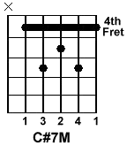
DirectSound
play wav sounds through
various playback devices
using special effects:
  Echo, Chorus, Compressor, Distortion, Flanger, Gargle, interactive3DLevel2Reverb, ParamEqualizer, WavesReverb
Advanced 3D positioning effects

Slide 13
Structur
Static Input Buffer
(File…)
+
Effects
=
Output Buffer
Dynamic Input Buffer
(Mic-Streaming…)
1..n Secondary Sound Buffers
(Hardware/Software)
Filters
1 Primary Sound Buffer

Slide 14
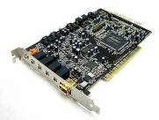
Example - Basic
// create DirectSound Device
private Device dSound;
// set it up
dSound = new Device();
dSound.SetCooperartiveLevel(handle,CooperativeLevel.Priority);
// create buffer and descriptor
private SecondaryBuffer sound;
private BufferDescription d = new BufferDescription();
// Set descriptor’s flags
d.ControlPan = true;
d.ControlVolume = true;
d.ControlFrequency = true;
d.ControlEffects = true;
// create the sound
sound = new SecondaryBuffer(filePath, d, dSound); // dSound = Device

Slide 15

Example - Operations
Operations for the SecondaryBuffer:
sound.Play(); // play sound
sound.Stop(); // pause sound
sound.SetCurrentPosition(pos); //stop sound
sound.PlayPosition; // returns current playback position
sound.Volume; // volume
sound.Pan; // balance
sound.Frequency; // sampling frequency
sound.Status.*; // informations (playing, looping…)
sound.Format.*; // informations (channels, SamplesPerSecond…)

Slide 16
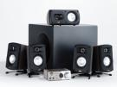
Example - Speakers
Set the correct type of speakers
// Create new Speakers
Speakers s = new Speakers();
// Set properties
s.Mono = false; // Sets as a mono speaker
s.Headphone = false; // Sets as headphones
s.Stereo = false; // Sets as generic stereo speakers
s.Quad = false; // Sets as quad system (two front, two rear)
s.FiveDotOne = false; // Sets as a 5.1 surround system
s.SevenDotOne = true; // Sets as a 7.1 surround system
s.Surround = false; // Sets as a generic surround system
dSound.SpeakerConfig = s;

Slide 17

Example - Effects
Applying effects to audio playback
// Create EffectDescription
EffectDescription[] fx = new EffectDescription[1];
// Set Parametric Equalizer effect
fx[0].GuidEffectClass = DSoundHelper.StandardParamEqGuid;
sound.SetEffects(fx);
ParamEqEffect eqEffect = (ParamEqEffect)sound.GetEffects(0);
EffectsParamEq eqParams = eqEffect.AllParameters;
// Specific properties
eqParams.Bandwidth = 36; // Apply a gain on the highest frequency
eqParams.Gain = ParamEqEffect.GainMax;
eqEffect.AllParameters = eqParams;
// overwrite sound to reset the effect
sound = new SecondaryBuffer(filePath, d, dSound);

Slide 18

Direct3DSound (1)
Advanced 3D positioning effects
// create DirectSound Device
private Device dSound;
private SecondaryBuffer sound;
private Buffer3D sound3D; // manages 3D virtualization of sound
private Listener3D listener; // point of listener
// set it up
private SecondaryBuffer sound;
private BufferDescription d = new BufferDescription();
// Set descriptor’s flags
d.ControlVolume = true;
…
d.Control3D = true; // Important to enable 3D audio!
d.Guid3DAlgorithm = DSoundHelper.Guid3DAlgorithmHrtfFull; // quality
// create the sound
sound = new SecondaryBuffer(filePath, d, dSound);

Slide 19
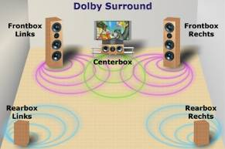
Direct3DSound (2)
// create the 3D buffer
sound3D = new Buffer3D(sound);
sound3D.Mode = Mode3D.HeadRelative; // considers distance
// set up the listener
Buffer b;
BufferDescription dp = new BufferDescription();
dp.PrimaryBuffer = true;
dp.Control3D = true;
b = new Buffer(dp, dSound);
// Create the Listener3D
listener = new Listener3D(b);

Slide 20
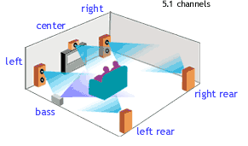
Direct3DSound (3)
// Setup initial position and options for listener and sound3D
listener.Position = new Vector3(0, 0, 0); // 3d coordinates
sound3D.Position = new Vector3(0, 0, 0);
// Make the listener ‘looking forward’
Listener3DOrientation o = new Listener3DOrientation();
o.Front = new Vector3(0, 0, 1);
o.Top = new Vector3(0, 1, 0);
listener.Orientation = o;
// Play the sound
sound.Play(0, BufferPlayFlags.Looping);

Slide 21

Conclusion
DirectSound is very fast
if the audio card doesn’t support 3D sounds, DirectSound will emulate them via software
→ could slow down the system
plays only wave-files
good choice for playback of short sounds
for long sounds or other formats (mp3) better use AudioVideoPlayback

Slide 22
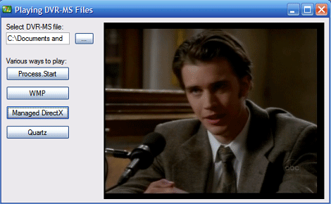
AudioVideoPlayback (DirectShow)
basic playback and simple control of audio and video files.
Video class to play video files, including those that contain audio.
Audio class to play audio-only files.
You can also use the Audio class to control the audio properties when you play a video file.
  Note: The Audio class is primarily designed for very simple playback scenarios, or for use with the Video class. You can also use Microsoft DirectSound to play audio files, which gives you much greater control over the audio playback.

Slide 23

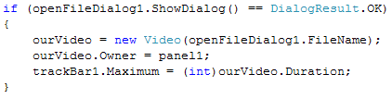
Playing a Video File
reference to include
open videofile
control playback

Slide 24

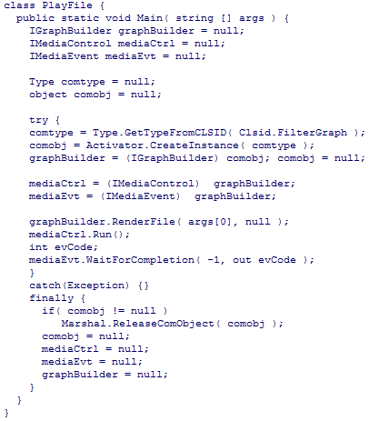
converting Video
no Support in managed code
only way to do use unmaneged code
walk through converted c++ code

Slide 25
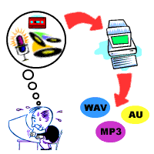

Playing an Audio File
audio object similar to video object
synchronize audio & video
many formats supported

Slide 26

OpenGL (Dis-)Advantages
Advantages
  Platform independent
  Extensible by user
  Open-source reference implementation
  Client-Server-Model
  Mostly better driver for profesional graphic hardware
Disadvantages
  New standard takes a long (long) time….
  Extension-chaos
  Badly support of cheap and standard graphic hardware

Slide 27
Direct3D (Dis-)Advantages
Advantages
  Short time until a new standard is „produced“
  Standard mostly more advanced than hardware
  Programming language independent (COM or .NET)
  DirectX also available (Sound, Audio…)
  Software emulation for not hardware supported functions
  More and better drivers for cheap (no-professional) graphic cards
Disadvantages
  Platform dependent (Windows)
  Closed-source (Greetings from Microsoft)
  Often many changes between different versions

Slide 28

Outlook
Windows Graphics Foundation (WGF)
should be the next subsequent API of DirectX 9 for Windows Vista
Following newest, unconfirmed news will WGF be named to DirectX 10
But regardless of name, there will be a complete new architecture, not compatible with DirectX 9
This would mean that all existing games would run only in a slower emulation modus

Slide 29

The end
Thank you very much for you attention!

