Slide 1



HACKVERSE’25
Home
About Us
Prototype
Archiva
A Smart Contract Lifecycle Management
Team : JNR
www.reallygreatsite.com

Slide 2


HACKVERSE’25
Home
About Us
Prototype
The Problem We're
Solving
Deploying and managing smart contracts can burn a hole in your wallet, especially with rising gas fees. As more contracts are deployed, storage and execution costs skyrocket, slowing down your progress. Developers need a smarter way to archive and manage these contracts—reducing gas fees, cutting costs, and optimizing blockchain resources without sacrificing efficiency.
Team JNR

Slide 3

HACKVERSE’25
Home
About Us
Prototype
Solution the Needs
EDU Chain
Introducing Archiva
Archiva transforms smart contract management by archiving contracts to slash gas fees and optimize storage. It streamlines deployment, archiving, and cost-efficiency, making blockchain development faster and more affordable.
Team JNR

Slide 4
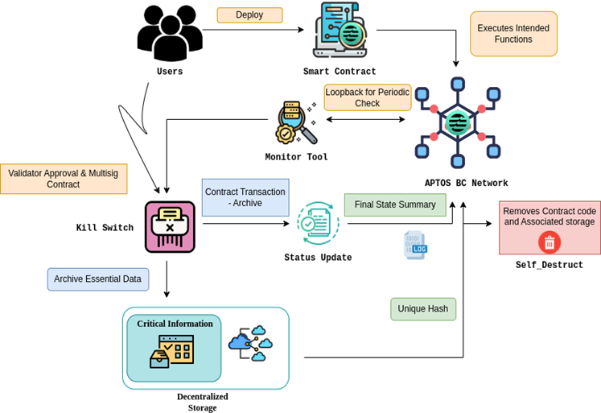
HACKVERSE’25
Home
About Us
Prototype
Solution
Overview
Smart Contract Archiving – Stores deployed contracts on IPFS, reducing EduChain storage costs.
Gas Fee Optimization – Minimizes gas usage by offloading inactive contracts from the blockchain.
AI-Assisted Development – Automates code suggestions, security fixes, and contract optimization.
Seamless Deployment – Upload and deploy smart contracts with optimized gas efficiency.
Full Lifecycle Management – Track, manage, and archive contracts from creation to expiration.
Instant Retrieval & Verification – Fetch archived contracts on demand with full authenticity.
Blockchain Scalability – Reduces on-chain congestion, making EduChain more efficient.
Secure & Cost-Effective – Ensures contract integrity while cutting operational costs.
EDU Chain
Team JNR

Slide 5
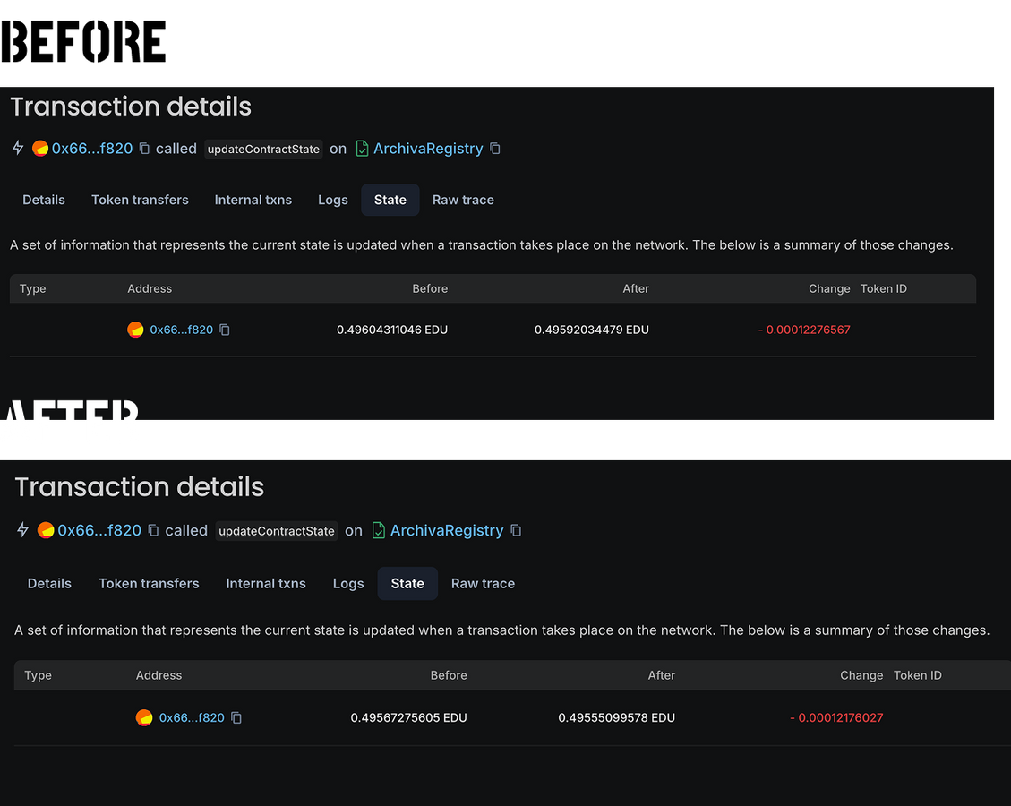
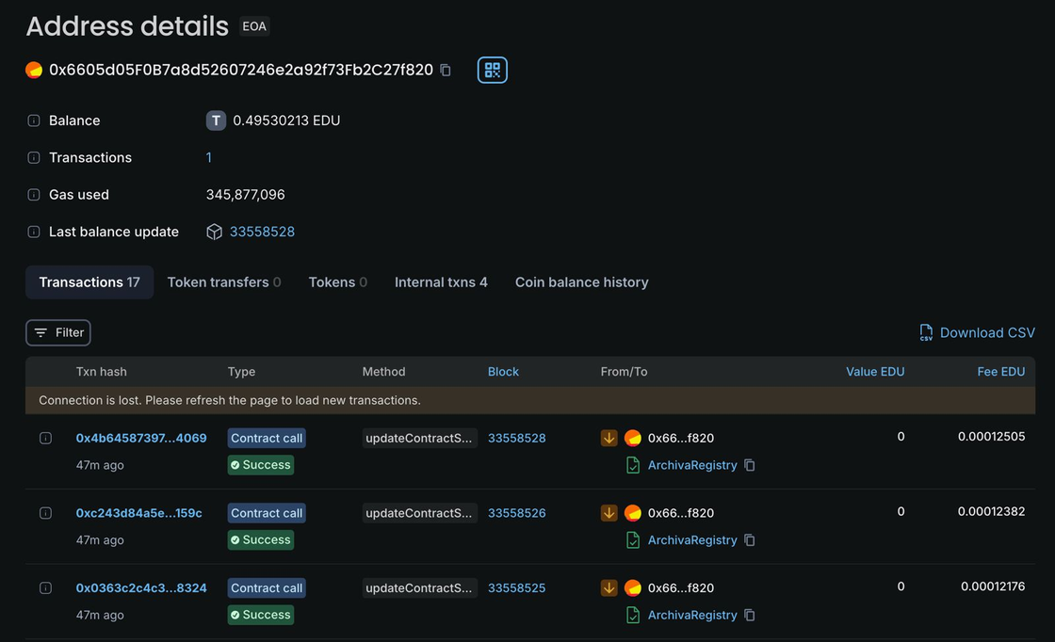
HACKVERSE’25
Home
About Us
Prototype
Demo Dump
Wallet Address
Team JNR

Slide 6
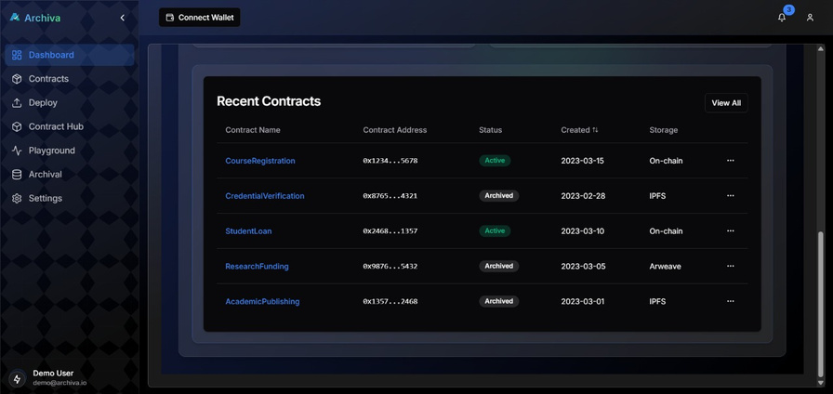
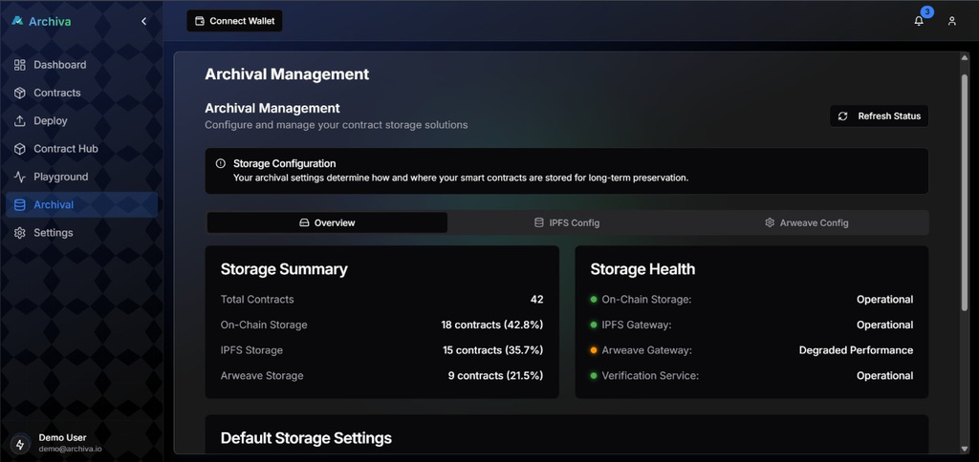


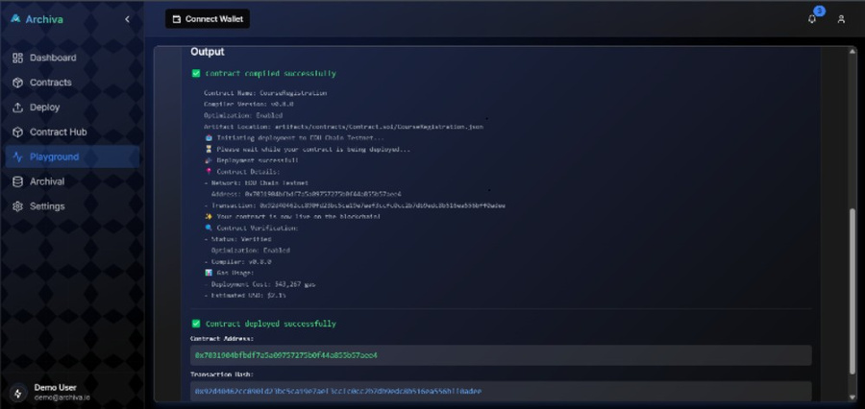

HACKVERSE’25
Home
About Us
Contact
Demo Dump
YOUTUBE
GITHUB
DEPLOYMENT
Team JNR

Slide 7
HACKVERSE’25
Home
About Us
Prototype
Team JNR
Jayashre K (Team Leader)
Nidhi Gummaraju (Team Member)
Roahith R (Team Member)
Thank You
Team JNR

