Slide 1

Ding: Next-Generation Enterprise Knowledge Engine
The Evolution from Data to Wisdom
NEXT-GENERATION ENTERPRISE KNOWLEDGE ENGINE
Notes:
大家好，欢迎参加今天的分享。在信息爆炸的时代，我们拥有海量数据，却常常陷入“知道很多，但无法有效利用”的困境。今天，我将向大家介绍一个革命性的解决方案——“钉”，一个旨在推动企业知识从静态数据进化为动态智慧的下一代知识引擎。让我们一起开启这场从数据到智慧的进化之旅。

Slide 2

CONTENTS
Knowledge Evolution · Contents Overview
01
Context & Core Challenges
Why Do We Need a Knowledge Revolution?
02
Ding’s Solution
Re-architecting Enterprise Knowledge Flow
03
Ding’s Core Capabilities
Five Engines Driving Knowledge Evolution
04
Application Scenarios
Ding’s Real Business Value
05
Summary & Outlook
Begin Your Knowledge Evolution Journey
Notes:
本次分享将分为五个部分。首先，我们将探讨当前企业在知识管理方面面临的时代背景与核心挑战。接着，详细介绍“钉”的解决方案，特别是其核心的“三级跃迁”理论。然后，我们会深入了解驱动知识进化的五大核心能力。之后，通过具体的应用场景展示“钉”的实际价值。最后，进行总结并展望未来。

Slide 3
01
Context & Core Challenges
Why Do We Need a Knowledge Revolution?
Notes:
让我们首先进入第一部分，探讨我们所处的时代背景，以及企业在知识管理方面面临的核心挑战。为什么我们说，一场知识革命迫在眉睫？

Slide 4
The Knowledge Dilemma: From “Owning” to “Effectively Using”
Data Dormancy, Value Erosion
Knowledge Silos, Disconnected
AI Hallucination, Decision Risk
Over 90% of enterprise data sits “dormant” — archived, forgotten, scattered across silos, and impossible to retrieve effectively.
When critical information is needed, we still experience the pain of “finding a needle in a haystack.”
Data from different departments and projects exist in isolation, forming independent knowledge silos.
Information lacks logical associations, unable to form synergies — let alone surface new insights and business opportunities.
Today’s AI chat tools often provide answers without reliable sources — sometimes even “confidently fabricating nonsense.”
In R&D, compliance, and strategic decision-making scenarios that demand precision, these answers cannot be trusted.
Core Pain Point: What we have is a “Data Library,” not an actionable “Decision Hub.”
Notes:
我们看似拥有海量数据，但实际上，我们面临着三大困境。首先，超过90%的资料都在沉睡，价值严重流失。其次，知识孤岛现象严重，信息无法有效连接。最后，现有的AI工具存在幻觉风险，无法满足企业级决策的严谨性要求。我们真正的痛点在于，我们拥有的只是一个静态的资料库，而不是一个能指导行动的动态决策库。

Slide 5

Theoretical Foundation: Karpathy’s LLM-Wiki Paradigm
The End of the Traditional Model
We used to “ask first, search later,” piecing together answers from massive archives each time — causing knowledge to remain unconsolidated in a “use-and-discard” state of inefficiency.
“Compiled” Knowledge Accumulation
True knowledge management should complete at the moment of information intake — let AI proactively write summaries, establish connections, and continuously update, achieving “organize once, grow richer and smarter with every use.”
Andrej Karpathy
World-Class AI Expert Former Core Member, OpenAI & Tesla Proposed a revolutionary knowledge paradigm in 2026
The Agent’s New Role: Knowledge Base Administrator
AI should not merely be a chat companion — it should handle the four core actions of knowledge: Ingest · Query · Synthesize · Lint.
Notes:
面对这些困境，我们需要新的理论指引。全球顶尖AI专家Andrej Karpathy在2026年提出了LLM-Wiki新范式。他主张，知识管理应该在信息摄入时就完成“编译”，让AI智能体成为我们的知识库管理员，负责知识的摄入、查询、综合和维护。这一革命性的理念，正是我们开发“钉”的理论基石。

Slide 6
02
Ding’s Solution
Re-architecting Enterprise Knowledge Flow
Notes:
接下来，让我们进入第二部分，详细了解“钉”是如何作为一种解决方案，来重构企业知识流动的。

Slide 7
What is Ding? — The Platform Bringing Karpathy’s Vision to Life
Ding is not just a tool — it is a complete knowledge evolution platform, designed to turn Karpathy’s LLM-Wiki theory into deployable enterprise productivity, providing organizations in the AI era with a solid knowledge foundation.
“Ding”: Knowledge Foundation
Represents the accurate, trustworthy knowledge provided to AI agents. It is the origin of all intelligent decisions, ensuring that AI-generated conclusions are factual, evidence-based, and free from “hallucination.”
“Ding!”: The Spark of Innovation
Represents the insight and innovation that emerge when vast knowledge undergoes accumulation, integration, and collision — transforming knowledge from static storage into dynamic creation and unlocking organizational intelligence potential.
Ding’s Core Mission
Drive enterprise knowledge assets through a three-stage evolution — from “Data Library” to “Knowledge Base”, and ultimately to “Decision Hub”.
Notes:
那么，“钉”到底是什么？它是Karpathy理论的商业践行平台。“钉”代表着为AI提供准确可信的知识内容，是决策的基石；而“叮”则代表知识碰撞后产生的创新火花。我们的核心使命，就是推动企业知识资产完成从资料库到知识库，最终到决策库的三级跃迁。

Slide 8
The Three-Stage Evolution: From Static Storage to Dynamic Intelligence
Data LibraryData Library
Knowledge BaseKnowledge Base
Decision HubDecision Hub
▍ Core Essence Organize files to be “well-stored and easily found” — building an orderly digital asset library.
▍ Typical Pain Points Files scattered across computers and cloud drives, versions in chaos, and retrieval efficiency extremely low.
▍ Core Capability: One-Stop Ingestion Supports one-click multi-format upload and online preview, with structured directory indexing to keep massive storage organized.
▍ Core Essence Enable data to “understand content, form associations, and be searchable” — activating dormant information value.
▍ Typical Pain Points Facing massive volumes of PDFs and documents, unable to quickly extract key information or find related materials.
▍ Core Capability: Intelligent Semantic Search Automatically extracts text to generate notes, precisely locates content via semantic understanding, and auto-generates knowledge tags and relationship graphs.
▍ Core Essence Make knowledge “support judgment, be verifiable, and be citable” — a trustworthy decision-making foundation.
▍ Typical Pain Points Worrying that AI-generated answers may be “fabricated,” making them unreliable for critical business and strategic decisions.
▍ Core Capability: Trustworthy Answers with Citations Adheres to “retrieve only, never fabricate” — every answer includes “source filename + original excerpt” to ensure traceability and verifiability.
This is a revolution from “dead” data to “living” knowledge.
Notes:
“钉”的核心是实现知识的三级跃迁。第一阶段是“资料库”，解决文件存储和查找问题。第二阶段是“知识库”，让资料变得可理解、可关联、可搜索。最高阶段是“决策库”，确保每一个回答都有据可查，让知识能够真正支撑企业的关键决策。这是一场从“死”数据到“活”知识的深刻革命。

Slide 9

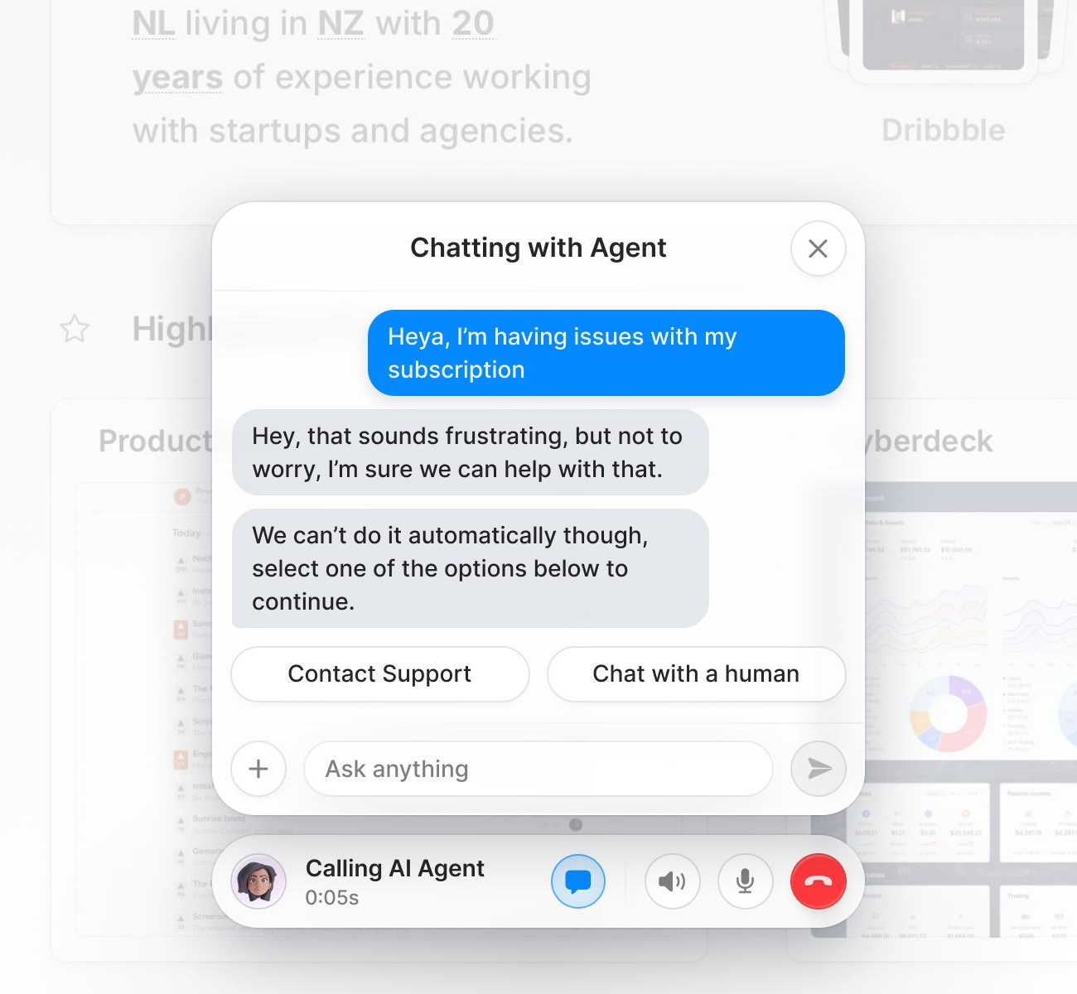
Key Distinction: You Need “Task AI,” Not “Chat AI”
A. Conventional Chat Tools (Chat)
Examples: Doubao, Yuanbao, ChatGPT, etc. Role: Like chatting with a consultant on WeChat — one question, one answer. Suitable for casual conversation and writing inspiration.
B. AI Agents (Agent)
Examples: OpenClaw, Hermes, Claude Code, etc. Role: Like delegating tasks to a professional assistant — capable of executing multi-step tasks such as batch processing, API calls, and report generation.
Limitation: They are fundamentally “chat products” — unable to install complex “skill packs” or achieve long-term, systematic enterprise knowledge operations and management.
Advantage: They are truly “task-execution AI” — able to seamlessly install Ding’s skill packs, enabling standardized, secure access, operation, and real-time updates to the enterprise’s core knowledge base.
💡 One-line Summary: Chat handles “conversation”; Agent focuses on “execution”.Ding serves only task-capable AI agents.
Notes:
要理解“钉”，我们必须区分两种AI：普通的聊天工具和AI智能体。聊天工具适合日常闲聊，而AI智能体则像专业助理，能执行复杂任务。“钉”正是为这些能办事的AI智能体设计的，它通过技能包的形式，让AI能够规范地管理企业知识。简单来说，Chat陪聊，Agent办事，而“钉”只服务于能办事的AI。

Slide 10
03
Ding’s Core Capabilities
Five Engines Driving Knowledge Evolution
Notes:
现在，让我们深入第三部分，了解驱动知识进化的五大核心引擎，看看“钉”具体是如何工作的。

Slide 11

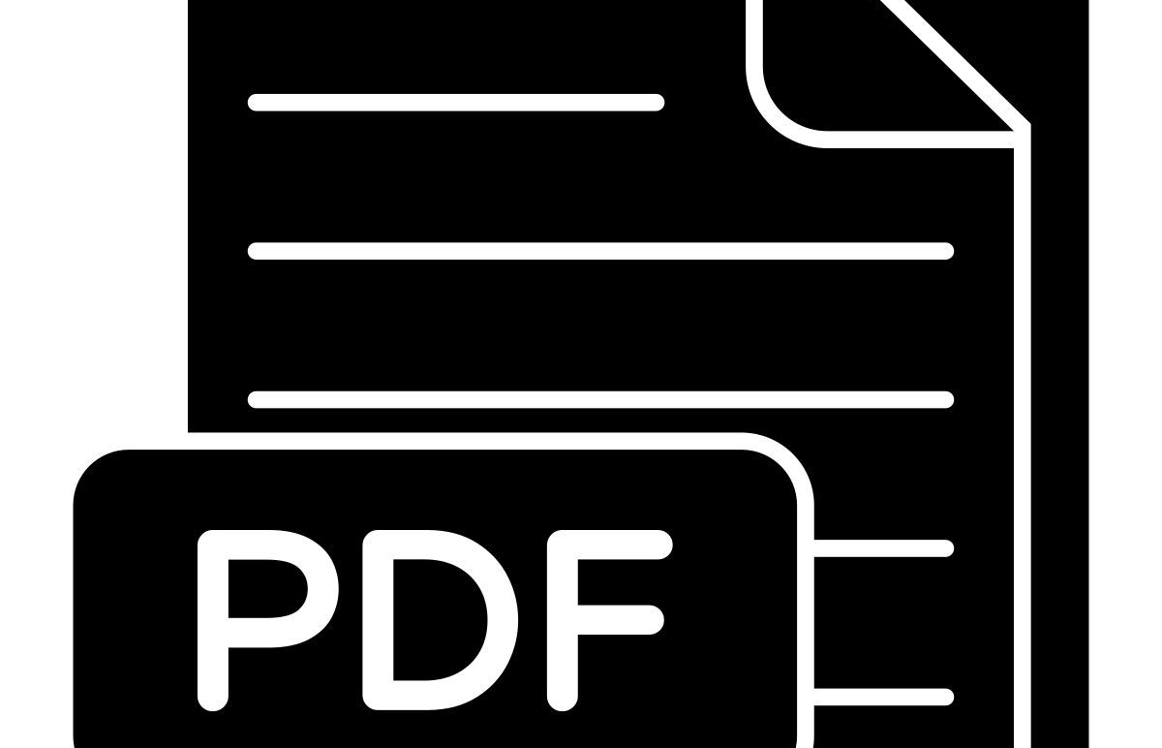
Engine 1: Everything is “Readable” — Multi-Format Intelligent Processing
Ding transforms all your data into structured, searchable knowledge
Universal Compatibility
Auto Extraction
Processing Dashboard
Full support for all Office formats (Word, Excel, PPT), various PDFs (digital, scanned/image-based), and common image formats.
Once uploaded, Ding automatically extracts content and generates clean Markdown notes — making unstructured documents instantly “readable and searchable.”
The system clearly shows which materials are pending processing, giving you a clear view of knowledge organization progress and easy control over document processing pace.
Notes:
第一个引擎是“万物皆可读”。无论您的资料是Word、Excel、PPT，还是各种PDF，甚至是扫描件，“钉”都能自动提取内容，将其转化为结构化的、可检索的知识。这彻底解决了非结构化文档难以利用的问题。

Slide 12
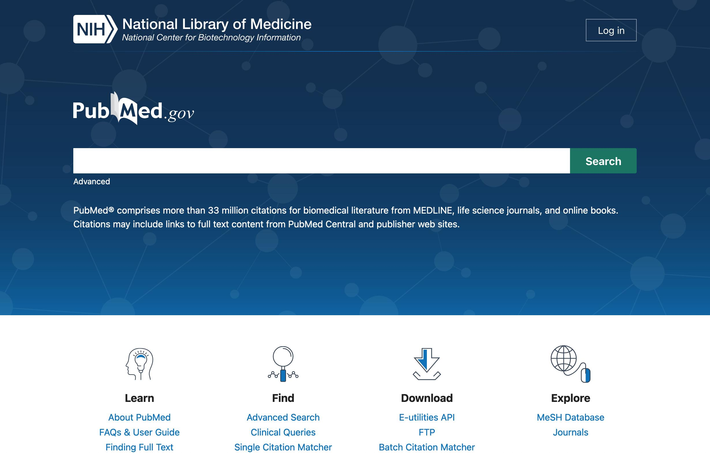
Engine 2: Web Knowledge, One-Click Import
Say goodbye to tedious manual copy-paste and file management — make knowledge accumulation more efficient.
You simply provide: a specific research topic (e.g., “2026 New Energy Vehicle Market Report”) or any public web link, and the intelligent workflow begins.
Web Search & Download
Automatically searches PubMed, industry portals, and other public web resources to precisely locate and download materials.
Auto Import & Classification
Automatically stores downloaded originals into your personal knowledge base, with structured archiving by document type.
Content Extraction & Tagging
Automatically extracts key notes and generates intelligent tags based on dimensions like topic, industry, and year.
Build Searchable Index
Instantly enters the semantic search system, supporting natural language Q&A — making knowledge immediately searchable and citable.
Strategic Value for Decision Makers
Fragmented high-value online information is no longer fleeting — it is efficiently consolidated into reusable, formal enterprise knowledge assets.
Notes:
第二个引擎是“网上知识，一键入库”。您只需提供一个主题或网页链接，AI智能体就能自动完成查找、下载、入库、提取和索引的全过程。这意味着，您在网上发现的高价值信息，可以瞬间沉淀为企业可复用的知识资产，实现了从发现到沉淀的完美闭环。

Slide 13
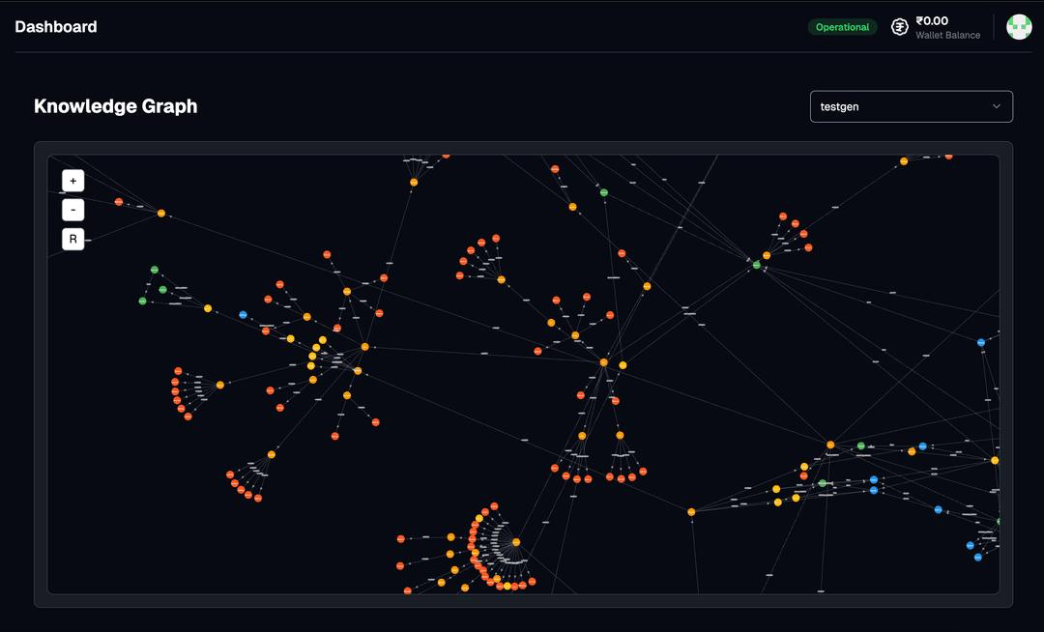
Engine 3: Knowledge Interconnection, Insight Emergence
Ding doesn’t just store knowledge — it connects it.
Tag Relationship Graph
Visually displays which topics frequently co-occur, helping you discover hidden knowledge clusters and information gaps.
Anchor Navigation
Jump directly from a tag to a specific paragraph in a specific file, achieving precise knowledge content targeting.
Global Directory Index
Provides a global bird’s-eye view of the knowledge base, combined with folder browsing, giving you full command of your organization’s knowledge assets.
From scattered files to an interconnected knowledge network — Ding brings knowledge to life.
Notes:
第三个引擎是“知识互联”。“钉”通过标签关系图、锚点跳转和全局目录索引，将零散的文件连接成一个互联互通的知识网络。这不仅让知识更容易被发现，更能从中涌现出新的洞见，让知识真正“活”了起来。

Slide 14
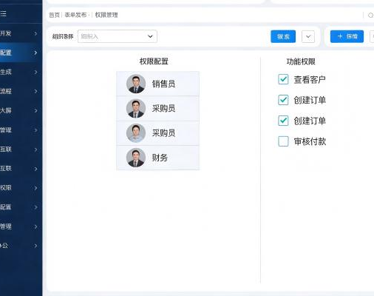
Engine 4: Secure, Controlled & Permission-Clear
The value of knowledge lies in sharing — and in security.
Independent Knowledge Bases
Admin Controls
Each user has an independent knowledge base, ensuring personal data privacy and logical data isolation.
Supports administrators in centrally creating, managing, and deactivating user accounts for unified organizational account governance.
Dedicated API Keys
Controlled Sharing
Agents access the knowledge base via dedicated API keys; once an account is deactivated, its key becomes immediately invalid, eliminating security risks.
Supports generating share links for individual files, enabling secure, flexible, and controlled management of external collaboration content.
Notes:
第四个引擎是“安全可控”。企业级应用，安全是基石。“钉”提供了独立的知识库、管理员权限、专用密钥和可控分享等一系列安全机制，确保您的知识资产在分享的同时，得到最高级别的安全保障。

Slide 15
Engine 5: Plug & Play, Seamless Integration
Ding uses standardized “Skill Packs” to easily empower all types of AI agents, bridging the connection between agents and the enterprise knowledge base.
Broad Compatibility
Standardized Operations
Focus on Core Tasks
In mainstream AI agents like OpenClaw, Hermes, and Claude Code, simply install Ding’s skill pack with one click to rapidly gain enterprise-grade knowledge management capabilities.
Built-in standardized query and ingestion workflows ensure every agent call and response meets enterprise compliance standards, and must return original source citations — eliminating hallucination risk.
Let your AI agents return to their core purpose — focusing on business logic and task execution — while Ding handles all the underlying complexity of knowledge storage, updating, and maintenance.
Notes:
第五个引擎是“即插即用”。“钉”通过标准化的技能包模式，可以轻松集成到OpenClaw、Hermes等主流AI智能体中。这意味着您现有的AI工具可以无缝获得强大的知识管理能力，让它们专注于执行任务，而将复杂的知识管理交给“钉”来处理。

Slide 16
04
Application Scenarios
Ding’s Real Business Value: From Point Efficiency to Enterprise-wide Digital Transformation
Organizational Collaboration & Efficiency
Business Process Automation
Data-Driven Decision Making
Break down traditional organizational silos through a unified digital foundation connecting internal and external stakeholders. Achieve efficient cross-department and cross-level collaboration with zero-latency information flow, dramatically reducing communication costs and improving organizational responsiveness.
Built-in low-code and AI capabilities automate repetitive, standardized business processes. From approval workflows and contract management to supply chain collaboration, reduce manual intervention across the board to cut costs and boost efficiency in critical business operations.
Break down internal data silos and build an integrated data cockpit. Aggregate and analyze full-chain business data in real time, presenting business dynamics through multi-dimensional visual charts to help managers make rapid, precise decisions.
Notes:
了解了核心能力后，让我们看看“钉”在实际业务中能带来哪些价值。我们将通过三个典型的应用场景来具体说明。
第一，组织协同与提效。“钉”打破了传统的组织壁垒，连接企业内外部，让信息流转实现零延迟，极大地降低了沟通成本。
第二，业务流程自动化。利用低代码和AI能力，实现了审批、合同、供应链等关键流程的自动化处理，减少人工干预，提升了整体效率。
第三，数据驱动决策。整合分散的数据孤岛，构建企业级数据驾驶舱，为管理者提供实时的业务洞察，助力科学决策。

Slide 17

Scenario 1: R&D & Literature Management
Current Challenge: The Bottleneck of Knowledge Acquisition & Alignment
R&D personnel spend significant effort searching and reading literature; team knowledge is dispersed, making it difficult for newcomers to quickly grasp past research findings, leading to long onboarding cycles.
Ding’s AI-Powered Solution
1. R&D staff discover literature through PubMed and other channels, directly submitting links or keywords to the AI agent. 2. The agent automatically handles download, structured ingestion, key note extraction, auto-tagging, and index building. 3. Supports semantic search by topic, rapidly generating literature reviews with citations; newcomers can immediately learn through the unified knowledge base, accelerating alignment.
Notes:
第一个场景是研发与文献管理。研发人员可以将找到的文献链接交给AI智能体，由它自动完成入库、提取和索引。这大大提高了文献处理效率，方便快速生成综述，也让新成员能迅速掌握团队知识，加速融入。

Slide 18

Scenario 2: Compliance & Quality Management
Compliance Pain Points: Numerous Standards, Difficult Traceability
Internal regulations (SOPs) and product inspection standards are numerous and frequently updated. Employees struggle to quickly locate relevant clauses, and traditional manual Q&A cannot provide traceable evidence — falling short of rigorous internal audit and compliance training requirements.
Ding’s AI-Powered Compliance Solution
• Centralized Management: All internal regulations, SOPs, and standards documents are uploaded to the Ding platform, building a structured compliance knowledge base.
• Semantic Query: Employees use natural language through AI agents to ask precise questions, e.g., “Look up Product A inspection standard, Section 3.2.”
• Fully Traceable: AI answers are directly linked to specific file names and original text passages, ensuring answers are accurate and traceable — confidently ready for audits.
Notes:
第二个场景是合规与质量管理。面对繁多的内部规章制度，员工可以通过AI智能体进行精准查询，并且返回的每一个结果都附带原文出处。这不仅提高了查询效率，更确保了答案的准确性和可追溯性，为企业的合规运营提供了坚实保障。

Slide 19
Scenario 3: Continuous Team Knowledge Accumulation
Current Challenge: Knowledge Silos & Loss
Team members maintain their own notes and materials without a unified aggregation mechanism, causing valuable experience and knowledge to be lost after project completion — never converted into organizational memory.
Ding’s Solution: Building a Living Knowledge Network
1. Collective Knowledge Building: Each member consolidates project documents, meeting minutes, and learning insights into the unified knowledge base.
2. AI-Powered Evolution: AI agents continuously auto-tag, generate summaries, and link similar content for materials, making knowledge continuously appreciate in value.
3. Building Organizational Memory: Scattered personal knowledge coalesces into a searchable, navigable, continuously growing team knowledge network — becoming the enterprise’s most valuable core asset.
Notes:
第三个场景是团队知识库的持续沉淀。在传统模式下，团队成员往往各自维护笔记，项目结束后这些宝贵的经验往往就随着人员流动而流失了，很难形成企业的“组织记忆”。
而在“钉”平台上，我们提供了完善的解决方案：
首先，通过统一的知识库工具，我们鼓励每位成员把项目文档、会议纪要、甚至是个人的学习心得都沉淀进来。这一步解决了知识“存”的问题。
其次，利用先进的AI智能体能力，系统能持续为这些文档自动打标签、补充摘要，并建立内容间的关联。这一步解决了知识“用”的问题，让知识在流动中增值。
最后，随着时间的推移，这些原本零散的个人知识，就会自动汇聚成一个可检索、可跳转、不断生长的团队知识网络。这个网络，就是企业最宝贵的资产，也是我们抵御人员变动风险、保持竞争力的护城河。

Slide 20
05
Summary & Outlook
Begin Your Knowledge Evolution Journey
KNOWLEDGE EVOLUTION JOURNEY
Notes:
最后，让我们对今天的内容进行总结，并展望“钉”将如何开启您企业的知识进化之旅。

Slide 21
Understanding Ding in Three Sentences
01 Theoretical Foundation
02 The Right Partner
03 Core Value
Ding is the commercial practitioner of Karpathy’s LLM-Wiki theory, dedicated to driving enterprise knowledge assets through the revolutionary evolution from
Data Library → Knowledge Base → Decision Hub
— enabling data to truly drive business decisions.
Ding’s best partner is a standards-capable AI agent:
AI agents supporting standard Skills
(e.g., OpenClaw, Hermes, etc.)
Note: Conventional chat tools like Doubao and Yuanbao cannot directly integrate with Ding.
Purpose-built for the agent era, surpassing traditional RAG solutions:
✔ Trustworthy evidence sources — no hallucinations
✔ One-click web import for rapid knowledge building
✔ Evolving knowledge base & interconnected knowledge network
✔ Strict enterprise-grade permission control system
Notes:
总结一下，三句话可以读懂“钉”。第一，它是Karpathy理论的商业践行者，推动知识三级跃迁。第二，它的正确搭档是AI智能体，而非普通聊天工具。第三，它的核心价值在于提供可信的证据、便捷的入库、可进化的知识库、互联的知识网络和企业级的安全管控。

Slide 22

The Future is Here — Evolve Now
Ready to Begin Your Enterprise’s Knowledge Evolution Journey?
BEGIN YOUR EVOLUTION JOURNEY
Notes:
“钉”不仅仅是一个工具，它是企业在AI时代保持竞争力的核心基础设施。它将释放您沉睡的数据资产，将信息转化为洞察，将知识转化为决策力。未来已来，进化即刻开始。感谢大家的聆听，期待与您一同开启企业的知识进化之路！

