Slide 1
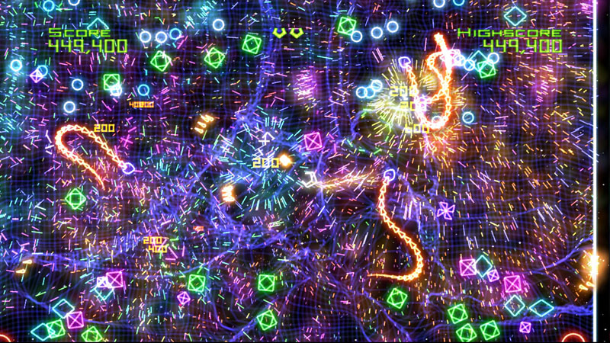
Geometry Wars Retro Evolved (clone)

Slide 2
Goals
Stay alive (don't lose all lives).
Destroy Enemies.
Earn lives.

Slide 3
Game Logic
3 Lives – Player starts with three lives and may earn more based on points.
Game ends when player is out of lives.
Points earned for killing enemies.
No specific levels, but difficulty metric increases based on time.
Difficulty resets temporarily, when the player loses a life but ramps up fast.
All on-screen enemies are destroyed when the player loses a life, temporarily clearing the level.

Slide 4
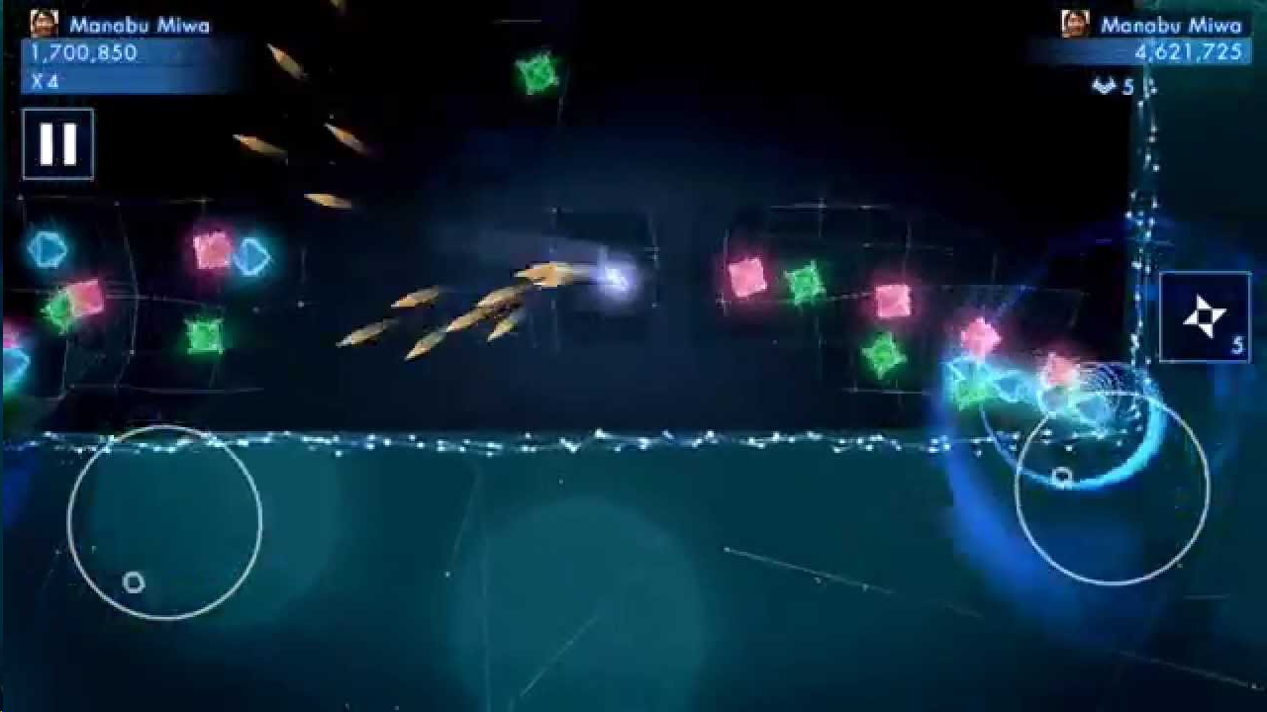

Inputs
Twin-stick
  Left + Right Joystick on game pad.
  Button to drop mines.
  Buttons to control pausing, etc.
Dual virtual joysticks + virtual buttons for mobile version.

Slide 5
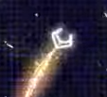
Player
Image using physics for movement and collision.
Moves in any direction based on left stick input.
Moves in any direction based on right stick input.

Slide 6
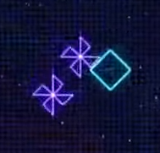

Enemies
Seven (7) types – Pinwheels, Diamonds, Green Squares, Pink Boxes, Snakes, Jacks, Pac Men.
  AI Note: We'll be separating the 'ai' for enemies into distinct 'brain' modules.
  Spawning Note: I will simplify this to a quadrant based random spawning.

Slide 7
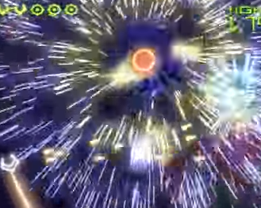
Obstacles
Black Holes - Both obstacles and strategic elements. They appear randomly at higher difficulties.
  Firing on them activates them.
  Once activated, they stay alive for a fixed amount of time, sucking in anything nearby, including enemies and player.
  Firing at an activated hole for a prolonged period will destroy it.

Slide 8

Weapons
Cannon - Starts as dual projectile, speeds up and increases projectile count and spread (randomly) based on points earned.
  Upgrades only last for short time, then weapon goes back to default starter config.
Mines - When a 'mine' is deployed, all enemies on screen are destroyed.
  Start with 3 mines, earn more via points.

Slide 9
Camera and World
Camera - Fixed (Tracks Player)
World - Bounded area, slightly larger than screen. Player may not move beyond bounds.
  Parallax starfield
  Perturbable grid.
  Neon border.

Slide 10
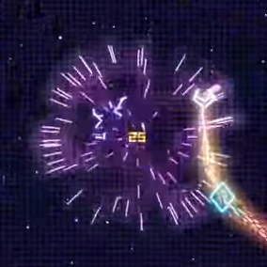
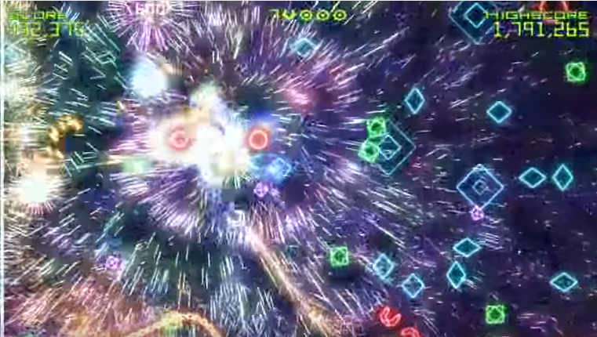
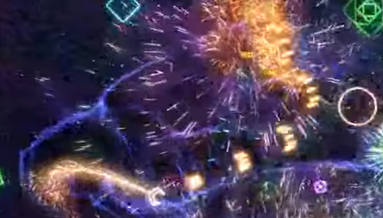
Effects
Radial Explosions and Trails
Grid perturbation.

Slide 11
HUDs
Score
High Score
Lives
Mines

Slide 12
Optimizations and Extras
Caching – We may end up caching objects and calculation results.
Extras – Possible things we'll cover
  Re-mapping inputs.
  Particle Alternatives
  Grid Perturbation

Slide 13
Links
Moby Games Listing: http://www.mobygames.com/game/geometry-wars-retro-evolved
IGN Wiki: http://www.ign.com/wikis/geometry-wars-retro-evolved/Enemies
YouTube Video of game:https://www.youtube.com/watch?v=OxtZUURTHzs

