Slide 1
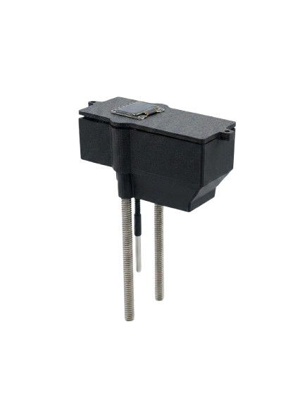
OilSense
Three sensors. Two independent channels.
One measurement that checks itself.
A ₹9,262 frying-oil degradation meter, built against a ₹40,000–50,000 commercial tester.
CAPACITIVE
OPTICAL
Roansh Desai · Class 11 · Mumbai · IRIS National Fair
Notes:
Open here. Do not read the slide — go straight into the 90-second script.

Slide 2
THE PROBLEM
Nobody measures the oil they fry in
25%
₹40–50k
3
Total polar compounds — India's legal
limit, binding on every food business
since 1 July 2018
What a handheld tester costs.
FSSAI's own published figure.
Reuses FSSAI advises as the
maximum. Frying runs at 170–190 °C.
FSSAI links polar compounds to hypertension, atherosclerosis, Alzheimer's and liver disease.
The limit is law. The instrument is priced out of the kitchens that need it. That gap is the opportunity.
Notes:
The legal limit carries the stakes on its own. Do not over-sell the health angle.

Slide 3
THE TARGET
Same measurement, one twentieth of the price
Commercial handheld tester
OilSense
₹40,000–50,000
₹9,262
One dielectric channel. Nothing to check it against.
Two independent channels that cross-check each other.
The cheap route is one cheap sensor. That is exactly the thing you cannot trust — a single low-cost channel has no way to tell a real reading from a drifting one. Two channels do.
Notes:
Price is the hook, not the contribution. Move quickly to why two channels.

Slide 4
HOW IT WORKS
One chemistry, two unrelated consequences
Frying degrades oil into polar compounds. Those compounds change two things that have nothing to do with each other.
CAPACITIVE
OPTICAL
Polar molecules align in an electric field
Conjugated double bonds absorb blue light
Permittivity rises linearly with concentration
Read by an FDC1004 across steel electrodes
Blind to anything not dissolved in the oil
Transmittance falls exponentially (Beer–Lambert)
18 channels, 410–940 nm, on an AS7265x triad
Blind to colourless contamination such as water
Each channel is blind to exactly what the other sees — and a third sensor, temperature, corrects the permittivity reading for heat.
Notes:
The blindness is the point — it is what makes the two channels genuinely independent.

Slide 5
WHY IT WORKS
One measurement.
Two ways to check it.
The two channels run on unrelated physics — so they confirm each other, and each one catches exactly what the other cannot see.
The capacitive channel
The optical channel
→ FINDS WATER
→ FINDS BURNT RESIDUE
Permittivity 80 against oil's 3, so it shows up at once. Water is colourless — optics alone never would.
Particulate blocks light, so it shows up at once. It is not dissolved — capacitance alone never would.
One channel gives you a number. Two tell you whether to believe it.
Notes:
The centrepiece. Walk the two cards left to right, then the closing line. Everything the device does well is on this slide.

Slide 6
THE SIGNAL PATH
Inside the instrument
FDC1004
capacitance · 0x50
OLED readout
index + which channels voted
ESP32
AS7265x
64 samples
per reading
18 channels · 0x49
hot oil
Firebase
DS18B20
temperature · 1-Wire
raw observables only
Probe
Capacitance, temperature and 36 channel values are uploaded. The index and the verdict are not — every derived number depends on calibration constants that change, so storing raw means the whole history re-derives.
Notes:
If a judge asks one technical question, it is usually this: why upload raw? Answer from this slide.

Slide 7
THE BUILD
What it is made of
Component | Role | ₹
SparkFun AS7265x triad | 18-channel spectrometer, 410–940 nm | 6,660
ProtoCentral FDC1004 | 24-bit capacitance-to-digital front end | 1,495
ESP32 DevKit | Acquisition, display, WiFi upload | 385
SSD1306 OLED + DS18B20 | Readout and temperature | 298
SS 304 rods, PETG housing, battery | Probe and enclosure | 424
Total | Against ₹40,000–50,000 commercial | 9,262
72%
of the build cost is the spectrometer — the one part a cheaper design would have to attack first.
All three sensors share one I²C bus — SDA 21, SCL 22 — at addresses 0x50, 0x49 and 0x3C. The probe is two steel electrodes plus a grounded thermowell.
Notes:
Do not read the table aloud. Point at the total and the 72% only.

Slide 8
METHOD
Built so it can be checked
1
Raw observables only, never conclusions
Calibration constants change whenever the probe geometry does. Storing raw means correcting a constant re-derives the entire history instead of invalidating it.
2
Dark-subtract before taking the ratio
The spectrum is read twice, bulb off then on. Ambient leak measured 67–87% of some channels — and the indicator is a ratio, so a leak biases it silently.
3
Normalise the optics in log space
Permittivity is linear in concentration; transmittance is exponential. Linear normalisation made the channels bow apart by 0.130 against a 0.15 tolerance. Log dropped it to 0.066.
4
A channel votes only if it is quiet AND physically possible
One session gave σ = 0.005 pF — beautifully steady — at a derived permittivity of 9.1. No edible oil exceeds 4.5. Low noise alone cannot see systematic drift.
Firmware is verified against stub libraries and a simulator that reproduces the Arduino IDE's prototype hoisting — a failure mode a plain compiler cannot reproduce.
Notes:
Rule 1 is the one judges probe. It is why every past reading survives a calibration fix.

Slide 9
RESULTS
The optical channel resolves degradation
Dark-corrected transmittance, fresh oil → amber. The signal rises monotonically with wavelength — that ordering is what absorbance does, and what noise does not.
Blue is absorbed by the conjugated double bonds frying creates; near-infrared passes almost untouched. The ratio between them is the indicator.
A 21% fresh-to-amber swing across the blue end, against a near-infrared reference that barely moves.
Every channel is stored raw, so the same dips re-analyse the moment the scale is anchored to lab-measured TPC.
Wavelengths verified against the sensor library's own channel map.
Notes:
If asked why 860 nm and not 940: the AS7265x letters are not in wavelength order, and I verified the mapping against the library rather than assuming it.

Slide 10
ENGINEERING
The v2 electrode is already designed
Capacitance scales with the logarithm of electrode spacing, so parallel rods have a hard ceiling no amount of wiring can lift. Four geometries were evaluated against the cell constant needed to resolve the 20% advisory threshold.
Geometry | Cell constant (pF/ε)
Parallel rods | 0.26
Plates 40×40 mm, 2 mm gap | 7.1
8 mm rod inside 10 mm tube, 50 mm | 12.5
Tube 10 mm inside 12 mm, 50 mm | 15.3
Selected: concentric tube
It reaches the target cell constant and the outer tube shields the inner electrode — one part solving two problems at once.
48×
improvement in cell constant over parallel rods, from a geometry change alone — no new components, no added cost.
Notes:
Frame as design work completed, not as a defect. If pressed on current performance, say the concentric cell is the build in progress.

Slide 11
WHAT COMES NEXT
Fix the geometry, then anchor the scale.
01
Concentric-tube electrode
Calculated at 12.5 pF/ε. Lifts the cell constant and shields the inner electrode in a single part.
02
Fixed optical path length
A defined gap to a reflector, so every dip presents the same path through the oil.
03
Anchor against lab-measured TPC
Because only raw data is stored, every reading already taken becomes absolutely calibrated the moment this happens.
Notes:
Close on the same line you built the talk around. Then stop talking.

