Slide 1
ROBOTICS

Slide 2
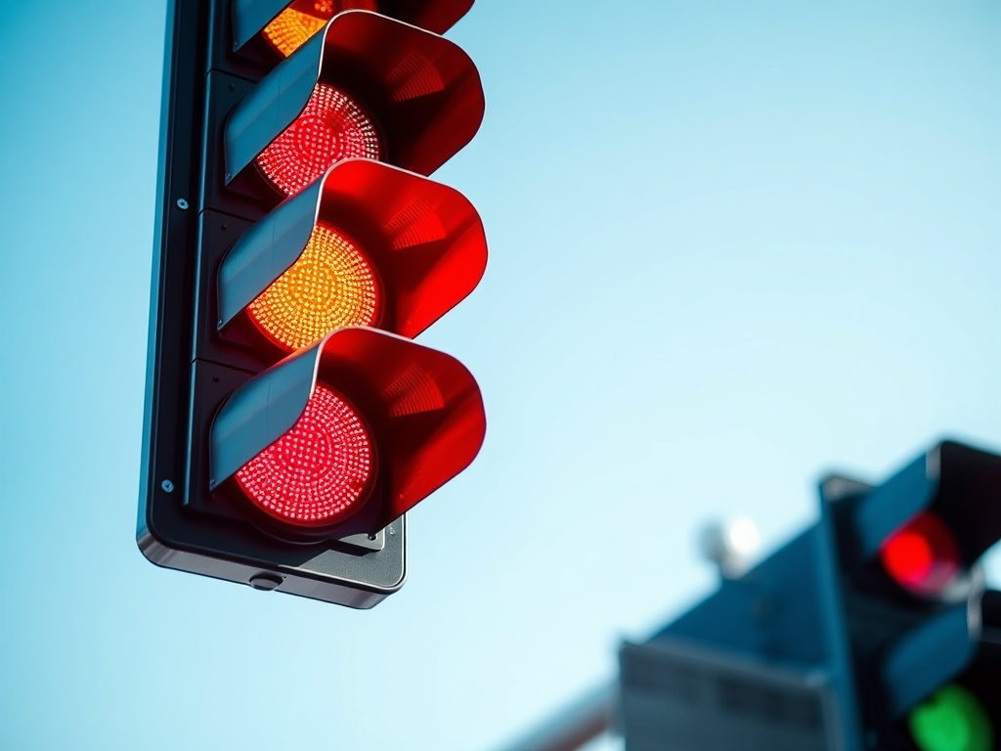
PROJECT 1
LED Traffic Light System

Slide 3
What is a Traffic Light System?
A traffic light system is a set of coloured lights that control vehicle and pedestrian movement at intersections.

Slide 4
It typically consists of three coloured lights:
Red: Indicates that vehicles must stop. Pedestrians may be allowed to cross, depending on the intersection rules.
Yellow (or Amber): Warns that the light is about to change to red. Drivers should prepare to stop if it is safe to do so.
Green: Indicates that vehicles may proceed. Pedestrians typically must wait for the signal to cross.

Slide 5
Materials Required
Arduino Uno
Breadboard
Resistors(3-220Ω, Pull-Up 10kΩ)
LEDs (Red, Yellow, Green)
Buzzer
Push button
Jumper wire (male-to-male)

Slide 6
Materials Required
Arduino Uno: Is a microcontroller board that acts as the brain of the project, processing inputs and controlling outputs.
Breadboard: Is a reusable platform for building circuits without soldering, allowing easy connections and modifications.
Resistor: It limit the flow of current in a circuit; the pull-up resistor keeps a pin at a high state when no button is pressed.
LEDs: Are Light-emitting diodes that indicate status or signals; each color can represent a different state (e.g., on/off).

Slide 7
Materials Required
Buzzer: Is a sound-producing device that generates beeps or tones based on electrical signals from the Arduino.
Push Button: Is a switch that allows users to send a digital signal to the Arduino when pressed, typically used for user input.
Jumper Wire: Are flexible wires used to make connections between components on the breadboard or to the Arduino.

Slide 8
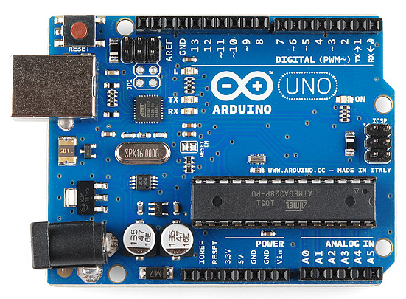
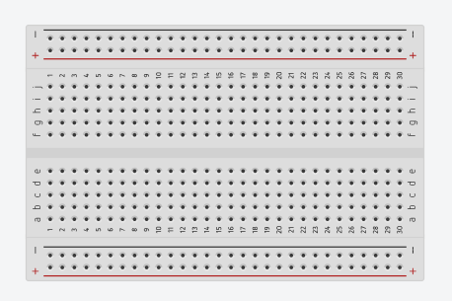
Arduino uno
Breadboard

Slide 9
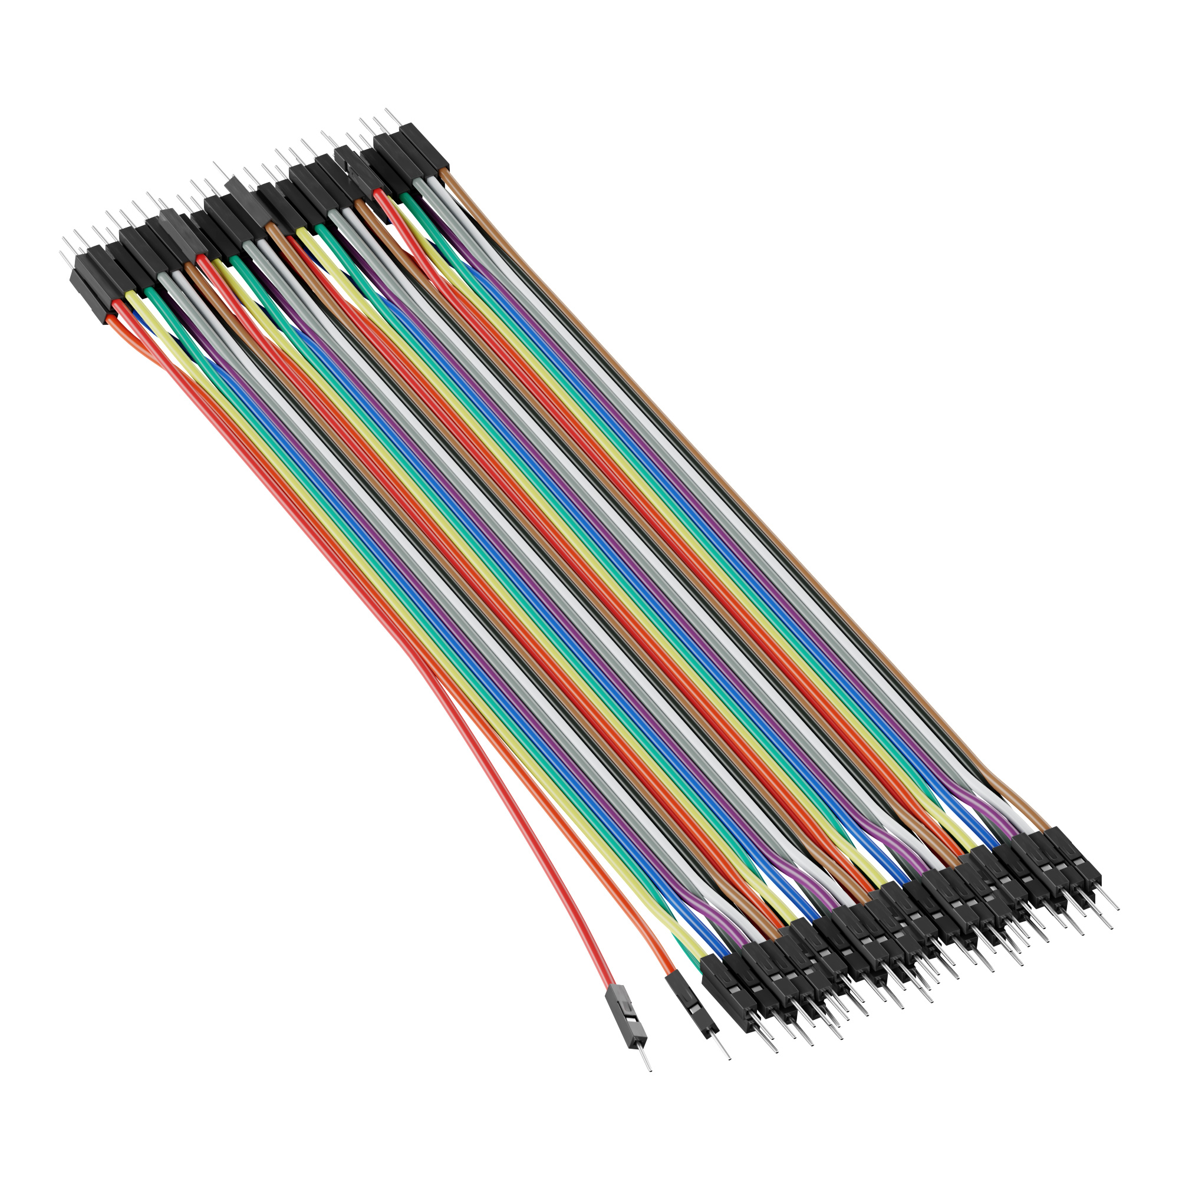
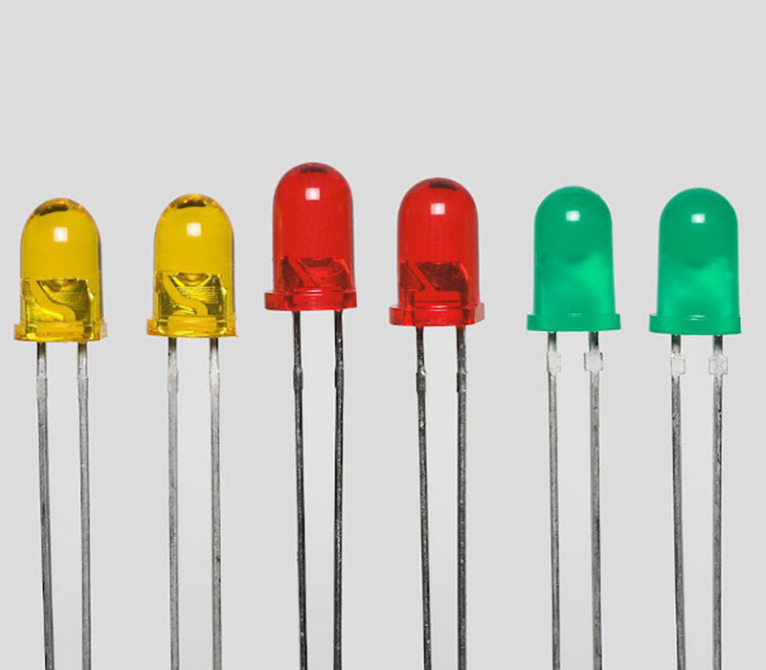
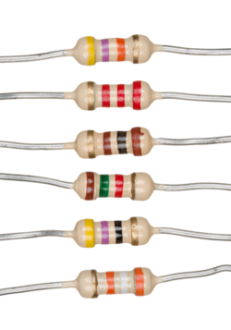
LEDs
Jumper wires (male-to-male)
Resistors

Slide 10
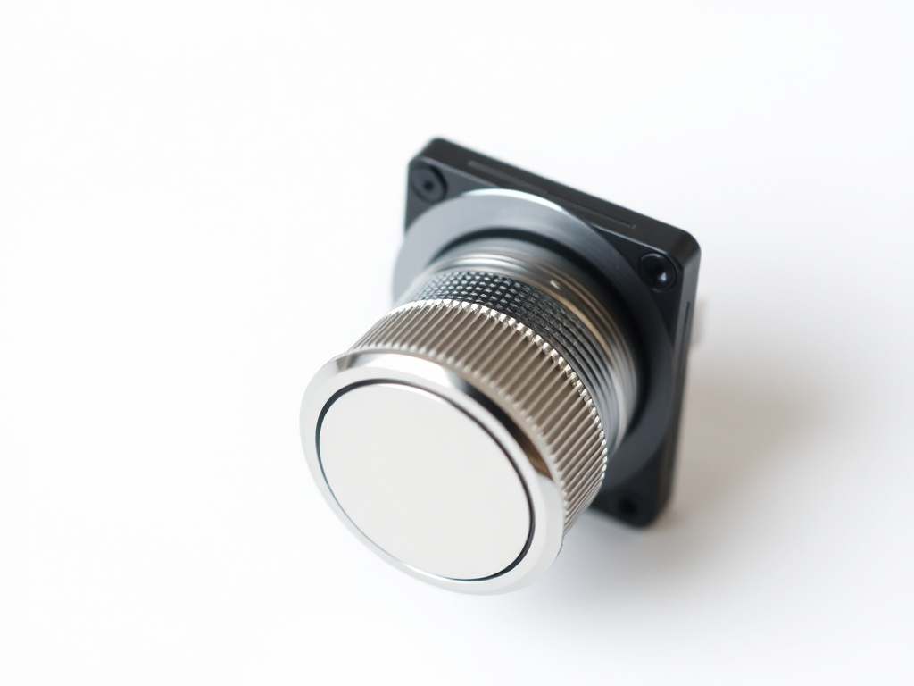
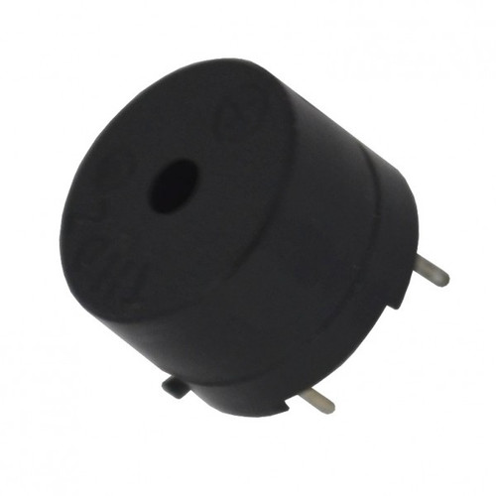
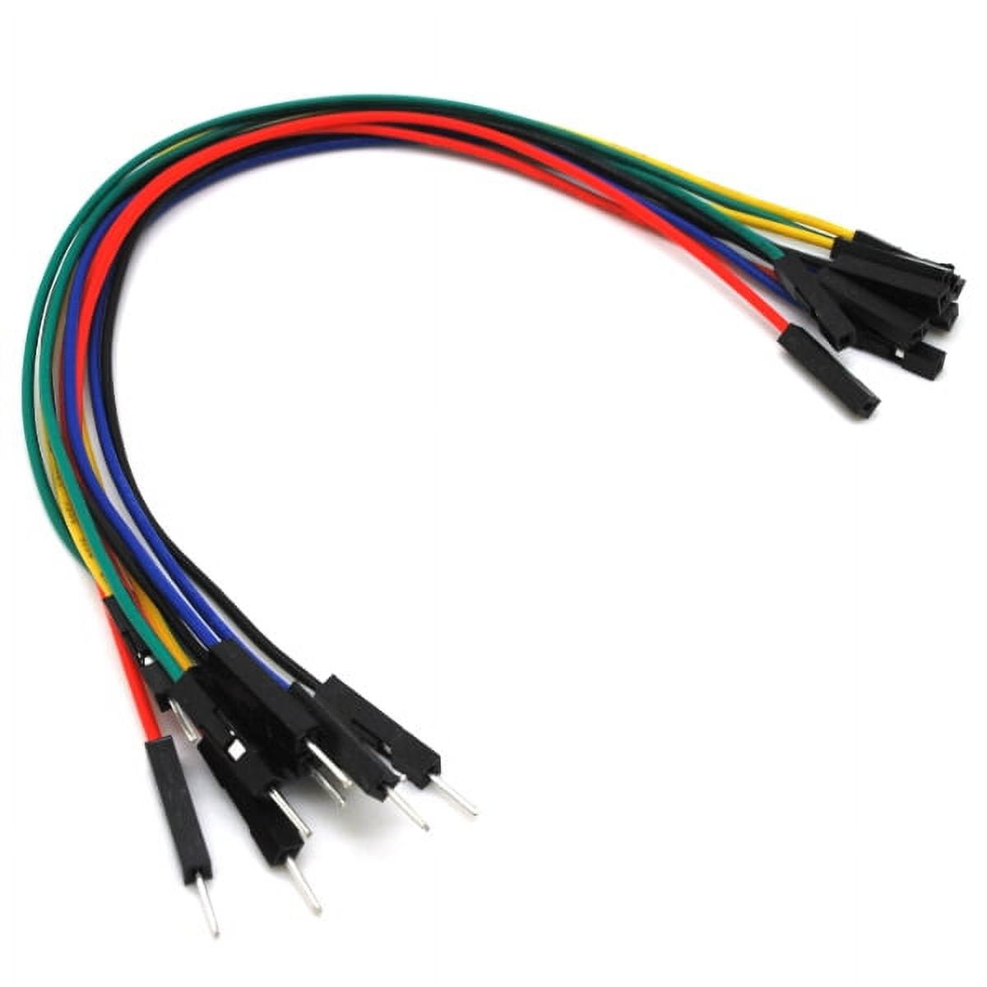
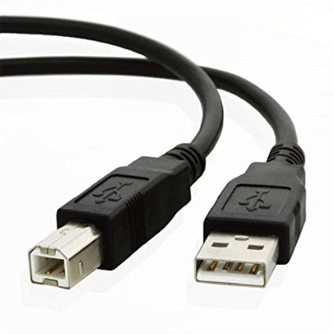
Push button
Jumper wires (male-to-female)
Buzzer
USB cable

Slide 11
Real life application of traffic light system
Intersections
Pedestrian Crossings
Emergency Vehicle Priority
Public Transport Management
Smart Traffic Management
School Zones

Slide 12
Circuit connection
LED Connection
Insert the three LEDs into the breadboard
Insert 3 - 220Ω resistors into the anode column of each LED
Connect the other end of the resistors to pins 11,12,13, that is, RED=>11, YELLOW=>12, GREEN=>13.
Connect the LEDs cathodes to the negative terminal.
Connect the negative terminal to the ground,GND.

Slide 13
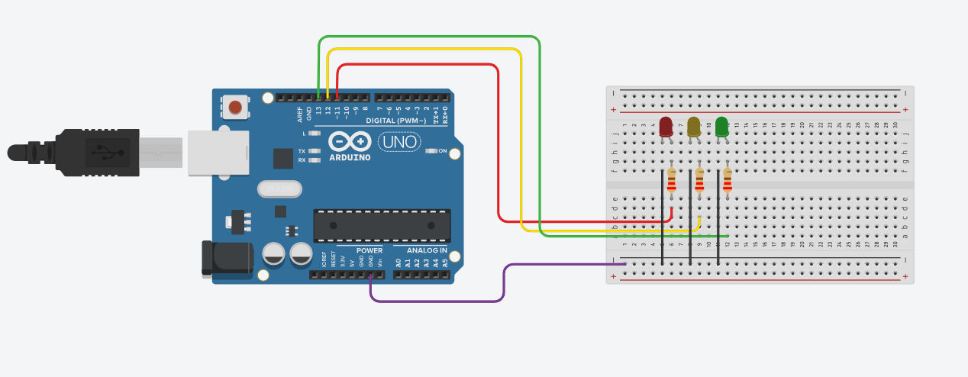
LEDs connection

Slide 14
Circuit connection(Cont’d)
Buzzer connection
Insert the buzzer into the breadboard.
Connect the positive terminal (+) to pin 8.
Connect the negative terminal (-) of the buzzer to the negative terminal of the breadboard.

Slide 15
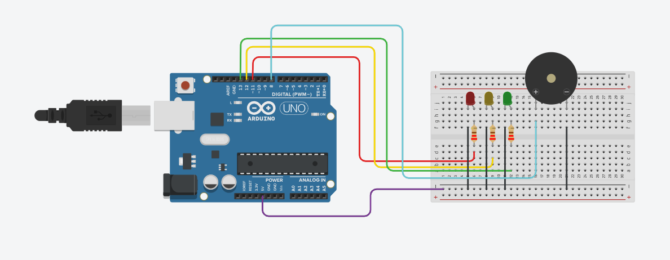
LEDs connection with buzzer

Slide 16
Circuit connection(Cont’d)
Push button connection
Insert the push button into the breadboard.
Connect a terminal to pin 7
Connect a terminal to negative terminal of the breadboard or the ground, GND.
Connect a 10kΩ resistor to another terminal of the push button.
Connect the other end of the resistor to 5v pin in the Arduino uno.

Slide 17
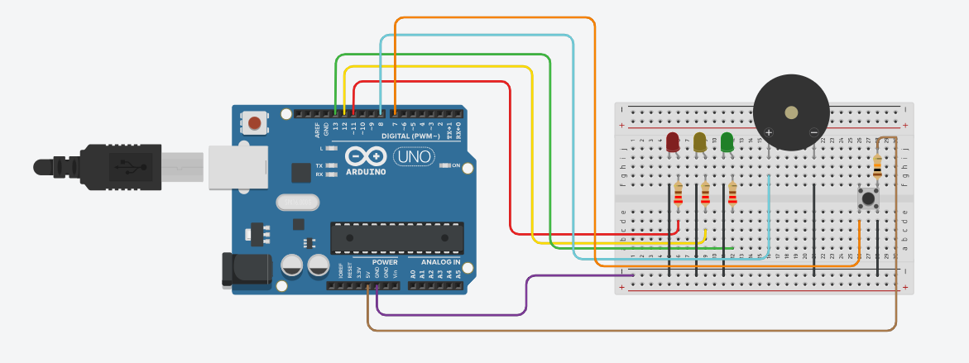
LEDs connection with buzzer and push button

Slide 18
THANK YOU
See you in the next class!!!

