Slide 1
ROBOTICS

Slide 2
What is Robotics?
Robotics is the branch of technology that
deals with designing, building, and using robots.

Slide 3
What is a Robot?
Robots are machines that can perform tasks
automatically or with some human guidance.
It is often controlled by a computer program and can interact with its environment.

Slide 4
Examples of Robots?
Robot vacuum cleaner
LED Traffic light system
Line-following robot
Obstacle avoiding robot
Drone
Robotic arm
NAO – Humaniod robot

Slide 5
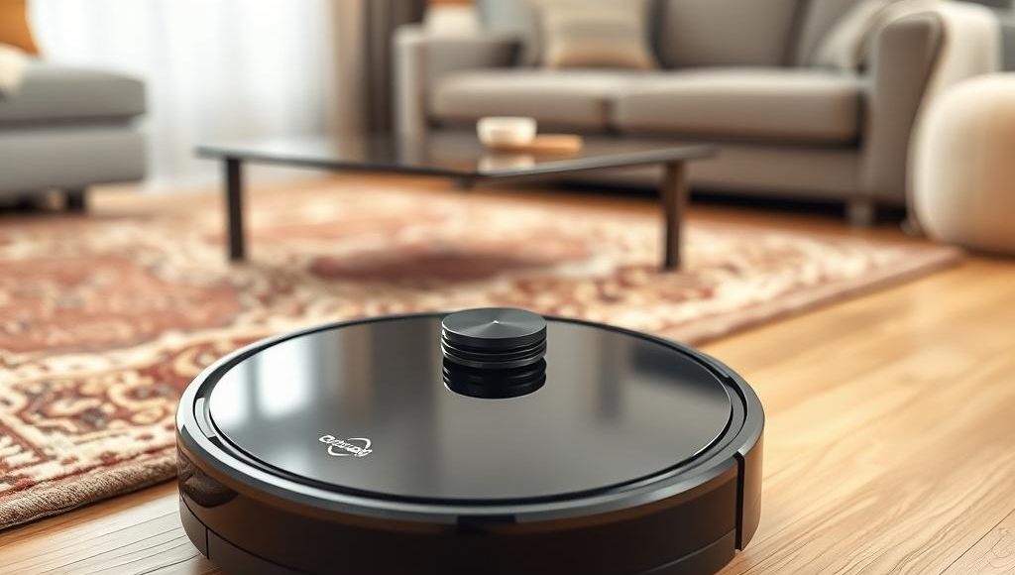
Examples of Robots(Cont’d)
Robot vacuum cleaner
It is a small, round robot that cleans floors on their own.
Notes:
NOTE: To change images on this slide, select a picture and delete it. Then click the Insert Picture icon in the placeholder to insert your own image.

Slide 6

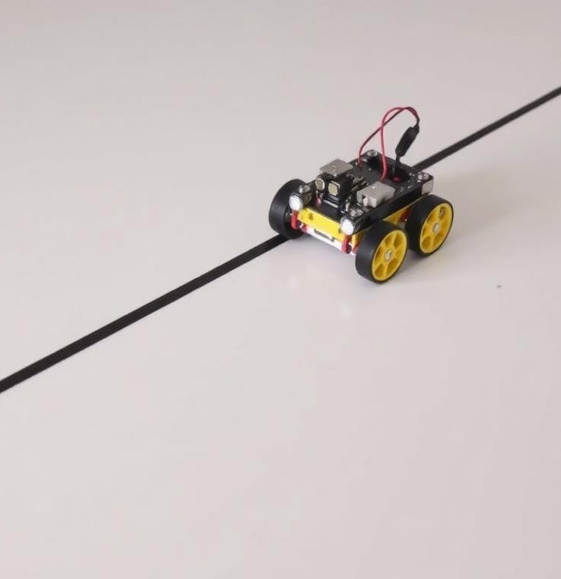
A LED traffic light system
It is a bright, energy-saving lights that control traffic at intersections and keep roads safe for drivers and pedestrians.
A line-following robot
It is a small machine that moves along a path marked by a line, usually using sensors to detect and follow it.
Notes:
NOTE: To change images on this slide, select a picture and delete it. Then click the Insert Picture icon in the placeholder to insert your own image.

Slide 7

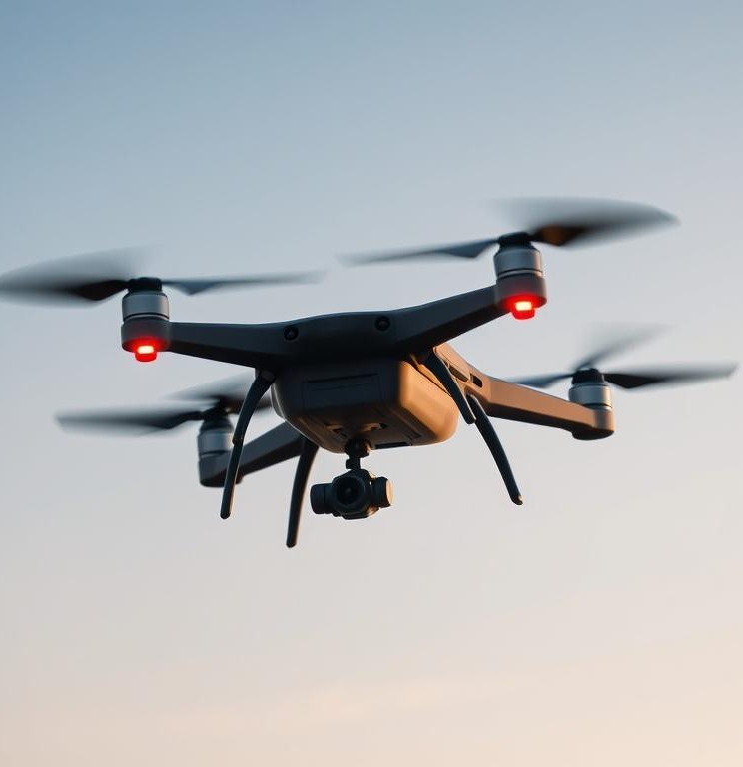
An obstacle-avoiding robot
It is a machine that can detect and
steer away from obstacles in its path
to prevent collisions.
A drone
It is a flying device that can be controlled remotely or fly automatically, often used for taking photos, delivering packages, or monitoring areas.

Slide 8
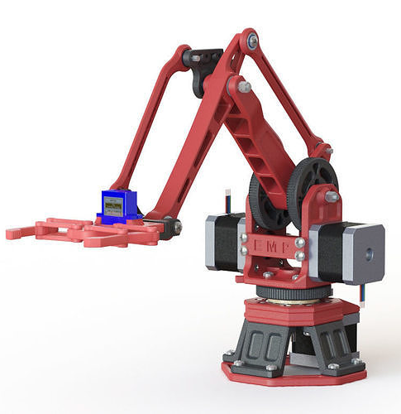
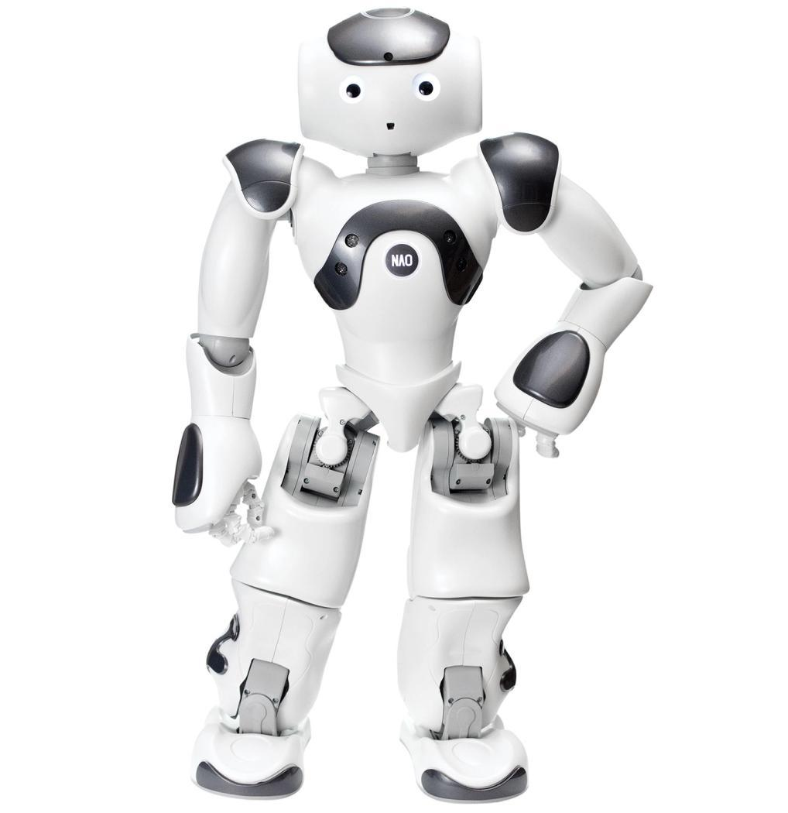
A robotic arm
It is a machine that mimics a human arm's movements to perform tasks like picking up objects or assembling items.
NAO Robot
is a small humanoid robot designed for education and research, capable of speaking, walking, and interacting with people.

Slide 9
Real life Applications of Robotic Systems
Manufacturing
Healthcare
Military
Agriculture
Exploration
Education
Logistics
Entertainment
Research
Household

Slide 10
PROJECT 1
LED Traffic Light System

Slide 11
Materials required
Arduino Uno
Breadboard
LEDs(Red, Yellow, Green)
Resistors
Jumper wires(male-to-male)
USB cable
Buzzer + Push button

Slide 12
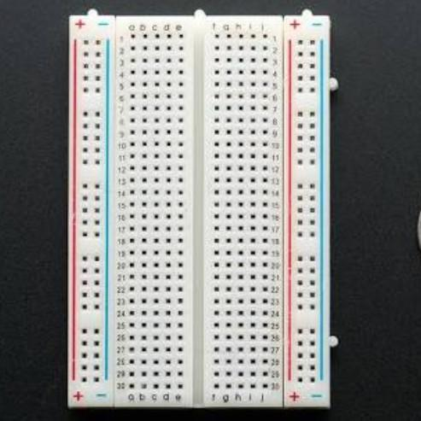
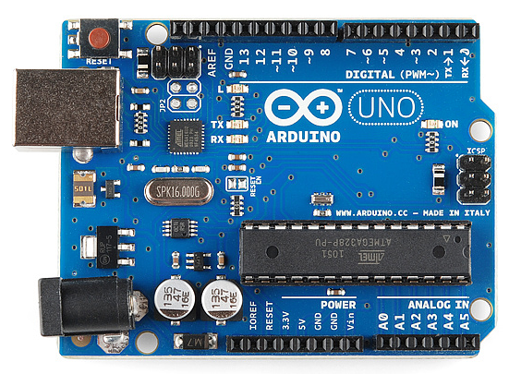
Arduino uno
Breadboard

Slide 13
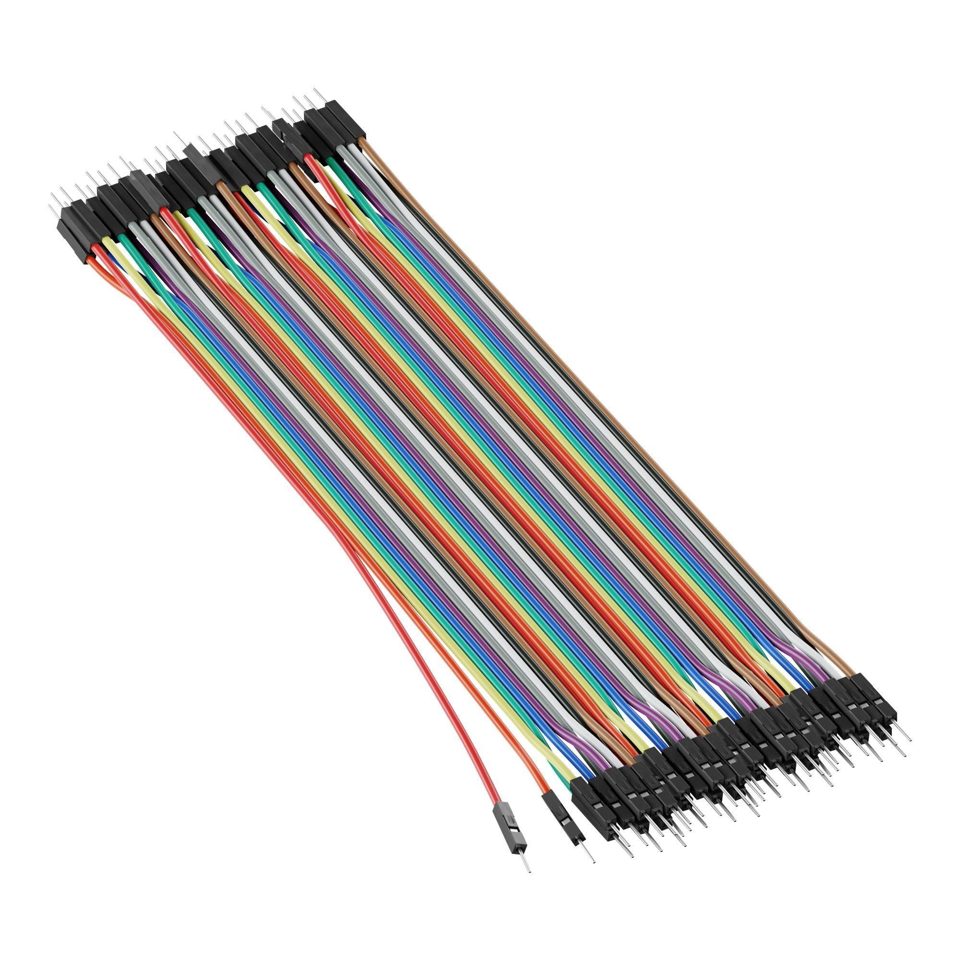
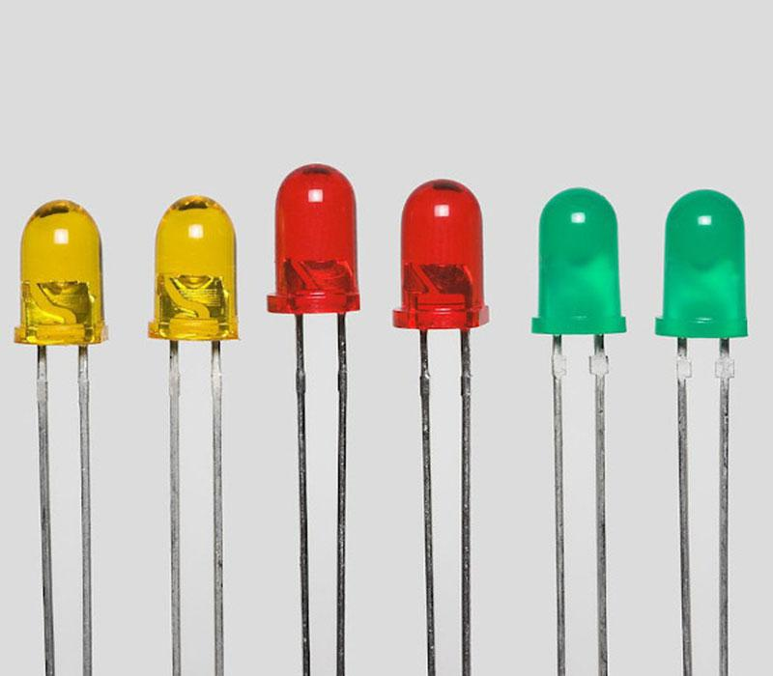
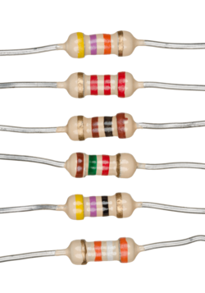
LEDs
Jumper wires (male-to-male)
Resistors

Slide 14
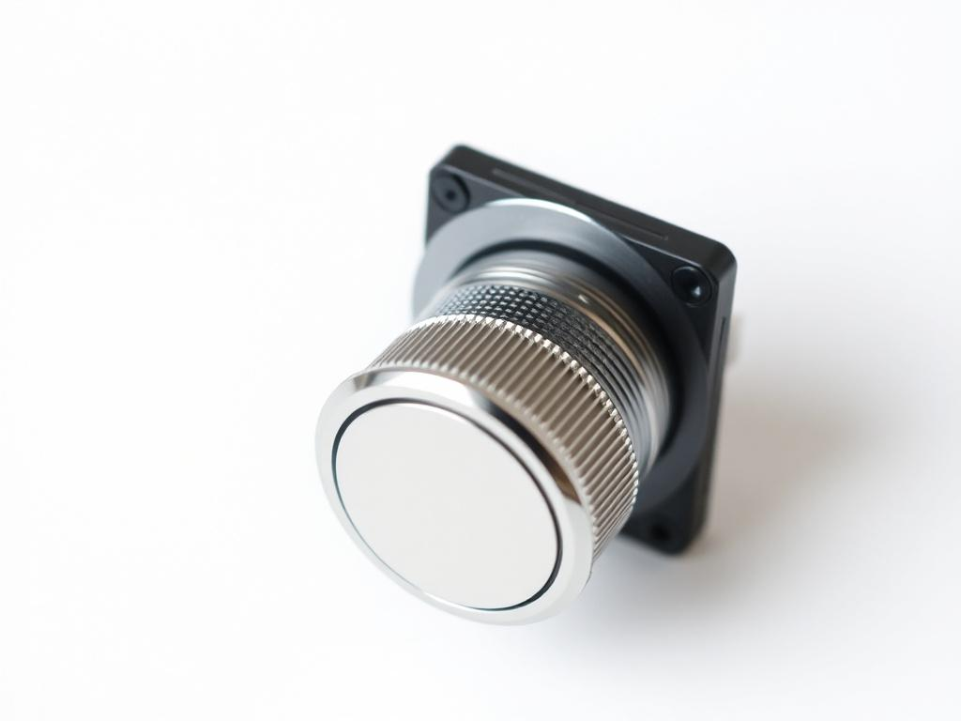
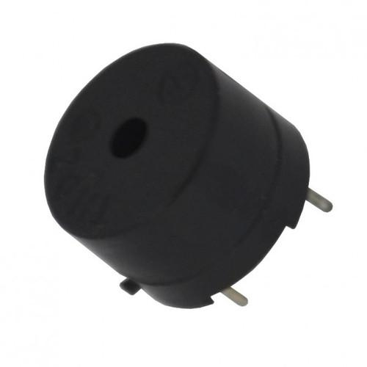
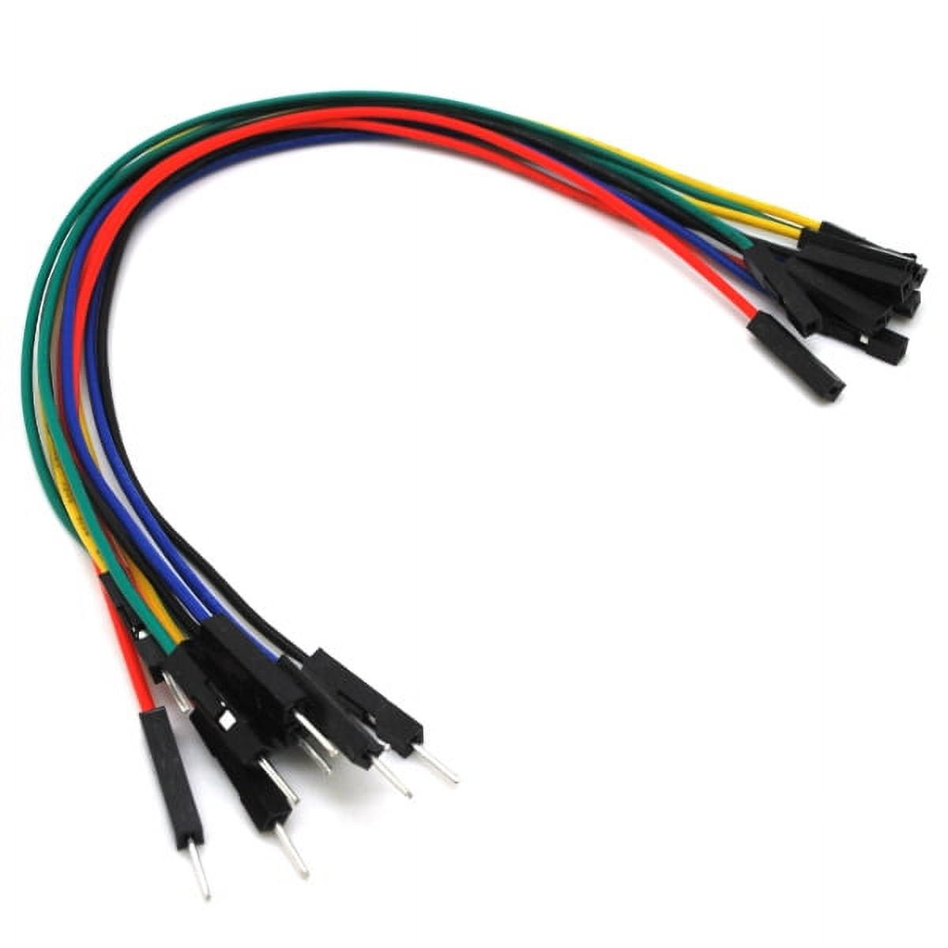
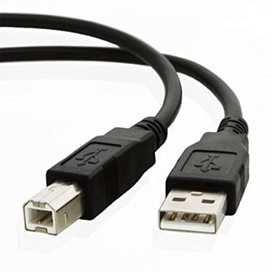
Push button
Jumper wires (male-to-female)
Buzzer
USB cable

Slide 15
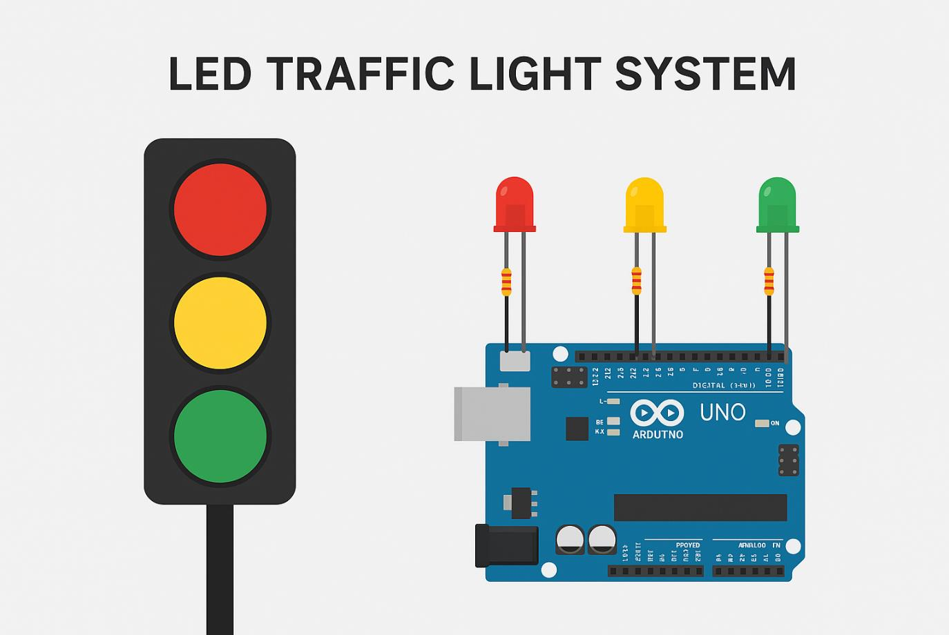

Slide 16
Steps to download and install the Arduino IDE on a Windows laptop
Step 1: Download Arduino IDE
Open your web browser and type “https://www.arduino.cc/en/software/”
Scroll down to the section labeled "Download the Arduino IDE.“
Click on the Windows installer option (either the Windows Installer or the ZIP file, depending on your preference).

Slide 17
Steps(Cont’d)
Step 2: Install Arduino IDE
If you downloaded the installer, locate the downloaded file (usually in the Downloads folder) and double-click it to run.
If you downloaded the ZIP file, extract the contents to a folder, then navigate to that folder and find the “setup.exe” file to run.
When prompted by the installer, click "Next" to proceed.
Accept the license agreement.

Slide 18
Steps(Cont’d)
Choose the installation location (you can use the default).
Select the additional tasks you want (usually, it’s fine to leave the defaults checked).
Click "Install" to begin the installation.
Once the installation process is complete, click "Close" to exit the installer.

Slide 19
Steps(Cont’d)
Step 3: Launch Arduino IDE
You can find the Arduino IDE in your Start Menu or on your Desktop if a shortcut was created.
Click on the Arduino icon to launch the application.

Slide 20
Steps(Cont’d)
Step 4: Install Drivers (if necessary)
Connect your Arduino board to your laptop using a USB cable.
If prompted to install drivers, follow the on-screen instructions. The Arduino IDE typically includes drivers for most boards.

Slide 21
Steps(Cont’d)
Step 5: Verify Installation
In the Arduino IDE, go to “File” > “Examples”, and select any example sketch (like "Blink").
Go to “Tools” > “Board” and select your Arduino model (e.g., Arduino Uno).
Go to “Tools” > “Port” and select the COM port associated with your Arduino.
Click the upload button (right arrow icon) in the IDE to upload the sketch to your Arduino.

Slide 22
Steps(Cont’d)
Step 6: Start Coding!
You’re all set! You can now start coding and working on your Arduino projects.

Slide 23
Resources
Project Material document can be found here
Lecture Slides can be found here
Project Components pictures and notes are found here

Slide 24
THANK YOU
See you in the next class!!!

