Slide 1
Destroyer2D
A pseudo sea battle game based on liquid-fun
计53 唐适之

Slide 2
Build and Battle!

Slide 3
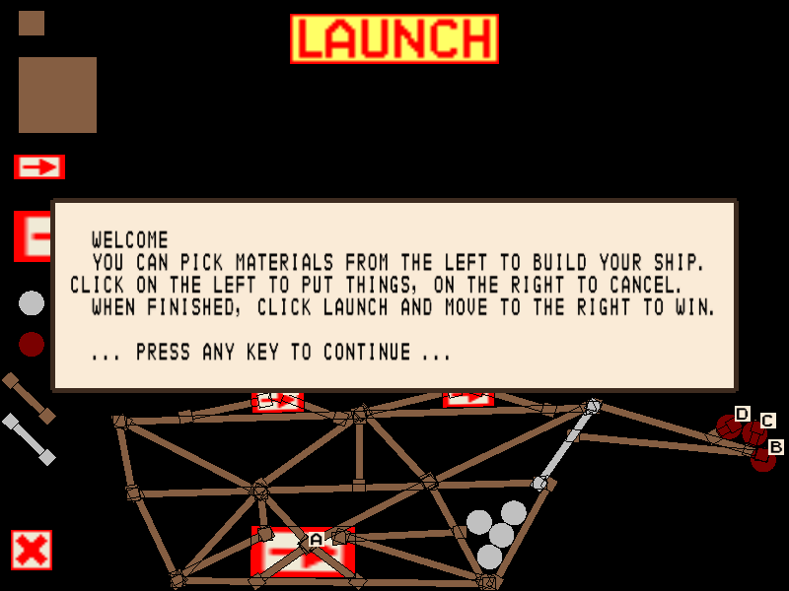
Screen shots
Welcome page

Slide 4
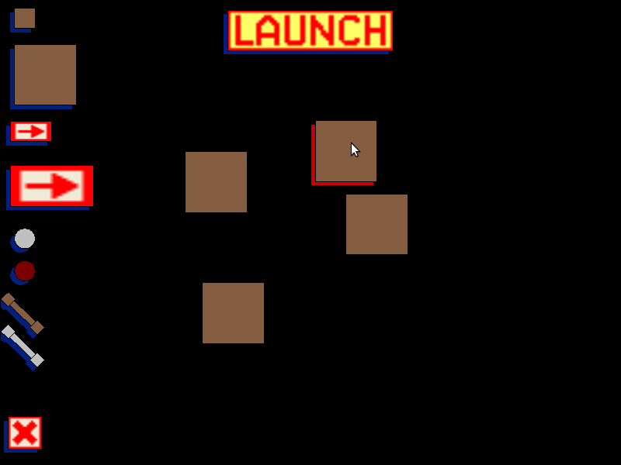
Screen shots
Putting blocks

Slide 5
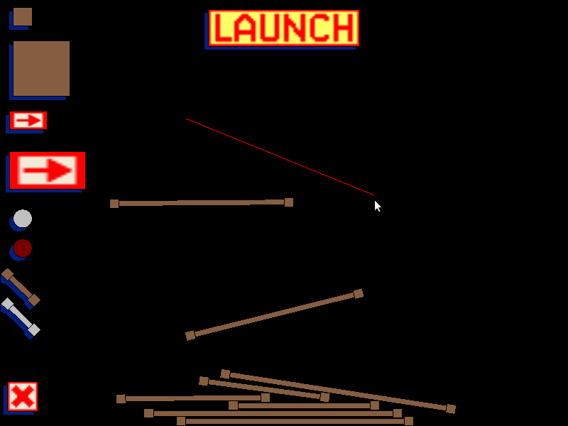
Screen shots
Drawing sticks

Slide 6
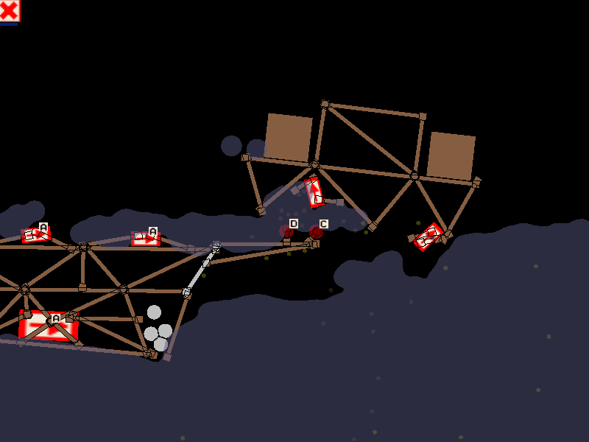
Screen shots
Battle scene

Slide 7
Flexible configuration for levels
level2.txt
mines.conf
missiles 40
mines 60
mines 80
X 20 0
Y 20 0
Z 20 0
W 20 0
A 40 0
B 40 0
C 40 0
D 40 0

Slide 8
Architecture

Slide 9
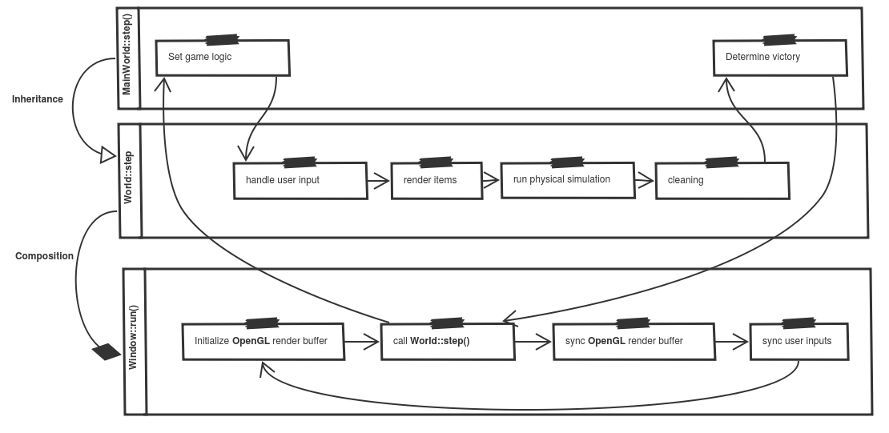
Main workflow

Slide 10
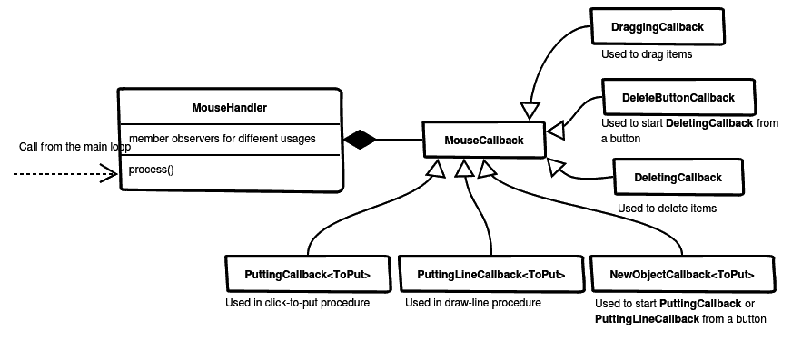
Observer pattern for listening mouse input

Slide 11
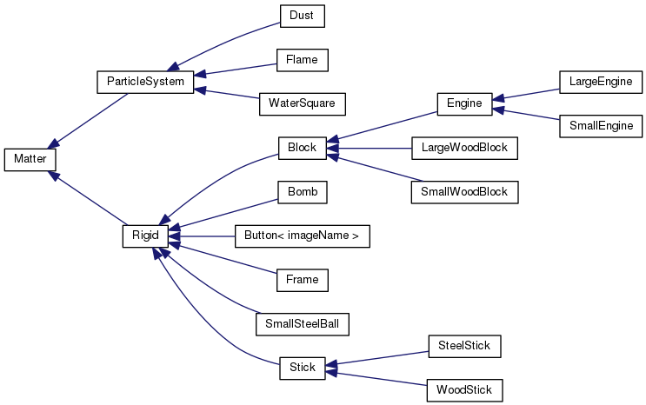
Polymorphism for items in the game

Slide 12
Thanks for your listening

