Slide 1
Destroyer2D
A pseudo sea battle game based on liquid-fun
计53 唐适之

Slide 2
Build and Battle!

Slide 3
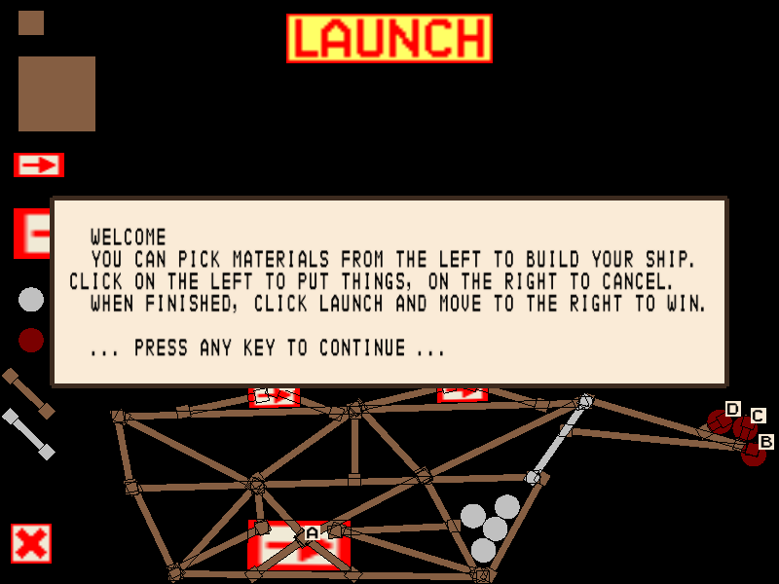
Screen shots
Welcome page

Slide 4
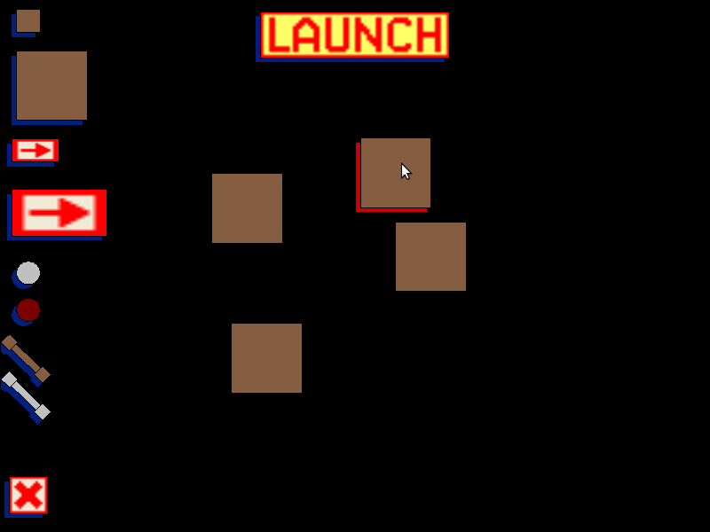
Screen shots
Putting blocks

Slide 5
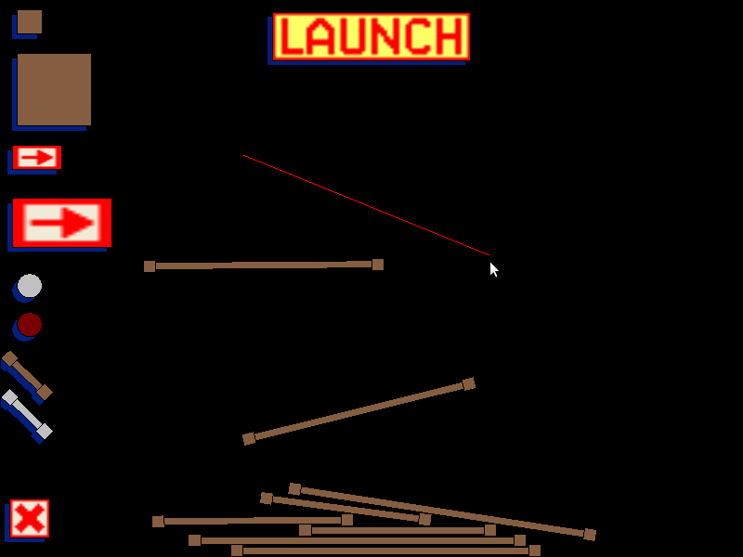
Screen shots
Drawing sticks

Slide 6
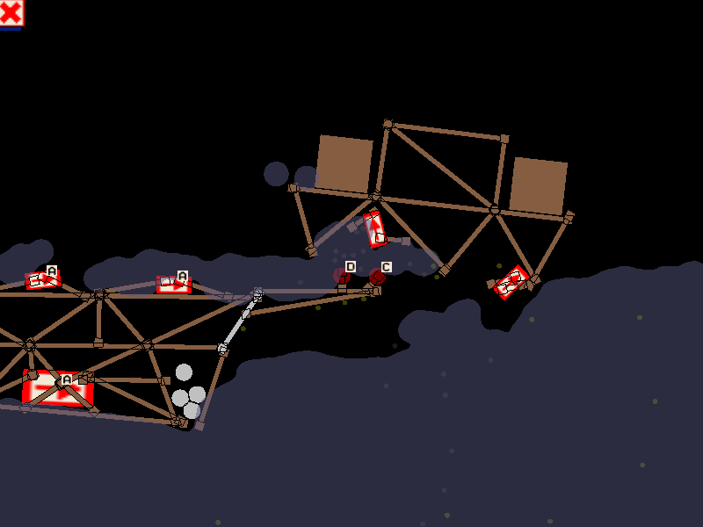
Screen shots
Battle scene

Slide 7
Flexible configuration for levels
level2.txt
mines.conf
missiles 40
mines 60
mines 80
X 20 0
Y 20 0
Z 20 0
W 20 0
A 40 0
B 40 0
C 40 0
D 40 0

Slide 8
Architecture

Slide 9
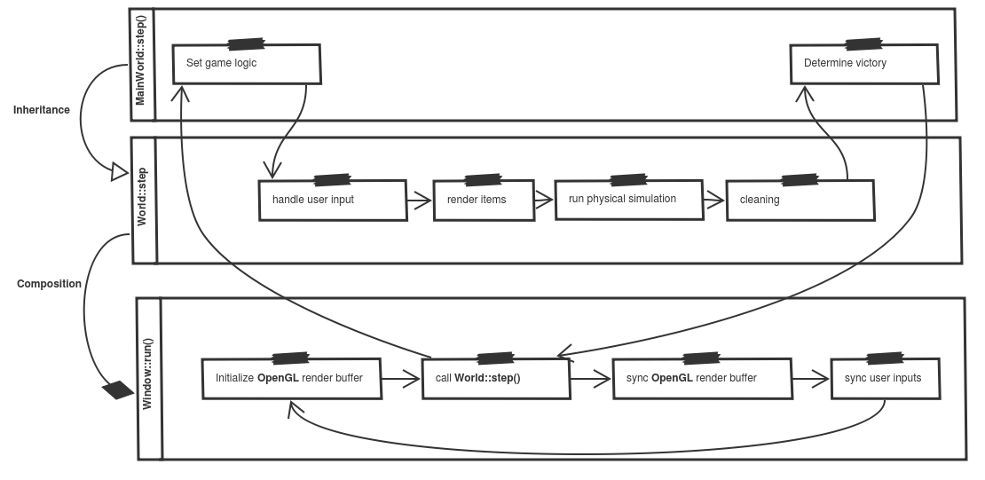
Main workflow

Slide 10
OOP Design

Slide 11
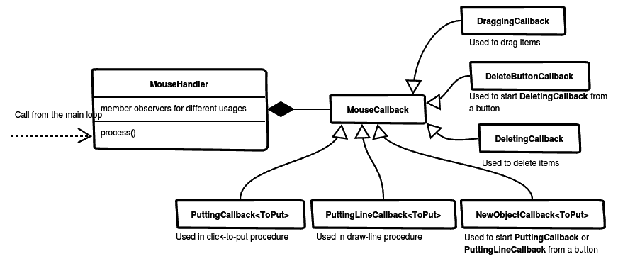
Observer pattern for listening mouse input

Slide 12
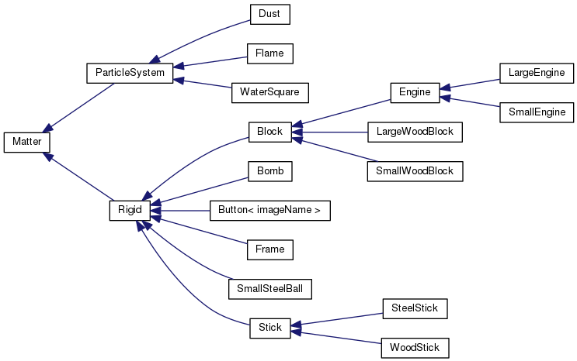
Polymorphism for items in the game

Slide 13
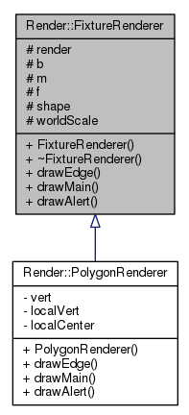
Strategy pattern for rendering fixtures

Slide 14
Special Techniques

Slide 15
How to display a smooth liquid surface?

Slide 16
How to make damage effect?

Slide 17
Thanks for your listening

