Slide 1
Case Study 2: Attrition and Salary
By: Rob Burigo
Ds 6306 – Spring 2021
04/16/21
youtube Presentation:
https://www.youtube.com/watch?v=zrN4GN6Uqyw

Slide 2
Task
Main Goal:
Explore which characteristics have the biggest impact on employee retention and salary
Data Set:
The set contains 870 employees in the company with 36 variables like Age, Distance From the Office, Years at the Company, etc.
Outline:
Explore the data set to see if there are any job role specific findings as well as the top characteristics that impact attrition
Develop 2 models:
1 classification model to predict employee attrition
1 regression model to predict monthly salary

Slide 3
Executive Summary
Top 3 most important factors when predicting attrition are
Number of Companies that the employee has worked at in their career
The number of years they have spent in their current role
How satisfied they are with their jobs
Age is close fourth
We can take this data and use it in our hiring practices by keeping an eye on how long someone's resume is while also using it in employee retention by monitoring HR surveys for Job Satisfaction.
Regarding job role specific findings, it was discovered that Manager is the role with the highest median salary while Manager and Research Director are positions where Employees stay the longest.
Using EDA and KNN classification model, we are able to predict with decent accuracy whether an employee will leave the company or not. We were also able to use multiple linear regression to predict the salary of an employee.
This can help us save money in on-boarding (decreasing attrition) as well as become more competitive in our salary offers.

Slide 4
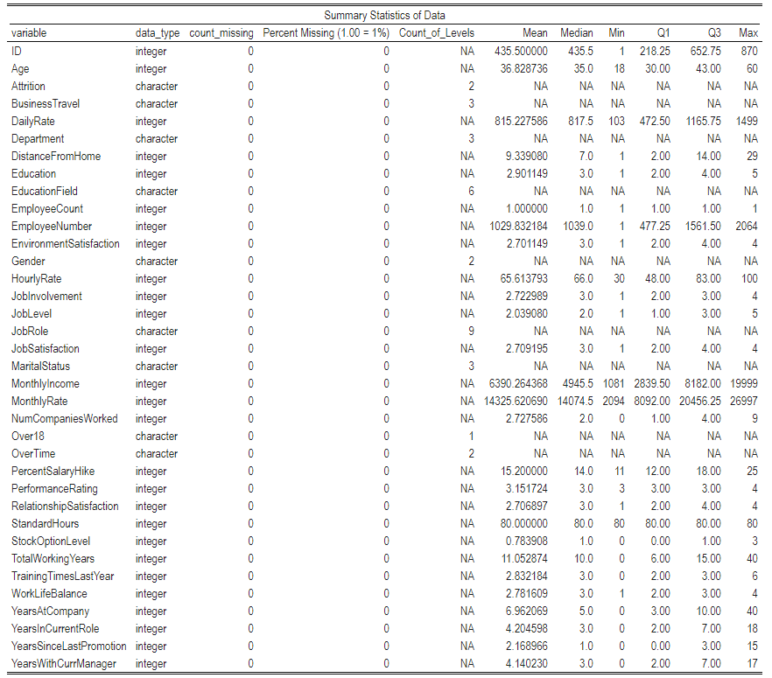
Summary Statistics
None of our columns contained any missing values
Noticed some potential scaling issus as variable like Monthly Income and Daily Rate of much larger scales than the rest.
9 categorical variabels with another 16 acting as categorical (i.e. Job Satisfaction on a 1-4 scale.

Slide 5
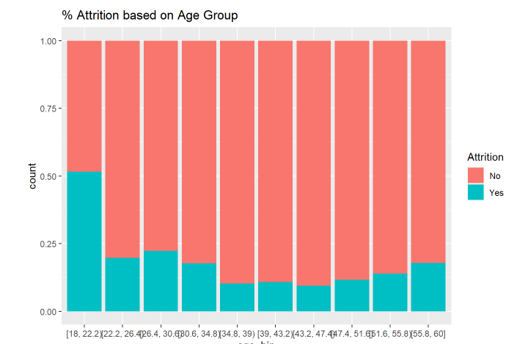
Plotting Variables vs Attrition
To get some context behind which variables might be useful for this analysis I plotted both continuous and categorical variables by % of total that left the company.
On the right, this is an example of the continuous variable comparison. The age’s of employees were put into bins and in each bin looked at the % retained.
As you can see, there appears to be some correlation between age and attrition. Younger and Older employees seem to have a lower retention % while middle aged have higher retention.
For more continuous charts please refer to the analysis here:

Slide 6
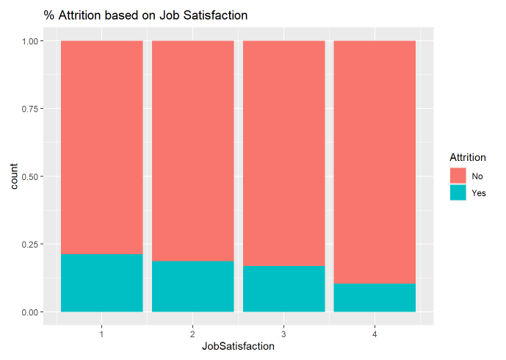
Plotting Variables vs Attrition (Cont’d)
On the right, this is an example of the categorical variable comparison. The job satisfaction of employees were split into each of the levels and plotted the % retained.
Once again, there appears to be some correlation between job satisfaction and attrition. People who are more satisfied with their current job are less likely to leave the company. Like touched on earlier, employee surveys could help us get ahead of retention.
For more categorical charts please refer to the analysis here:

Slide 7
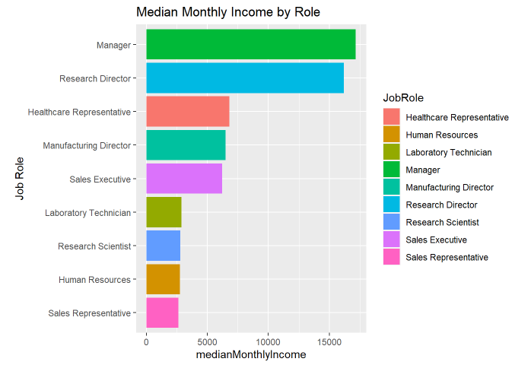
Income by Role
Tasked with finding some job role related findings.
Managers and Research Directors are the two highest earning positions. Both having salaries over $15k per month.
There definitely appears to be 3 “levels” of pay. There isn’t consistency between the titles within each level and we should consider changing titles to match pay.

Slide 8
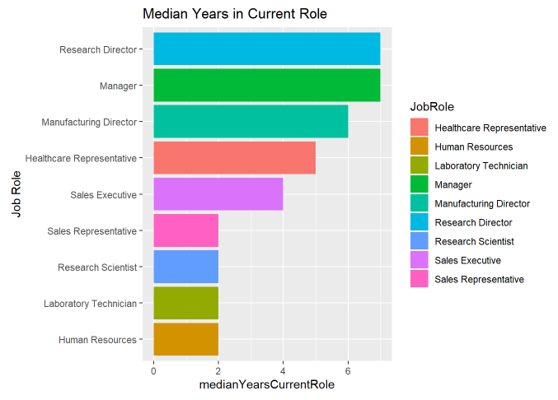
Longevity in Role
Also wanted to look at which roles were people staying in the longest.
Once again Mangers and Research Directors have the highest longevity, which makes sense due to the high pay.
Our lowest earning roles also have the highest turnover. Should consider merit bonus to increase retention.

Slide 9
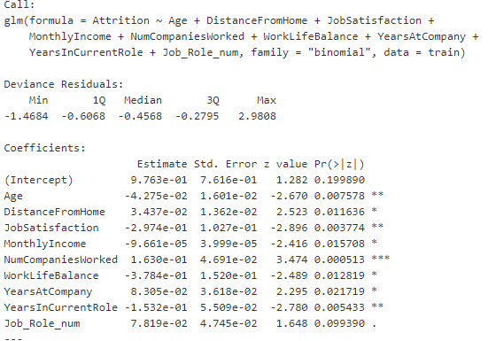
Top 3 Important Features Impacting Attrition
Ran a logistic Regression with stepwise selection to determine which variables had the most significance in the model.
The table on the right shows each selected variable as well as its p-value for significance.
Top 3 (based on lowest p-value)
Number of companies worked for
Years in current role
Job satisfaction

Slide 10
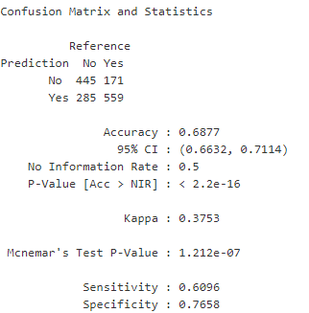
Understanding Attrition: Using the Knn Classifier
Problem statement:
We want to investigate how a KNN classifier can be used to predict Attrition.
Step 1: Tidying the Data
Due to an unbalances data set, decided to use an “over-sampling” method to increase the number of attritions in the data set. .
Standardize the data to reduce the variance due to scale of certain variables
Using the KNN Classifier (with 80%-20% Training-Test Split)
After running a loop with different train/test splits, we found that our best k is 15.
We were able to predict Attrition with an accuracy of approximately 69%
Takeaways
The matrix on the right is a confusion matrix outlining how many were predicted Yes/No and assessing the model
Sensitivity (false negatives) and Specificity (false positives) are both greater than .6

Slide 11
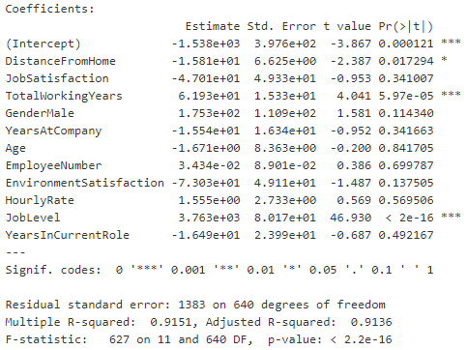
Understanding Salary: Using Multiple Linear Regression
Problem statement:
We want to investigate how a regression can be used to predict monthly salary.
Step 1: Tidying the Data
Bucket the Monthly Income into a factor variable and run a logistic regression to determine possible features to use in regression.
Trim data set to only those features that were used by the logistic regression model
Using the Linear Regression (with 75%-25% Training-Test Split)
After splitting the data and running the model, then calculate the RMSE to assess the model.
Target RMSE was <$3,000 and this model achieved $1,370 RMSE
Takeaways
The model summary on the right shows which variables are being used and what the coefficients are.

Slide 12
The End

