Slide 1
CLASSIFYING Benign and MALICIOUS URLS WITH APACHE SPARK
An
MSML651 Project
By
Rob Chavez

Slide 2
Motivation and SCOPE
Clicking on the wrong URL can spell disaster for you, financially and mentally
Anti-Virus companies put a lot of money in building solutions that help prevent their users from becoming victims of cyber crime when they click on a wrong URL; Malware Analysis, deep learning models
Cursory Internet searches reveal a lot of work in the space but very little of it presents clear, interpretable results, which often is a cost of using deep learning models
As such, the scope of this project is to use Apache Spark—a requirement for this class project—to build one of the most interpretable machine algorithms : a Decision Tree
In doing so, one question to be asked is whether those interpretable results can help defeat Deep Learning models?
Finally, given the short turnaround time on this project, this effort will not go beyond the project assignment: building a machine learning model utilizing Apache Spark. However, the write-up will include what additional efforts could be done continue experimenting on this topic

Slide 3
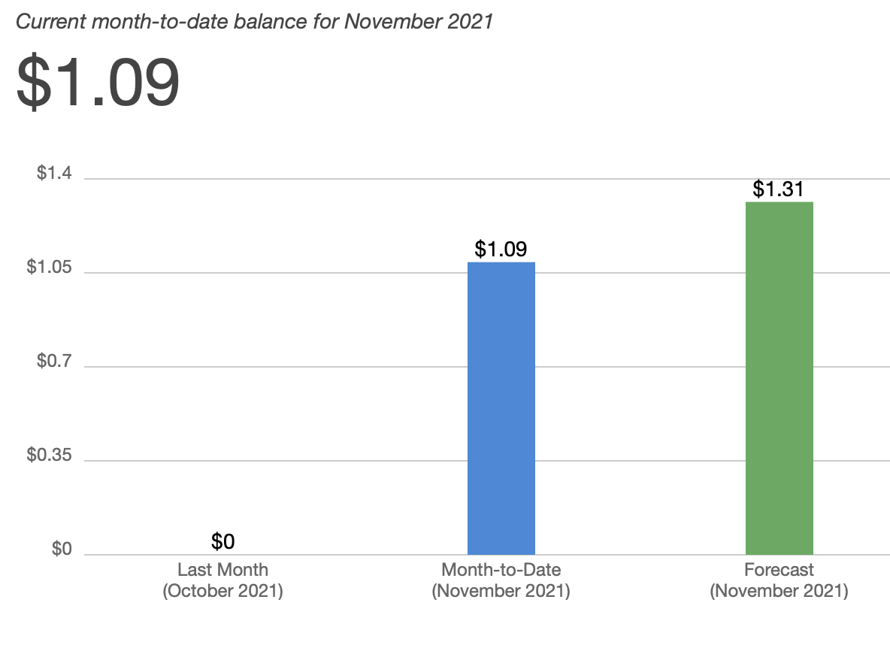
Project(ED) Costs
Allocating compute and storage resources
Used AWS Cloud Platform
Spun up three EC2 instances (free tiered) running Ubuntu 20.04.3 (LTS)
Installed Apache Spark on each (three-node cluster); several Python packages
Spun up Jupyter Notebook server to code in Pyspark and Python
Created an s3 bucket called MYUMDBUCKET; used s3fs to mount bucket to EC2

Slide 4
WHAT ABOUT THE DATA!?
Several Sources Exist for Finding Benign and Malicious URL Data
Kaggle; https://www.kaggle.com/sid321axn/malicious-urls-dataset
GitHub; https://github.com/shramos/Awesome-Cybersecurity-Datasets
Mendeley Data; https://data.mendeley.com/datasets/gdx3pkwp47/2

Slide 5
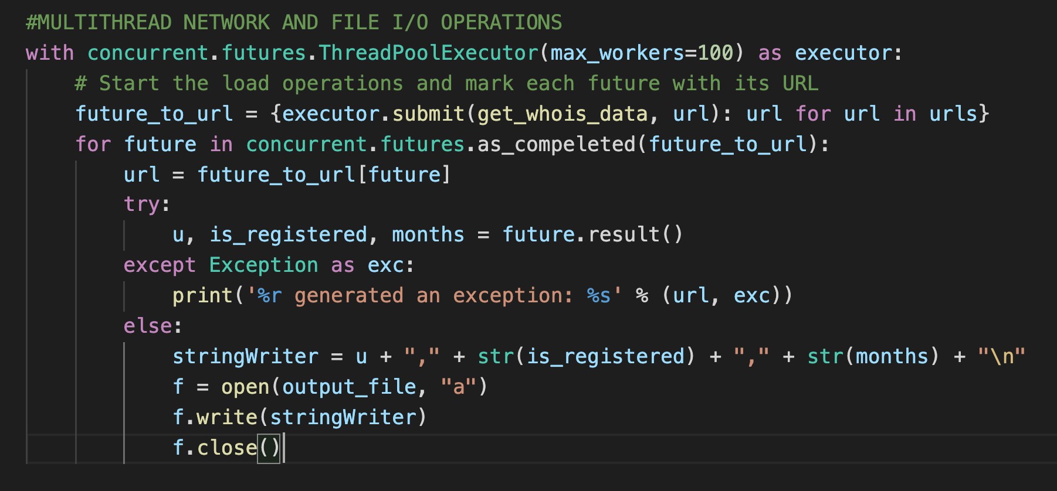
ETL & Feature engineering
Queried WHOIS server to get additional insight on data; used concurrent programming to optimize time needed to make over 1.5 million queries to the server and I/O file operations
https://web.mit.edu/6.005/www/fa14/classes/17-concurrency/

Slide 6
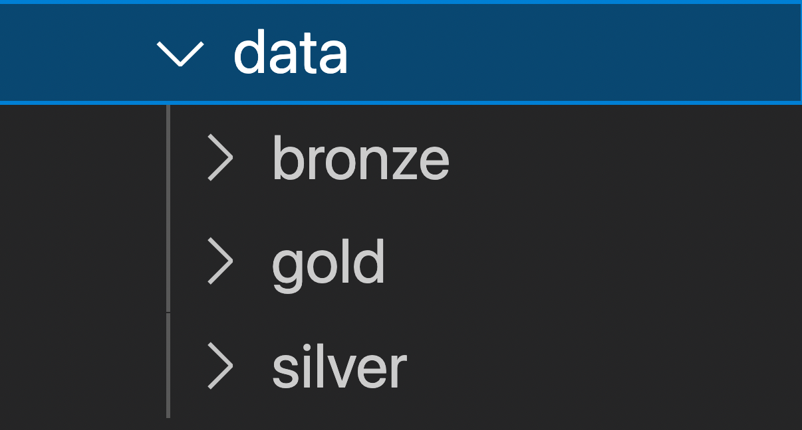
DATA DIRECTORY
ETL & Feature engineering continued
Bronze: contains raw source data obtained from Medeley data; WHOIS data
Silver: Joins data sources in bronze, reformats to parquet, and adds new features based on URL
Gold: Labeled Point Data
https://k21academy.com/microsoft-azure/data-engineer/delta-lake/

Slide 7
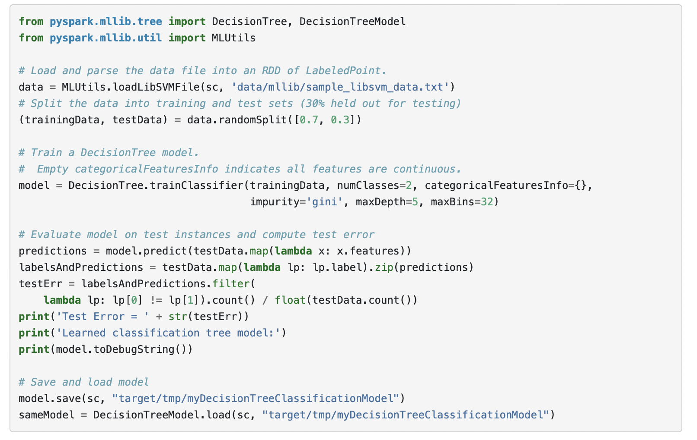
Building (Copying?) … A MODEL
https://spark.apache.org/docs/latest/mllib-decision-tree.html

Slide 8
RESULTS
Is domain length <= 36.5 characters?
Is path length <= 14.5 characters?
Is dot count <= 2.5 characters?
Is dot count <= 3.5 characters?
Is registered?
Is registered?
Is path_length <= 10.5
Is slash count <=5.5

