Slide 1
A PROPOSAL · FINE ART MEDIA & RMIT UNIVERSITY
ARCHAI × ACMI
Sovereign AI for the living archive, turning the collection into something people can talk to, while every record stays on hardware ACMI owns.
Rob Graham Creative technologist · Founder, Fine Art Media · PhD Researcher, RMIT University
rob@fineartmedia.tech · fineartmedia.tech/archai
Notes:
Australia’s national museum of screen culture meets a sovereign, local-first AI. This is a concept demo and an independent proposal.

Slide 2
THE PROBLEM
Digitised, but still hidden.
And the easy AI takes your collection offshore.
01
02
03
Locked in cataloguing
Cloud AI, real cost
Sovereignty = preservation
Millions of records built for documentation, not discovery. Most collections are surfaced in single-digit percentages.
Conversational and semantic AI is on offer everywhere, but it moves your collection data and visitor conversations into jurisdictions and models you don’t control.
An institution that can’t keep independent access to its own interpretive systems has, in a real sense, lost control of its collection.

Slide 3
WHAT ARCHAI IS
A sovereign semantic layer above your systems.
It reads, never writes, and stays in the building.
Heritage foundation
Derivative processing
Editorial
Your CMS / DAMS. Read-only. No AI output ever enters the record. Permanent, authoritative, citable.
Vectors + AI responses. Entirely regenerable, rebuilt from unchanged source when models improve.
Curator interpretation. Flows one way, archive → visitor. Never writes back.

Slide 4
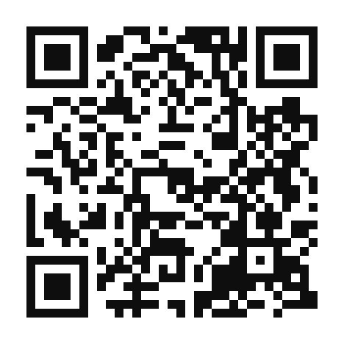
THE CONCEPT DEMO
The Object Wall
A wall of moving-image objects, speaking from ACMI’s own records, out loud or by text, in the language you choose.
Genuine Australian voice + 11 languages, on-device
Tap any object, it answers in the first person
Curator / Guide / Education / Technical personas
Scan to try it
Message wall, kept safe by the Saftio safety layer
fineartmedia.tech/acmi
Best on a phone

Slide 5
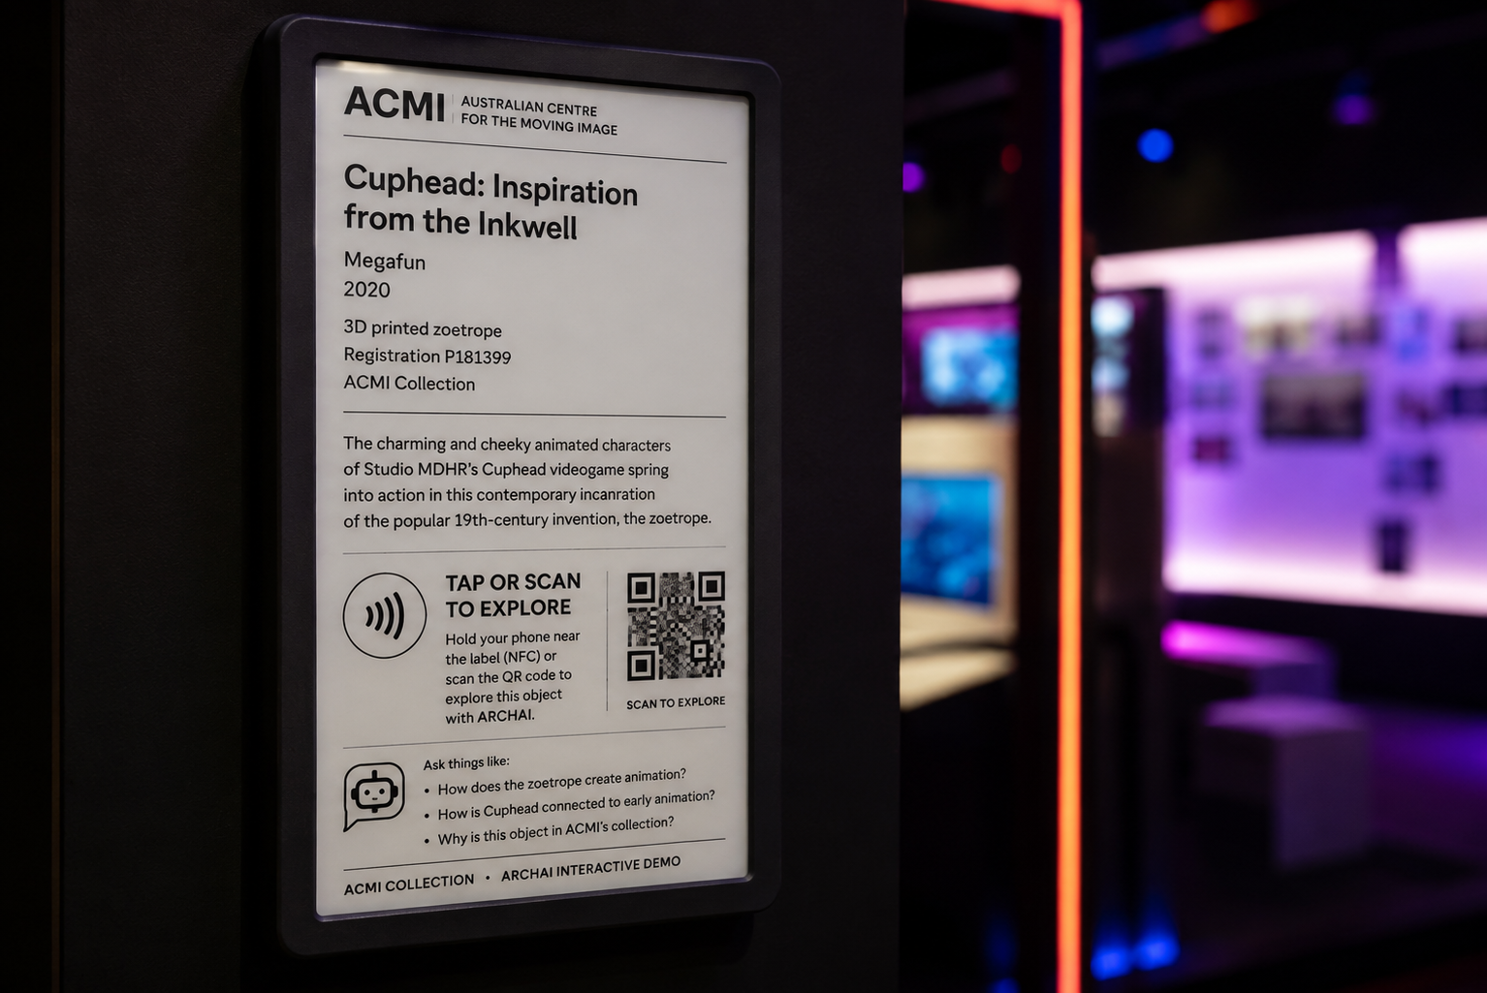
A LIVING LABEL · E-PAPER + NFC
The label itself becomes
conversational.
Updatable
The label redraws from the collection record. A curator edits the CMS; the label on the floor updates, no reprint.
Conversational
Tap (NFC) or scan the QR, and the object answers on the visitor’s own phone, grounded in ACMI’s record.
Sovereign & low-power
Concept mockup · ARCHAI interactive e-paper label
E-paper sips power and stays on. Built on your existing Lens NFC, nothing leaves the building.

Slide 6
THE SOVEREIGN STACK, ALL ON-DEVICE
No cloud AI. Nothing leaves the building.
Search
Reasoning
Qdrant + local embeddings, semantic, rights- and place-aware.
Local LLM (Qwen) with a five-layer framework that keeps answers to verified fact.
Voice
Access
Whisper + MeloTTS, speech in and out, multilingual, a genuine Australian voice.
A CORS-locked tunnel to the local box. The collection stays on-premises.
Integrates with your existing interpretation and hardware, including The Lens and its touch-points, rather than duplicating them.
Built and improved with Huggle (a transparent agent-coordination log); secrets held in Keytec, a sovereign API-key wallet.

Slide 7
ETHICS & SAFETY, BUILT IN, NOT BOLTED ON
Saftio, an on-device safety layer
Crisis
Hate / threats
Cultural
Verified facts
Routed to real human help, never an AI reply.
Held from public view for curatorial review.
Held under your protocols for cultural review.
A ★ green star, the fact is added to the object’s record by curators.
Visitor contributions become living-archive provenance, community knowledge, verified by curators, feeding the record.

Slide 8
FIRST NATIONS COLLECTIONS & DATA SOVEREIGNTY
Cultural protocols enforced by the architecture,
not written in a policy beside it.
Community-governed, consent-first. Authority to Control sits with communities. ARCHAI can read and enforce Traditional Knowledge (TK) Labels, exclude restricted material at ingest, honour differential access, and never surface what shouldn’t be. Running locally, restricted material never leaves the building.
Aligned with
CARE Principles
Maiam nayri Wingara
Mukurtu · TK Labels / Local Contexts
AIATSIS Code
The proposition is not “ingest Indigenous collections.” It is sovereign infrastructure that enforces your protocols, on your terms, on hardware you control.

Slide 9
A PILOT WITH ACMI
Scoped small, low-risk,
rights and protocols set by your team.
Your records, your rules
Straightforward to connect
Owned outright
A bounded set of ACMI-approved records. Rights, terminology, cultural protocols and publication rules all set by you.
Reads from ACMI’s open collection API. Three ACMI-record demos already run, the green zoetrope, a praxinoscope strip, Muybridge’s horse.
One-time capital, on hardware you keep, not a per-seat cloud subscription.

Slide 10
A RESEARCH AGENDA FOR THE MUSEUM
Seven Research-through-Design experiments
1 · Curatorial collection intelligence
STAFF-FACING
2 · Accessibility & multilingual voice
VISITOR-FACING
3 · Local-LLM evaluation → sovereign appliance
TECHNICAL
4 · E-paper signage + NFC “living labels”
PHYSICAL
5 · The federated “museum mega brain”
FLAGSHIP
6 · The living archive (community provenance)
SAFTIO
7 · Cultural protocols as architecture
GOVERNANCE
Each maps to the PhD question, runs in a real gallery, and shares its data and findings openly.

Slide 11
WHY NOW
This extends a live relationship,
not a cold ask.
RMIT is already ACMI’s Major University Partner, a decade-long relationship, renewed in 2026. ARCHAI extends it into sovereign AI research.
Scoped pilot ACMI-approved records; rights & protocols yours.
ARC Linkage RMIT + ACMI partners; Major-Partner status strengthens the bid.
Audience Lab In-gallery prototypes tested with real audiences.
Studies & co-authorship Visitor studies, shared outputs, student placements.

Slide 12
WE COULD EXPLORE
A collaboration to shape,
not a product to install.
?
Which collection subset makes the best low-risk pilot?
?
Which systems should ARCHAI read from, and what does the API expose?
?
What rights and First Nations governance must be enforceable from day one?
?
A light informal pilot, or a formal research partnership / ARC Linkage?
Rob Graham rob@fineartmedia.tech · fineartmedia.tech/acmi · github.com/rob-e-graham

