Slide 1
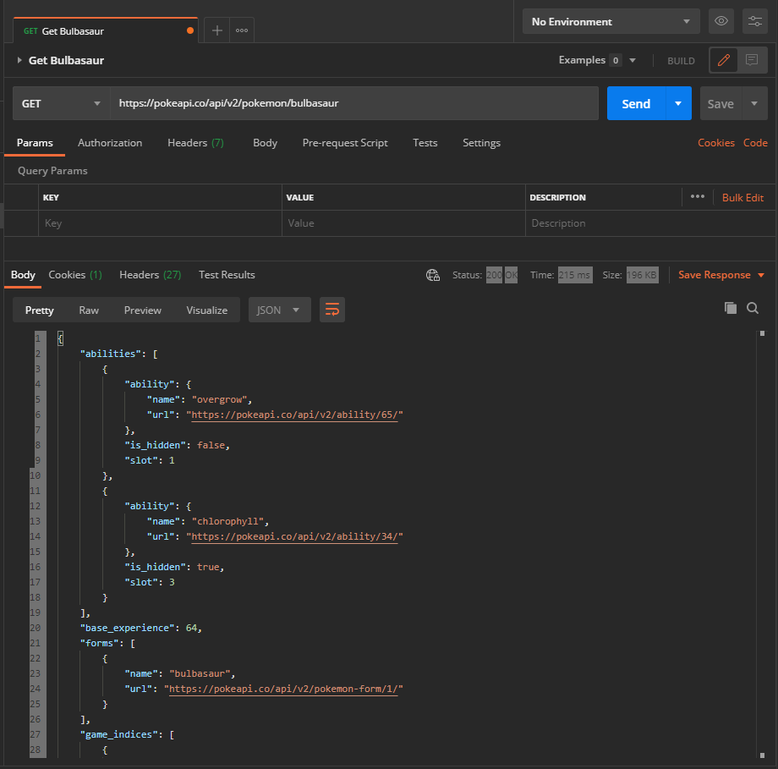
Get Bulbasaur

Slide 2
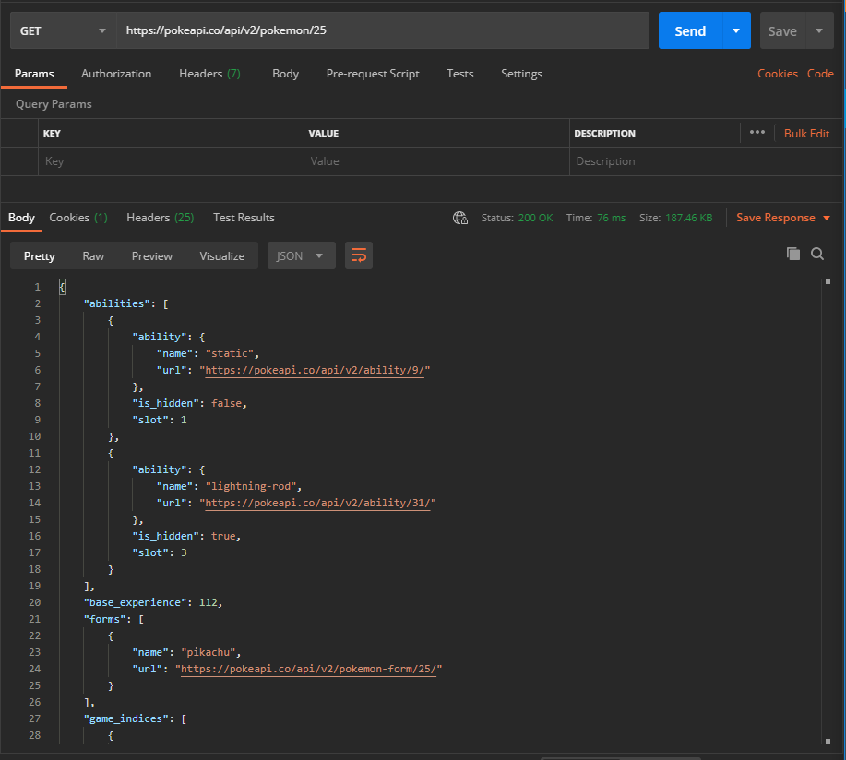
2. Get Pokemon by id: 25
- Pikachu

Slide 3
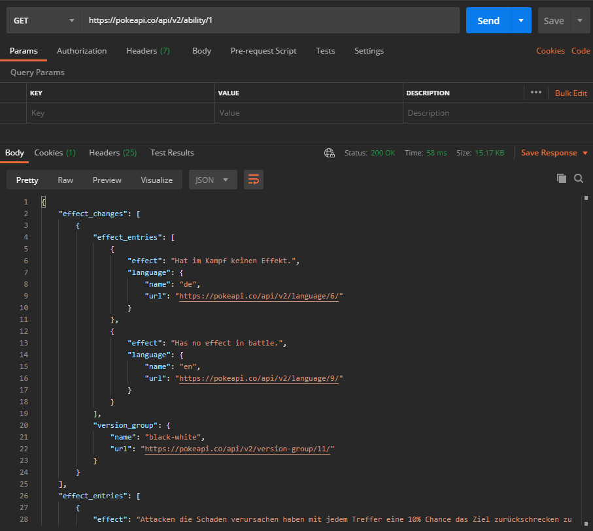
3. Get Ability by id: 1

Slide 4
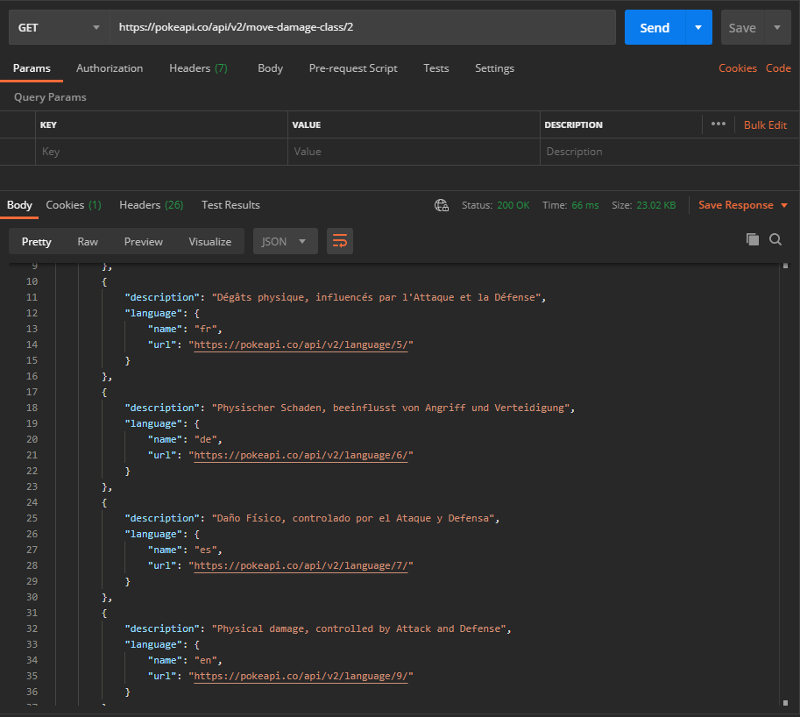
4. Get Move Damage Class by id: 2

Slide 5
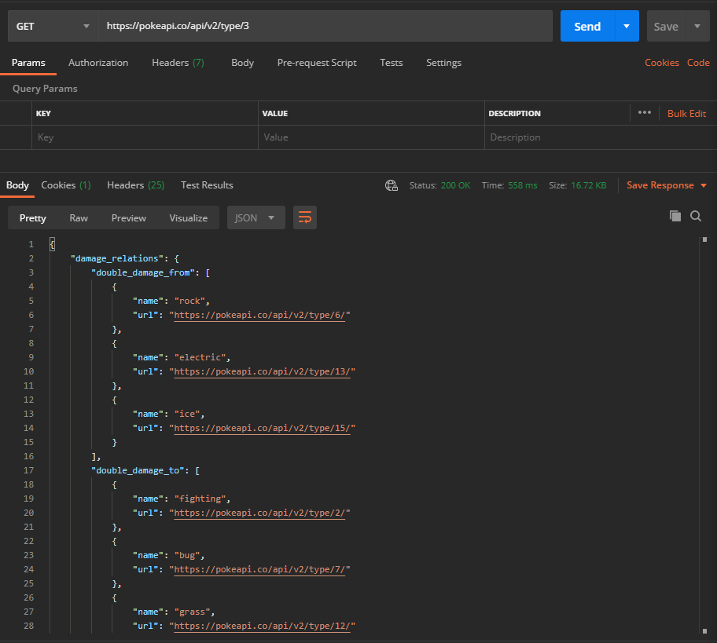
5. Get Type by id: 3

