Slide 1
Probability and Statistical Inference: Introduction
TU Dublin City Campus,
School of Computer Science

Slide 2
What are we
dealing with
?

Slide 3
Thing

Slide 4
Thing
width
colour
shape

Slide 5
What are these?
Thing
width
colour
shape

Slide 6
Properties
Thing
width
colour
shape

Slide 7
Properties
Thing
width : 10cm
colour : magenta
shape : circle

Slide 8
What are these?
Properties
Thing
width : 10cm
colour : magenta
shape : circle

Slide 9
Properties
Values
Thing 1
width : 10cm
colour : magenta
shape : circle

Slide 10
Properties
Values
Thing 2
width : 10cm
colour : blue
shape : rectangle

Slide 11
Thing 3
Properties
Values
width : 15cm
colour : green
shape : triangle

Slide 12
Properties
Values
width : 7cm
Thing 4
colour : yellow
shape : rhomboid

Slide 13
Properties
Values
width : 20cm
Thing 5
colour : pink
shape : rectangle

Slide 14
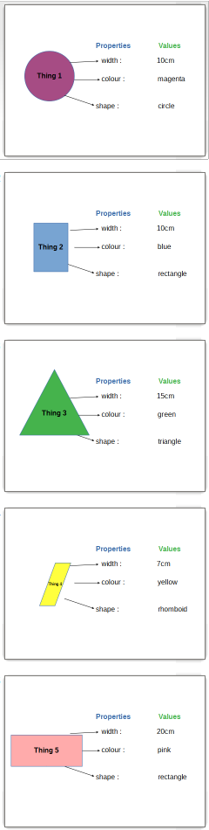
WE HAVE
4 properties (variables,
attributes, features)
ID | width (cm) | colour | shape
1 | 10 | magenta | circle
2 | 10 | blue | rectangle
3 | 15 | green | triangle
4 | 7 | yellow | rhomboid
5 | 20 | pink | rectangle
WE HAVE
5 things
(instances,
observations,
examples)
This table is what we analyse

Slide 15
The analysis cycle

Slide 16
The data analysis cycle
Visualisation/reporting
Summarisation
and description
Exploration and knowledge extraction
Data extraction and preparation
Modelling and prediction
Subject area

Slide 17
The data analysis cycle
Visualisation/reporting
Summarisation
and description
Exploration and knowledge extraction
Data extraction and preparation
Modelling and prediction
Subject area
earth sciences
business
sport
population (census)
finance

Slide 18
The data analysis cycle
Visualisation/reporting
Summarisation
and description
Exploration and knowledge extraction
Standard and once-off visualisation
Examples:
Human loss in WW2
Minard Napoleon in Russia
Data extraction and preparation
Modelling and prediction
Subject area

Slide 19
The data analysis cycle
Visualisation/reporting
Summarisation
and description
Exploration and knowledge extraction
the analysis is only as good as the data, which must be representative of the reality we wish to study i.e. unbiased
collection methods
surveys (social science, psychology)
measurements (earth and natural science)
logs and other digital ‘traces’
types
structured (conventional variables)
unstructured (speech, video…)
Data extraction and preparation
Modelling and prediction
Subject area

Slide 20
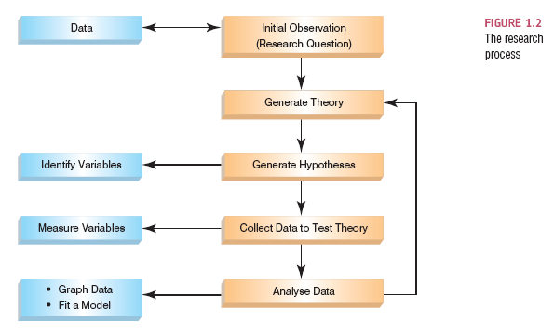
The data analysis cycle
Visualisation/reporting
Summarisation
and description
Exploration and knowledge extraction
the analysis is only as good as the data, which must be representative of the reality we wish to study i.e. unbiased
collection methods
surveys (social science, psychology)
measurements (earth and natural science)
logs and other digital ‘traces’
types
structured (conventional variables)
unstructured (speech, video…)
Data extraction and preparation
Modelling and prediction
The design of the data collection process (i.e. the experiment) must be grounded in sound conceptual understanding of the problem domain.
A theory is expressed in terms of domain concepts, e.g. ‘TU Dublin attracts local students’. A hypothesis is expressed as a concrete prediction e.g. ‘the majority of students grew up within 10km of Grangegorman’. Falsification occurs when a theory or hypothesis is disproved.
Subject area
Original picture source: Andy Field

Slide 21
The data analysis cycle
Visualisation/reporting
Summarisation
and description
Exploration and knowledge extraction
the analysis is only as good as the data, which must be representative of the reality we wish to study i.e. unbiased
collection methods
surveys (social science, psychology)
measurements (earth and natural science)
logs and other digital ‘traces’
types
structured (conventional variables)
unstructured (speech, video…)
Data extraction and preparation
Modelling and prediction
The variables involved in the experiment are identified from the hypothesis (in the example already used these would be ‘college name’ and ‘distance to home’).
Good understanding of the domain and consequent good experimental design ensure:
reliability (consistency)
validity (explored in exercise)
accuracy of measurement
absence of confounding variables
Subject area
Original picture source: Andy Field

Slide 22
The data analysis cycle
Visualisation/reporting
Summarisation
and description
Exploration and knowledge extraction
the analysis is only as good as the data, which must be representative of the reality we wish to study i.e. unbiased
collection methods
surveys (social science, psychology)
measurements (earth and natural science)
logs and other digital ‘traces’
types
structured (conventional variables)
unstructured (speech, video…)
Data extraction and preparation
Modelling and prediction
The instances for which data is collected represent a sample of the population of all instances. Two important (but not only) factors in how unbiased a sample will be are its size and sampling method (some type of random sampling is desirable).
Small samples may lead to wrong conclusions. Large samples can be wasteful.
Subject area
Original picture source: Andy Field

Slide 23
The data analysis cycle
Visualisation/reporting
Summarisation
and description
Exploration and knowledge extraction
the analysis is only as good as the data, which must be representative of the reality we wish to study i.e. unbiased
collection methods
surveys (social science, psychology)
measurements (earth and natural science)
logs and other digital ‘traces’
types
structured (conventional variables)
unstructured (speech, video…)
Data extraction and preparation
Modelling and prediction
In the case of predictive models, an undesirable state of affairs, reflected in the data, can be perpetuated by a model that uses them (e.g. racism or misogyny). This, however, is a problem inherent in the data i.e. one of initial data selection rather than a problem in sampling.
Subject area
Original picture source: Andy Field

Slide 24
The data analysis cycle
Visualisation/reporting
Summarisation
and description
Exploration and knowledge extraction
cleaning the data (e.g. removing non-numerical values and converting text to numbers)
removing outliers
scaling data if combining multiple data-sets
combining variables
converting continuous data to categories
Data extraction and preparation
Modelling and prediction
Subject area

Slide 25
The data analysis cycle
Visualisation/reporting
Summarisation
and description
Exploration and knowledge extraction
representations of a single variable
visual
diagrams (e.g. barchart)
tables
summarising measures
central tendency (e.g. mean, median)
spread (e.g. range, standard deviation)
Data extraction and preparation
Modelling and prediction
Subject area

Slide 26
The data analysis cycle
Visualisation/reporting
Summarisation
and description
Exploration and knowledge extraction
looking at the data without preconceptions
looking at two or more variables at the same time for
relationships
clusters
Data extraction and preparation
Modelling and prediction
Subject area

Slide 27
The data analysis cycle
Visualisation/reporting
Summarisation
and description
Exploration and knowledge extraction
determining the values of a variable based on the values of other variables pertaining to the same instances
most often not really ‘prediction’ in a temporal or causal sense, except in the case of time-series analysis
Data extraction and preparation
Modelling and prediction
Subject area

Slide 28
The data analysis cycle
Visualisation/reporting
Summarisation
and description
Exploration and knowledge extraction
statistical inference:
using a sample of instances to understand an entire population and its parameters
understanding how much we can trust such conclusions about the population
relevant in in some form at all stages of the data cycle
Data extraction and preparation
Modelling and prediction
Subject area

Slide 29
Statistics in the data analysis landscape
B
A
C

Slide 30
The place of statistics in the
data analysis landscape
Data science: concepts and theory behind the analysis of data
underlies
Statistics: mathematically-based description of and inquiry into data
Machine learning: computationally- based algorithms, for predictive modelling and exploration
operate on
Prepared data

Slide 31
In this module
you will learn

Slide 32
to…
Present the question you are interested in
in a way that makes sense to conduct a statistical analysis
Inspect and prepare the data you have
to support a statistical analysis
Describe the data you have
in a way that demonstrates the constraints placed on the analysis by the data
Conduct a statistical analysis
using appropriate statistical tests
Report on your statistical analysis
in a way that makes sense for your consumer
Interpret the outcomes of your statistical analysis
drawing appropriate conclusions
Report on the findings of your statistical analysis
in a way that makes sense for your consumer

