Slide 1
PSI Group Exercise 1
Instructions
The exercise should take about 10 minutes
Everyone introduce themselves to each other
Discuss each picture and accompanying question
Agree a list of conclusions to report back to the class
Elect a person to do the reporting

Slide 2
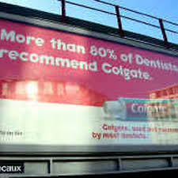
This statistic was banned in the UK for not meeting advertising standards. Why do you think this was?

Slide 3
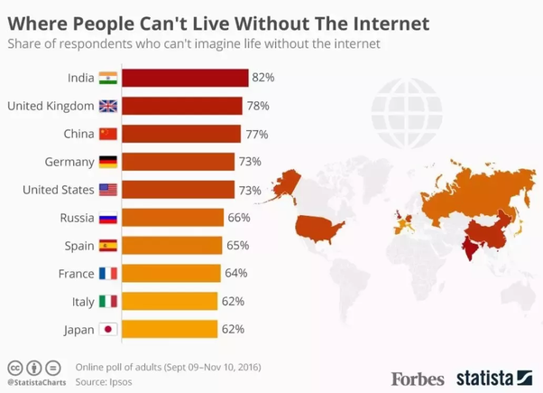
What’s wrong with this?

Slide 4
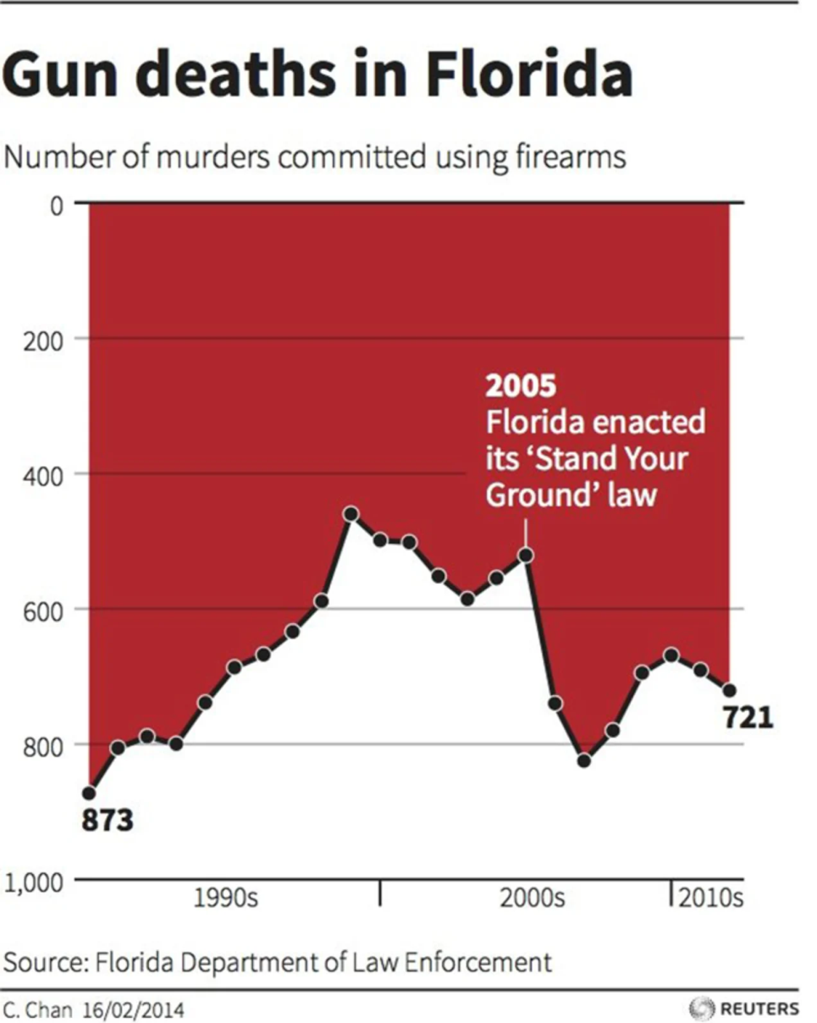
Effect of ‘Stand Your Ground’ law making it legal to defend yourself and your property.
What does this graph suggest and why?

Slide 5
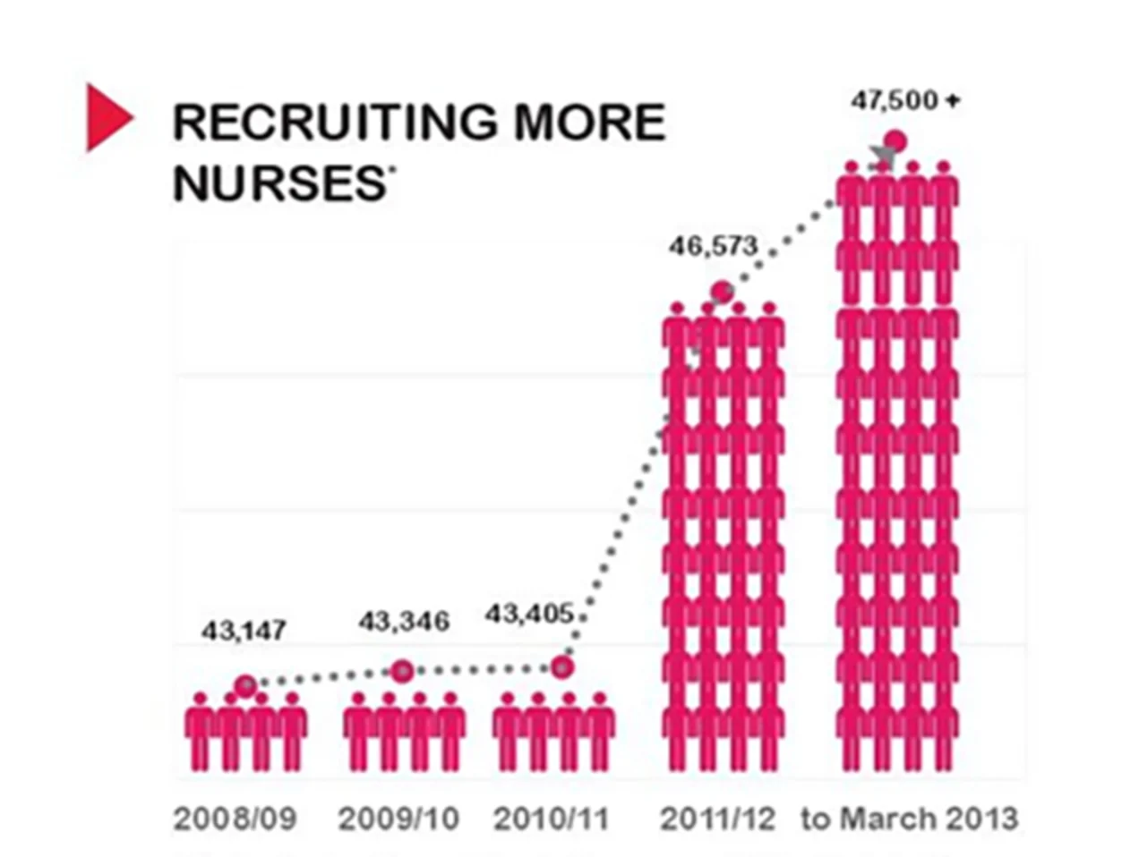
What is wrong with this?

Slide 6
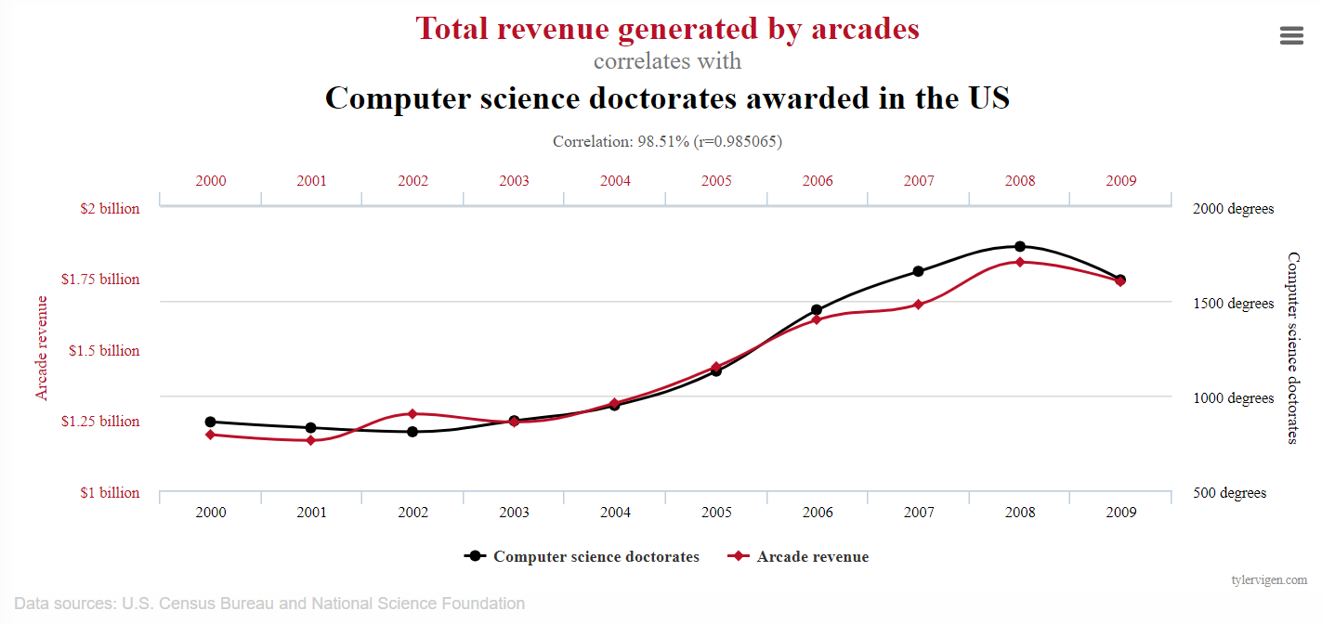
What does this imply?

Slide 7
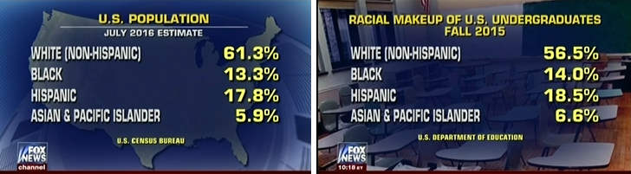
What is wrong with with these two pictures side-by-side?
Attempt by Fox News to demonstrate under-representation of one section of population at undergraduate education using categorisations for ethnicity from US census.

Slide 8

What about this?

