Slide 1
PSI Group Exercise 4
Instructions
The exercise should take about 10 minutes
Everyone introduce themselves to each other
Discuss the questions on the following pages
Be aware that the questions might have more than one right answer
Agree a list of conclusions to report back to the class
Elect a person to do the reporting

Slide 2
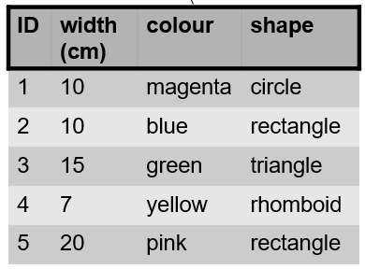
(1) What kinds of variables are in the table?
Be careful, some are tricky.
Also, describe in detail e.g. for a numeric variable, is it discrete or continuous and what is its scale…
(2) Could colour be converted to a meaningful numeric variable and if yes, for what purpose?

Slide 3
(3) What kind of variable is the vertical position of a shower head adjustable on a bracket with a clamp?
(4) What kind of a variable is measured by digital kitchen scales?
(5) What kind of variable could be used in a class attendance record?
(6) What kind of variable is the height of mountain peaks?

