Slide 1
x0
3.6
x1
2.6
h_{θ}(x)
11
x2

Slide 2
x1
h_{θ}(x)
x2

Slide 3
x0
-3
x1
2
h_{θ}(x)
2
x2

Slide 4
x0
-1
x1
2
h_{θ}(x)
2
x2

Slide 5
x0
1
h_{θ}(x)
-2
x1

Slide 6
x0
-3
x0
-1
x0
1
NOT
2
AND
1
-2
2
x1
2
-3
2
NOT
OR
-2
2
x2
2
AND

Slide 7
Input Layer
Hidden Layer
Output Layer

Slide 8
Input Layer
Hidden Layer
Output Layer

Slide 9
1
1

Slide 10
Input Layer
Hidden Layers
Output Layer

Slide 11
Input Layer
Hidden Layers
Output Layer
.
.
.
.
.
.
.
.
.
.
.
.
.
.
.
.
.
.
.
.
.
.
.
.

Slide 12
1
1

Slide 13
1
1

Slide 14
1
1
1

Slide 15
1
1
1

Slide 16
1
0.9
δ¹₁
-0.5
δ²₁
δ¹₂
0.11
δ¹₃
0.1

Slide 17
δ¹₁
δ¹₂
δ¹₃
…
δ¹_{n}
δ²₁
δ²₂

Slide 30
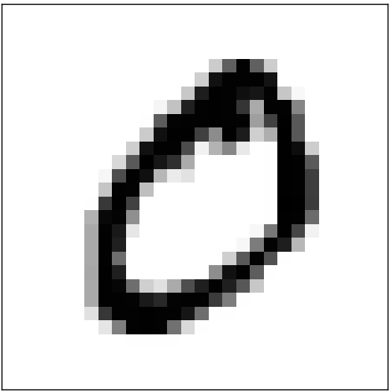
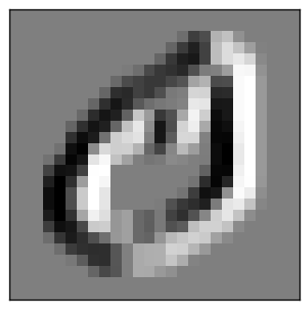
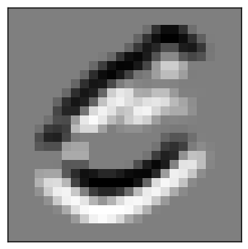
F1 Input
3x3
Input Activations
28x28
F2 Input
3x3
-1,0,1
-1,0,1
-1,0,1
F1 Weights
3x3
-1,0,1
-1,0,1
-1,0,1
-1,0,1
-1,0,1
-1,0,1
F2 Weights
3x3
F1 Feature Map
26x26
F2 Feature Map
26x26

Slide 31
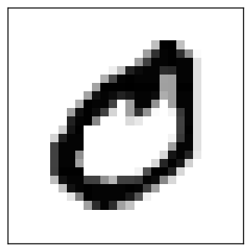
Depth
Heigth
Width

Slide 33
Fully Connected Layer

Slide 34
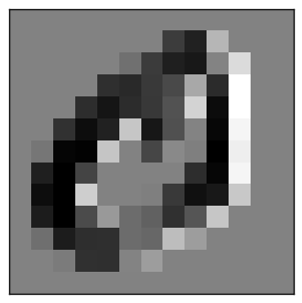
Pooling Layer

Slide 41
I.z | x | H.z | I.a * I.theta | O.z | H.a * H.theta
I.a | g(I.z) | H.a | g(H.z) | O.a | g(O.z)
I.theta | defined | H.theta | defined | O.theta | None
I.delta | defined | H.delta | defined | O.delta | None
I.Delta | defined | H.Delta | defined | O.Delta | None
I.bias | defined | H.bias | defined | O.bias | None

Slide 42
Y₁
Y_{j}
Y_{p}
δ¹₁
δ¹₁
δ¹₁
δ¹₁
δ¹₁
into
the
car
and
turned

Slide 43
Doc 1: I contacted you last two weeks and I got no response. I mentioned
about my late client that has the same surname with you. He deposited
the sum of US$10.5 million dollars in one of the bank here in our
country and they have asked me to provide a next of kin.
BOW 1: About 1; Ask: 1; ... Dollar: 1; ... Million: 1; ... Week: 1
Convert to Bag of Words
Convert to Bag of Words
Term Frequency Matrix
ID | Abacus | About | Above | ... | Dollar | Dollop | ... | Week | ... | Zyzzogoten
1 | 0 | 1 | 0 |  | 1 | 0 |  | 1 |  | 0
2 | 0 | 1 | 0 |  | 0 | 0 |  | 0 |  | 0
3 | 0 | 0 | 1 |  | 0 | 0 |  | 0 |  | 1
4 | 0 | 0 | 0 |  | 0 | 0 |  | 0 |  | 0
5 | 0 | 0 | 0 |  | 0 | 1 |  | 0 |  | 0
6 | 0 | 0 | 0 |  | 0 | 0 |  | 0 |  | 0
7 | 1 | 0 | 0 |  | 0 | 0 |  | 0 |  | 0
8 | 0 | 0 | 0 |  | 0 | 0 |  | 0 |  | 0
9 | 0 | 0 | 0 |  | 0 | 0 |  | 0 |  | 0

Slide 44
 | f1 | f2 | f3 | f4 | f5 | f6 | f7 | f8 | ...
the
quick
brown
fox
jumped
over
the
lazy
dogs

Slide 45
 | ... | brown | ... | dogs | ... | fox | ... | the | ...
the |  |  |  |  |  |  |  | 1
quick
brown |  | 1
fox |  |  |  |  |  | 1
jumped
over
the |  |  |  |  |  |  |  | 1
lazy
dogs |  |  |  | 1

Slide 46
 | f1 | f2 | f3 | f4 | f5 | f6 | f7 | f8 | ...
the | 0.11 | 0.18 | 0.85 | 0.5 | 0.5 | 0.33 | 0.444 | 0.99
quick | 0.55 | 0.48 | 0.22 | 0.48 | 0.58 | 0.73 | 0.44 | 0.212
brown | 0.48 | 0.22 | 0.48 | 0.812 | 0.4 | 0.33 | 0.19 | 0.57
fox | 0.812 | 0.33 | 0.444 | 0.99 | 00.73 | 1 | 0.04 | 0.02
jumped | 0.99 | 0.73 | 0.44 | 0.212 | 0.18 | 0.85 | 0.48 | 0.22
over | 0.212 | 0.001 | 0.3 | 0.129 | 0.48 | 0.22 | 0.48 | 0.373
the | 0.11 | 0.18 | 0.85 | 0.5 | 0.5 | 0.33 | 0.444 | 0.99
lazy | 0.44 | 0.22 | 0.901 | 0.33 | 0.44 | 0.18 | 0.85 | 0.5
dogs | 0.33 | 0.49 | 0.828 | 0.73 | 0.44 | 0.48 | 0.22 | 0.48

Slide 47
X
X
Fully Connected Network
Network with Dropout in Hidden Layer

Slide 48
Dropout Implemented with Mask

