Slide 1


Robert Concepcion III
CSCI-870
Dr. Jafari
mid progress report
Browser-Based Application
Multimedia Framework

Slide 2
Goals
Create a more cohesive way to make interactive HTML5 web applications
Cohesively link sound, input, graphics and animation effortlessly and non-adhoc -> more intuitive
Make animations/transitions easier
Cross browser, Plugin-less
Maintain high performance for mobile devices

Slide 3
Technologies
HTML5
( Web Audio API, Canvas, File )
CSS3
(+ PureCSS )
JavaScript
( + YUI Library, Misc. Libraries )

Slide 4
Design Principles (1/4)
1) Modular
Create a self contained app attached to one canvas at a time
No collisions with environment, can function simultaneously with other libraries without duplicating functionality
[notorious problem with web development]
Each module within an app should function independently

Slide 5
[Modular Apps]
<DOM>
HTML:
<canvas id=‘canvas_1’/>
<canvas id=‘canvas_2’/>
JS:
<script>
var $canvas1 = document.getElementById(‘canvas_1’),
$canvas2 = document.getElementById(‘canvas_2’);
var app1 = new BAMF({canvas: $canvas1, width: 250, height: 250,
fullScreen: false}),
app2 = new BAMF({canvas: $canvas2, width: 250, height: 250,
fullScreen: false});
app1.start();
app2.start();
</script>
$canvas1
$canvas2
app1
app2

Slide 6
Design Principles (2/4)
2) Efficient
“Vanilla JavaScript” used whenever possible
Best practices for JavaScript; e.g.
→ document references made once
→ for loop lookup variables pre-computed
(e.g. for(var i=0, n=obj.length; i < n; i++)
Optimization Tests run throughout development to ensure complex entity/object behaviors slow down at a rate comparable to expandability
→ sometimes a question of automation vs more
work on the end of the app developers

Slide 7
Design Principles (3/4)
3) Clearly documented!
→ as this is a (soon-to-be) Open Source API,
documentation is essential for its usefulness to “
others
Users can figure out easily how the API works to use it in their projects, (without spamming creator’s email inbox ☺)
→ subsequently, a better chance at extending it too!
JavaScript is mainly parsed via text in most browsers, and intellisense is extremely weak in even the best IDEs when compared to Java or C++

Slide 8
Design Principles (4/4)
4) Intuitive
Best practices, naming conventions, consistent API name scheme. e.g. get/set vs get/push, etc.
JSON Literals provided as constructor parameters with self-documenting names e.g.:
var ball = new BAMF.AnimE(
{ app: myApp, x: 20, y: 20
init: function(){this.x = Math.random()*1000,
this.y = Math.random()*1000,
this.dx = 0, this.dy = 0;},
logic: function(){this.x+= this.dx; this.y+= this.dy;},
anims: { … } …
});
→ Visual sprite editor(possibly more later as time
permits), more natural user-friendly editing of
animations and positioning.

Slide 9
Entities
BAMF API is focused around entities
Each entity has its own initialization, behavior, and drawing methods
“behavior” is fundamental to API, calls everything timed
Objects can be concrete or abstract
(e.g. in an MVC model, represent either a controller or a module)

Slide 10
Key Module(Key)
Contains a collection of constants to test for each key being pressed
Key.state[key_constant] can be:
  0 [not pressed] OR
  Key.KEY_PRESSED OR
  Key.KEY_HELD

Slide 11
Web Audio Module(IMAudio)
All sound resources within currently running Apps are located within a specific namespace, IMAudio
→ allows us to monitor sounds playing,
as well as prevent redundant data

Slide 12
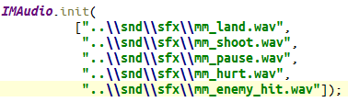
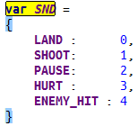
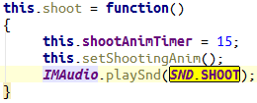
Audio Module Usage
(1) initialize
(2) declare constants
(3) use anywhere after

Slide 13
API Documentation
Using JSDOC for JavaScript API Doc
Similar to JavaDoc; documentation is generated from code itself
A bit more involved
Nice clean output

Slide 14
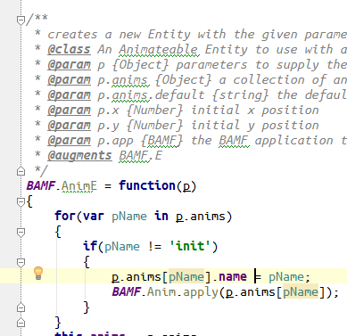
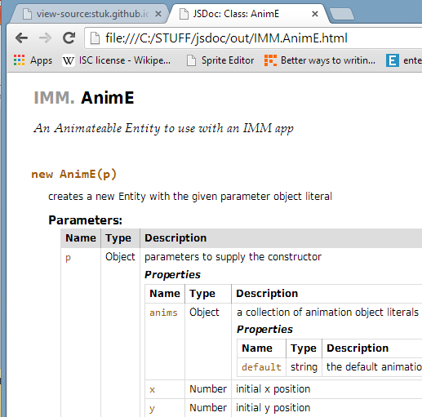
API Documentation

Slide 15
Structure of a BAMF App
IMAudio
<<Singleton>>
BAMF
E
(Entity)
Key
<<Singleton>>
Level
AnimE
ImgE

Slide 16
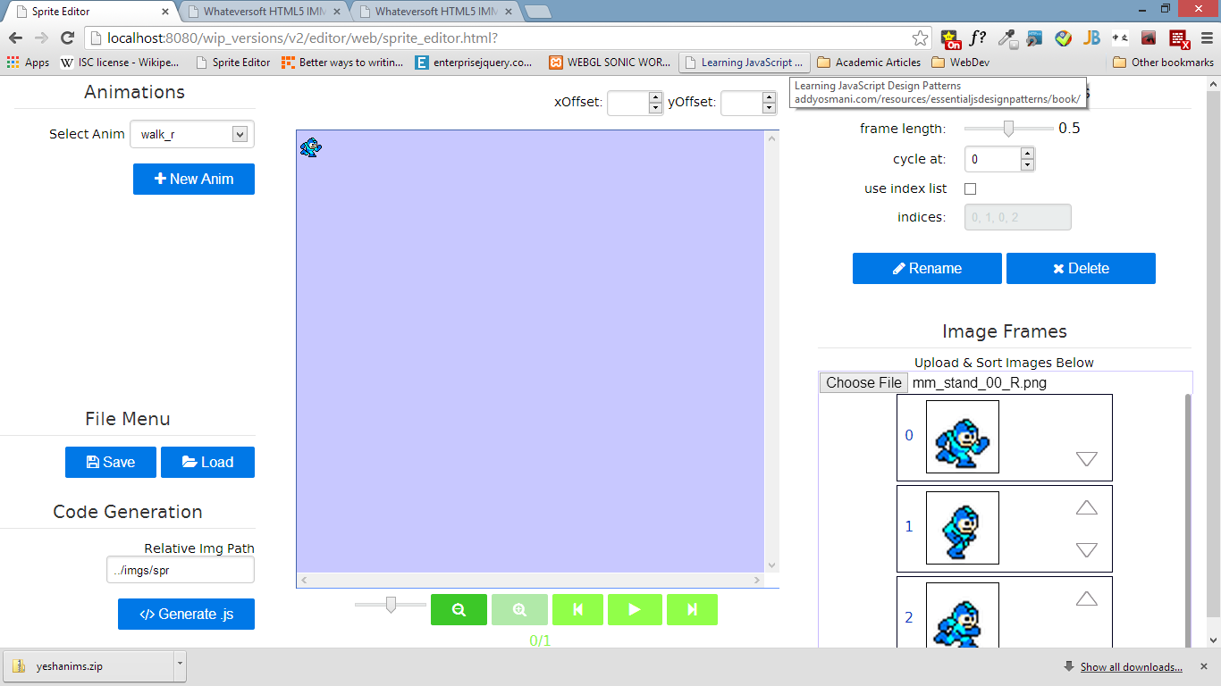
Sprite Editor Overview

Slide 17
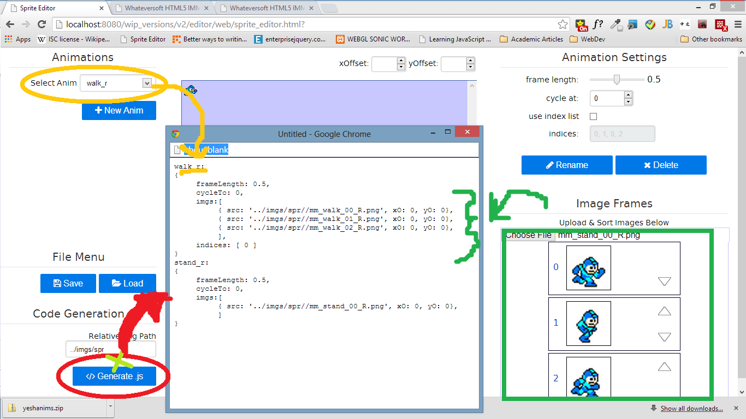
Sprite Editor Overview

Slide 18
WIP Features
Finish Second Revision
More Entity Types(e.g. Text, Shape)
Better/smarter sound management
Splitting the app into “scenes”
More Documentation
Demos

Slide 19
Live Demos
A BAMF App using an early build:
http://bamfapi.appspot.com/wip_versions/v1/mj_demo/web/index.html
http://bamfapi.appspot.com/wip_versions/v1/mm_demo_090913/web/index.html
Browser Based Sprite Editor/Code Generator:
http://bamfapi.appspot.com/wip_versions/v2/editor/web/sprite_editor.html

Slide 20
Questions, Comments?
Thank you for your time!

