Slide 1
autoadd by emberjs
posts
....
....
....
....
....
post
router setup
App.Router.map(function() {
// this.route('index', { path: '/' });
this.resource('posts', function() {
// this.route('index', { path: '/' });
this.resource('post', { path: ':post_id' });
});
});
want:
App.PostRoute = Ember.Route.extend({
model: function(params) {
return this.store.find('post', params.post_id);
}
}
App.PostsRoute = Ember.Route.extend({
model: function(params) {
return this.store.find('post');
}
}
routes
<script type="text/x-handlebars" data-template-name="posts">
<ul>
{{#each model}}
<li>
<span>{{#link-to 'post' this}} {{name}} {{/link-to}}</span>
</li>
{{/each}}
</ul>
<div>
{{outlet}}
</div>
</script>
<script type="text/x-handlebars" data-template-name="post">
<a>{{postText}}</a>
</script>
tmplts
emberjs knows this because: router setup
this is rendered into {{outlet}} in application.hbs

Slide 2
router setup
App.Router.map(function() {
// this.route('index', { path: '/' });
this.resource('posts', function() {
// this.route('index', { path: '/' });
this.resource('post', { path: ':post_id' });
});
});
Ember.js will render the
"application template"
as the main template
<script type="text/x-handlebars">
{{#link-to "index"}}Home{{/link-to}} |
{{#link-to "posts"}}Posts{{/link-to}} |
{{#link-to "post"}}Post{{/link-to}}
{{outlet}}
</script>
<script type="text/x-handlebars" data-template-name="index">
Home page
</script>
<!-- You can remove this if it all it contains is an outlet
<script type="text/x-handlebars" data-template-name="posts">
{{outlet}}
</script>
-->
<script type="text/x-handlebars" data-template-name="posts/index">
<ul>
{{#each}}
<li>{{name}}</li>
{{/each}}
</ul>
</script>
<script type="text/x-handlebars" data-template-name="post">
</script>

Slide 3
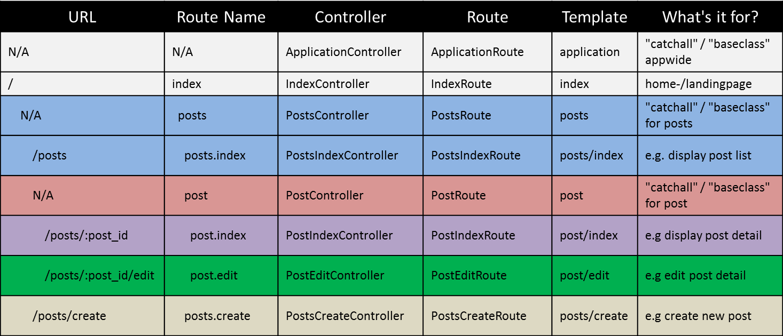
App.Router.map(function(){
this.resource('posts', function(){
this.resource('post', { path:'/:post_id' },
function(){
this.route('edit');
});
this.route('create');
});
});
“If your user interface is nested, your routes should be nested” – Yehuda Katz

