Slide 1

ROHINI COLLEGE OF ENGINEERING AND TECHNOLOGY
(AUTONOUMOUS)
BACHELOR OF ENGINEERING IN COMPUTER SCIENCE AND ENGINEERING
PROJECT FINAL VIVA VOCE
TITLE : ADVANCE AND SECURE WEB-BASED AUCTION SYSTEM
\
PRESENTED BY:
SUPERVISOR:
ALEX HAOBIJAM (963321104005)
Dr.M.SANTHANAKUMAR
JISHNU JINO (963321104028)
PROFESSOR/CSE
ROBERT LOITONGBAM (963321104043)
ROSHAN LATEEF (963321104044)
PRESENTED ON: 09 - 05 -2025

Slide 2
AGENDA
Abstract
Introduction
Objectives
Literature Survey
Existing System
Proposed System
Methodology used
Architecture
Modules
Snapshots
Conclusion
References

Slide 3
ABSTRACT
Auction is a Latin word meaning increase. An auction is a bidding and selling procedure in which goods and services are offered for sale. There are several sorts of auctions, and each auction has its own set of regulations. The web-based auction system is built to be scalable and can handle a large number of bids in a live auction. Online auctions have become a common technique of procuring goods and services. Users' data can be kept secret to protect the legitimacy and integrity of contract papers, and bidders can be maintained in a single database if required. Clear reporting saves time and money by reducing paperwork, postage, and photocopying. It is quite simple to communicate with numerous bids. Individual users can submit numerous bids using this technique.

Slide 4
INTRODUCTION
The "Advanced and Secure Web-Based Auction System" is designed to provide a reliable, scalable, and user-friendly platform for online auctions. It addresses the limitations of existing systems by incorporating security measures, including database protection and user authentication to ensure a safe environment for buyers and sellers. The system features real-time bidding and a modular architecture to support both user and admin functionalities. By facilitating seamless transactions and ensuring the integrity of auction activities, the platform enhances user trust and engagement. This system is a comprehensive solution for the evolving needs of online commerce.

Slide 5
OBJECTIVE
The objective of the "Advanced and Secured Web-Based Auction System" project is to design and develop a robust online platform that facilitates real-time bidding while ensuring a secure and transparent auction process for both buyers and sellers. This system aims to provide a user-friendly interface with advanced features such as live auction updates using SignalR, interactive buyer-seller communication for verifying users before participation. The system also supports the uploading and management of artwork or product listings, complete with detailed descriptions and starting prices. Ultimately, the goal is to create a seamless and trustworthy environment that enhances user experience, and maintains the integrity of each transaction within the auction process.

Slide 6
LITERATURE SURVEY

Slide 7
S.NO | TITLE OF THE PAPER | AUTHORS | YEAR | METHODOLOGY USED | ADVANTAGES | DISADVANTAGES
1 | Web-Based Auction System | Sheharyar Khan, Shandong University | 2022 | Developed using ASP.NET MVC, C#, SQL Server; Implements JWT authentication, AES encryption, and role-based access. | - Strong authentication mechanisms - Scalable and modular design - Database security with SQL injection prevention | - Limited decentralization - Requires strong server-side security to prevent vulnerabilities
2 | Secure and Private Vickrey Auction Protocols: A Secure Multiparty Computation Approach | Lucy Klinger, Mengfan Lyu, Lei Zhang | 2023 | Uses Secure Multiparty Computation (SMC) and Homomorphic Encryption to prevent bid exposure while ensuring correctness. | - Provides bid privacy - Resistant to collusion - Public verifiability of auction results | - High computational cost - Requires specialized cryptographic knowledge
3 | A Survey on Secure Electronic Auction Protocols | A. Kumar, B. Gupta | 2021 | Comparative analysis of electronic auction security mechanisms (e.g., cryptographic techniques, trust models). | - Comprehensive overview of different security models - Identifies key vulnerabilities | - Lacks a specific implementation - Theoretical focus without practical testing
4 | Enhancing Security in Online Auctions Through Blockchain Technology | S. Patel, R. Singh | 2022 | Implements Ethereum smart contracts to store bids transparently and immutably on the blockchain. | - Decentralized and transparent - Prevents data tampering | - High gas fees on blockchain - Slower transaction processing

Slide 8
S.NO | TITLE OF THE PAPER | AUTHORS | YEAR | METHODOLOGY USED | ADVANTAGES | DISADVANTAGES
5 | Privacy-Preserving Auction Mechanisms: A Comprehensive Review | M. Chen, Y. Wang | 2020 | Examines Paillier encryption, Mix Networks, and Secure Two-Party Computation (2PC) for private bidding. | - Strong privacy protection - Prevents bid leakage | - Complex implementation - Computationally expensive
6 | Implementing Secure Dutch Auctions in E-Commerce Platforms | L. Nguyen, T. Tran | 2019 | Implements progressive price reductions with secure real-time monitoring via TLS encryption. | - Faster auction clearance - Reduces fraudulent bidding | - Limited to Dutch auction type - Susceptible to denial-of-service (DoS) attacks
7 | A Framework for Secure Online Auctions Using Homomorphic Encryption | P. Verma, S. Sharma | 2021 | Uses Fully Homomorphic Encryption (FHE) to encrypt bids so that processing occurs without decryption. | - High data security - Protects bid confidentiality even from the auctioneer | - Computationally heavy - Requires advanced encryption knowledge
8 | Secure Online Auction System Based on Multi-Agent Technology | H. Lee, K. Kim | 2018 | Implements AI-driven autonomous agents that securely handle bid validation and fraud detection. | - Automated fraud detection - Real-time bidding efficiency | - Complex AI model training - Can be resource-intensive

Slide 9
S.NO | TITLE OF THE PAPER | AUTHORS | YEAR | METHODOLOGY USED | ADVANTAGES | DISADVANTAGES
9 | An Analysis of Security Protocols in Online Auction Systems | D. Brown, E. Davis | 2020 | Compares TLS, SSL, Zero-Knowledge Proofs (ZKP), and Blockchain for auction security. | - Identifies best security measures for different auction types | - No real-world implementation - Does not address scalability
10 | Designing a Secure Reverse Auction Framework for Procurement Processes | F. Rossi, G. Bianchi | 2019 | Uses Zero-Knowledge Proofs (ZKP) to verify the legitimacy of bids without revealing actual values. | - Ensures bid fairness - Prevents price manipulation | - Requires high computational resources - Complex integration with existing auction platforms

Slide 10
EXISITING SYSTEM
Many existing platforms have limited or no proper user verification, which can lead to fake bidders, fraudulent sellers, and manipulation of auction results.
Most traditional auction systems do not support real-time interaction between buyers and sellers, making the bidding process slow and less engaging.
Existing systems often lack intuitive interfaces, confirmation prompts, and limited data storage, making it difficult for non-technical users to navigate and participate effectively in auctions.

Slide 11
PROPOSED SYSTEM
The system uses technologies like SignalR to enable live auction updates and interactive chat features, allowing buyers and sellers to engage in real-time bidding sessions.
The platform implements secure login systems with scalable user identity database to verify both buyers and sellers before allowing access to sensitive auction functionalities, reducing fraud and ensuring authenticity.
The proposed system uses Microsoft Entity Framework Core and its packages for intuitive forms for artwork/product submission, guided workflows, and confirmation prompts before key actions (e.g., submitting listings or placing bids), ensuring a smooth and error-free user experience.

Slide 12
METHODOLOGY USED
Requirement Analysis:
Identified the key functionalities needed in the auction system, such as real-time bidding, user verification, artwork/product submission, and secure access control for buyers and sellers.
System Design:
Designed the architecture using the ASP.NET Core MVC framework with a layered structure separating models, views, and controllers.
Database Design and Integration:
Designed with a database using SQL Server Management Studio for persistent storage of auction data.
Real-Time Communication Module:
Integrated SignalR to support live bidding and chat features, allowing dynamic updates without page reloads.

Slide 13
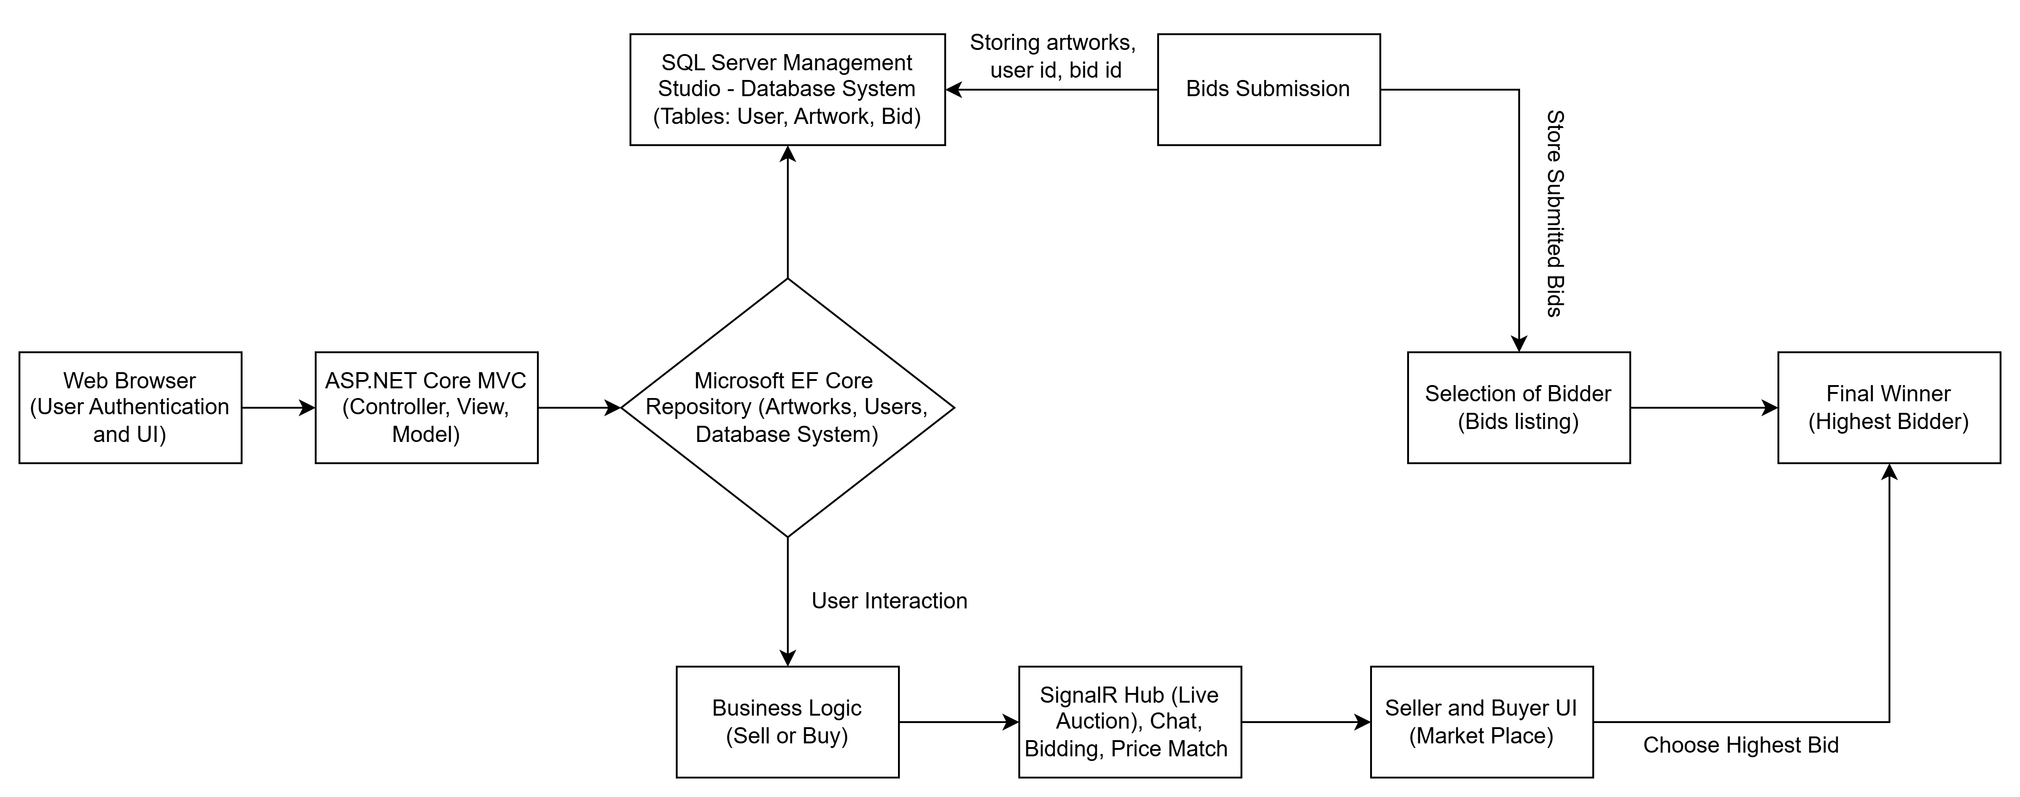
ARCHITECTURE DIAGRAM

Slide 14
MODULES
User Authentication Module
Auction Listing Module
Real-Time Bidding Module (SignalR)
Buyer Interaction Module
Seller Dashboard Module

Slide 15
MODULE DESCRIPTION

Slide 16
User Authentication Module
Role-Based Access Control: Differentiates between buyers and sellers, granting access only to relevant functionalities based on their role.
Credential Verification: Uses hardcoded login credentials to verify user identity before allowing access to the auction or submission pages.
Secure Navigation Flow: Redirects unauthorized users to the login page and ensures only authenticated users can access or interact with the system.

Slide 17
Auction Listing Module
Displays Active Auctions: Shows all currently listed artworks or items with details like title, image, description, and starting price.
User-Friendly Layout: Organizes listings in a clear and responsive format for easy browsing by buyers.
Link to Bidding Interface: Provides access to the live bidding page where interested buyers can place bids in real-time.

Slide 18
Real-Time Bidding Module (SignalR)
Live Bid Updates: Enables real-time broadcasting of bid changes to all connected users without refreshing the page.
Interactive Communication: Allows buyers and sellers to interact instantly during the auction through live chat or messages.
Smooth Bidding Experience: Ensures fast and synchronized updates, making the auction feel dynamic and engaging for all participants.

Slide 19
Buyer Interaction Module
Interest Expression Feature: Allows buyers to click an "Interested" button to show their intent to participate in an auction.
Buyer Verification Process: Redirects buyers to a login page with hardcoded credentials for identity confirmation before joining the auction.
Access to Marketplace: Grants verified buyers access to the bidding interface and seller interactions within the marketplace.

Slide 20
Seller Dashboard Module
Listing Management: Allows sellers to view and manage their active auction listings, including current bids and auction status.
Bid Monitoring: Provides real-time updates on bids placed by buyers on the seller's listed items.
Auction Control: Enables sellers to edit or remove their auction listings before the auction ends, ensuring flexibility in managing their products.

Slide 21
Database Management
Data Storage: Stores user information, auction listings, bids, and transaction history in a secure SQL Server database.
Persistent Data: Ensures that auction data, such as item details and submit bids, are retained across sessions and system restarts.
Efficient Queries: Implements optimized queries for fast retrieval of active listings, user information, and bidding details to ensure smooth performance.

Slide 22
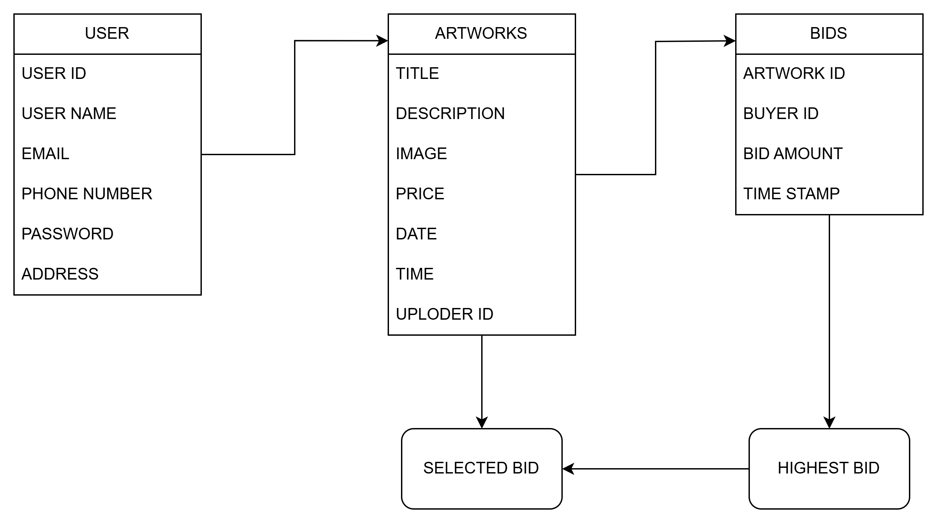
DATABASE DESIGN

Slide 23
SNAPSHOTS

Slide 24
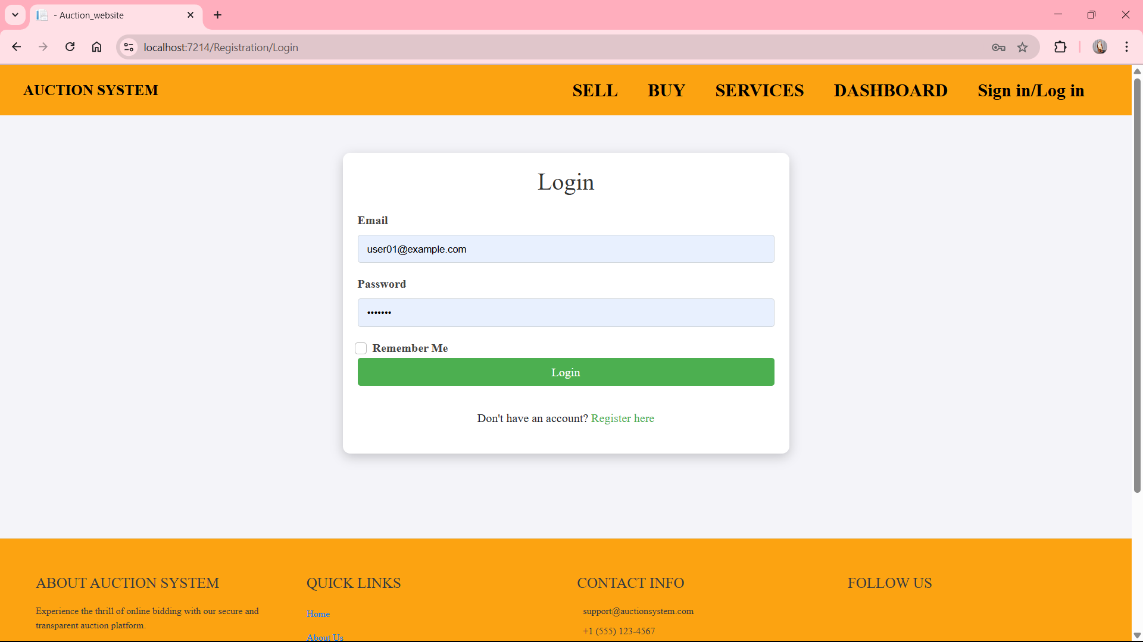

Slide 25
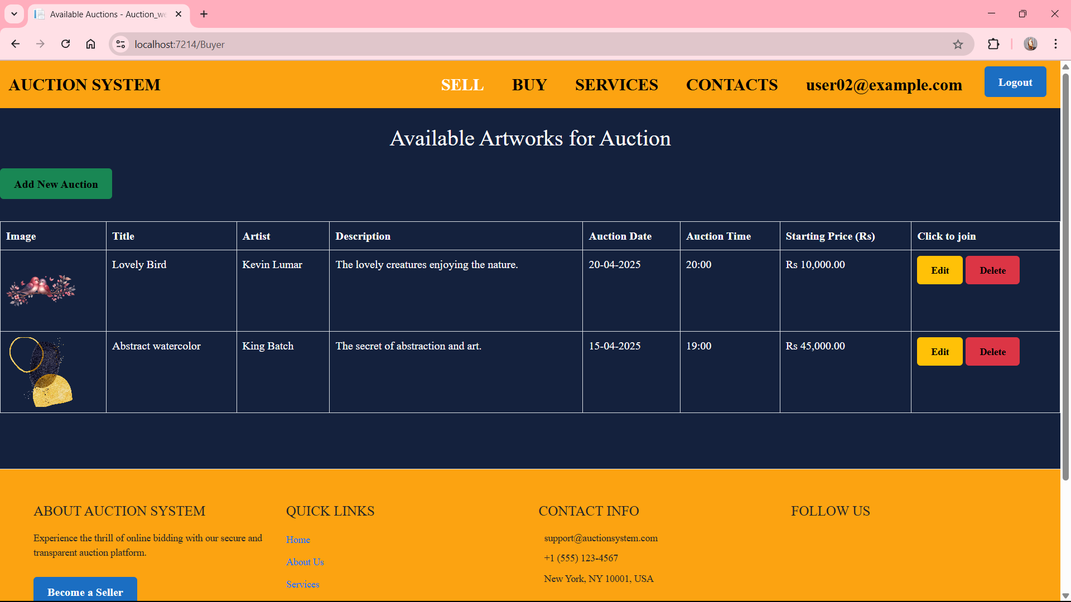

Slide 26
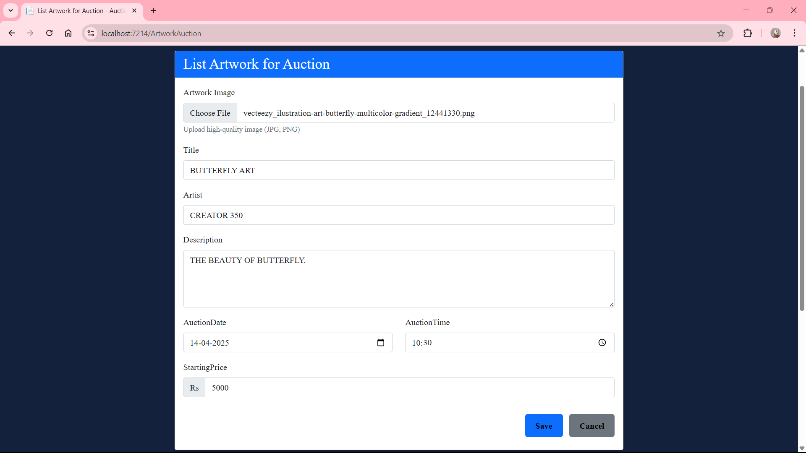

Slide 27
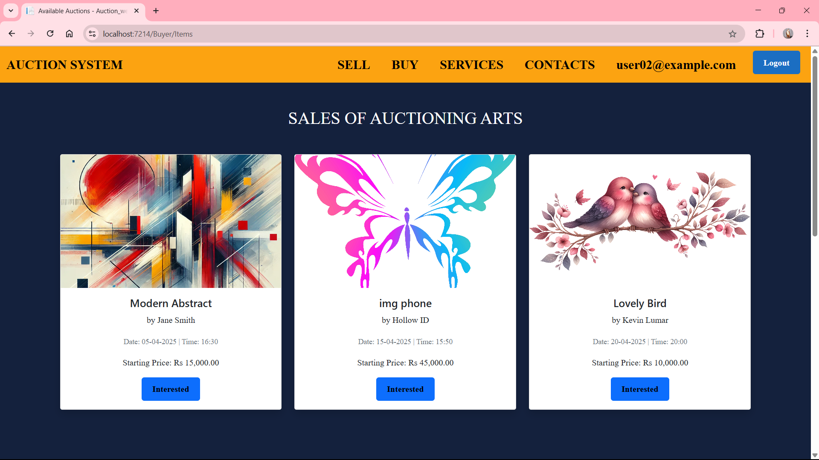

Slide 28
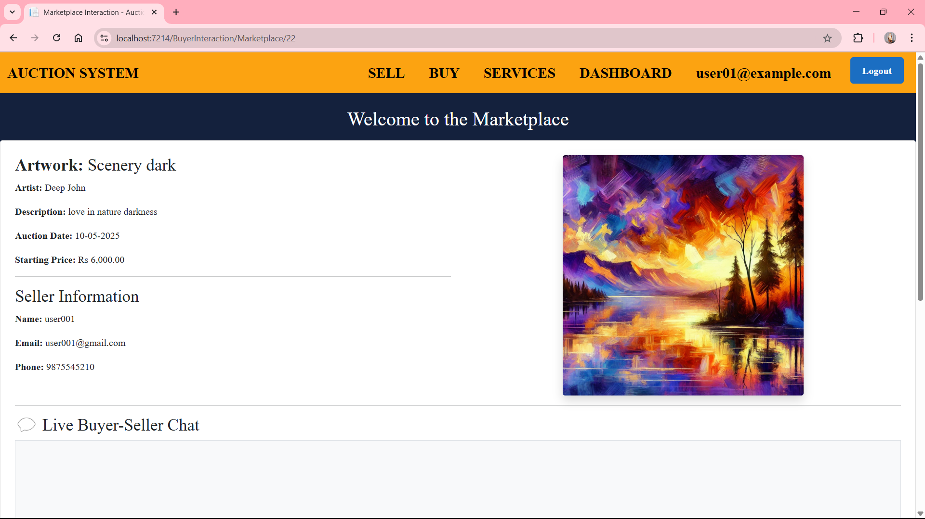

Slide 29
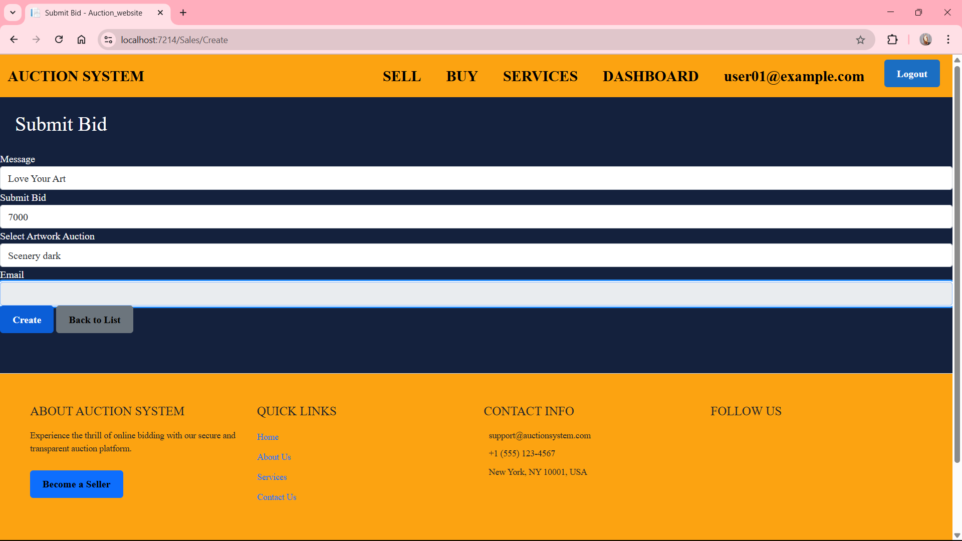

Slide 30
CONCLUSION
The Advance and Secure Web-Based Auction System project successfully delivers a secure, user-friendly platform that facilitates online sealed-bid auctions between sellers and buyers. By implementing user verification, structured data handling, and a confidential bidding process, the system ensures fairness and trust throughout the auction lifecycle. The use of modern technologies like ASP.NET Core MVC and Entity Framework makes the system efficient and scalable. This project not only replicates the traditional auction process in a digital environment but also enhances it with accessibility, privacy, and automation. Overall, the system provides a practical solution for conducting auctions online, with real-world applications in areas such as art sales, collectibles, and e-commerce.

Slide 31
REFERENCES
Albert, M. R. (n.d.). "E -Buyer Beware:Why Online Auction Fraud Should Be Regulated. American BusinessLawJournal.
Benjamin J. Ford, H. X. (2012). “A Real Time Self-Adaptive Classifier for Identifying Suspicious Bidders in Online Auctions”. Published by Oxford University Press on behalf of The British Computer Society.
C., R. (2009). Research and Design of Online Auction System Based on the Campus Network Using UML. Second Pacific-Asia Conference on Web Mining and Web-based Application.
Chuan-Hoo Tan, H.-H. T. (2010). “Online Auction: The Effects of Transaction Probability and Listing Price on A Sellers Decision-Making Behaviour”. Electron Markets, 20:6779.
Costin BadicaCostin, S. I. (2014). Distributed agent-based online auction system. Computing and Informatics, 33(3):518-552.

Slide 32
THANK YOU!

