Slide 1
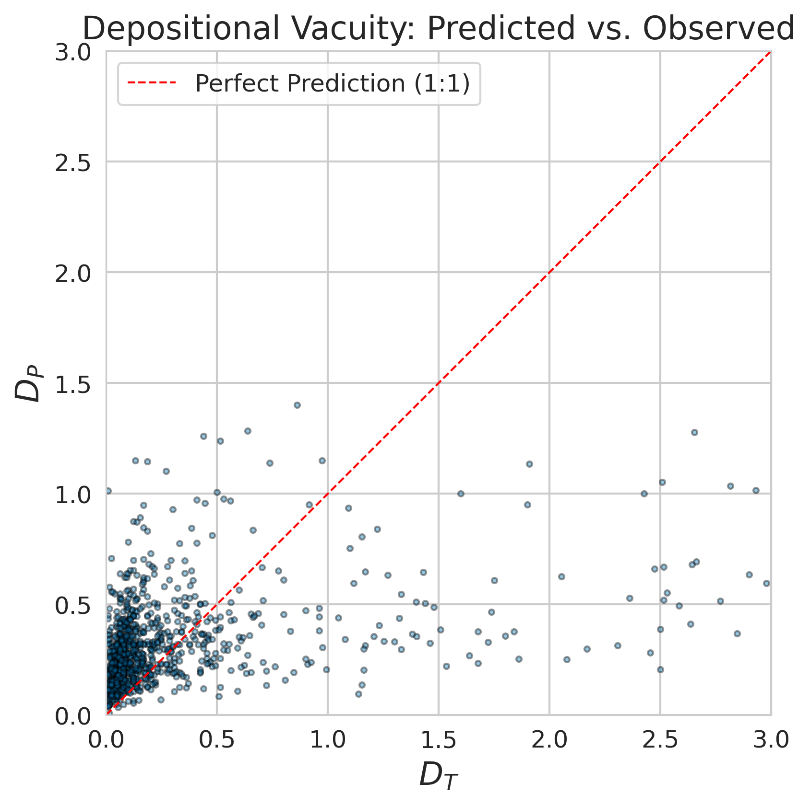
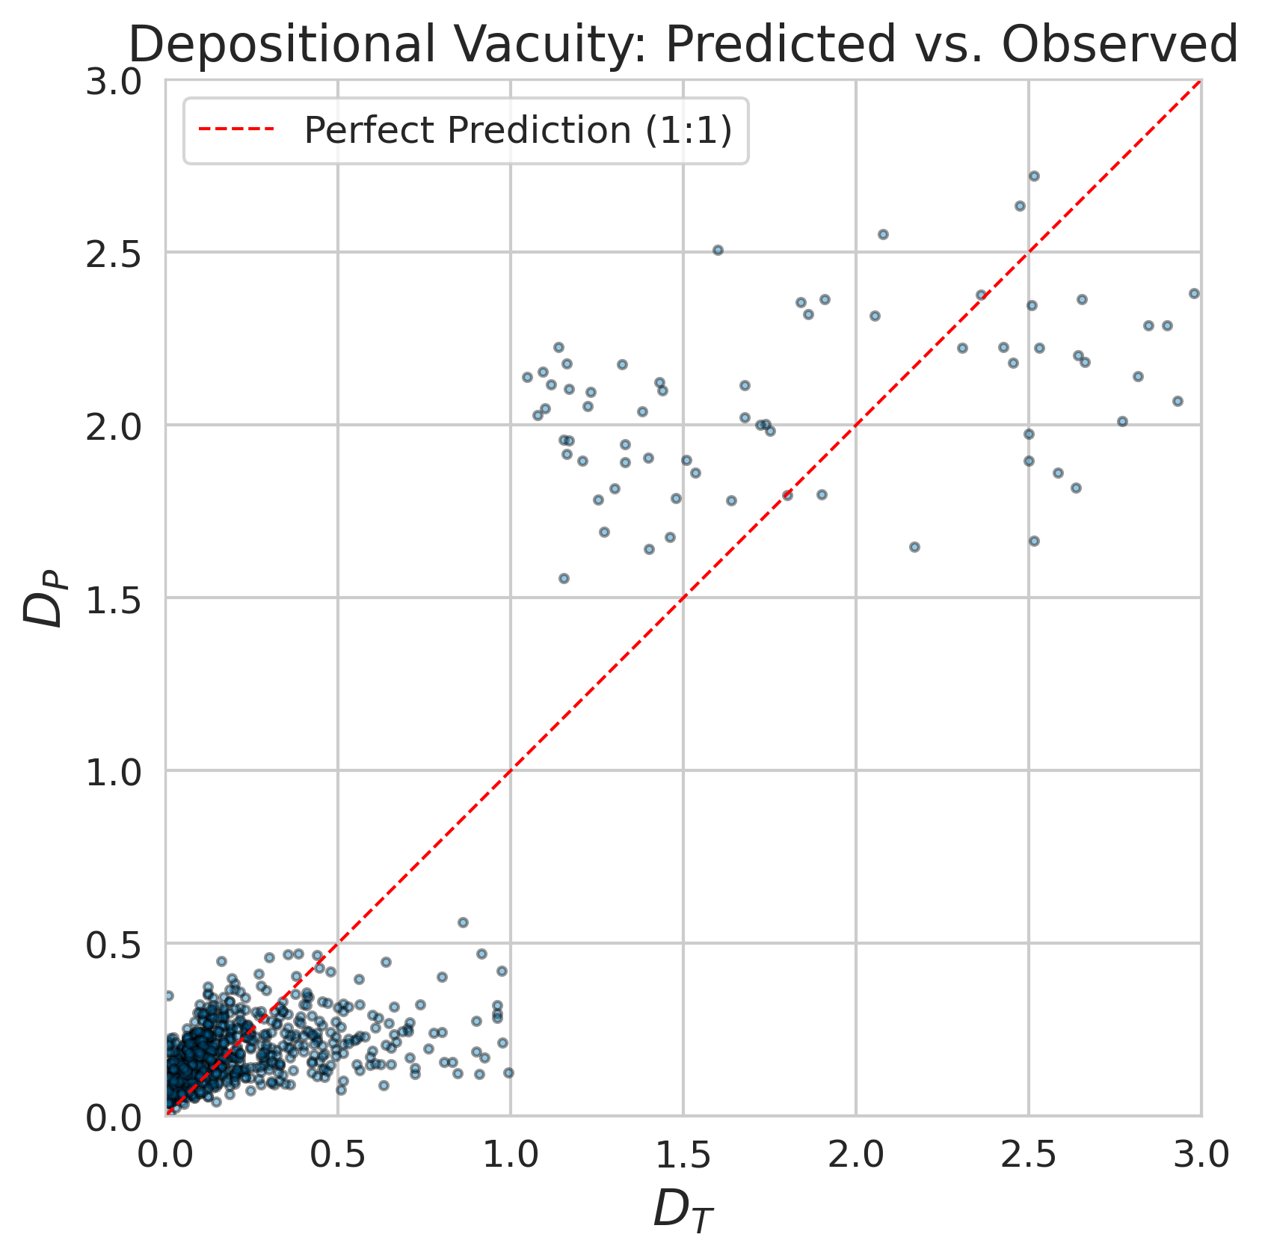
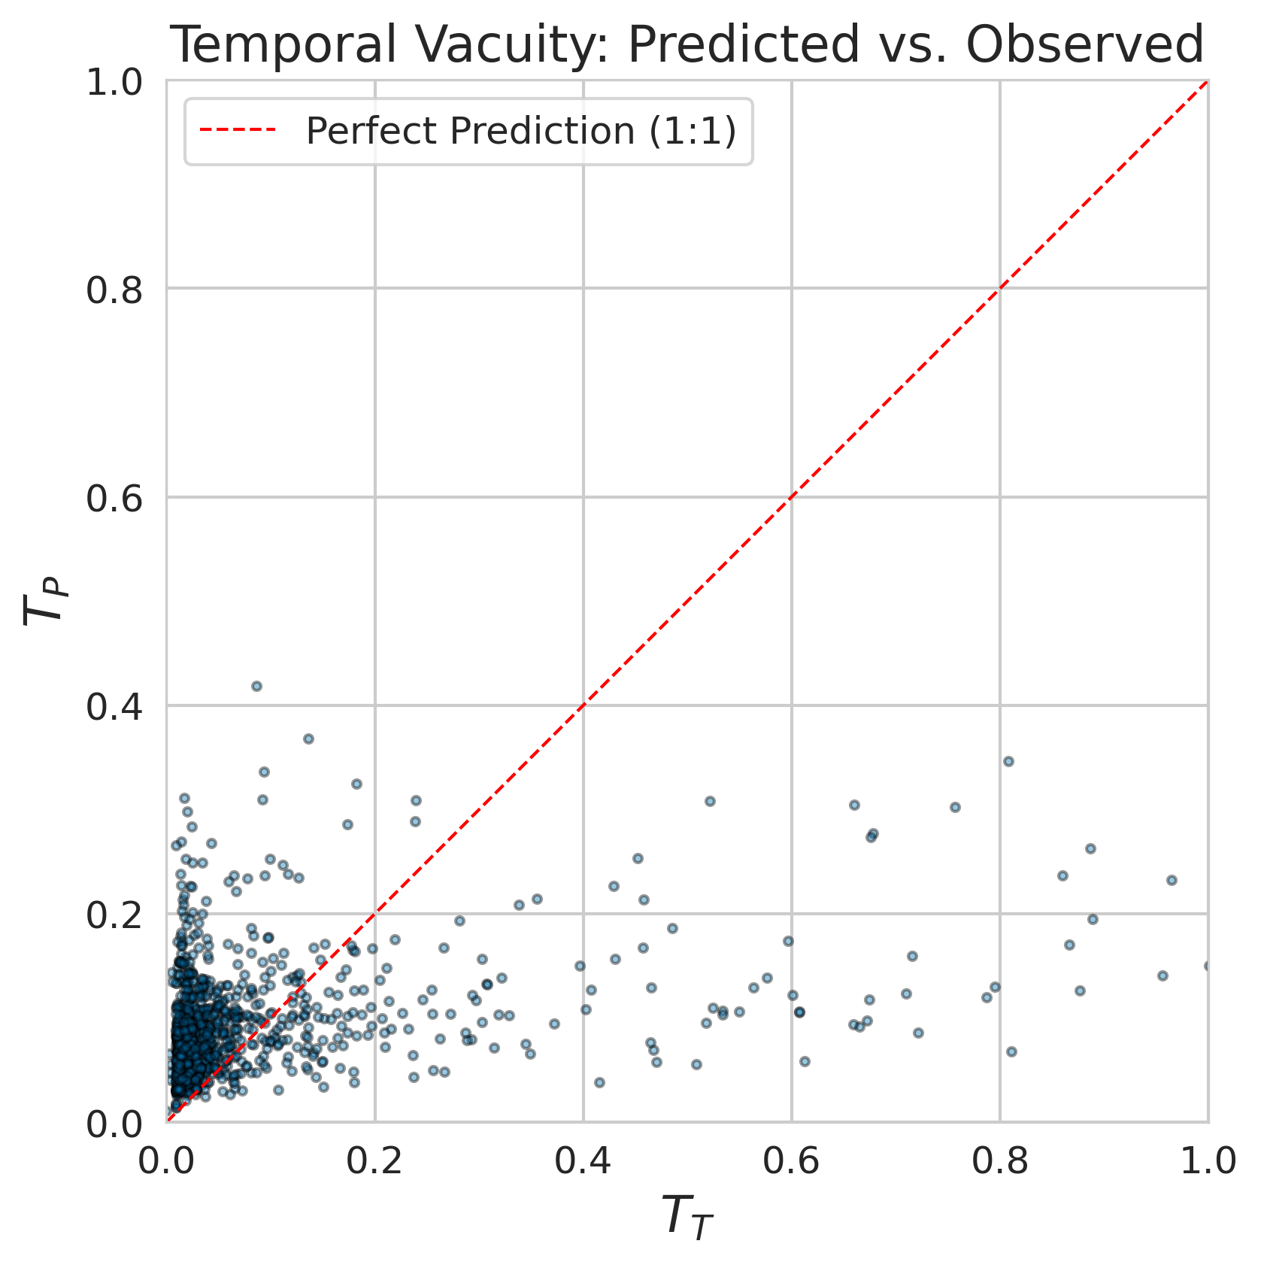
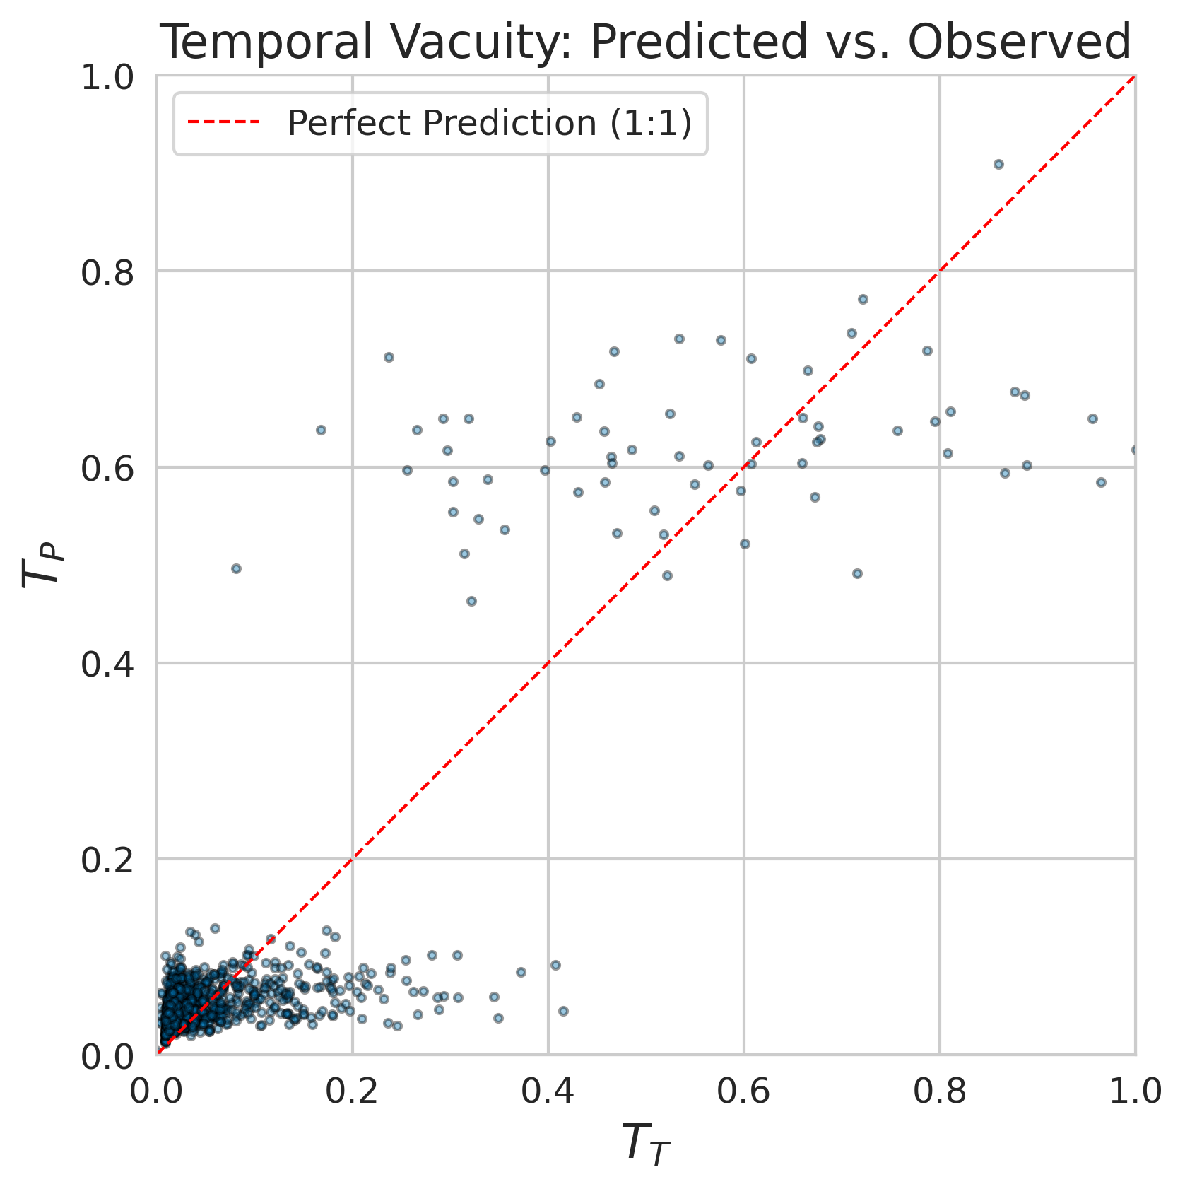
Original Dataset
Modified Dataset (Erosional Feature)
A
C
B
D

Slide 2
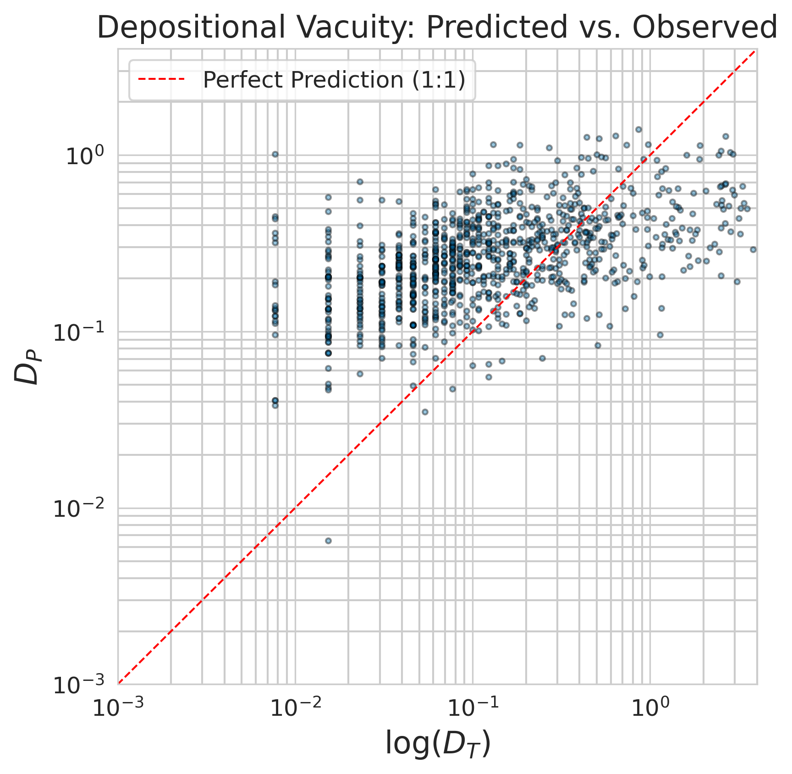
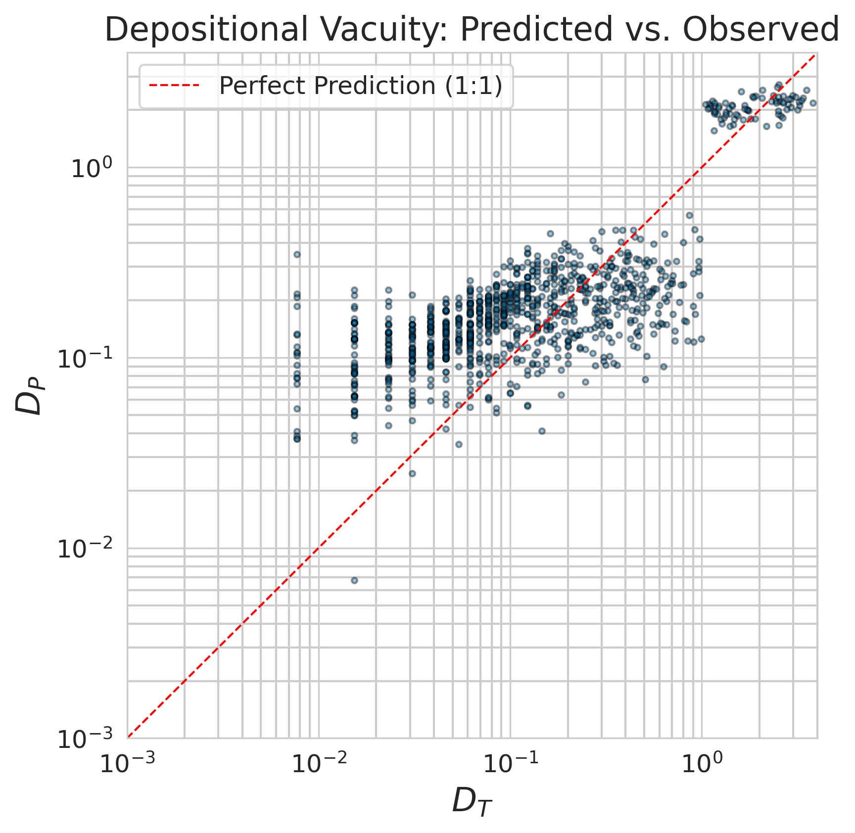
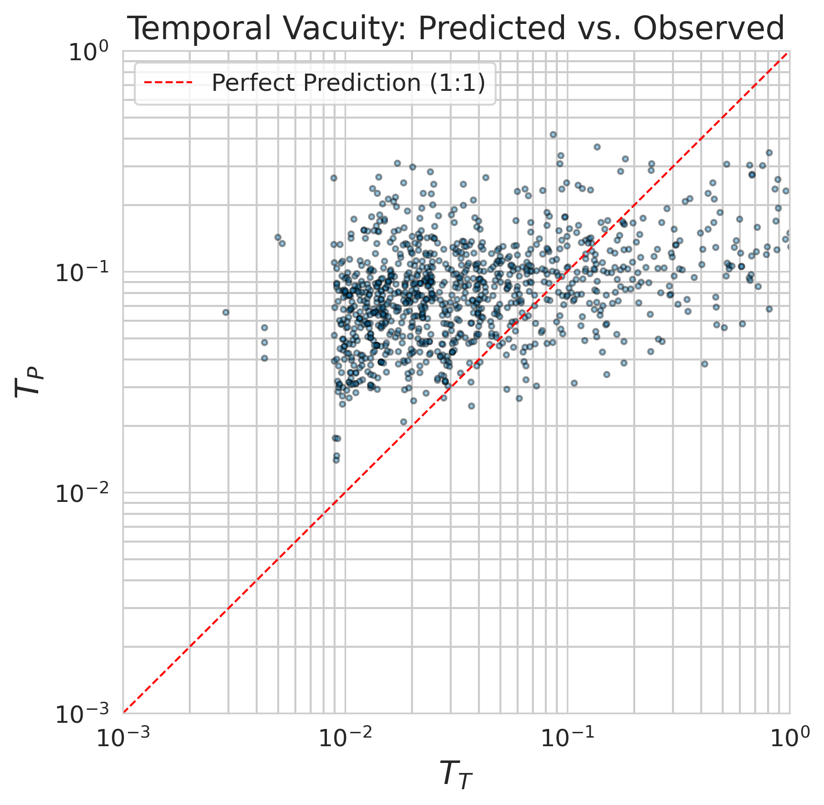
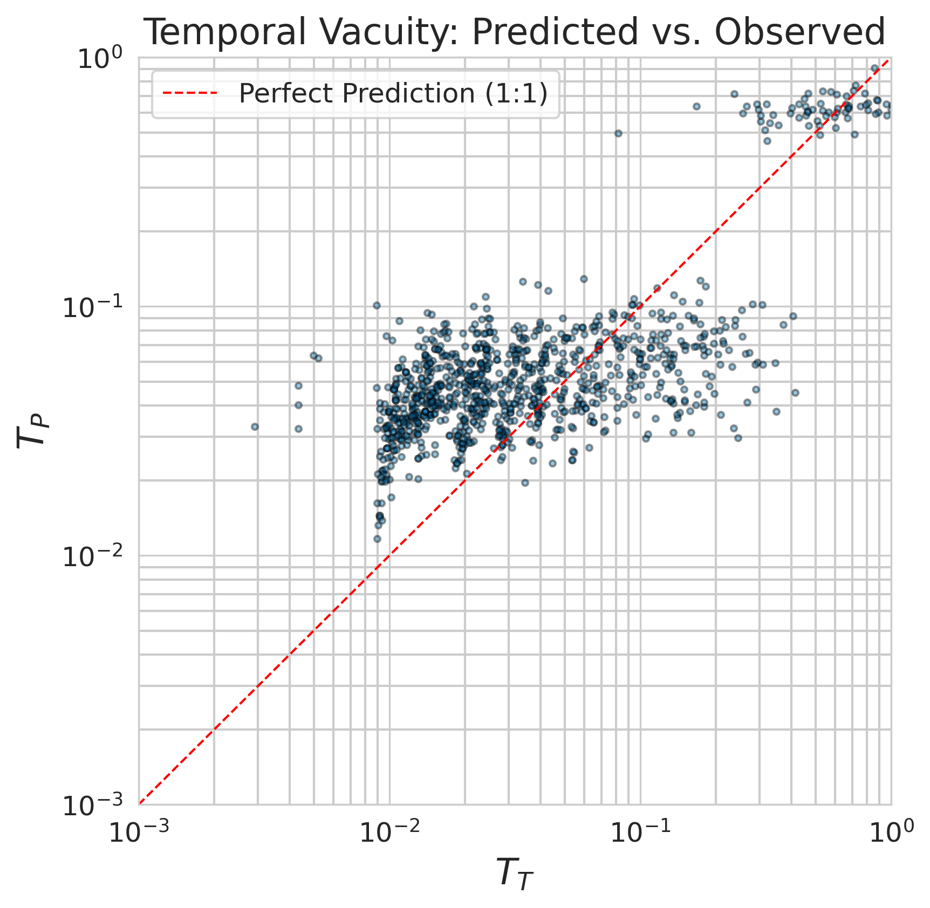
Original Dataset
Modified Dataset (Erosional Feature)
A
C
B
D

Slide 3
Original Dataset
Variable | Mean Absolute Error (MAE) | R²
Missing Deposition | 0.3182 | 0.4328
Missing Time | 0.0989 | 0.0602
Original Dataset (Erosional Feature)
Variable | Mean Absolute Error (MAE) | R²
Missing Deposition | 0.1810 | 0.8150
Missing Time | 0.0566 | 0.6859

