Slide 1

Humanoid Control Software
Design Outline
Bob Sherbert
2010 – 7 – 12

Slide 2
Motivation
PIRE Grant – Humanoid architecture development
Multiple platforms – HUBO, Miniature Humanoids, Simulators
Desire For:
  Experiments scaling control strategies
  Ease of exchanging controllers
  Fault Detection
  Extensive logging facilities
  Prototyping in simulation

Slide 3
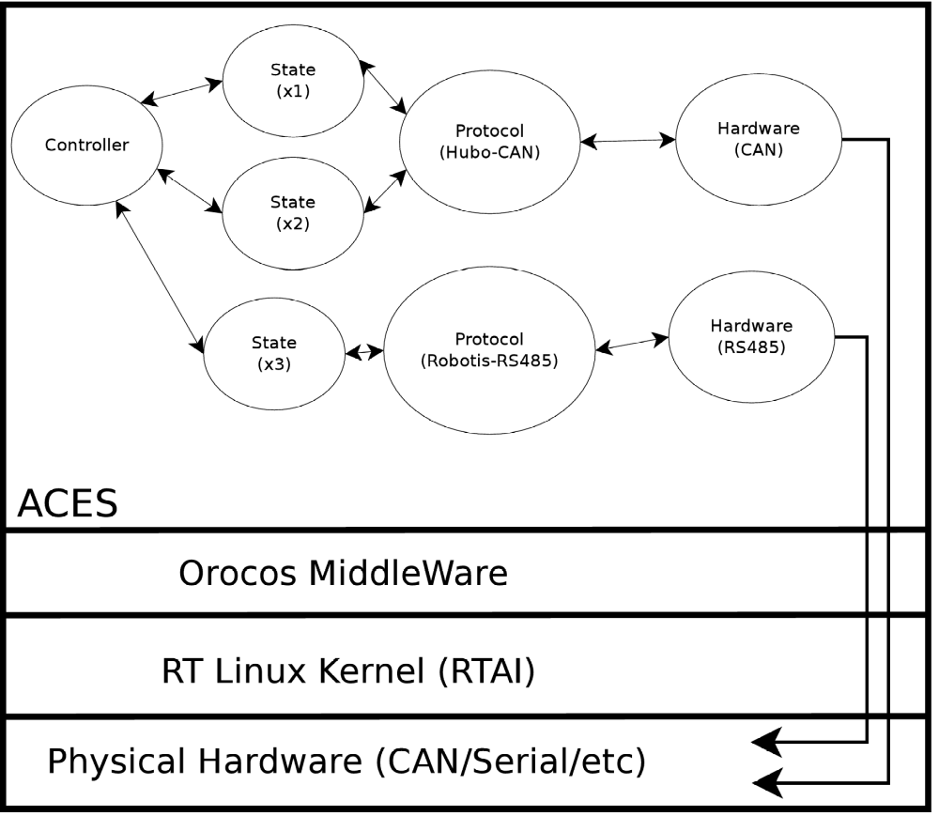
Overview

Slide 4
Overview
Real Time (RT) services provided by the OS through Orocos
Each instance of a component is associated w/an RT thread
Communication between modules is event driven
  Each component ‘subscribes’ to the events of other components
  Information in transmissions is available to all, and each makes own decision about reception

Slide 5
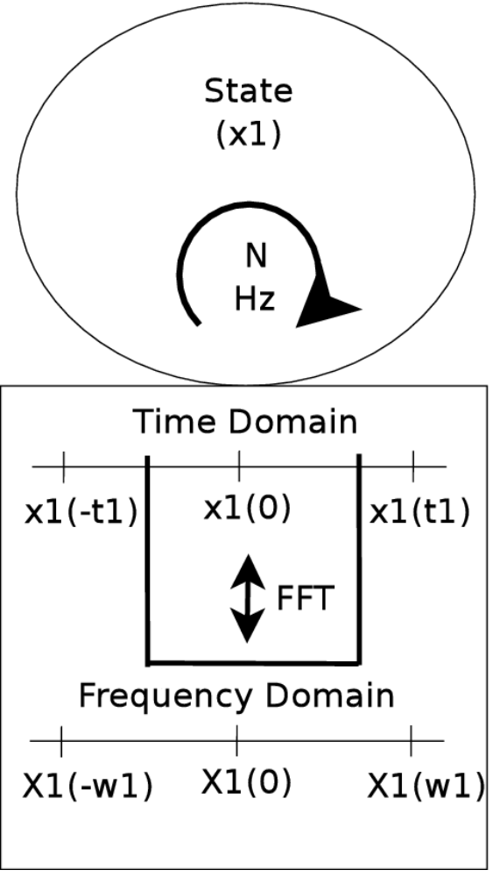
State
Corresponds with state variable from control theory
Presents last known value to system internals
Independent of communication hardware (RS232, CAN, etc)

Slide 6
State
Stores historical data
Can provide averaged (smoothed) data based on historical data
Can estimate future data based on user selected algorithm
Compute Fourier/Laplace transforms for frequency domain controllers

Slide 7
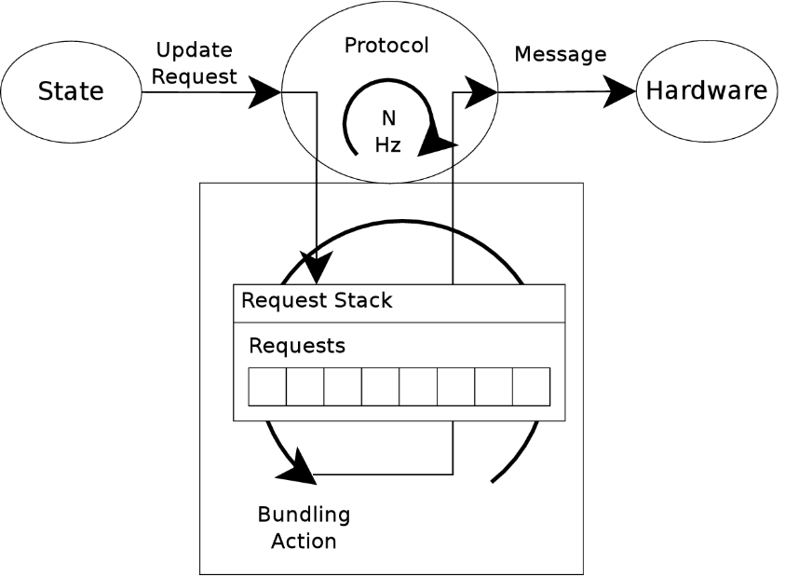
Protocol
Describes a data format/protocol for communicating with a bus device
  Arrangement of bytes in packet
  Data contained within packet
States communicate w/their corresponding devices through the protocol
  State emits request event when update required

Slide 8
Protocol
Collects, buffers, and bundles state requests
Converts bundles into Messages that the Hardware can transmit to physical devices
Emits Message as event – Hardware picks up event

Slide 9
Hardware
Gatekeeper to physical hardware
  Prevents multiple access to line in the thread-based environment
Converts messages from protocol into packets on the physical bus
Tracks expected responses
Handles Tx/Rx error reporting to higher levels

Slide 10
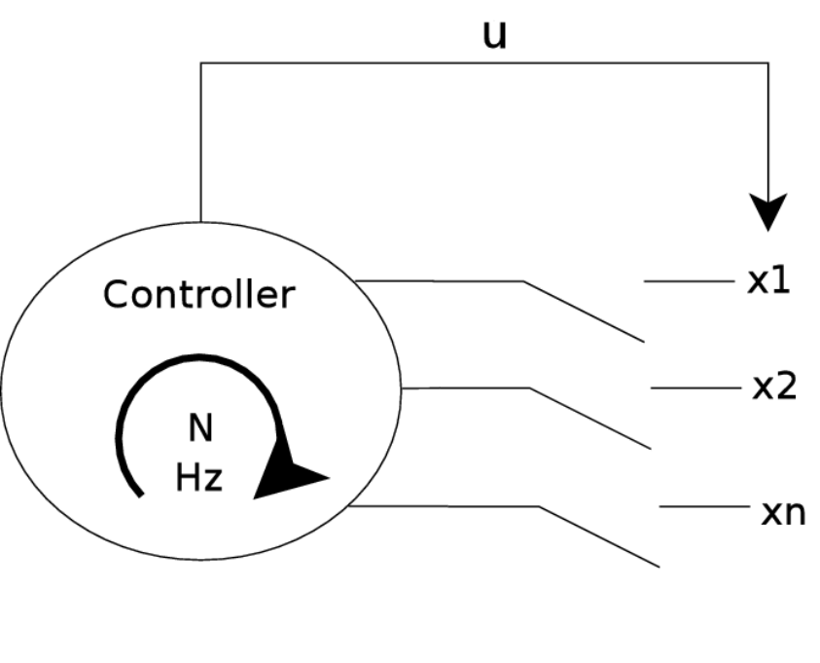
Controller
Controller implements the feedback laws
No restrictions placed on controller internals
May draw from states, external data sources, algorithms, etc
The determined control signal is broadcast to the entire system
Subscribers take appropriate action to realize the control signal

Slide 11
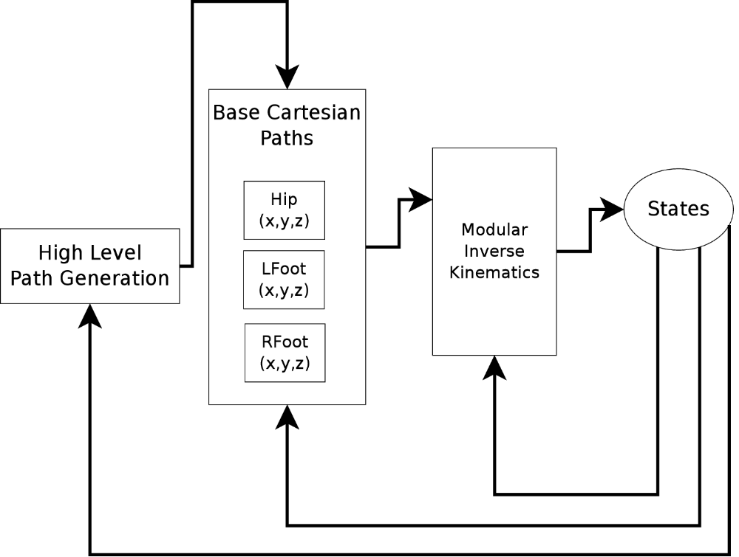
Template Controller (ex.)
Modular design for humanoid control
Cartesian path, IK, and joint space are each modules
  Different module used for Hubo/Mini/Virtual
Feedback can be provided at any level
  Landing control vs Ankle roll control

Slide 12
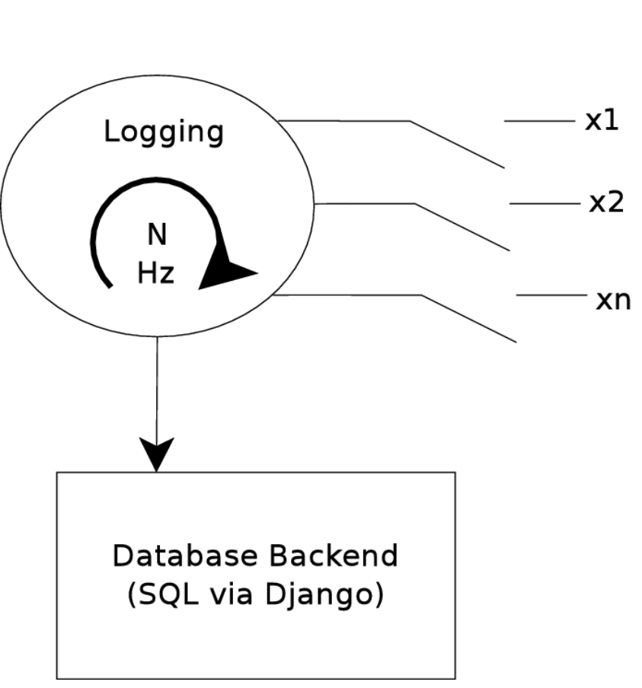
Logging
Internal sampling of states
Data stored to an SQL database
Data easily accessible through web
Easily exported to analysis packages (Matlab)

Slide 13
Playback
Specialize controller can be loaded which reads logged data back from database
The recorded data can be played back within the simulator
Simulator provides contact highlighting and single step advance
Allows for failure analysis

Slide 14
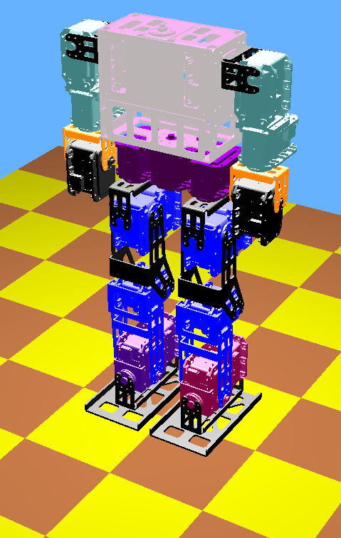
Current Progress
Miniature Humanoid physical properties fully implemented in simulation
Prototype software connected to playback simple statically stable walking scripts
Requires addition of sensors

Slide 15
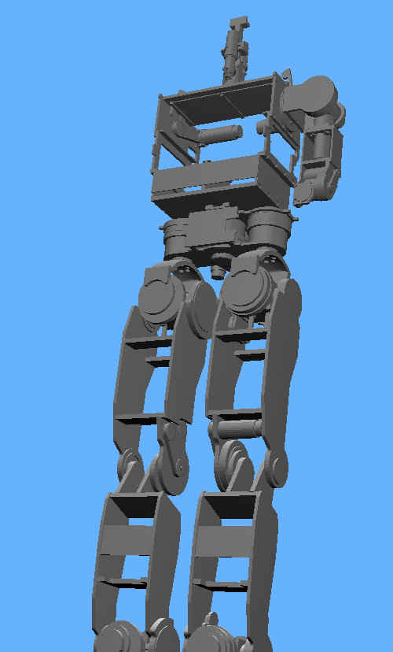
Current Progress
HUBO model ~70% complete
Physically geometry mostly imported
Appropriate inertial data collected
Sensors need to be implemented

Slide 16
Movie Time

