Slide 1
Content
The Problem
1-NN Results FADE
k-NN Results UFADE
FADE vs. UFADE
Bayes Classifier

Slide 2
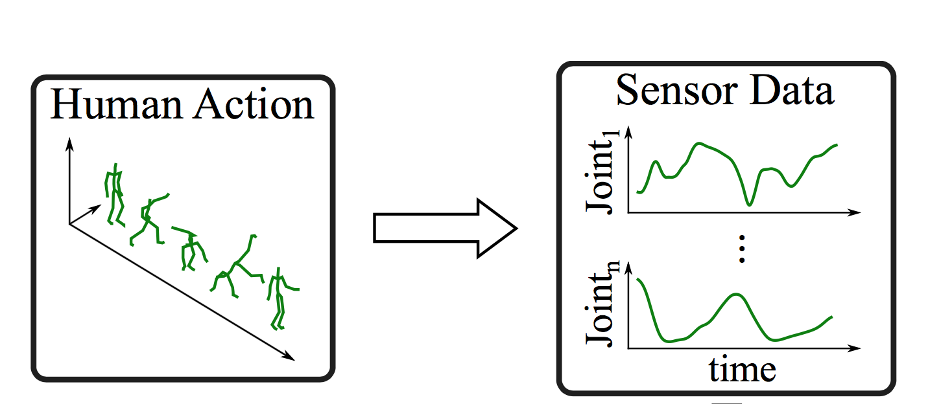
The Problem
Set of joint angles over time (HDMI05 dataset)
An example of the data with visualization
Figure taken from [1]

Slide 3
The Problem
Set of joint angles over time (HDMI05 dataset)
We want to classify the motions, i.e.
Wave right hand
Jump
etc.
An example of the data with visualization
Figure taken from [1]

Slide 4
k-NN Results for FADE
@NN = 1

Slide 5
k-NN Results for FADE
@NN = 1
Distance Metric | Manhatten Distance | Euclidean Distance | Mahalanobis Distance | Chebychev Distance
Recognition Rate | 77% | 76% | 71% | 68%
Time | Low | High | High | High

Slide 6
k-NN Results
@NN = 1
Distance Metric | Manhatten Distance | Euclidean Distance | Mahalanobis Distance | Chebychev Distance
Recognition Rate | 77% | 76% | 71% | 68%
Time | Low | Low | High | High
Distance Metric | Manhatten Distance | Euclidean Distance | Mahalanobis Distance | Chebychev Distance
2NN | 69% | 64% | 62% | 58%
5 NN | 57% | 52% | 49% | 46%
TODO: Compare to UFADE and change cut_off_frequency

Slide 7
k-NN Results for UFADE
@NN = 1
Distance Metric | Manhatten Distance | Euclidean Distance | Mahalanobis Distance | Chebychev Distance
Recognition Rate | 73% | 70% | - | 52%
Time | Low | Low | - | Medium

Slide 8
FADE vs. UFADE
The confusion matrix
Recognition rate
Computing and comparing time
Note: Filtering on provided data improvement of 1-2% with FADE, but about 20% on UFADE

Slide 9
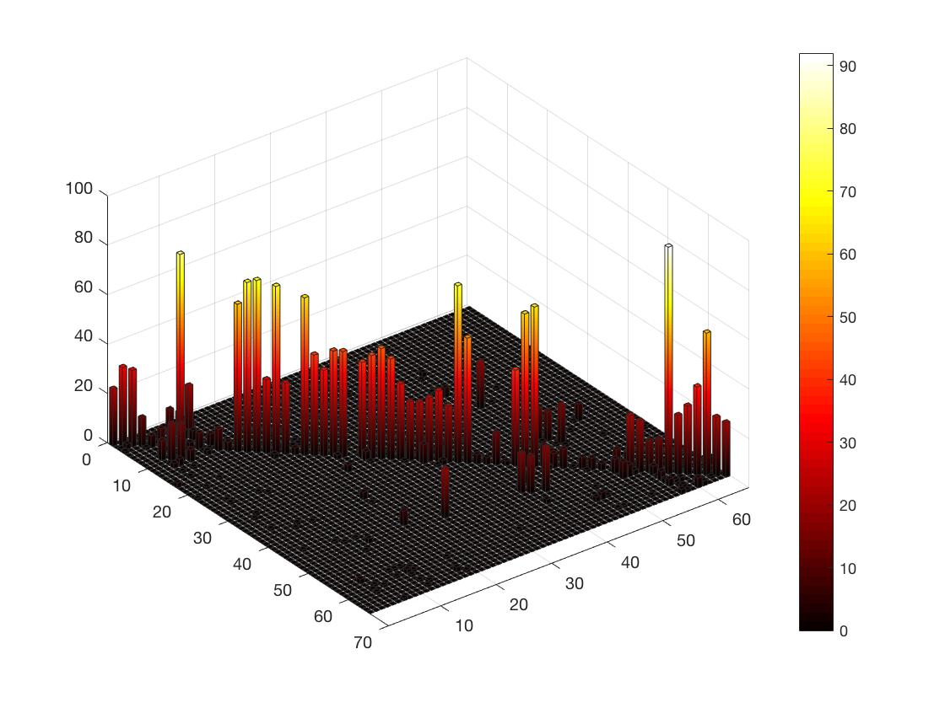
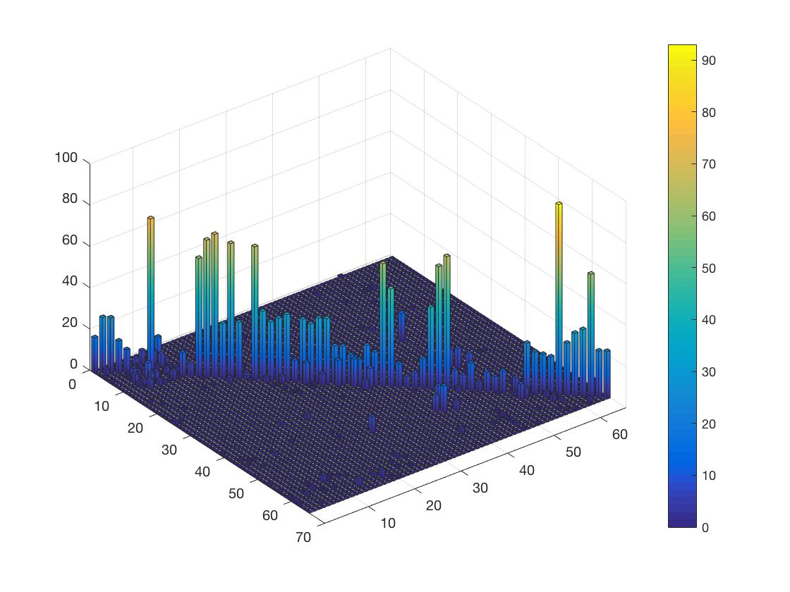
FADE vs. UFADE
Recognition rate = 77% on 1-NN Manhatten Distance
Recognition rate = 73% on 1-NN Manhatten Distance

Slide 10
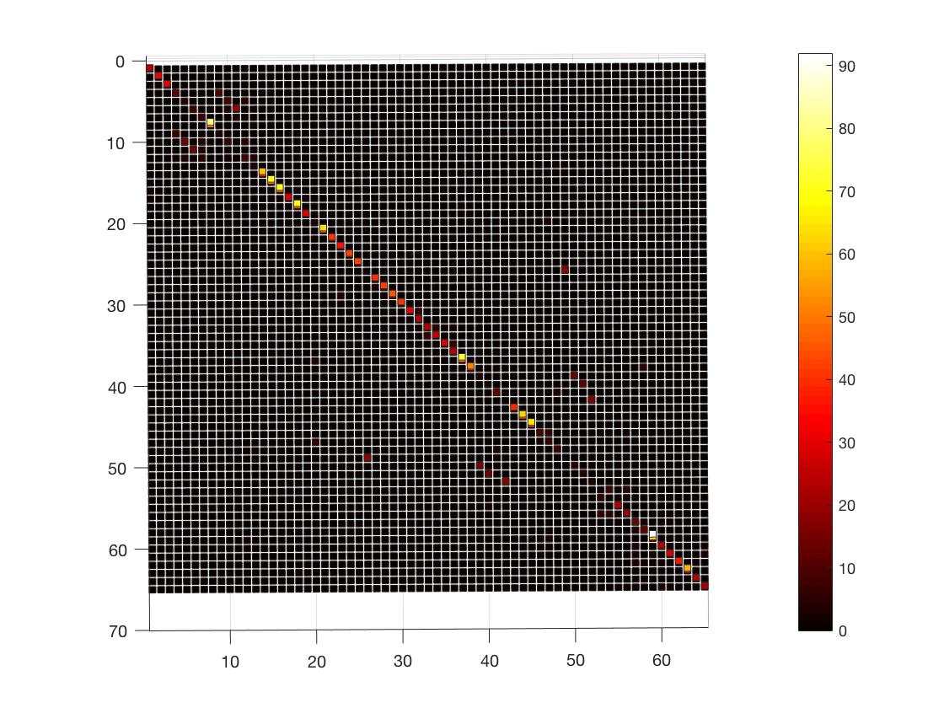
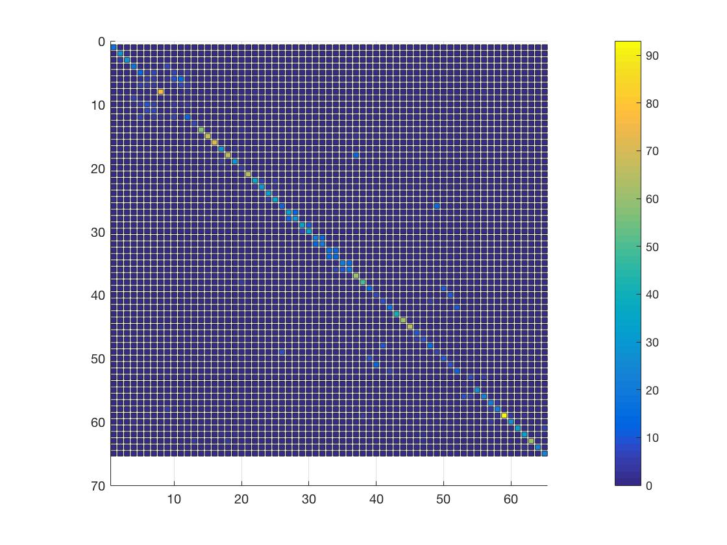
FADE vs. UFADE
Recognition rate = 77% on 1-NN Manhatten Distance
Recognition rate = 73% on 1-NN Manhatten Distance

Slide 11
FADE vs. UFADE
Recognition rate = 77% on 1-NN Manhatten Distance
Recognition rate = 73% on 1-NN Manhatten Distance
Time: 35.9 seconds
Time: 175 seconds
(due to very high dimensionality of descriptor)

Slide 12
Bayesian Classifier (on FADE)
Works by probability

Slide 13
Bayesian Classifier (on FADE)
Works by probability:
Train on training set and build a model

Slide 14

Bayesian Classifier (on FADE)
Works by probability:
Train on training set and build a model
Evaluate by Bayesian Inference:
$$predicetedClass= \max_{i}{P({class}_{i}|{input}_{x})}$$

Slide 15
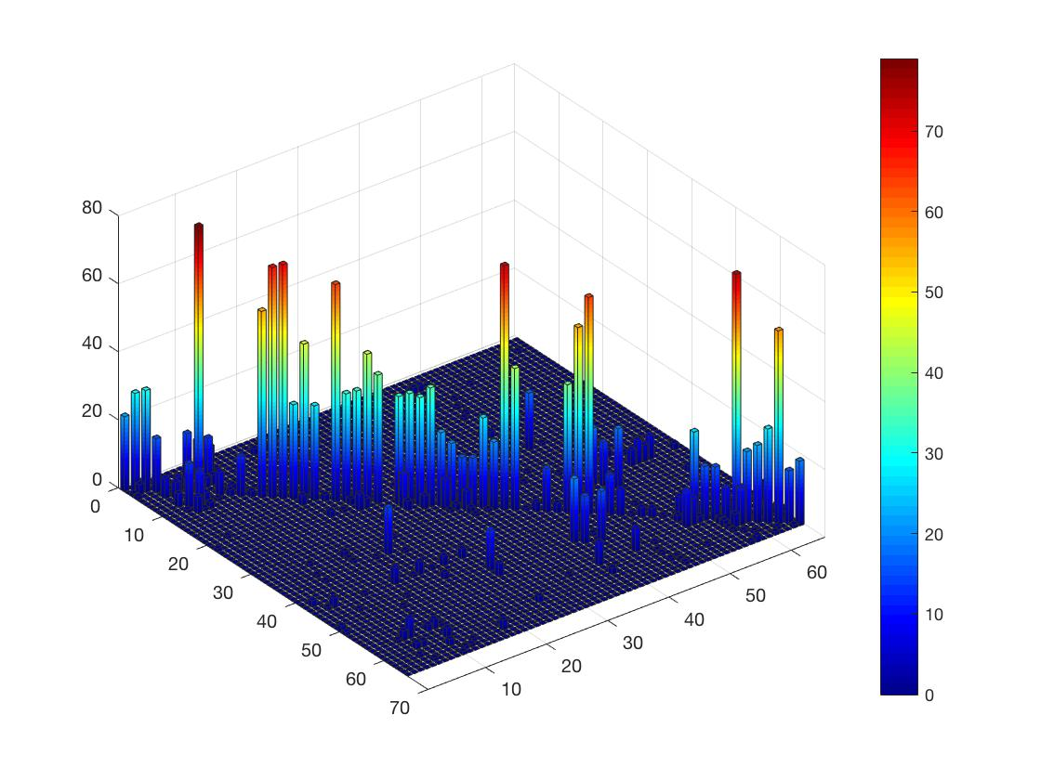

Bayesian Classifier (on FADE)
Works by probability:
Train on training set and build a model
Evaluate by Bayesian Inference:
$$predicetedClass= \max_{i}{P({class}_{i}|{input}_{x})}$$
Recognition Rate: 68% (1-NN: 78%)
Time: 37 seconds (1-NN: 35 seconds)

Slide 16
References
[1] Shah, D.; Falco, P.; Saveriano, M.; Lee, D.: Encoding Human Actions with a Frequency Domain Approach. International Conference on Intelligent Robots and Systems (IROS), 2016
[2] M. Müller, T. Röder, M. Clausen, B. Eberhardt, B. Krüger, A. Weber: Documentation Mocap Database HDM05. Technical report, No. CG-2007-2, ISSN 1610-8892, Universität Bonn, June 2007.

Slide 17
Thank you for your attention

