Slide 1
Terminal App Presentation
by:Roba Elshazly

Slide 2
App Idea:
An E-learning school that provides online courses .
App Features:
1- Welcoming message: Users can run the app with an option of passing their names in command line arguments , A welcoming message will then appear.
2- Enrolling in a course: Users can choose a course from the list of courses , and then choose to enrol the course.
3- Showing course’s details: Users can choose a course to display details about .
4- Unenrolling from a course: Users can choose to unenroll from a course by showing enrolments list and the choose to unenroll ,a confirmation message will then appear with yes or no options.

Slide 3
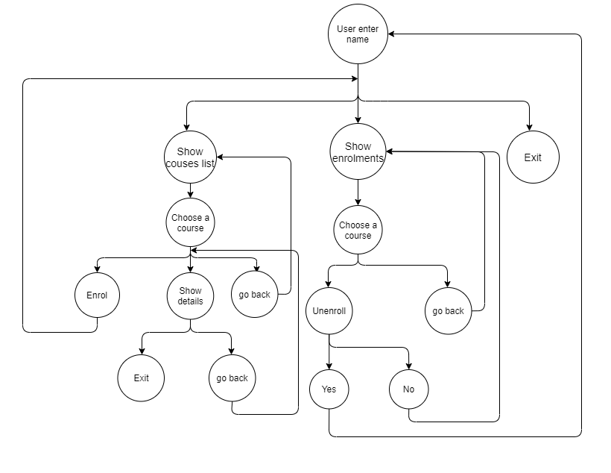
Overall Structure

Slide 4
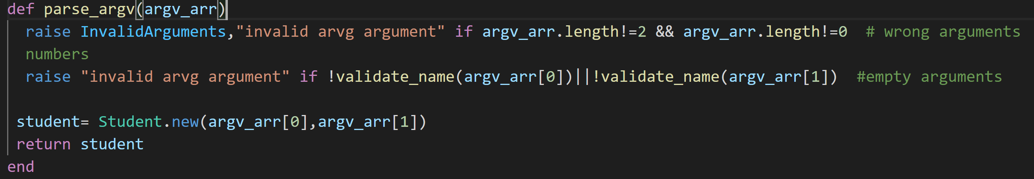
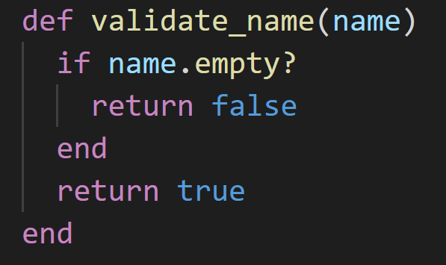
Parsing ARVG arguments

Slide 5
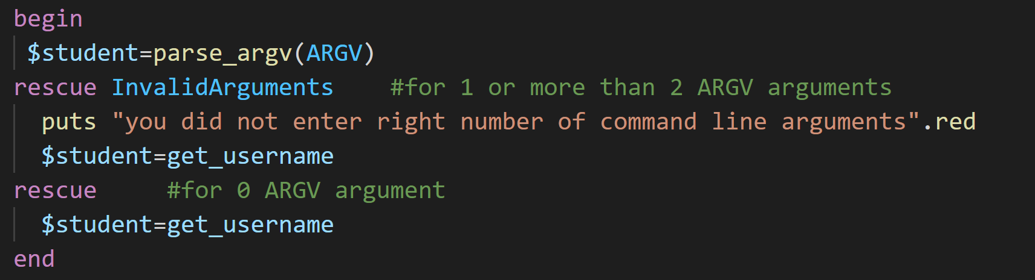
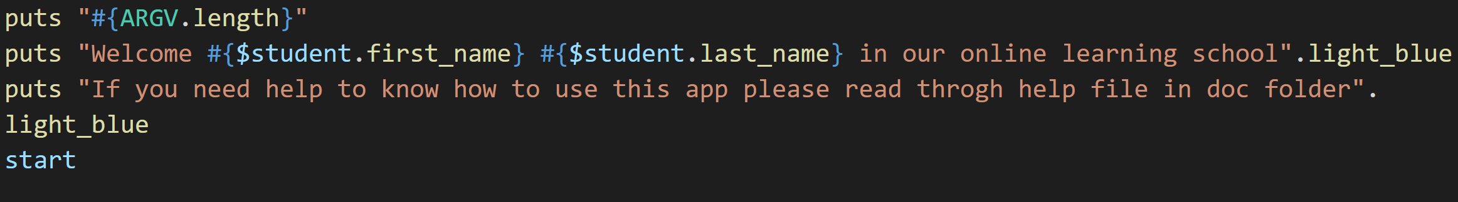

Slide 6
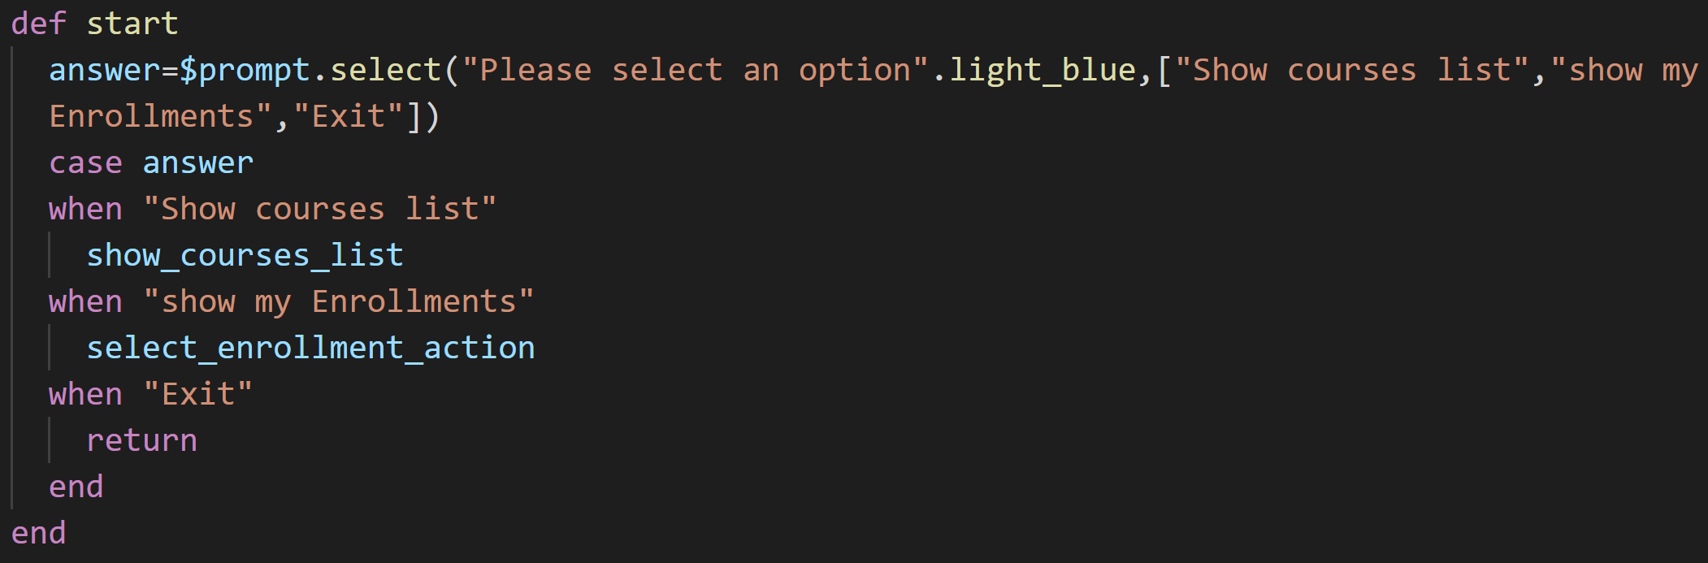

Slide 7
