Slide 1
Terminal App Presentation
by:Roba Elshazly

Slide 2
App Idea:
An E-learning school that provides online courses .
App Features:
Enrolling in a course
Showing course’s details
Unenrolling from a course

Slide 3
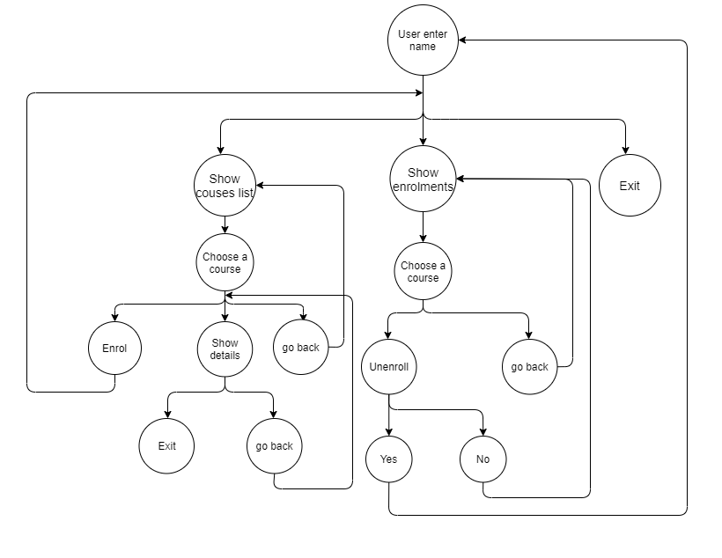
Overall Structure

Slide 4
Classes used:
Classes used | School class | Course class | Student class
Attributes used | Name Courses_list | name Duration Price Syllabus_array | first_name last_name Enrollments_list
Methods used | print_courses_names add_course find_course | to_s | enrol_course unroll_course show_enrollments

Slide 5
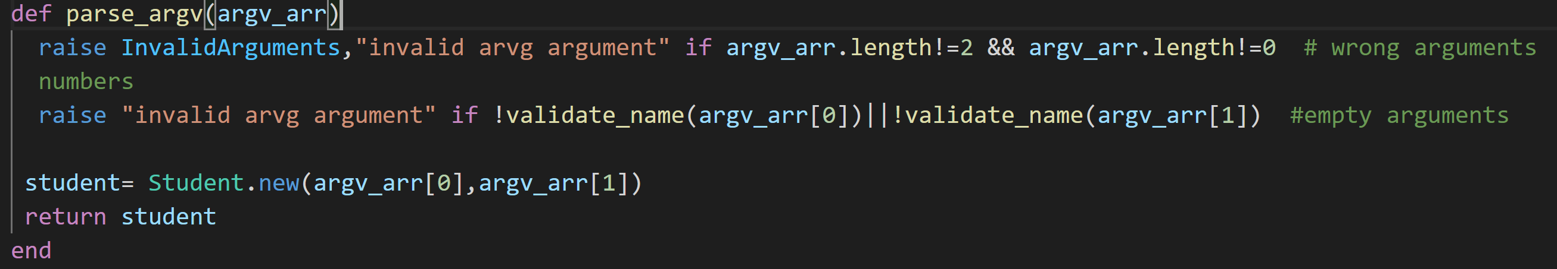
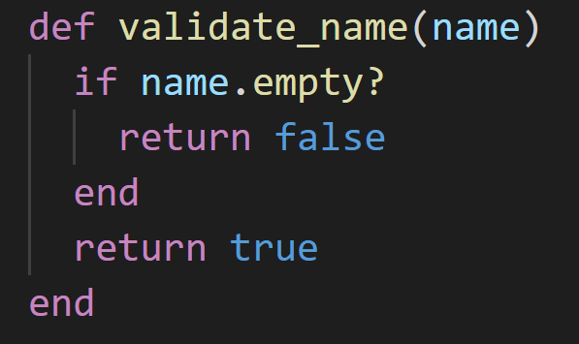
Parsing ARVG arguments

Slide 6
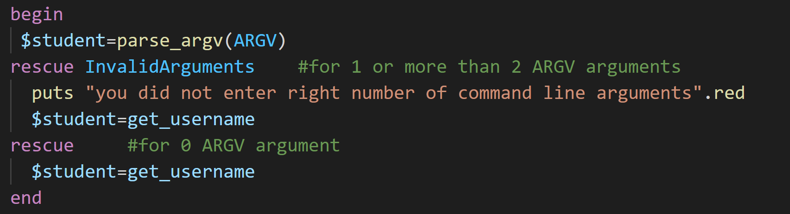
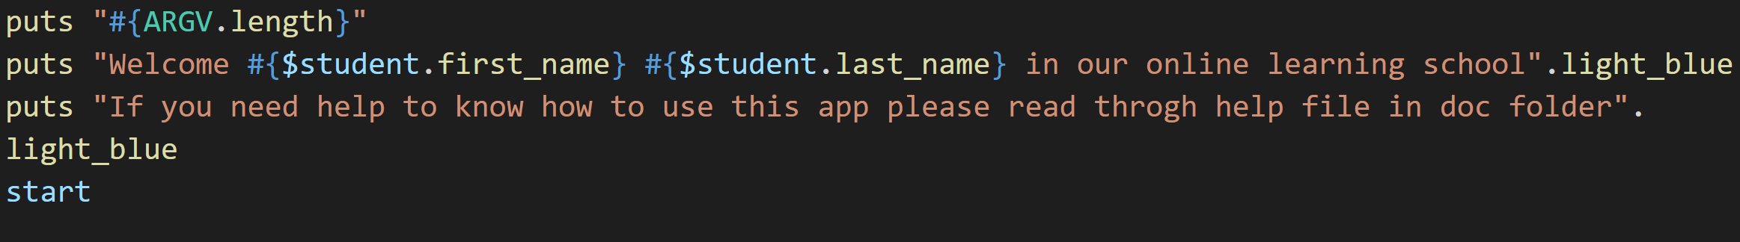
Using parse_argv function

Slide 7
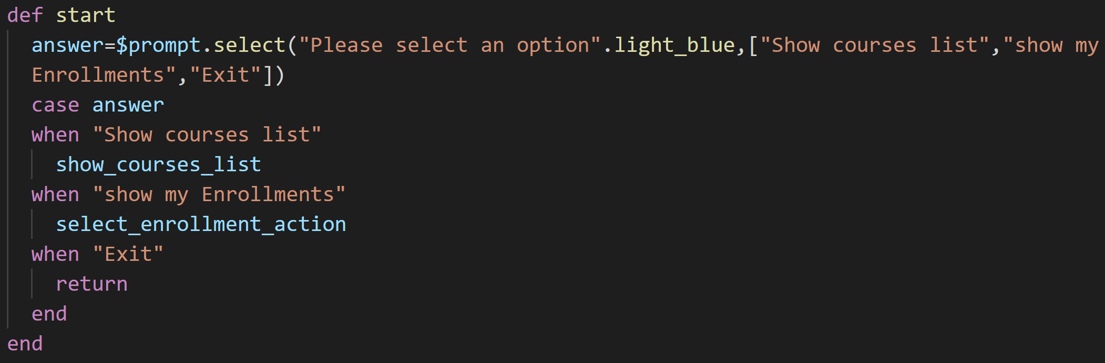
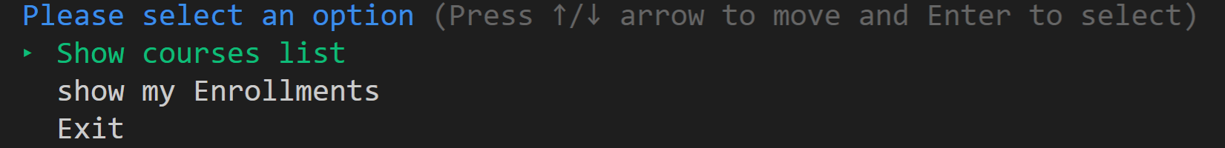

Slide 8
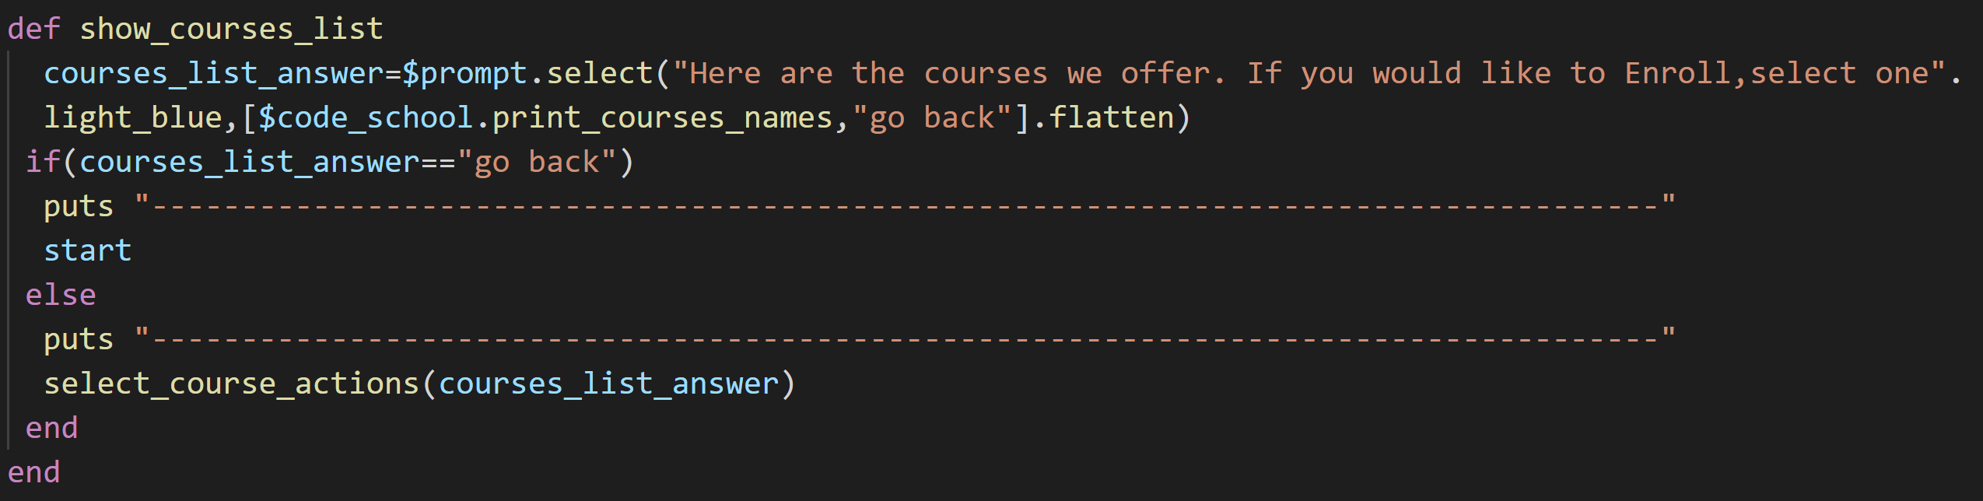
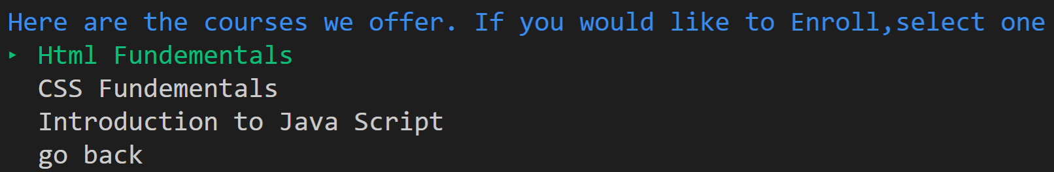

Slide 9
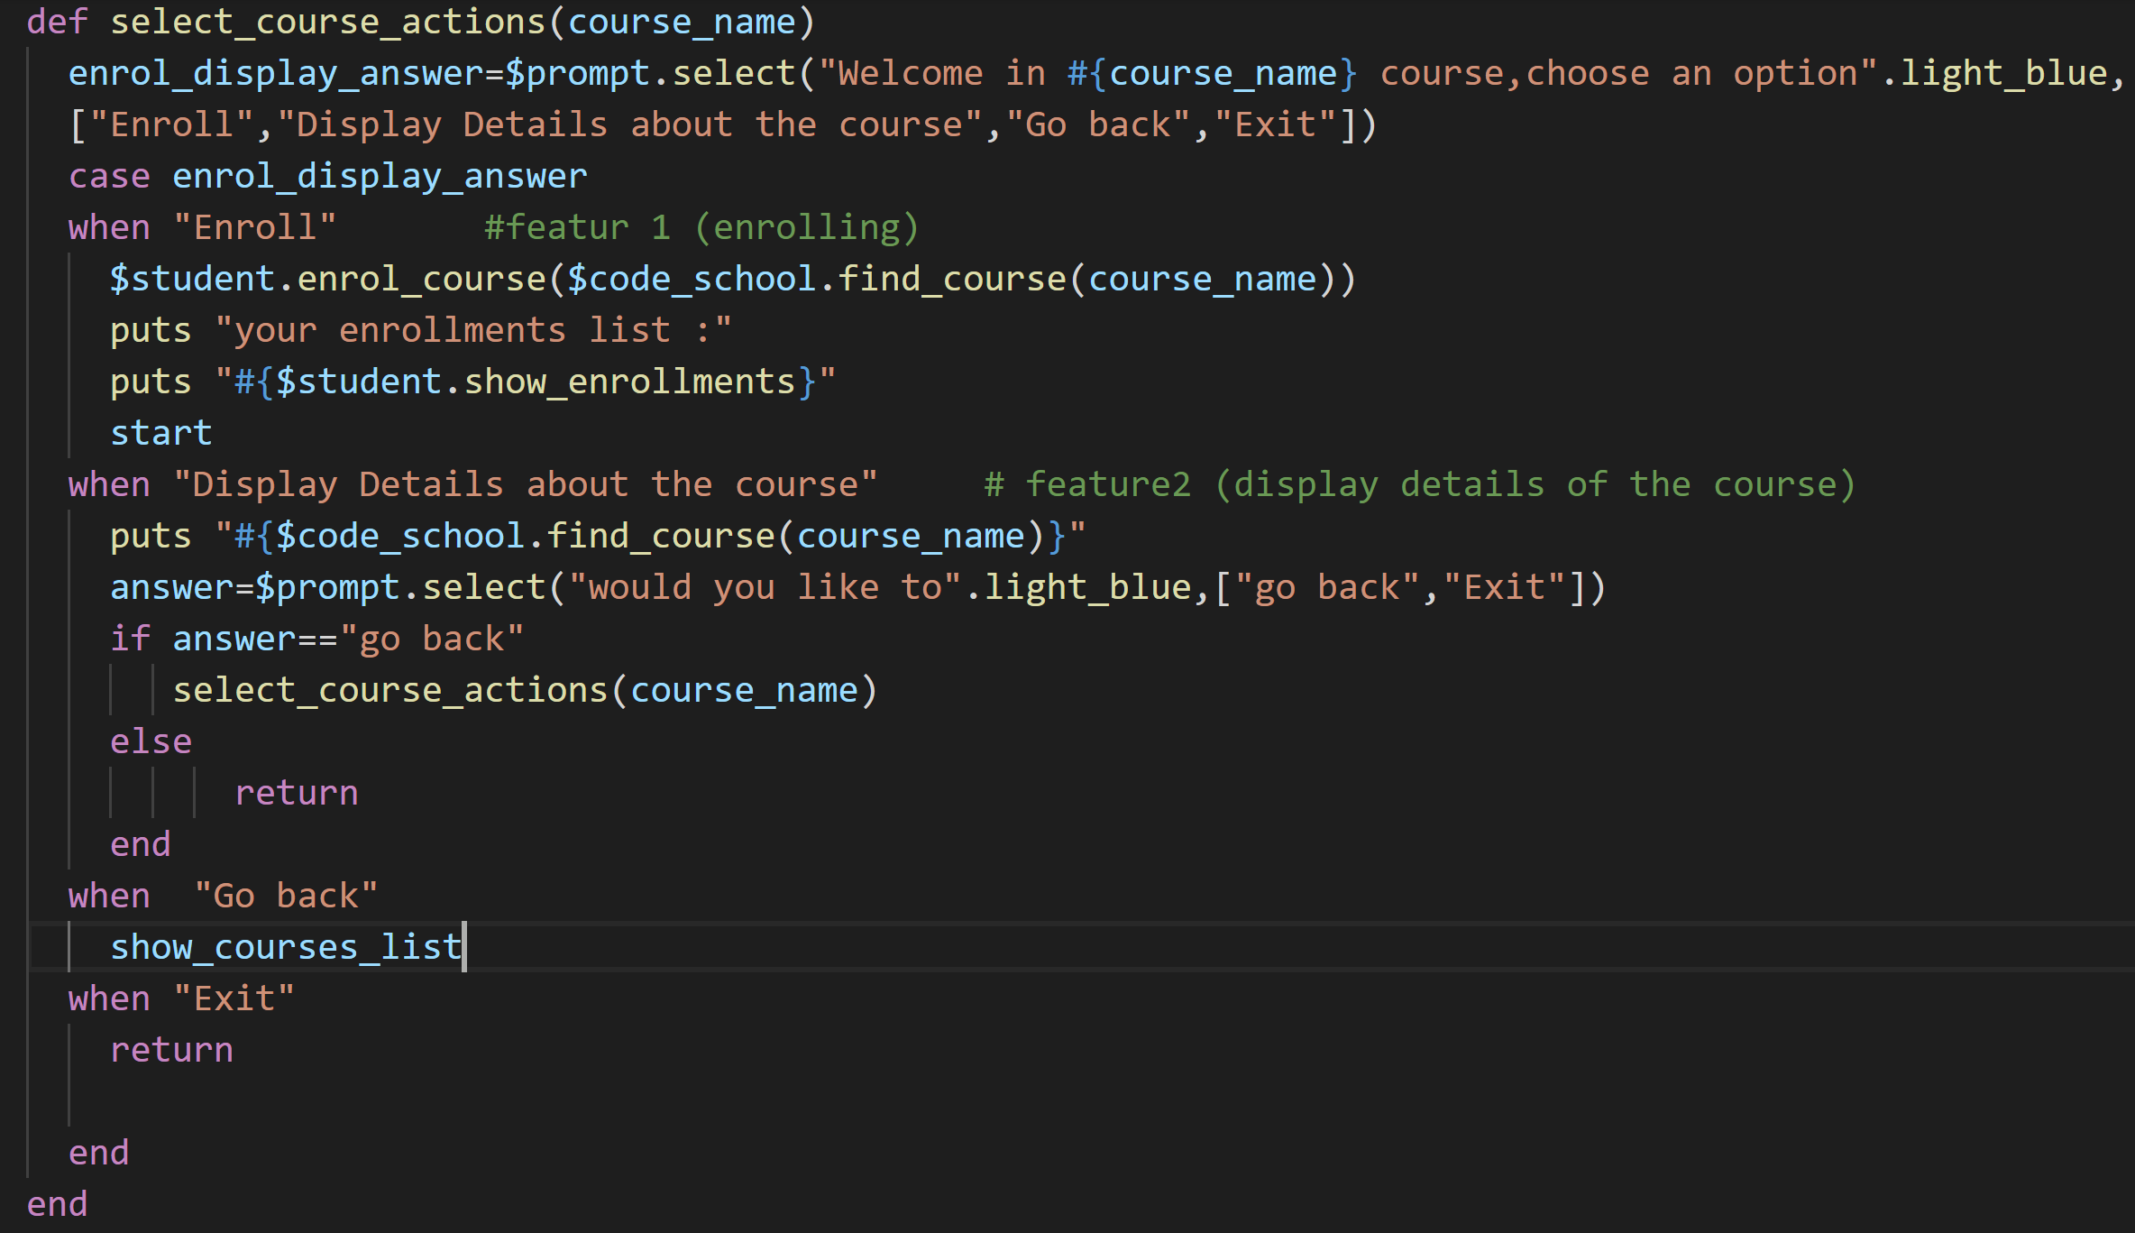
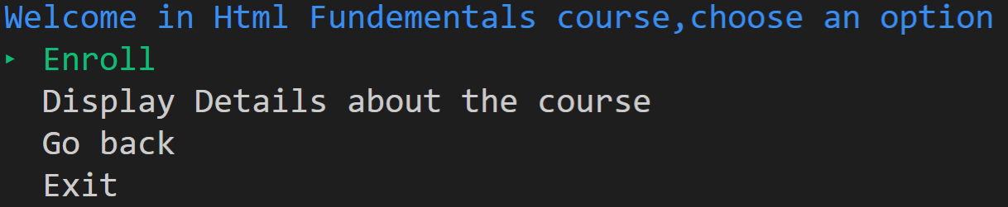

Slide 10
Favourite Parts:
Creating the logic and coding the app.
Using gems to make terminal app more user friendly.
Challenges:
Trying to find a better more complicated idea and adding more features within the time frame.
Working on the documentations.

