Slide 1
Healthcare Provider Fraud Detection Using Machine Learning
Team: Roba Ahmed · Yahia Walid · Abdelrhman Shady · Ali Yasser

Slide 2
Main Problem
Healthcare fraud causes $68+ billion in yearly losses
Current detection uses manual audits & rule-based checks
These miss evolving and complex fraud patterns
Our goal is to build an ML model to detect fraudulent providers
Priority = high recall

Slide 3
Dataset Overview
We used four datasets:
Inpatient claims
Outpatient claims
Beneficiary info
Provider fraud labels
Challenges:
Strong class imbalance (Fraud cases = only 9% of providers)
Claim-level → must aggregate to provider-level
Large number of features

Slide 4
Data Preparation & Feature Engineering
Steps performed:
Cleaned missing values + standardized formats
Merged all datasets using Provider ID
Engineered provider-level features:
  Total claim counts
  Total reimbursement amounts
  Average claims per beneficiary
  Inpatient vs outpatient ratios
  Deceased beneficiary ratio
Output: provider_level.csv

Slide 5
Handling Class Imbalance
Fraud is the minority class (~9%)
Without handling imbalance → model predicts “legit” for EVERY provider
Our solutions:
SMOTE oversampling
Class weights
Ensures model learns fraud behavior properly

Slide 6
Modeling Approach
Models tested:
Logistic Regression
Random Forest
Gradient Boosting
Evaluation metrics:
Precision
Recall
F1-score
ROC-AUC
PR-AUC
Top 2 Models Before Tuning:
Random Forest (Class Weight) → Highest PR-AUC
Random Forest (SMOTE) → Highest Recall & F1

Slide 7
Model Comparison Table
Model Variant | Precision | Recall | F1-Score | ROC-AUC | PR-AUC
Logistic Regression (Class Weight) | 0.61 | 0.55 | 0.58 | 0.88 | 0.59
Random Forest (Class Weight) | 0.71 | 0.65 | 0.68 | 0.91 | 0.76
Gradient Boosting (Class Weight) | 0.67 | 0.58 | 0.62 | 0.89 | 0.64
Random Forest + SMOTE (Before Tuning) | 0.58 | 0.73 | 0.65 | 0.90 | 0.73

Slide 8
Key insights
Best Recall (Before Tuning) → Random Forest + SMOTE
Highest ability to catch fraud (primary project objective).
Best Precision / PR-AUC (Untuned) → Random Forest (Class Weight)
Strong discrimination, lowest false alarms.

Slide 9
Hyperparameter Tuning (GridSearchCV)
The top-performing model before tuning was Random Forest SMOTE
Tuning helps:
✔ Reduce false positives
✔ Improve stability
✔ Boost precision & PR-AUC
Outcome
  Fewer false alarms
  Higher precision
  Stronger fraud detection performance

Slide 10
Results before tuning RF SMOTE
Precision ≈ 0.58
Recall ≈ 0.73
F1 ≈ 0.65
ROC-AUC ≈ 0.90
PR-AUC ≈ 0.73

Slide 11
Final Results
Metric | Score
Accuracy | 0.910
Precision (Fraud) | 0.500
Recall (Fraud) | 0.670
F1-score | 0.580
ROC-AUC | 0.922
PR-AUC | 0.627
Interpretation:
Higher Recall → detects more fraudulent providers
Moderate Precision → acceptable for fraud investigations
High ROC-AUC (0.922) → strong separation between fraud and non-fraud
PR-AUC = 0.627 → strong performance for rare-event (9%) fraud detection

Slide 12
Final Best Model: RF_tuned
Selected Best Model:
➡ RF_tuned (Random Forest with optimized hyperparameters)
Why RF_tuned was chosen:
Best Precision → reduces unnecessary audits
High Recall → catches most fraudulent providers
Strongest PR-AUC → best for imbalanced datasets
Robust ROC-AUC
Significantly fewer False Positives after tuning
Model saved as: best_model.pkl

Slide 13
Confusion Matrix
A confusion matrix shows how many predictions our model got right and wrong, split into four categories:
True Positives (TP): Fraud cases the model correctly detected
False Positives (FP): Legitimate providers incorrectly flagged as fraud
False Negatives (FN): Fraud cases the model missed
True Negatives (TN): Legit providers correctly identified

Slide 14
Confusion Matrix Results
The confusion matrix helps us understand exactly where the model makes mistakes.
Results:
True Positives: 68
False Negatives: 33
False Positives: 67
True Negatives: 912

Slide 15
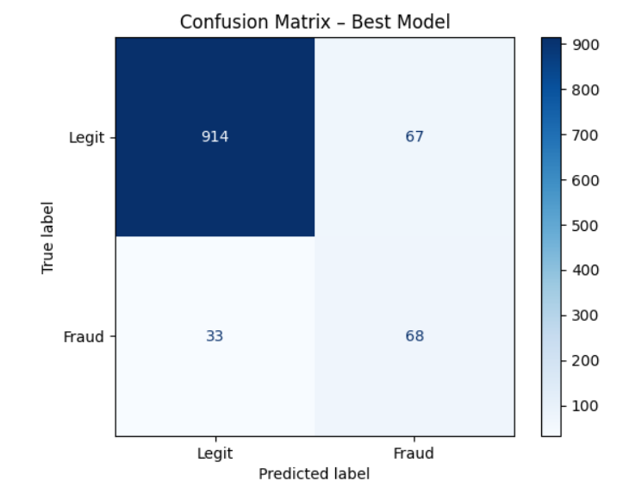
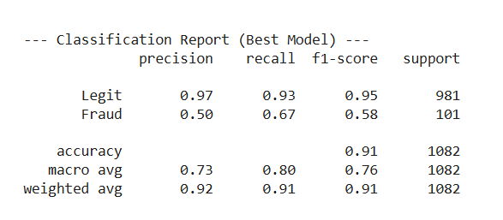

Slide 16
ROC Curve
Plots True Positive Rate (Recall) vs False Positive Rate
Used to evaluate how well the model separates fraud from non-fraud.
ROC-AUC = 0.922 (excellent)

Slide 17
Precision–Recall (PR) Curve
Focuses on minority class
Important for imbalanced datasets
PR-AUC = 0.627
Measures Precision vs Recall

Slide 18
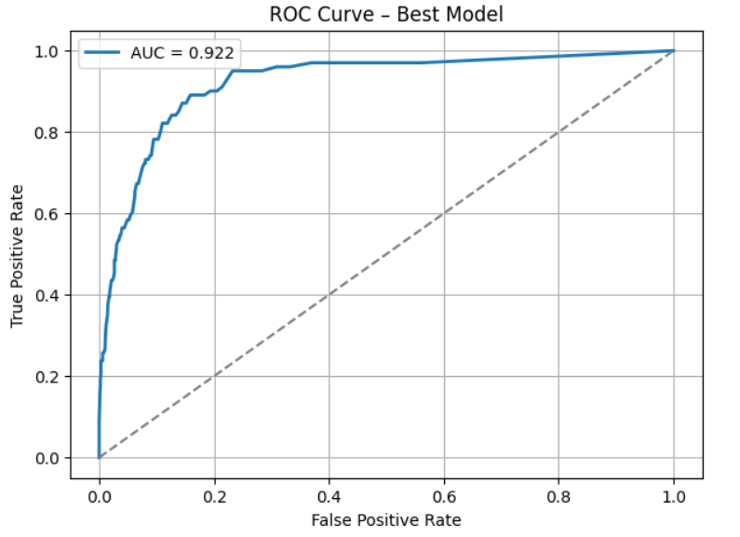
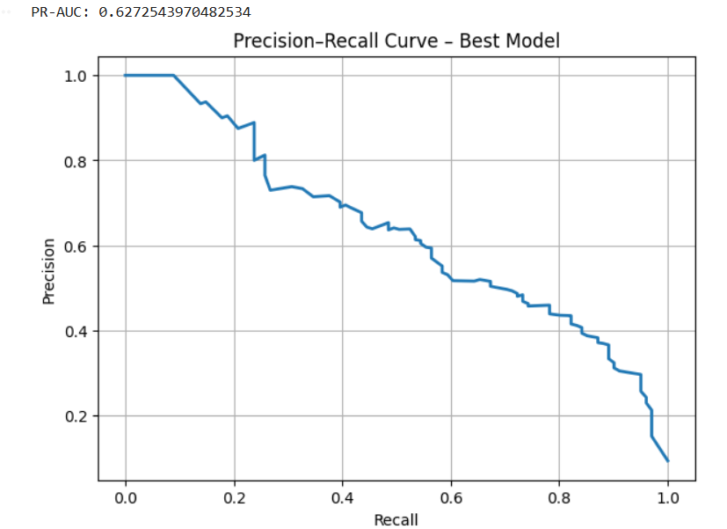
ROC & PR Curves Results
ROC-AUC = 0.922
Excellent class separation
PR-AUC = 0.637
Shows model handles rare fraud cases well

Slide 19
Error Analysis
False Positives (Legit flagged as fraud):
High billing volume
Aggressive reimbursement patterns
Similar to known fraud behavior
False Negatives (Fraud missed):
Low activity providers
Subtle fraud signals
Hard to detect without anomaly-based methods

Slide 20
Conclusion & Business Impact
Model detects majority of fraud cases
ROC-AUC = 0.922 → high discrimination
Model Recall = 0.673
PR-AUC = 0.627
Helps CMS save time and money
Reduces manual audits
Future work:
  Specialty-based models
  Anomaly detection
  Real-time fraud scoring API

Slide 21
Thank you

