Slide 1
Using Natural Language Processing (NLP) to Predict Psychiatric Consultation in two Inpatient Hospitals
Rob Arao
Springboard Data Intensive Program
March 22, 2018

Slide 2
The Problem
Increasing number of patients with mental health problems.
Decreasing number of available psychiatric health-care resources.
May result in poor patient safety:
Missed opportunity of windows to treat
Some patients may never be seen by mental health care providers
Lack of developed and/or implemented interventions

Slide 3
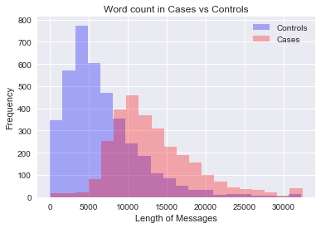
A Picture paintS a thousand words
Words and phrases unique to cases?
Words and phrases unique to cases?
There may be words and phrases that are unique among those that receive psychiatric consultation (cases) vs. those that do not (controls)
Overlapping curves

Slide 4
PROPOSED SOLUTION
1. Use Natural Language Processing (NLP) to identify word(s) that are unique in predicting patients that need to see psychiatric consultation.
These words would be located in text-based medical narratives (blob contents)
2. Develop a single-word predictive model
3. Develop a tri-gram predictive model
4. Use something similar to a case-control study design.

Slide 5
WHAT IS NLP and HOW DOES IT WORK?
Pre-Test Processing
Vectorization
Model-Fitting
Model Assesment
Natural Language Processing involves understanding, interpreting, and manipulating human language using techniques from artificial intelligence and computational linguistics
Remove familial words
Remove punctuation
Separate out each word into a vector space
Multinomial Naïve Bayes classifier algorithm
Accuracy
Precision
Recall
F1-Score

Slide 6
THE DATA
1. Inclusion:
between the ages of 18 and 100
admitted as inpatients at between January 1, 2015 and September 20, 2017
at the University of Washington Medical Center (UWMC) and Harborview Medical Center (HMC).
2. Exclusion criteria: Deceased patients
3. Use Propensity Score Matching to create final sample (6,775 medical records):
2,767 patients that received psychiatric consult (cases)
2,767 patient that did not receive psychiatric consult (controls)
Notes:
There were 5,875 deceased patients

Slide 7
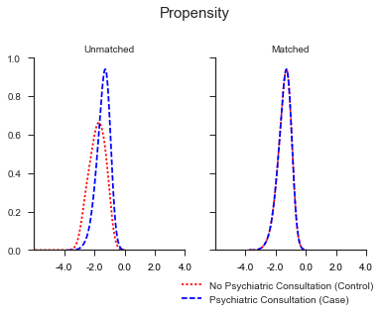
What is propensity SCORE MATCHING?
Propensity Score (PS) Matching
PS calculated by modelling the probability of receiving psychiatric consult vs not receiving psychiatric consult.
PS scores calculated using logistic regression.
Controlled for age, gender, race, ethnicity, language spoken, veteran status, employment status, and admission year.
match 1:1 (case:control) with a caliper width of 0.2.

Slide 8
DATA WRANGLING
1) Create data frame
Electronic health records (EHR’s) exported as excel files from SQL database
2) Remove duplicates
3) Assess missingness
4) Changing format of variables for further analysis
Datetime format
Blob content as string
4) Remove punctuation, familial words and any other word(s) that may not be meaningful.

Slide 9
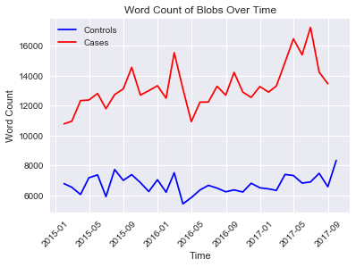
Exploratory Analysis: Word count does not vary over time.

Slide 10
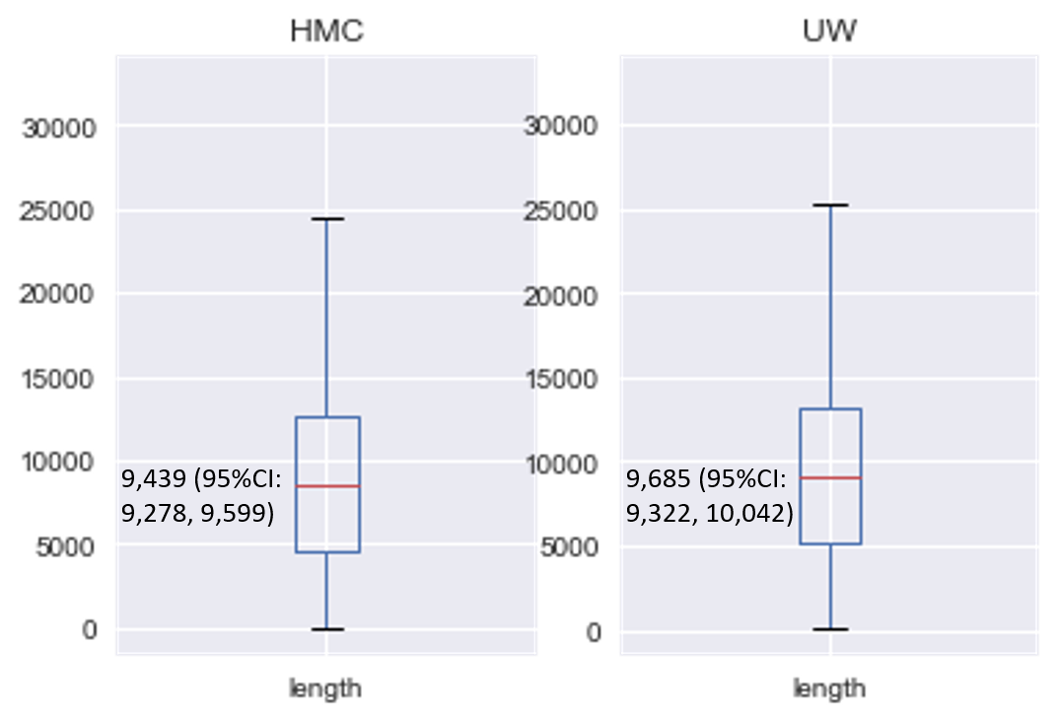
Exploratory Analysis: Word count does not vary by medical institution.

Slide 11
RESULTS : Performance of Single-word Model
Training Dataset
Accuracy: 88.5%
Test Dataset
Accuracy: 87.6%

Slide 12
RESULTS : Performance of Tri-gram Model
Training Dataset
Accuracy: 90.2%
Test Dataset
Accuracy: 90.6%

Slide 13
RESULTS: Top 10 Words

Slide 14
RESULTS: Top 10 phrases

Slide 15
RESULTS: Testing other a priori phrases

Slide 16
RECOMMENDATIONS
1. The tri-gram model better performed than the single-word model.
Therefore, it is recommended that the tri-gram model be used to identify unique phrases.
2. The context of which these phrases appear needs to be explored in order to fully understand the relevance of these phrases.
Therefore, it is important to have a meeting with several psychiatrists and psychologists to better understand the context of some of these notes.

Slide 17
PRACTICAL CONSIDERATIONS
Limitations
First, we did a 1:1 case-control match. Could the true underlying distribution be different?
Second, each person that enters their text-based notes may have their own abbreviations and linguistic nuances.
Third, the nuances and abbreviations may vary between hospitals. We analyzed EHR's from only two medical hospitals.
Future Work
a different classifier algorithm such as the Random Forrest classifier
reducing reflected or derived word(s) into their word stem (stemming).

