Slide 1
Nvidia CUDA
A half-cocked attempt at a grok talk

Slide 2

What?
“Cluster GPU Quadruple Extra Large 22 GB memory, 33.5 EC2 Compute Units, 2 x NVIDIA Tesla “Fermi”M2050 GPUs, 1690 GB of local instance storage, 64-bit platform, 10 Gigabit Ethernet”
“I gotta hire me one of those”

Slide 3
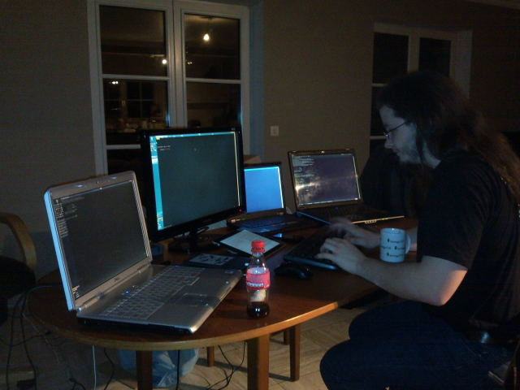



Recipe

Slide 4

GPU Hardware
Built for maths, in parallel

Slide 5
How it looks in my head
Host
Device
GPU
CPU
RAM
RAM

Slide 6
Some definitions
Global method: Runs on GPU, called from CPU
Device method: Runs on GPU called from GPU
Device memory: RAM only accessible from GPU
System memory: RAM only accessible from CPU

Slide 7
CUDA C
nvcc myamazingcode.cu

Slide 8
Allocating memory on the GPU
cudaMalloc
int* gpuData;
cudaMalloc( (void**)&p , sizeof(int) * 5);

Slide 9
Uploading data to the GPU
cudaMemcpy
int cpuData[] = { 0, 1, 2, 3, 4 }
cudaMemcpy(gpuData,cpuData, sizeof(int) * 5 ,cudaMemcpyHostToDevice);

Slide 10
A global method in CUDA c
__global__ void add(int x, int y, int* output)
{
*output = x + y;
}

Slide 11
Invoking that method
Add<<<1,1>>>(4, 6, output);
Wait what?
<<<Blocks, ThreadsPerBlock>>>

Slide 12
The typical for-loop
for(int x = 0; x < 5 ; x++){
values[x] = values [x] + 5;
}
values [0] = values[0] + 5
THEN
values [1] = values [1] + 5
THEN
values [2] = values[2] + 5
....

Slide 13
__global__ void addValueToEach(float values[], float adder) {
int x = blockIdx.x;
values[x] = values[x] + adder;
}
addValueToEach<<<5, 1>>>(numbers, 5);

Slide 14
numbers[0] = numbers[0] + adder
AND
numbers[1] = numbers[1] + adder
AND
Numbers[2] = numbers[2] + adder
ETC
AT THE SAME TIME

Slide 15
So threads?
A further way of subdividing, accessed by
threadId.x

Slide 16
You can also do...
dim3 blocks(5,5,1);
blockIdx.x - 0 to 4
blockIdx.y – 0 to 4
blockIdx.z - 1
callMethod<<<blocks, 1>>>

Slide 17
And
dim3 threadsPerBlock(5,5,1);
threadIdx.x
threadIdx.y
threadIdx.z
callMethod<<<blocks, threadsPerBlock>>>

Slide 18
Suited for
Cracking passwords
Cracking wifi access
Cracking some encryption
Oh yeah, science

Slide 19
Demo
Game of life
A million cells
Each “generation” means evaluating each cell in a snapshot
Perfect.

Slide 20
Job done
Try it out, it’s fun

