Slide 1
Outside in Testing of ASP.NET MVC Applications
Actually that's a lie, but whatever – let's just do this.

Slide 2
Who am I?
I am @robashton
I write code
My favourite is the Javascripts
I work in Rails, I hate rails
I do .NET for pizza

Slide 3
Who are you?
You use ASP.NET MVC
You want to test stuff
You're probably working at enterprise company ACME1337 Ltd
You're curious about how I do things

Slide 4
ASSUMPTIONS
You know what a container is
You know how ASP.NET MVC works
  Controllers, action filters, model binding, etc
If I gloss over a definition, either SHOUT AT ME or ignore it as it's probably not important

Slide 5

Let me tell you a story about every client ever...

Slide 6

“We tried to do TDD because Uncle Bob said so”

Slide 7

“We should test trivial code*”
*If you're NASA

Slide 8

“You should inject all your dependencies”

Slide 9

You should avoid ALL THE COUPLING*
*Can recommend avoiding coupling -->

Slide 10

How did that go for you?

Slide 11

“We had 100% test coverage at the unit level”

Slide 12

“Too many tests broke on changing things”
:(

Slide 13
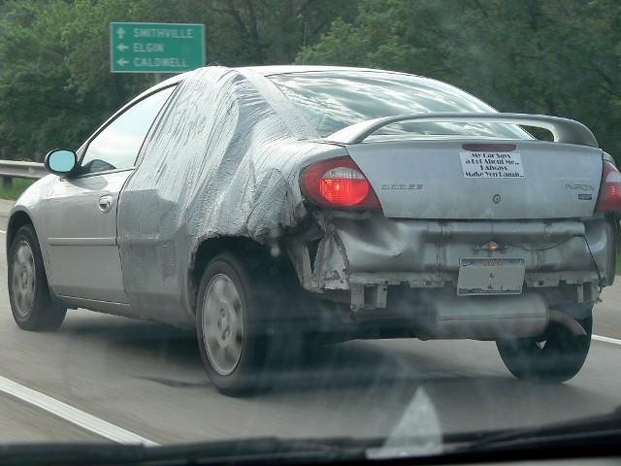
“We spent more time fixing tests than writing new code”

Slide 14

“Our test suite slowed down our build too much”

Slide 15

“We deleted the tests because they got in our way”

Slide 16
No really – every client ever.

Slide 17

So, let me say some things...

Slide 18

TDD has failed us

Slide 19

TDD is not “wrong”, it's just too hard

Slide 20

That's okay

Slide 21

So... this talk then?
Let's save the definitions for white-coat mailing list discussions
Let's focus on the core things that can help us now
That's it.

Slide 22

Boom, explosion.

Slide 23

You're starting a new project

Slide 24

What is it?
It is the latest in the line of our company's own line of unique blue-sky PRM systems. (Pony Relationship Management)

Slide 25
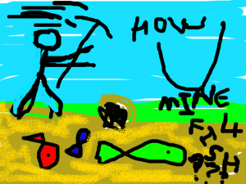
Where to start?

Slide 26
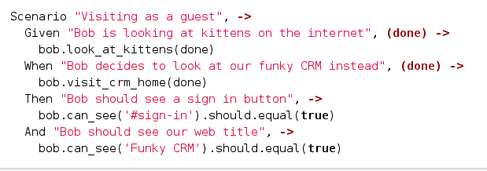
This test is the FIRST THING you do

Slide 27
It is a statement of intent.

Slide 28
It's a forcing mechanism.

Slide 29
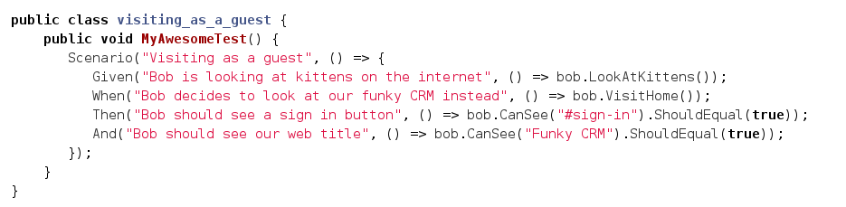
Okay you can do it in C# if you want

Slide 30
Avoid cucumber and associated foolery
Forced/harmful abstraction
Only useful if non-devs are writing acceptance criteria
This is nearly never the case

Slide 31
So... that test?
We need to run some HTTP server
We need some sort of browser
Anything else...?

Slide 32
What are the most important things about this test?
Speed
Feedback

Slide 33
Right now...
XSP from the Mono project is good enough (feel free to play with IIS express)
PhantomJS is the greatest thing ever.
This might not be the case next month

Slide 34
Don't use PhantomJS though
Coupling our tests to Phantom is the worst decision we can make
Use WebDriver to drive Phantom
Selenium is dead, long live Selenium

Slide 35
Testing ASP.NET with Phantom
WebDriver
XSP Web Server
HTTP
PhantomJS
Tests
HTTP

Slide 36
Means we can do this
Firefox
WebDriver
Tests
XSP Web Server
HTTP
Chrome
HTTP
Phantpm

Slide 37
Or this
Firefox
WebDriver
HTTP
Chrome
HTTP
Selenium Grid
HTTP
Tests
XSP Web Server
Phantpm

Slide 38
I write my tests in CoffeeScript

Slide 39
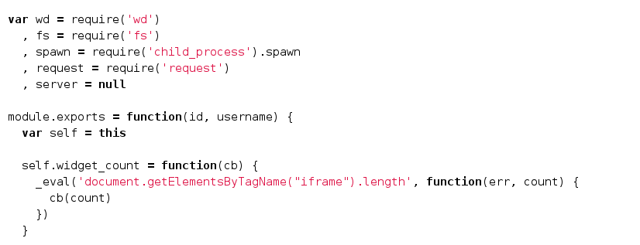
I write my contexts in JS

Slide 40
I run it all using
NodeJS
Mocha
Mocha-Cakes
Should

Slide 41
Do it your way
It's not important
Use whatever
C# is fine, I just like JS so I use it

Slide 42
A good C# stack
NUnit or any other test framework
PhantomJS or any WebDriver browser
Coypu or any WebDriver client

Slide 43
Testing Architecture
System setup/teardown
WebDriver Client
Test code
Client Abstractions (bob)

Slide 44
So let's see it in action...

Slide 45
A good test
Doesn't use CSS selectors
Doesn't show implementation details
Doesn't have any logic in it
Is understandable for any casual reader

Slide 46

Instead of

Slide 47

Consider

Slide 48

Instead of

Slide 49

Consider

Slide 50
Avoid duplication in your UI tests
Don't use the same selector more than once across your contexts
Consider using conventions across your UI
Push everything into your testing model

Slide 51
Avoid duplication in your UI tests
Consider using Capybara from Ruby
Consider using Coypu from .NET

Slide 52
When to drop to the next level?
There are two reasons to drop down a level
“Low level tests are faster”
“You need more feedback”

Slide 53
When to drop to the next level?
There are two reasons to drop down a level
“Low level tests are faster”
“You need more fine-grained feedback”

Slide 54
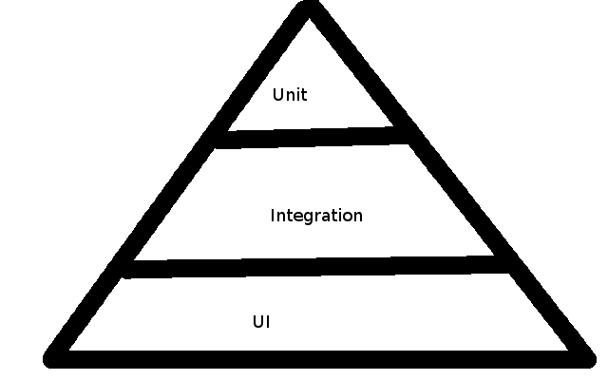
Inverting the test pyramid?

Slide 55
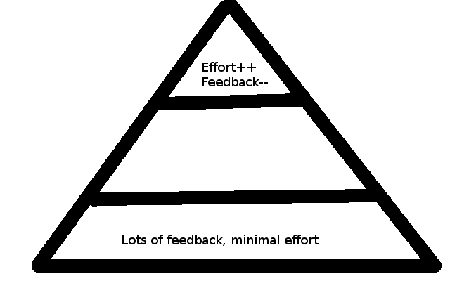
“inverting the test pyramid is not a goal in itself”

Slide 56
Times have moved on
Focus on speed
Focus on reducing effort
Focus on increasing feedback
Ignore dogma at every level
Listen to the pain

Slide 57
Avoid solutions for problems you haven't got yet
Starting on the outside means you can change all the details later
Don't make decisions about technology until you have to
Focus on features and iteration time

Slide 58
Example: Defer all the decisions
Let's store some ponies

Slide 59
Example: Avoid layers
Let's use RavenDB for example

Slide 60
What did we learn?
You don't need a container when you only have one external dependency
You don't need to create interfaces and classes all over the show
Let these things emerge if the complexity dictates it

Slide 61
Avoid writing tests for trivial code
Controller actions should be trivial
Model binding should be largely automatic
It'll make you feel good, but that's about it

Slide 62
That said...
Drop down to lower level tests for code with a large number of variants
That's validation rules/domain logic
If your controller has more than one “if”, then it shouldn't

Slide 63
Example: Dropping down

Slide 64
Don't avoid the hard stuff
Filters often hide complexity
They need testing
TDD the code for that filter
Then bring it in
Don't mock ASP.NET MVC!!

Slide 65
Example: The hard stuff

Slide 66
That's it
Follow your nose
Listen to the pain
Focus on the feedback loop
Ignore everything I've just said

Slide 67
Useful things
PhantomJS
WebDriver
Capybara / Coypu
Common sense
Selenium (not so much)
NodeJS/Coffeescript/Mocha/Mocha-Cakes

