Slide 1






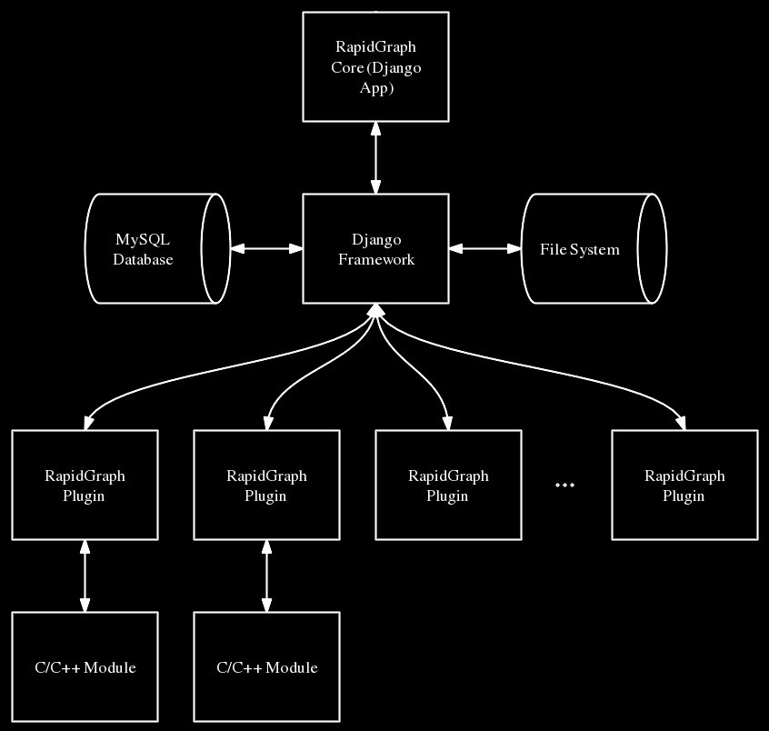
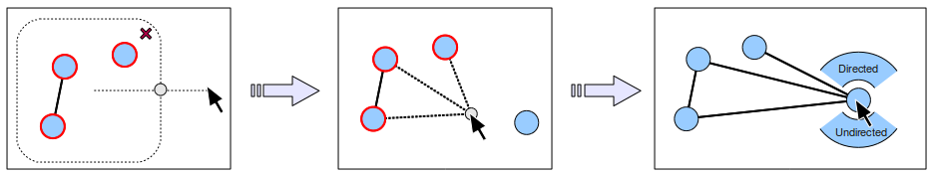
Project Description
Web-Based Visual Graph Analyzer
The mathematical graph analyzers that exist today generally require installation and/or use of unintuitive, complicated mathematics software.
RapidGraph is a web-based graph analyzer that is easily accessible to anyone with a modern web-browser.
It is easy to rapidly create graphs with a visually-appealing and intuitive user interface, and efficiently analyze them with an modular, plugin-based, extendable back-end.
Features
Technical Details
Rapidly Accessible - It's web-based which means it will work in any modern browser without needing to install any additional software.
Rapidly Createable - An intuitive, consistent, and easy-to-use interface encourages fast and accurate graph creation.
Rapidly Portable - RapidGraph is built with standard, open languages ensuring maximum portability both server-side and client-side.
Rapidly Modular - A plugin system allows for fast and consistent functional extendibility.
RapidGraph is mostly written in Javascript with the jQuery and Raphaël libraries. The UI uses standard CSS, and HTML, and the <canvas> tag.
The server runs Apache and Django, which handles server-side tasks and the plugin system. Python and C++ is used with plugins requiring high algorithmic performance.
Git was used for code versioning, and Trac was used for project management. You can find out more at trac.osuosl.org/rapidgraph
Applications
There are many base applications bundled with RapidGraph, including:
Analyzing graph type - simple, planar, bipartite, complete, clique, n-cubes, and different flavors of trees.
Real-world applications – The "knight's tour" problem, the "traveling salesman" problem, the "instant insanity" puzzle, map-coloring, and more!
Conclusions
We learned that... (will fill when finished)
Placeholder
Placeholder
Creating Edges
A “handle” orbits around selected
Prospective edges created
Context menu appears when created
Block diagram demonstrating component interaction
Credits: Rob McGuire-Dale, Project manager (mcguirer@engr.oregonstate.edu) | Michael Anderson, Developer (andermic@engr.oregonstate.edu) | Christine Wallace, Sponsor (wallach@eecs.oregonstate.edu)

