Slide 1
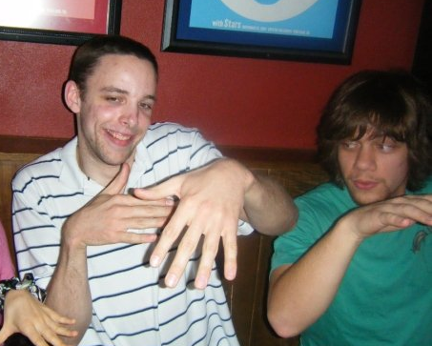


Web-Based Visual Graph Analyzer
Features
Applications
Project Description
Features
Rapidly Accessible - It's web-based which means it will work in any modern browser without needing to install any additional software.
Rapidly Createable - An intuitive, consistent, and easy-to-use interface encourages fast and accurate graph creation.
Rapidly Portable - RapidGraph is built with standard web languages and open-source technologies allowing it to be installed on and used with virtually any computer system.
Rapidly Modular - A plugin system allows for fast and consistent functional extendibility.
There are many base applications bundled with RapidGraph, including:
Analyzing graph type - simple, planar, bipartite, complete, clique, n-cubes, and different flavors of trees.
Real-world applications – The "knight's tour" problem, peer-to-peer networking, the "travelling salesman" problem, the "instant insanity" puzzle, and map-coloring.
The mathematical graph analyzers that exist today generally require installation and/or use of unintuitive, complicated mathematics software.
RapidGraph is a web-based graph analyzer that is easily accessible to anyone with a modern web-browser.
It is easy to rapidly create graphs with a visually-appealing and intuitive user interface, and efficiently analyze them with an modular, plugin-based, extendable back-end.
Rapidly Accessible - It's web-based which means it will work in any modern browser without needing to install any additional software.
Rapidly Createable - An intuitive, consistent, and easy-to-use interface encourages fast and accurate graph creation.
Rapidly Portable - RapidGraph is built with standard web languages and open-source technologies allowing it to be installed on and used with virtually any computer system.
Rapidly Modular - A plugin system allows for fast and consistent functional extendibility.
Credits
“Knight's Tour” graphs for different sized boards
Michael Anderson
(andermic@engr.oregonstate.edu)
Back-end and plugin developer
Rob McGuire-Dale
(mcguirer@engr.oregonstate.edu)
Project manager/Front-end developer
Christine Wallace
(wallach@eecs.oregonstate.edu)
Project Sponsor
Technical Details
Conclusion
The front-end was created using the following W3 standard web languages: HTML, JavaScript, CSS, and jQuery.
The back-end was built using Django, Python, Apache, C and C++
This project is entirely open-source. You can find out more at www.rapidgraph.org
We learned that... (will fill when finished)
Placeholder
Placeholder
Placeholder
Placeholder

