Slide 1
Start-Up
No Thunder detected
If upgrade available or required.
First Time Executing App
Default scenario
Learn More
Loyalty Program
Home
Firmware Upgrade
Promo
About

Slide 2
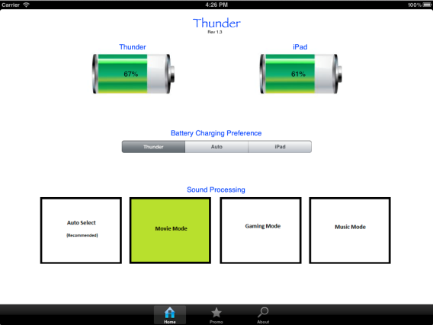
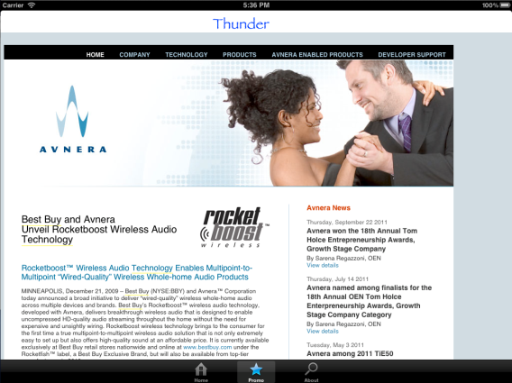
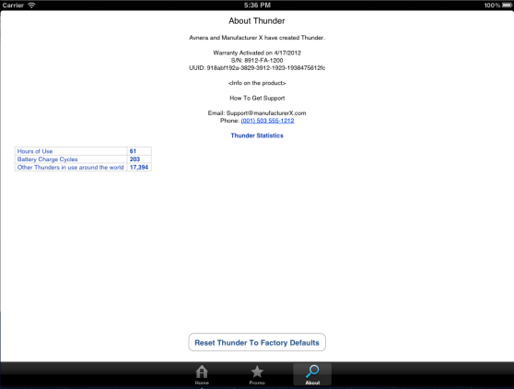
Thunder App Tabs
Home
Promo
About

