Slide 1
Image Viewing Console r1
Design and Pattern Usage
Project Code: Petulant-Batman

Slide 2
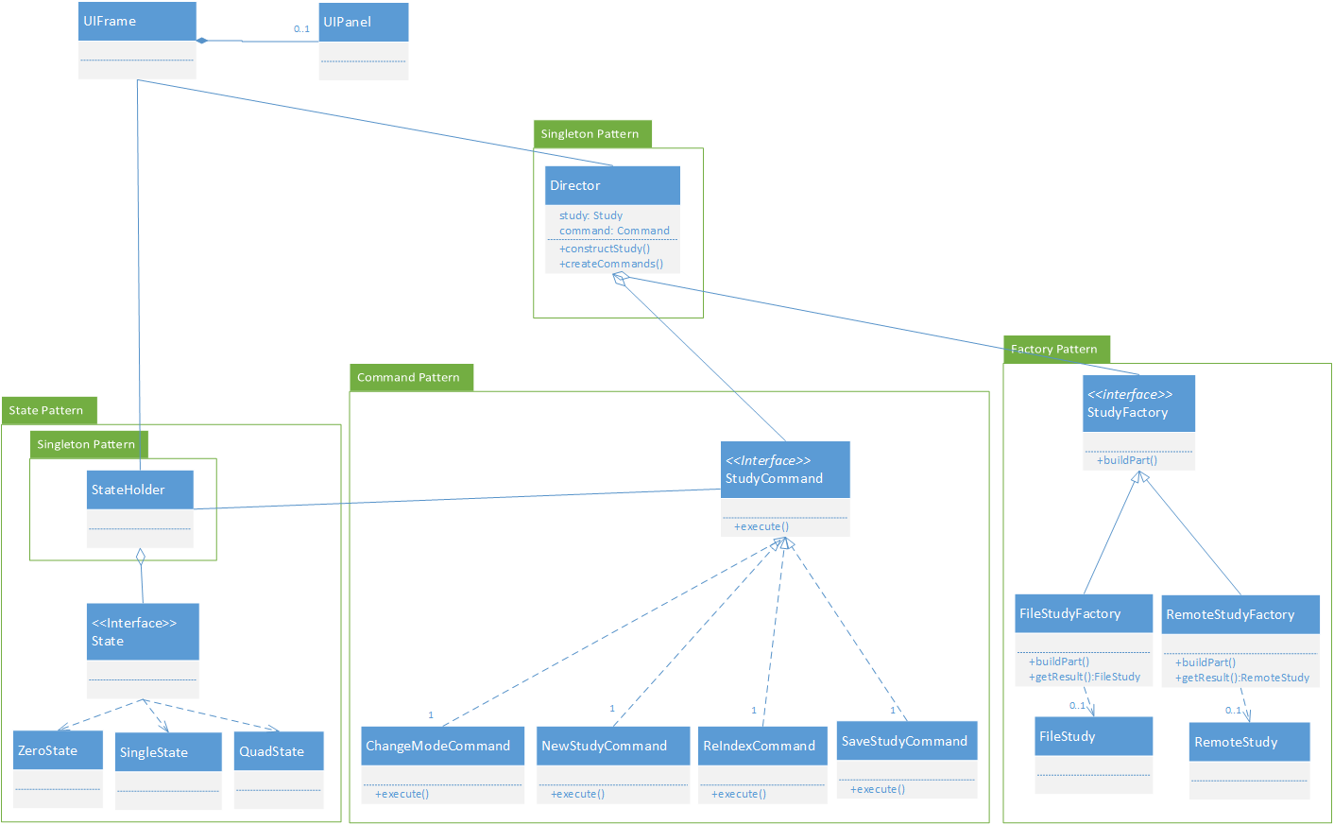
Discussion of the design

Slide 3
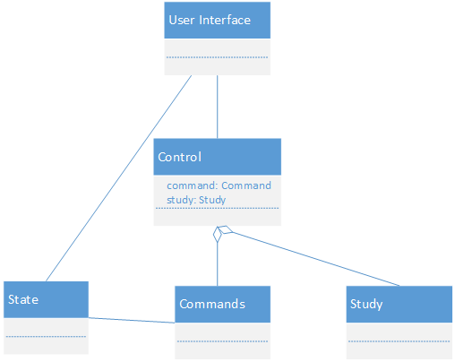
Overall System

Slide 4
Overall System
A singleton creates and holds the active study
Commands are created when the program starts
Commands are stored in the singleton
A State machine exists to inform the system of how many pictures are currently being displayed

Slide 5
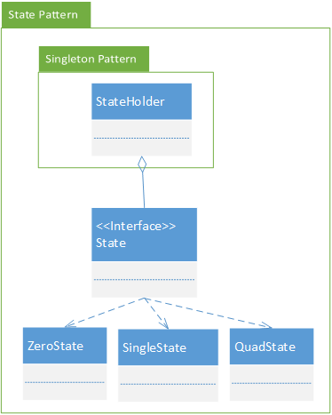
State Pattern

Slide 6
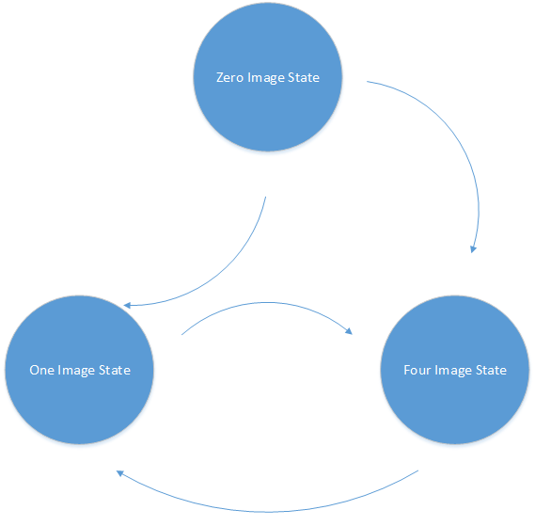
State Pattern
The state pattern exists for two reasons
to control how the commands act
to control what the GUI displays
The system can be in three different states
A singleton exists to hold the current state object
Allows both the GUI and the commands to change their behavior at run time without complicated if statements

Slide 7
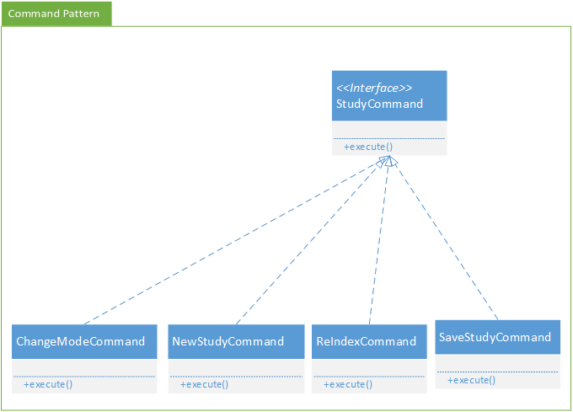
Command Pattern

Slide 8
Command Pattern
Commands are created by, and stored in the singleton
These can be accessed by the GUI
Commands are only created once when the Singleton is instantiated
Commands have different behavior based on the system’s state
These commands can be called at any time by the UI
Simplifies GUI classes by encapsulating functionality in cohesive separate classes

Slide 9
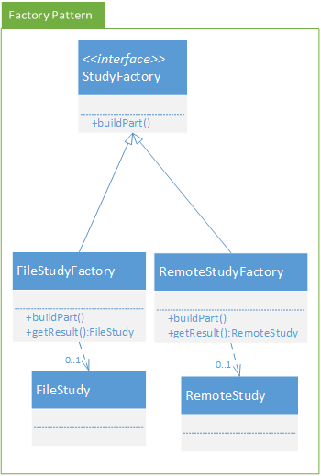
Factory Pattern

Slide 10
Factory Pattern
Factory is used here to enable polymorphism
allows for the addition of a remote study
Allows different types of studies to be created
Controller singleton acts as the director, constructing and holding the product

Slide 11
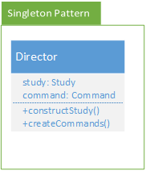
Singleton Pattern

Slide 12
Singleton Pattern
The singleton used in this design acts as the controller
The User Interface is only aware of this class and the state of the system
The singleton restricts the gui to accessing only the current study, and the commands it is allowed to use
An anti-pattern is avoided by removing all functionality except the functionality needed to provide the UI with the study and the commands, and the ability to create the commands and the study
This achieves the purpose of a singleton by coordinating the actions across the system except for the state

Slide 13
How your design choices support the project requirements
Study builder allows easy implementation of different ways to access studies
State pattern provides an easy way for the entire system to know what mode the UI is currently displaying
The study object contains all the information needed to save a study and its current state

Slide 14
Identification of design pattern usage
Command pattern for separating the methods for dealing with changing Study State
Builder Pattern to handle building a generic Study pattern based on the location and type of connection(network/file)
State pattern to deal with 4 image mode vs 1 image mode

Slide 15
Discussion of the difficulties encountered in creating the design
Difficulty creating commands that would always work with the UI
Differing opinions on where and how to store the current state object
Difficulty keeping functionality out of the controller class without overcomplication of the system

Slide 16
Strengths and weaknesses of your design
Strengths
Forward compatibility
State allows for more display modes
Command allows for more commands to be added
Builder allows different types of studies to be implemented
Separation of model and view via controller
Efficient command creation
Cohesive objects
Low coupling
Weaknesses
Complicated design
Large overhead
Director singleton may not be as cohesive as originally planned

Slide 17
Questions?

