Slide 1
Artificial Intelligence: Cambio carsharing
Maxim Aelterman
Robbe Goovaerts
Paul Albert Leroy
Notes:
Paul

Slide 2
Overview
Solution representation
Initial solution
Algorithm A
Algorithm B
Experiments
Strength – weakness analysis
Notes:
Paul

Slide 3
Solution representation
Notes:
Paul

Slide 4
Solution representation
Areservatie
resId | ID of the reservation
voertuigId | ID of assigned vehicle. NULL means no vehicle assigned.
penalty1 | Copy of penalty1 from the data. Copy for faster computation.
penalty2 | Copy of penalty2 from the data. Copy for faster computation.
AVoertuig | Pointer to vehicle object.
Notes:
Paul

Slide 5
Solution representation
AVoertuig
voertuigId | ID of the vehicle
zoneId | ID of assigned zone.
reservaties | This is a list of all reservation which this vehicle got assigned to.
Notes:
Paul

Slide 6
Initial solution
Notes:
Robbe

Slide 7

Initial solution
R3
R1
R2
Notes:
Robbe

Slide 8
Algorithm A
Notes:
Robbe

Slide 9
Algorithm A
R3
R1
R2
Notes:
Robbe

Slide 10
Algorithm B
Notes:
Maxim

Slide 11
Algorithm B
start
Get random reservation
Get vehicle
Y
Is vehicle possible?
Assign vehicle
N
N
End of vehicle list?
Y
Find unassigned vehicle &
assign to reservation
Notes:
Maxim

Slide 12
Experiments
Notes:
Paul

Slide 13
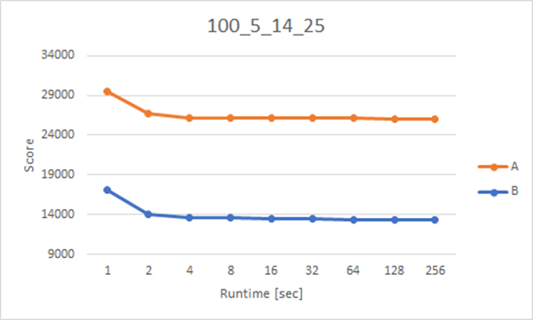
Experiments: 100 reservations
Notes:
Paul
Start big increase
Difference gap between A and B

Slide 14
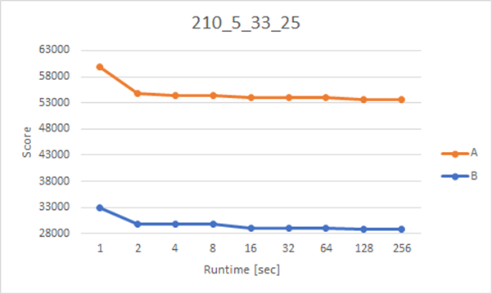
Experiments: 210 reservations
Notes:
Paul

Slide 15
Strength – weakness analysis

Slide 16
Strength – weakness analysis
Algorithm A:
Strengths
Randomness
Easy to understand
Weaknesses
Only 2 reservations maximum to a vehicle
Algorithm B:
Strengths
Fast solution
Better score than Algorithm A
Easy to understand
Weaknesses
Starting from initial solution per iteration
Better for small datasets
Notes:
Maxim en Robbe
We can generate every possible solution because of the randomness

Slide 17
Thank you for your attention.
Questions?

