Slide 1
Computer Architectures Session 3
Pipelined RISC-V processor with control-hazard handling
&
Advanced acceleration
TAs :
Jun Yin (jun.yin@kuleuven.be)
Yuanyang Guo (yuanyang.guo@imec.be)
Xiaoling Yi (xiaoling.yi@kuleuven.be)
Yunzhu Chen (yunzhu.chen@imec.be)

Slide 2

Timeline
Final Schedule
Submission Deadline [May-2]
Session 1
Session 2
Session 3
Session 4
[Mar-05/06]
[Apr-02/03]
[Apr-23/24]
[May-7/8]
Functional single cycle processor
Single cycle processor with multiplication
Pipelined processor
Control hazard resolution
Project Feedback
Data hazard resolution
Advanced acceleration
Written Exam Exercises
Simulation
Backend flow (synthesis-only)

Slide 3

Last session recap
Session 1
Session 2
Session 3
[Apr-02/03]
Single cycle processor skeleton
Functional single cycle processor
Single cycle processor with multiplication
Pipelined processor
Pipelined processor with data hazard resolution
Advanced acceleration
Simulation
Backend flow (synthesis-only)
Backend flow (complete)

Slide 4
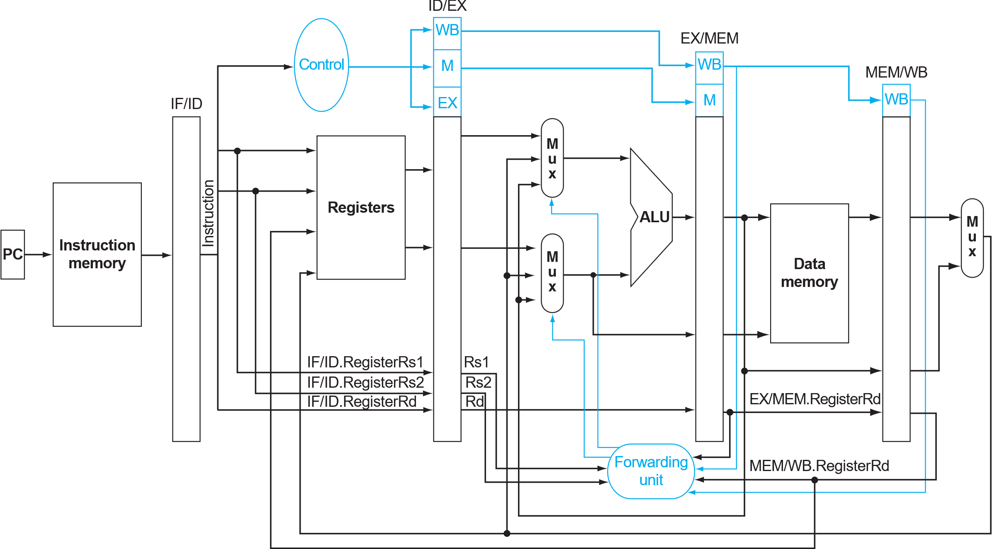
Last session recap
Pipelined Processor
Mult2
Mult3
Backend complete
Prerequisite for this session!

Slide 5
Today’s session: Advanced acceleration
Session 1
Session 2
Session 3
[Apr-02/03]
Single cycle processor skeleton
Functional single cycle processor
Single cycle processor with multiplication
Pipelined processor
Pipelined processor with data hazard resolution
Advanced acceleration
Simulation
Obj-1: mult4
Backend flow (synthesis-only)
Backend flow (complete)

Slide 6
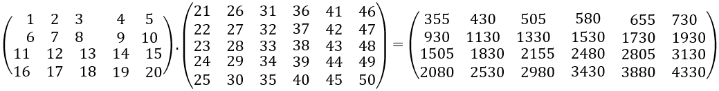
Obj-1: mult4
(B = 4 , C = 5, K = 6)
Testing example:
Matrix-matrix multiplication (MULT4)
Input matrices stored in mult4_dmem_content.txt
Methods
Add more RTL modules
Modify the mult4_imem program
or both …
Pass the simulation
Synthesize
I[B][C]
W[C][K]
O[B][K]
Data memory layout:
[Addr/8]
0
19
20
49
50
73
0x1
0x2
0x3
…
0x15
0x16
0x17
…
0x163
0x1AE
0x1F9
…
I[B][C]
(given)
Row-major
W[K][C]
(given)
Column-major
Results are written back to this part of the data memory
O[B][K]
(expected)
Row-major
We check on this part!
Notes:
[Jun-0324]:
+ dmem addr index
+ dmem data layout

Slide 7
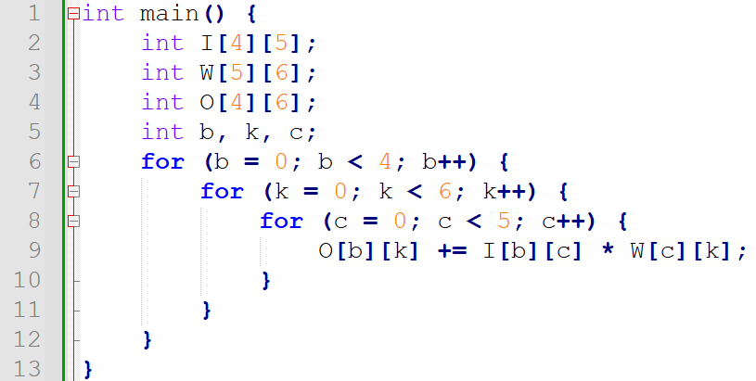
MULT4: our baseline solution
RISC-V assembly code
C code:
addi x25, x0, 0 # input's address starting point in dmem addi x26, x0, 160 # weight's address starting point in dmem addi x27, x0, 600 # output's address starting point in dmem addi x11, x0, 5 # total C loop size addi x12, x0, 6 # total K loop size addi x13, x0, 4 # total B loop size addi x21, x0, 0 # C loop index starts with 0 addi x22, x0, 0 # K loop index starts with 0 addi x23, x0, 0 # B loop index starts with 0 addi x7, x0, 0 # accumulation result initialization B_CHECK: beq x23, x13, B_END K_CHECK: beq x22, x12, K_END C_CHECK: beq x21, x11, C_END ld x4, 0(x25) # load 1 input data ld x5, 0(x26) # load 1 weight data mul x6, x4, x5 # multiply the input with the weight add x7, x7, x6 # accumulate the result addi x21, x21, 1 # C loop index +1 addi x25, x25, 8 # input's 64-bit word address +1 addi x26, x26, 8 # weight's 64-bit word address +1 jal C_CHECK C_END: addi x21, x0, 0 # C loop index restarts with 0 sd x7, 0(x27) # store the output data addi x7, x0, 0 # accumulation result reset to 0 addi x22, x22, 1 # K loop index +1 addi x25, x25, -40 # input's 64-bit word address -5 addi x27, x27, 8 # output's 64-bit word address +1 jal K_CHECK K_END: addi x22, x0, 0 # K loop index restarts with 0 addi x23, x23, 1 # B loop index +1 addi x25, x25, 40 # input's 64-bit word address +5 addi x26, x26, -240 # input's 64-bit word address -30 jal B_CHECK B_END:
I[B][C]
W[C][K]
O[B][K]
Testing example:
(B = 4 , C = 5, K = 6)
I[B][C]
W[C][K]
O[B][K]
Required modifications to the processor
Full data forwarding logic
Hazard detection unit (control/data hazard)
Notes:
[Jun-0324]:
+ diagram
+ todo list

Slide 8
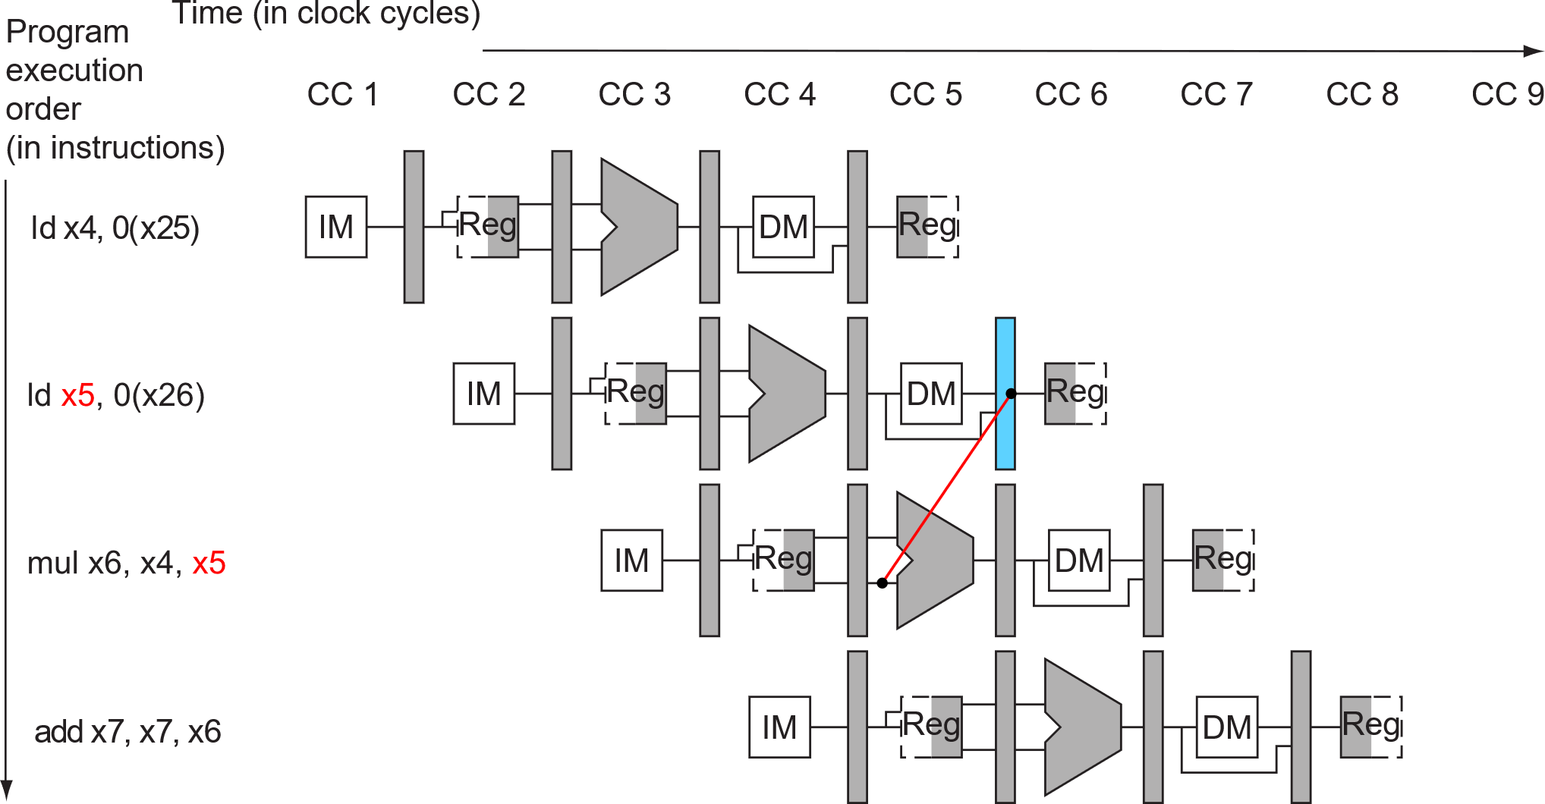
I. Full data forwarding logic (Book §4.7)
MULT4:
addi x25, x0, 0 # input's address starting point in dmem addi x26, x0, 160 # weight's address starting point in dmem addi x27, x0, 600 # output's address starting point in dmem addi x11, x0, 5 # total C loop size addi x12, x0, 6 # total K loop size addi x13, x0, 4 # total B loop size addi x21, x0, 0 # C loop index starts with 0 addi x22, x0, 0 # K loop index starts with 0 addi x23, x0, 0 # B loop index starts with 0 addi x7, x0, 0 # accumulation result initialization B_CHECK: beq x23, x13, B_END K_CHECK: beq x22, x12, K_END C_CHECK: beq x21, x11, C_END ld x4, 0(x25) # load 1 input data ld x5, 0(x26) # load 1 weight data mul x6, x4, x5 # multiply the input with the weight add x7, x7, x6 # accumulate the result addi x21, x21, 1 # C loop index +1 addi x25, x25, 8 # input's 64-bit word address +1 addi x26, x26, 8 # weight's 64-bit word address +1 jal C_CHECK C_END: addi x21, x0, 0 # C loop index restarts with 0 sd x7, 0(x27) # store the output data addi x7, x0, 0 # accumulation result reset to 0 addi x22, x22, 1 # K loop index +1 addi x25, x25, -40 # input's 64-bit word address -5 addi x27, x27, 8 # output's 64-bit word address +1 jal K_CHECK K_END: addi x22, x0, 0 # K loop index restarts with 0 addi x23, x23, 1 # B loop index +1 addi x25, x25, 40 # input's 64-bit word address +5 addi x26, x26, -240 # input's 64-bit word address -30 jal B_CHECK B_END:
Notes:
[Jun-0324]: + slide order change

Slide 9
I. Full data forwarding logic (Book §4.7)
MULT4:
Another data forwarding scenario
Beyond data forwarding
Can’t get data from the future.
We need to stall the “mul” instruction.
Similar to the case in MULT3
Notes:
[Jun-0324]:
- replace “Forwarding already known results”
- delete the 2nd arrow: it was not covered/needed previously. Part of this session’s forwarding — the data forwarding after 1-cycle stall.
+ condition explanation

Slide 10
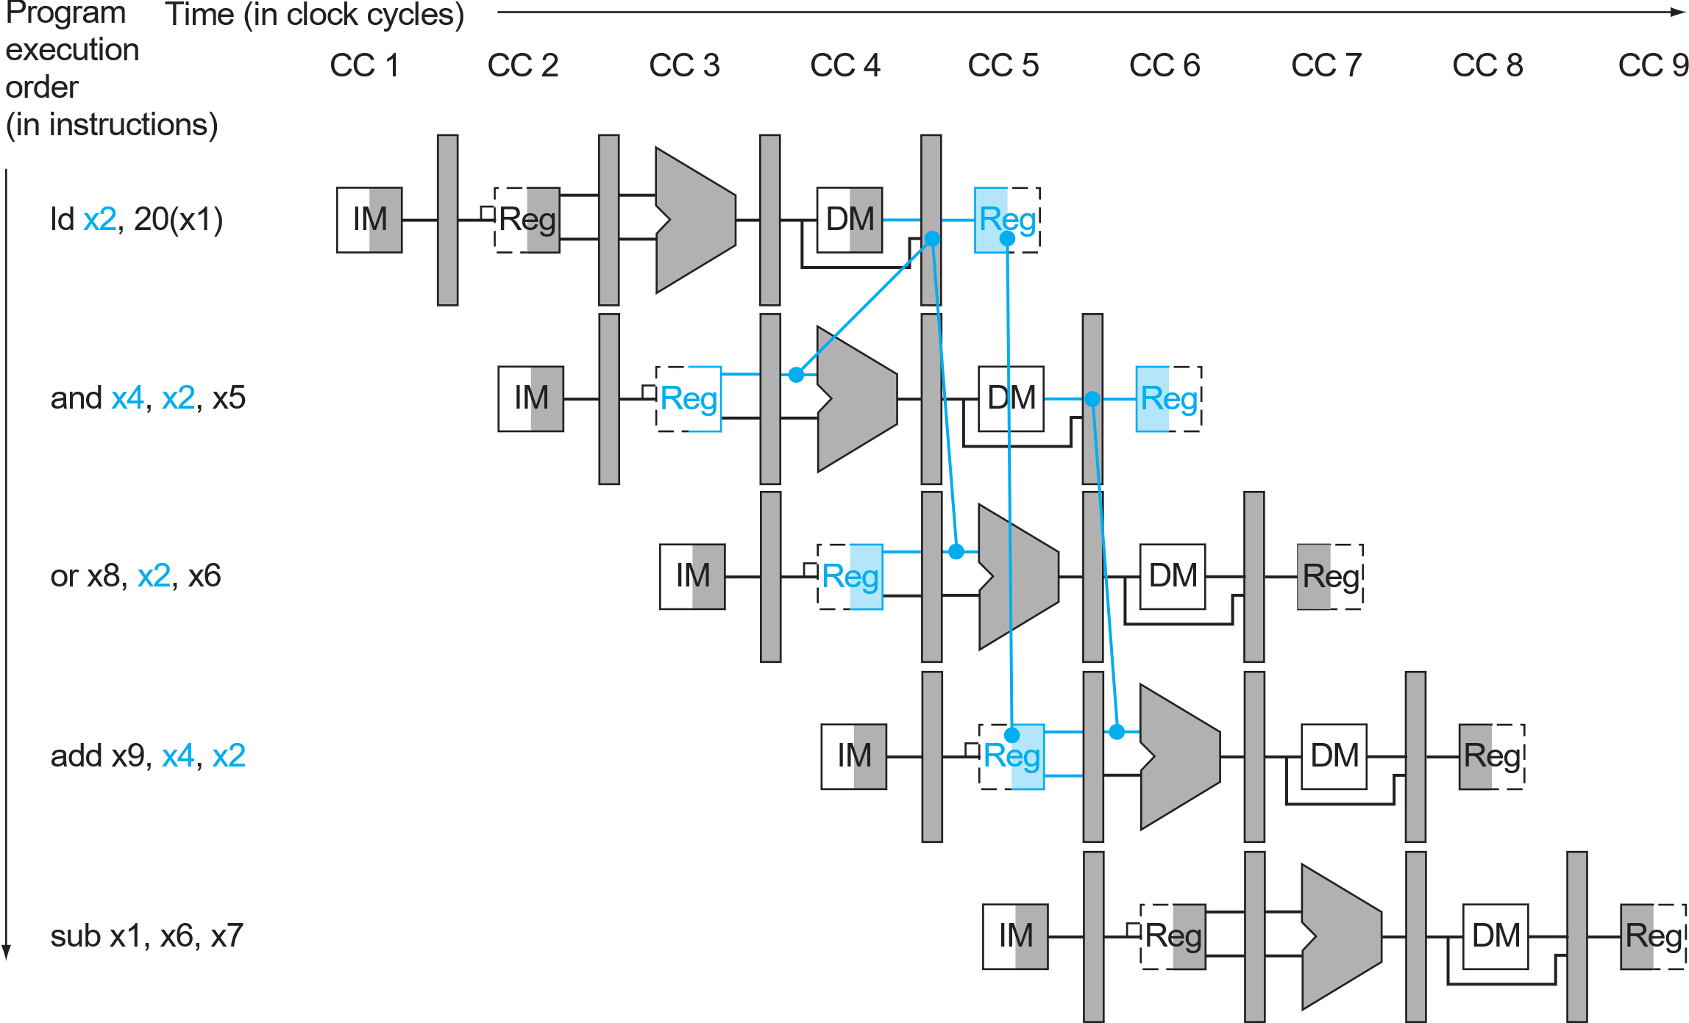
II. Data hazard resolution with stalling
Load and use
Patterson Book. FIGURE 4.56
Notes:
[Jun-0324]: + explanation

Slide 11
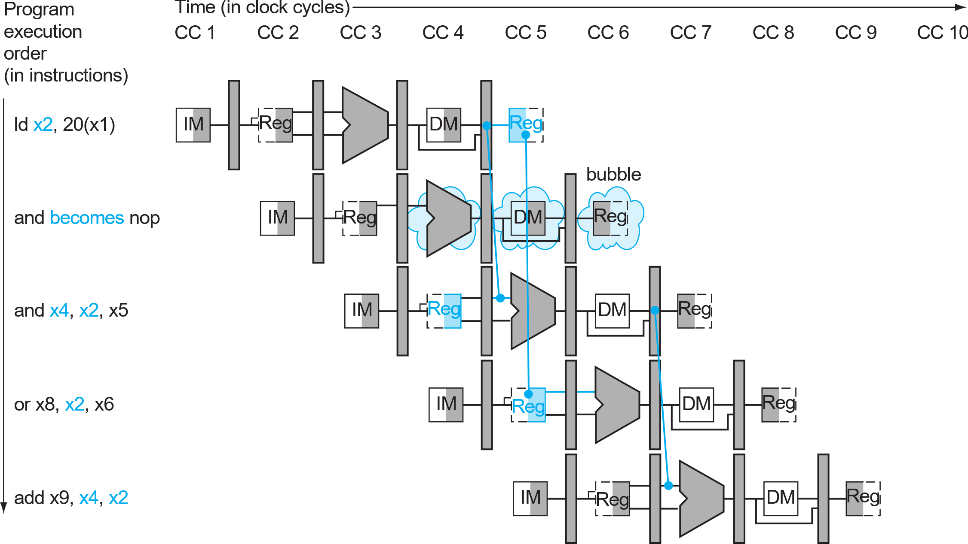
II. Data hazard resolution with stalling
After 1-cycle stall, the hazard between [ld] and [and] becomes a normal WB->EX forwarding.
Load and use
Notes:
[Jun-0324]: + explanation

Slide 12
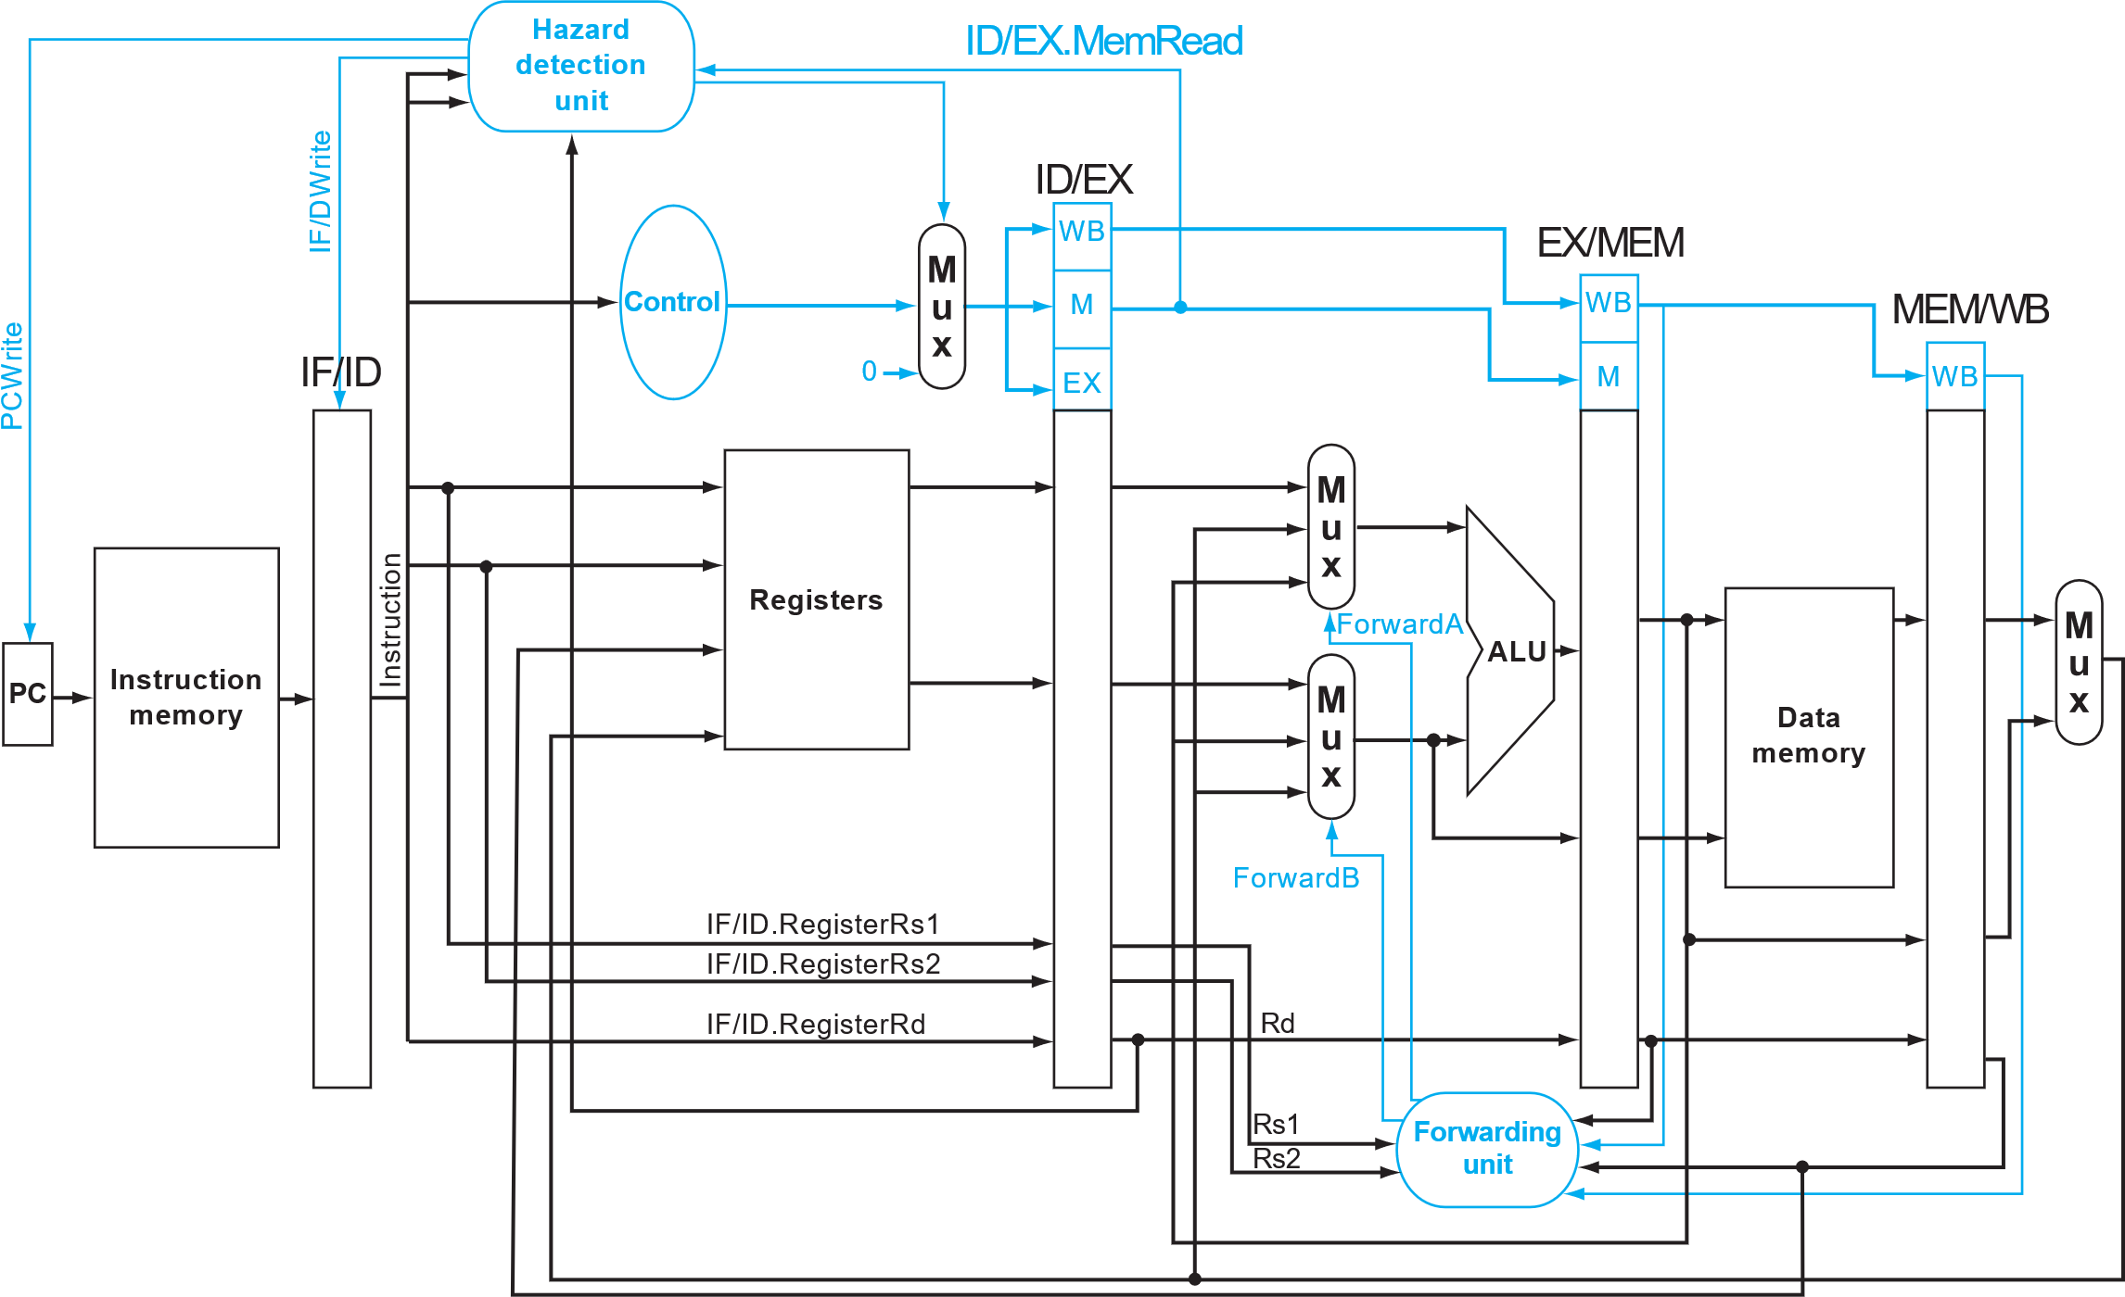
II. Data hazard resolution with stalling
1.
Add bubble to control signal if stall
To be implemented:
Stall
WB->EX forwarding (register_file)
Prevent PC and IF/ID register updates if hazard is detected
2.
Patterson Book. FIGURE 4.58

Slide 13
II. Data hazard resolution with stalling
After 1-cycle stall, the hazard between [ld] and [and] becomes a normal WB->EX forwarding.
Load and use
Now we need the register file forwarding here after stalling.
Notes:
[Jun-0324]: + explanation

Slide 14
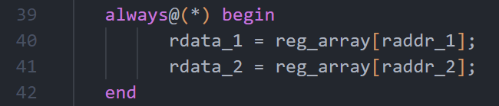
I. Full data forwarding logic (Book §4.7)
MULT4:
Register file data forwarding
Modify the register_file.v
Think:
In which case should you forward the wdata to rdata?
Notes:
[Jun-0324]:
- replace “Forwarding already known results”
- delete the 2nd arrow: it was not covered/needed previously. Part of this session’s forwarding — the data forwarding after 1-cycle stall.
+ condition explanation

Slide 15
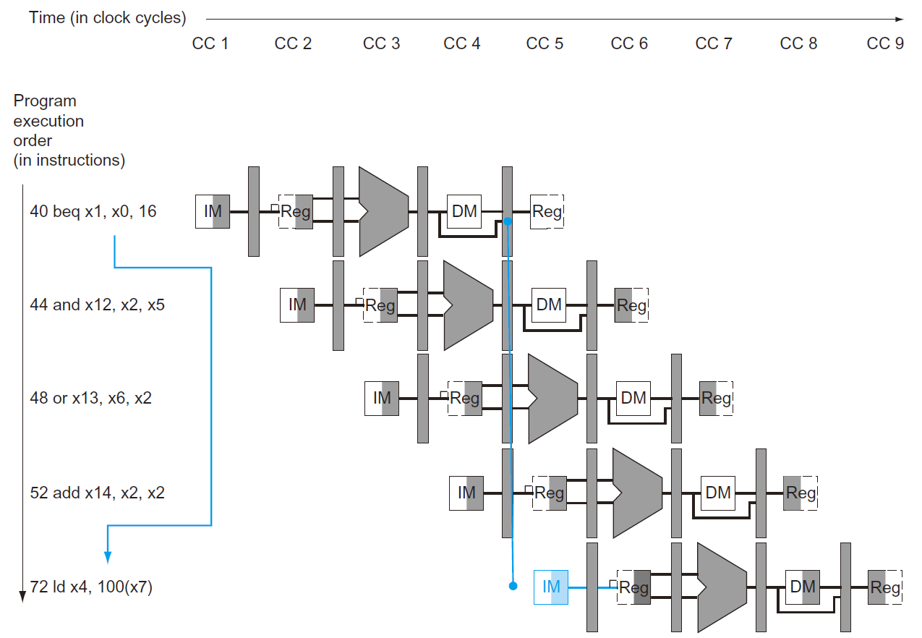
III. Control Hazard solution (Book §4.8)
MULT4:
Control Hazard:
addi x25, x0, 0 # input's address starting point in dmem addi x26, x0, 160 # weight's address starting point in dmem addi x27, x0, 600 # output's address starting point in dmem addi x11, x0, 5 # total C loop size addi x12, x0, 6 # total K loop size addi x13, x0, 4 # total B loop size addi x21, x0, 0 # C loop index starts with 0 addi x22, x0, 0 # K loop index starts with 0 addi x23, x0, 0 # B loop index starts with 0 addi x7, x0, 0 # accumulation result initialization B_CHECK: beq x23, x13, B_END K_CHECK: beq x22, x12, K_END C_CHECK: beq x21, x11, C_END ld x4, 0(x25) # load 1 input data ld x5, 0(x26) # load 1 weight data mul x6, x4, x5 # multiply the input with the weight add x7, x7, x6 # accumulate the result addi x21, x21, 1 # C loop index +1 addi x25, x25, 8 # input's 64-bit word address +1 addi x26, x26, 8 # weight's 64-bit word address +1 jal C_CHECK C_END: addi x21, x0, 0 # C loop index restarts with 0 sd x7, 0(x27) # store the output data addi x7, x0, 0 # accumulation result reset to 0 addi x22, x22, 1 # K loop index +1 addi x25, x25, -40 # input's 64-bit word address -5 addi x27, x27, 8 # output's 64-bit word address +1 jal K_CHECK K_END: addi x22, x0, 0 # K loop index restarts with 0 addi x23, x23, 1 # B loop index +1 addi x25, x25, 40 # input's 64-bit word address +5 addi x26, x26, -240 # input's 64-bit word address -30 jal B_CHECK B_END:

Slide 16
III. Control Hazard solution (Book §4.8)
Branch Unit ?
We missed our Branch Unit!
Not used in MULT2 & MULT3
But will be useful here for
BR instruction
JAL instruction
Which pipeline should we put it to?
What is its input?
How is the data computed?
Who is using its output?

Slide 17
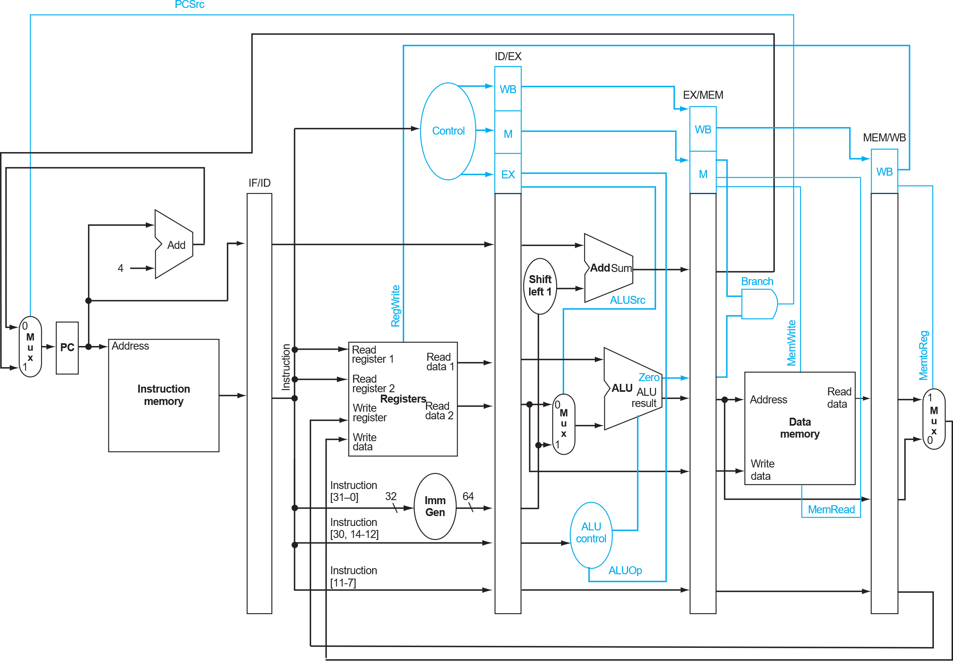
III. Control Hazard solution (Book §4.8)
Recall §4.6:
We know if the branch was taken at the MEM stage.
Patterson Book. FIGURE 4.49

Slide 18
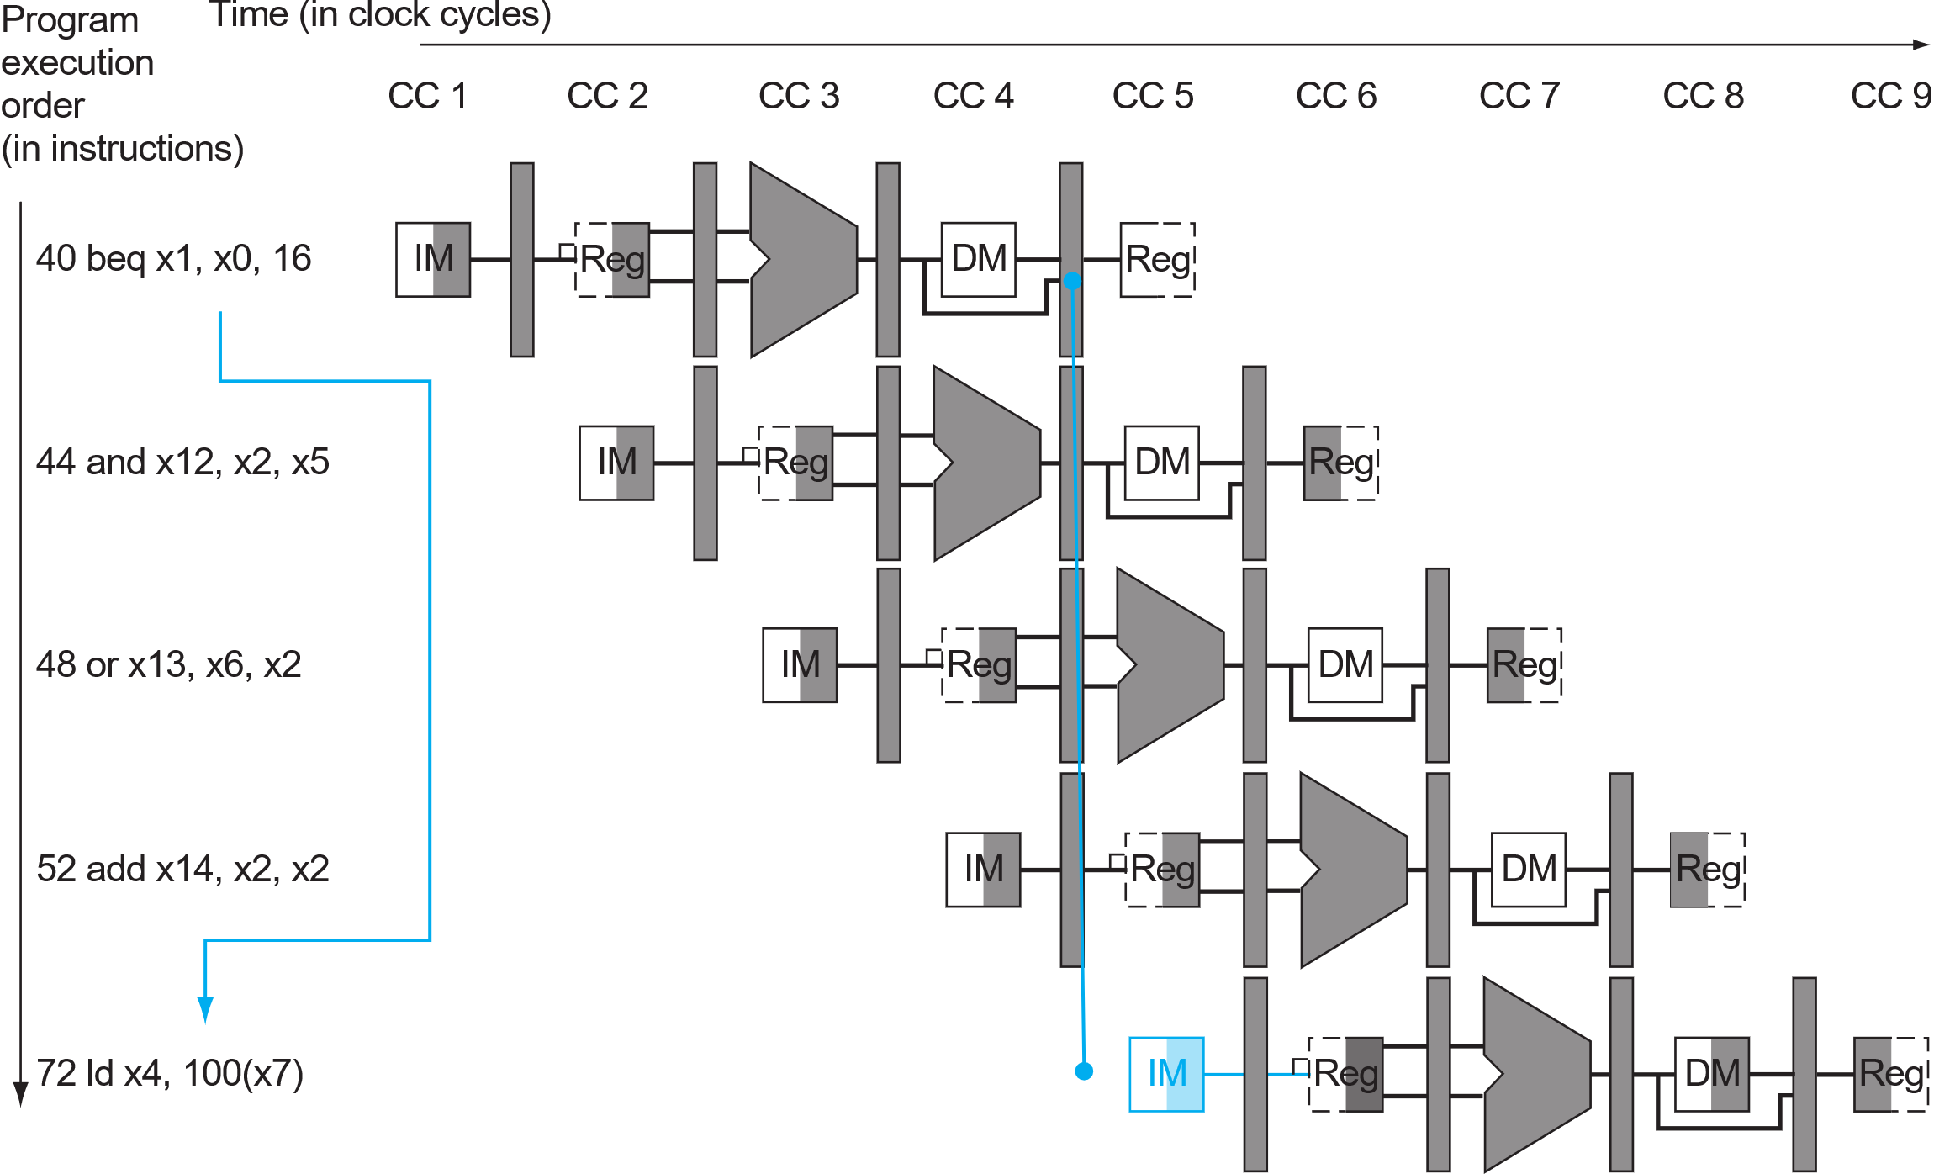
III. Control Hazard solution (Book §4.8)
Such solution comes at a cost…
Recall §4.6:
By that time, 3 instructions are already in the pipeline.
They should be discarded, hence 3 cycles are wasted (§4.8.1).
These should be discarded
Branch was taken

Slide 19
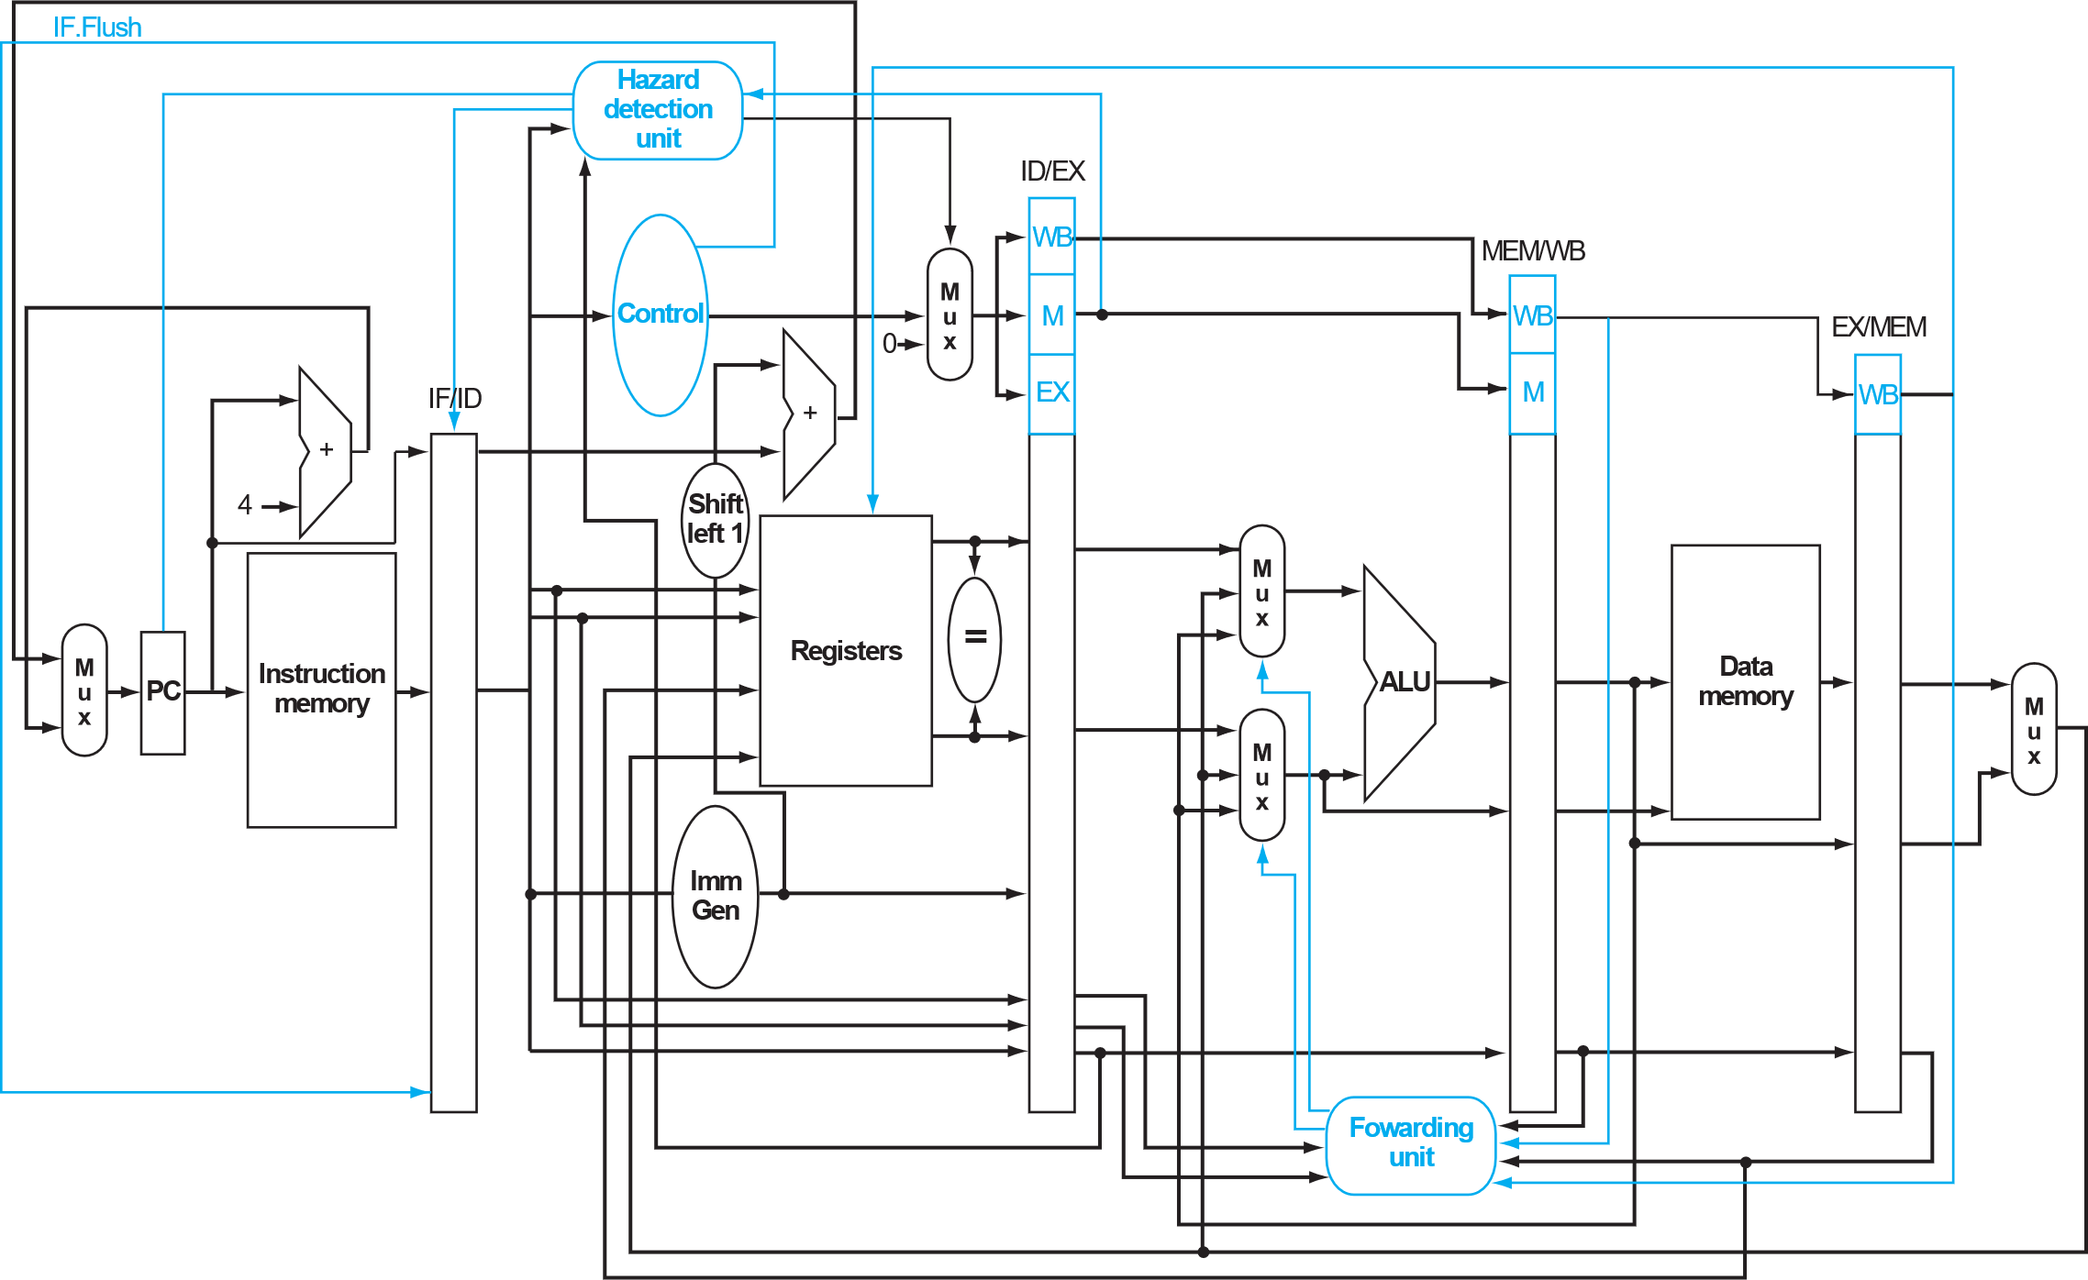
Control Hazard - Our baseline
To save this overhead:
Make branch/jump decision ASAP (at the ID stage, §4.8.2).
This is our baseline architecture for MULT4 (in terms of saving the total cycle amount).
branch_unit (pc value)
We still use the branch-not-taken prediction (in our baseline).
ID judges the branch/jump.
IF basically fetches imem[PC+4].
If branch-taken/jump, next PC is overwritten and the false IF instruction is flushed before next clock edge comes.
Feel free to use different prediction scheme if you find it valuable(§4.8.3).
branch
taken?
Flush instruction if branch is taken (§4.8.2)
Patterson Book. FIGURE 4.62

Slide 20
IV. PLAN B – hazards can be solved with nop insertion
Recall MULT2, the software solution.
[Fail-Safe] If the deadline is right ahead,
at least make your processor functional on MULT4!
Understand the program, locate the hazard, understand your design, upgrade the imem…
addi x25, x0, 0 # input's address starting point in dmem addi x26, x0, 160 # weight's address starting point in dmem addi x27, x0, 600 # output's address starting point in dmem addi x11, x0, 5 # total C loop size addi x12, x0, 6 # total K loop size addi x13, x0, 4 # total B loop size addi x21, x0, 0 # C loop index starts with 0 addi x22, x0, 0 # K loop index starts with 0 addi x23, x0, 0 # B loop index starts with 0 addi x7, x0, 0 # accumulation result initialization B_CHECK: beq x23, x13, B_END nop nop nop K_CHECK: beq x22, x12, K_END nop nop nop C_CHECK: beq x21, x11, C_END nop nop nop
ld x4, 0(x25) # load 1 input data ld x5, 0(x26) # load 1 weight data nop mul x6, x4, x5 # multiply the input with the weight add x7, x7, x6 # accumulate the result addi x21, x21, 1 # C loop index +1 addi x25, x25, 8 # input's 64-bit word address +1 addi x26, x26, 8 # weight's 64-bit word address +1 jal C_CHECK nop nop nop C_END: addi x21, x0, 0 # C loop index restarts with 0 sd x7, 0(x27) # store the output data addi x7, x0, 0 # accumulation result reset to 0 addi x22, x22, 1 # K loop index +1 addi x25, x25, -40 # input's 64-bit word address -5 addi x27, x27, 8 # output's 64-bit word address +1 jal K_CHECK nop nop nop K_END: addi x22, x0, 0 # K loop index restarts with 0 addi x23, x23, 1 # B loop index +1 addi x25, x25, 40 # input's 64-bit word address +5 addi x26, x26, -240 # input's 64-bit word address -30 jal B_CHECK nop nop nop B_END:
Don’t just copy and paste this one!
Understand your architecture and insert the necessary nops.
Hazard control and nop insertion are related
The better hazard control logic you have,
The fewer nops you will need,
The better performance you will achieve.

Slide 21
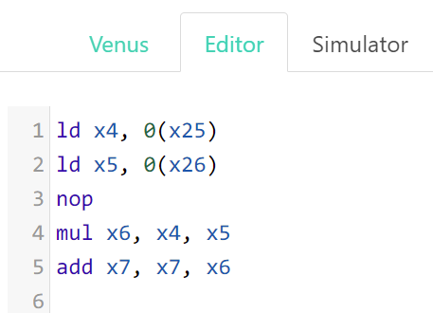
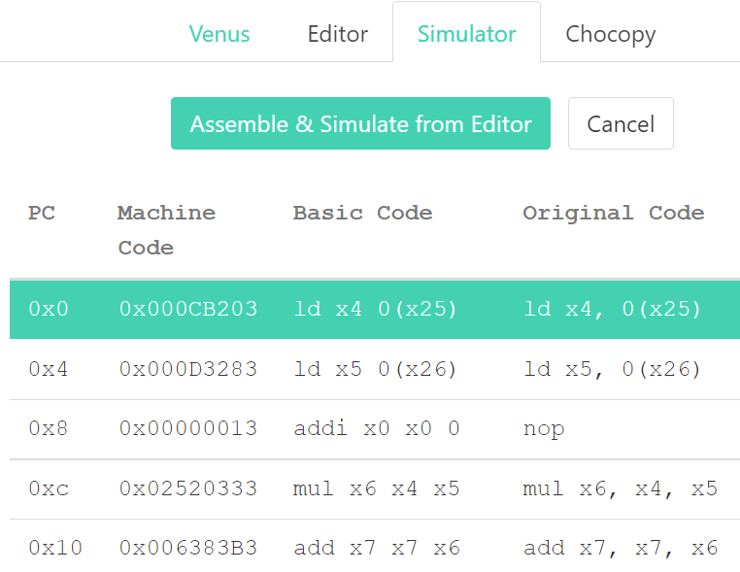
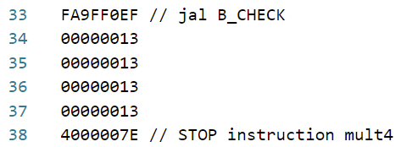
IV. PLAN B – hazards can be solved with nop insertion
Whenever you change the program, DO NOT FORGET to regenerate the machine code (imem_content)!
Make use of the online tool we mentioned in session-1 (link-online-converter, link-github).
1. Paste your assembly code in Editor.
2. Go to Simulator and click the Green button.
3. Upgrade the imem_content (remove “0x”!).
4. Never forget to add the finishing lines. 👇

Slide 22
Today’s session: task summary
With session_guide.pdf
Study the RUN CYCLE-ACCURATE SIMULATION and RUN BACKEND FLOW
Follow the TASKS TO BE DONE and fill in the report.docx
Copy-paste your finished /RTL/*.v into the SOLUTION folders.
Obj-1 → RTL_SOLUTION5_pipeline_hazard_advanced_MULT4
Note:
We use universal test patterns for fair grading.
Do not modify cpu_tb.v & sky130_sram_2rw.v
Do not modify mult4_dmem_content.txt
This time you can modify mult4_imem_content.txt

Slide 23
Grading
Be creative
ITEM | Points
Functional pipelined MULT2 | 0.5
Functional pipelined MULT3 | 0.5
Functional MULT4 | 0.4
Functional MULT4 #cycles ≤ baseline impl. (1636 cc) | 0.8
Advanced MULT4 #cycles ≤ advanced impl. (828 cc) | 0.8
Report | 1.0
Total | 4.0
Useful resources to make it go faster!
Patterson Book. End of section 4.8 on branch prediction tricks.
Patterson Book. From Section 4.10 on advanced acceleration tricks.
RISC-V specification. Chapter 17 on the “V” Standard Extension for Vector Operations
Project handover
Deadline: May 2nd

