Slide 1
Dynamic export limits for prosumers
PPC SMARTHACK XI · 24H TO POWER PPC
An AI agent decides, every 30 minutes, how much each house under a transformer station may export to the grid, so less solar energy is wasted and the grid stays safe.
Everything shown is simulated.
Notes:
We built an agent that decides how much each house with solar panels may export right now, instead of one fixed limit for the whole year. Everything we show is simulated: the grid is synthetic and the household data is Australian.

Slide 2
Prosumers complain they are capped and lose what they produce
A GROWING CROWD
INVERTERS TRIP
A FIXED CAP
332,684
253.40 V
20.6%
prosumers in Romania on 30 April 2026
measured in Botoșani, above the trip level: production is lost
of the exportable surplus is clipped by a fixed limit of 36% of kWp (our simulation)
25 kW of panels, 9 kW allowed into the grid. The limit is set once, from grid capacity, not from the sun or the day’s consumption.
Sources: ANRE and operators, energy press (confidence levels in docs/06). The 20.6% comes from our simulation (docs/04).
Notes:
Prosumers say they are limited and that they lose energy they produce. Romania has over 330,000 of them, inverters trip on overvoltage, and one prosumer with 25 kW of panels may send only 9 kW. In our simulation a fixed limit clips about a fifth of the surplus.

Slide 3
Predict the highest safe limit, check it, act
1
FORECAST
2
GUARD
3
ACT
A model trained by us
A power-flow check
A limit for every house
Quantile regression predicts the highest safe limit one hour ahead, using a cautious 5% quantile.
The whole station is recomputed with the plan’s limits. Voltage, line or transformer overload: the plan is rejected.
Renewed every 30 minutes. Each decision comes with its main factors and goes into an append-only action log.
When the model is unsure, it says so. The agent falls back to the fixed limit and sends the case to a person. There is a kill switch.
A simulation check, not a certified protection system. Code: src/ml, src/agent, src/grid.
Notes:
Our idea in three steps. A model we trained predicts the highest safe limit one hour ahead. A guard re-computes the whole station and rejects unsafe plans. The agent acts, explains and logs. When it is unsure it falls back to the fixed limit and asks a person.

Slide 4
From 41.5% lost to 14.0%, with no overload
One simulated day · 50,078 houses · 507 neighbourhoods · energy that would reach the grid without a limit: 1,325 MWh
LOST ENERGY
550 → 185 MWh
365 MWh recovered in one day
NEIGHBOURHOOD-HOURS WITH PROBLEMS
296 → 0
with no limit at all: 1,466
Honest caveat: the dynamic limit here is the safe limit computed by physics for each neighbourhood, the best our model can approach. In a separate test year the model exports 101–131 against a fixed limit of 100, with at most 2.0% of intervals over the limit when it falls back to the fixed limit. German test grids, Australian household data, not PPC’s network.
Source: docs/04 (simulation).
Notes:
Before: a fixed limit loses 550 megawatt-hours in one simulated day, 41.5% of what would reach the grid, and still leaves 296 neighbourhood-hours with problems. After: the dynamic limit loses 185, 14.0%, and no neighbourhood-hour has problems. This is simulation, and the dynamic limit here is the physics result the model aims for, not the model itself.

Slide 5
Imported energy vs energy from prosumers
MARKET PRICE (PZU)
WHAT ROMANIA BUYS PER DAY
SAME 125 GWh FROM PROSUMERS
239 EUR/MWh
≈125 GWh
BEST CASE
October 2026 average
about 30 million EUR (estimate)
14.7M EUR
July average, 118 EUR/MWh
July: 118 EUR/MWh
September: 174 EUR/MWh
Day-ahead market: 40 GWh, 9.7 million EUR
Imports: up to 3,400 MW on 3 Oct
Import price not published, we assume PZU
TYPICAL
29.8M EUR
October average, 239 EUR/MWh
Always about 88,000 EUR a day less than buying from outside
We recover 365 MWh a day: 87,000 EUR, 255 EUR saved. A prosumer loses 6.6 → 2.2 EUR a day.
Estimates from one simulated day. Midday prices are lower, so they overstate.
Sources: Economica.net, OPCOM, PPC, Gandul. Lei converted at the BNR rate of 6 Nov. Consumption, savings and prosumer figures are our estimates.
Notes:
The market price is the day-ahead average: 239 euro per megawatt-hour in October 2026, 174 in September and 118 in July. Romania consumes about 125 gigawatt-hours a day by our estimate, about 30 million euro a day; the day-ahead market trades about 40 of them, 9.7 million euro. If prosumers supplied the same 125 gigawatt-hours at the day-ahead price minus the injection tariff, it would cost about 14.7 million euro in the best case, a July-average day, and 29.8 million on a typical October day. In both cases it is about 88,000 euro a day less than buying from outside, which is the tariff of 0.7 euro per megawatt-hour that we could not confirm. The import price is not published, so we assume it equals the day-ahead price. Prosumers could not really supply that much, roughly 10 gigawatt-hours a day or less by a rough estimate. What we do recover is 365 megawatt-hours a day, worth about 87,000 euro, of which about 255 euro is saved on the purchase. One prosumer loses 6.6 euro a day under a fixed limit and 2.2 with ours. Everything is an estimate from a simulated day, and midday prices are lower than the daily average.

Slide 6
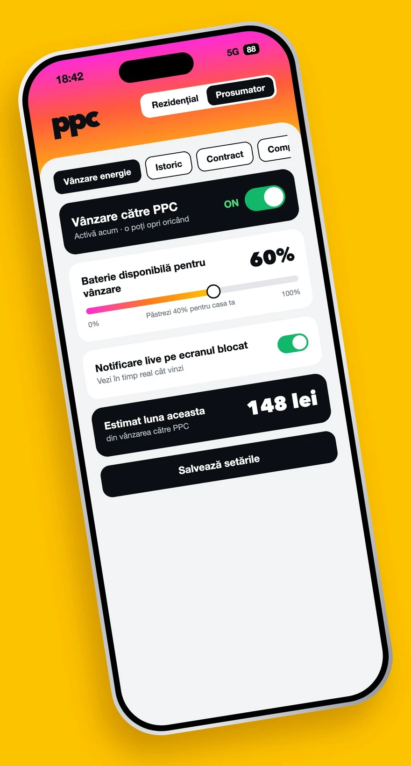
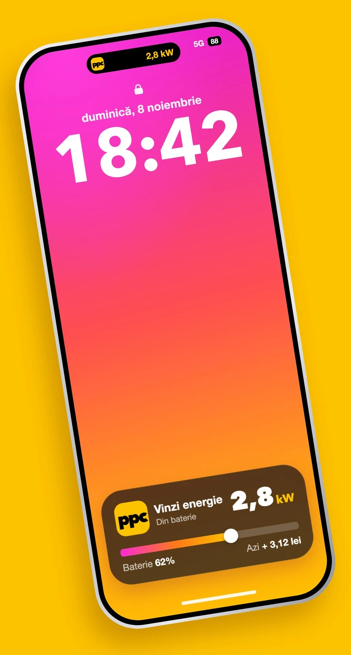
Our app: sell to PPC from your phone
Sell to PPC
One switch, stop any time.
60% of the battery
The rest stays for your home.
Live on the lock screen
2.8 kW sold, battery 62%, +3.12 lei today.
148 lei
estimated this month.
App mock-up; the figures are illustrative.
Notes:
This is our app. A prosumer turns selling to PPC on or off with one switch, sets how much of the battery is available for sale with a slider while the rest stays for the home, and sees the estimate for the month. A live notification on the lock screen shows the power being sold, the battery level and the money earned today. The screens are a mock-up and the figures on them are illustrative.

Slide 7
Thank you for your attention
PPC SMARTHACK XI · 24H TO POWER PPC
Questions?
Notes:
Thank you for your attention. We are happy to take questions.

