Slide 1
An Introduction to Revision Control System
Robbie Cao
Mar, 2010

Slide 2
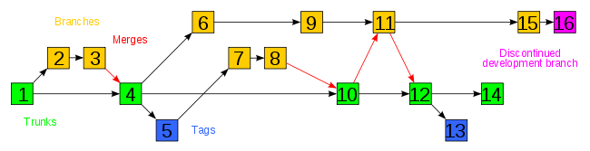
Why We Need Version Control System
Backup and Restore
Synchronization
Short-term undo
Long-term undo
Track Changes
Track Ownership
Sandboxing (or insurance against yourself)
Branching and merging
Notes:
Backup and Restore. Files are saved as they are edited, and you can jump to any moment in time. Need that file as it was on Feb 23, 2007? No problem.
Synchronization. Lets people share files and stay up-to-date with the latest version.
Short-term undo. Monkeying with a file and messed it up? (That’s just like you, isn’t it?). Throw away your changes and go back to the “last known good” version in the database.
Long-term undo. Sometimes we mess up bad. Suppose you made a change a year ago, and it had a bug. Jump back to the old version, and see what change was made that day.
Track Changes. As files are updated, you can leave messages explaining why the change happened (stored in the VCS, not the file). This makes it easy to see how a file is evolving over time, and why.
Track Ownership. A VCS tags every change with the name of the person who made it. Helpful for blamestorming giving credit.
Sandboxing, or insurance against yourself. Making a big change? You can make temporary changes in an isolated area, test and work out the kinks before “checking in” your changes.
Branching and merging. A larger sandbox. You can branch a copy of your code into a separate area and modify it in isolation (tracking changes separately). Later, you can merge your work back into the common area.

Slide 3
Without a Revision Control System
Source/docs missed with longer period
Source code files easily “damaged” in isolated storage, PC lost, HD crash, delete by mistake…
Conflict when access to same code/project in teamwork development
Conflict between multiple individual-development projects based on common baseline
Difficult to rollback to some historical status
Out of control to develop/debug outside MEMSIC facility
Not easy to handover project to the new developers
Long time to setup/duplicate the development status
No change history, no change ownership
…

Slide 4
Terminology
Repository (Repo/Depot): The database storing the files.
Server: The computer storing the repository.
Client: The computer connecting to the repository.
Working Copy: Your local directory of files, where you make changes.
Trunk/Main: The “primary” location for code in the repository. Think of code as a family tree — the “trunk” is the main line.

Slide 5
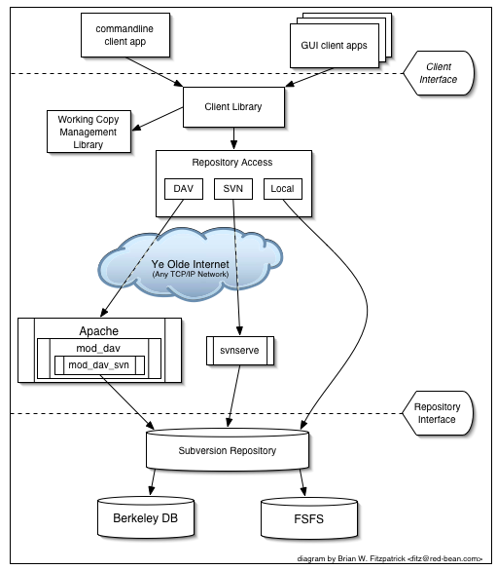
System Architecture

Slide 6
Basic Actions
Add: Put a file into the repo for the first time, i.e. begin tracking it with Version Control.
Revision: What version a file is on (v1, v2, v3, etc.).
Head: The latest revision in the repo.
Check out: Download a file from the repo.
Check in / Commit / Submit: Upload a file to the repository (if it has changed). The file gets a new revision number, and people can “check out” the latest one.
Checkin message: A short message describing what was changed.
Changelog / History: A list of changes made to a file since it was created.
Update / Sync: Synchronize your files with the latest from the repository. This lets you grab the latest revisions of all files.
Revert: Throw away your local changes and reload the latest version from the repository.

Slide 7
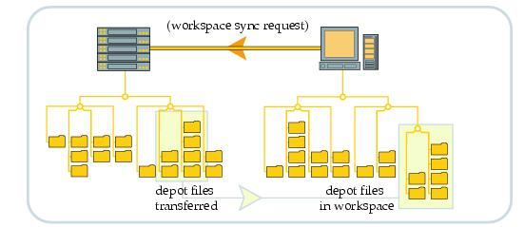
Working Copy

Slide 8



Revisions
0 1 2 3 4
0
1
2
3
4
1
1
1
4
1
1
1
1
1
1
1
1
1
1
1
4
2
3
3
2
2
2
3
3
3
3

Slide 9
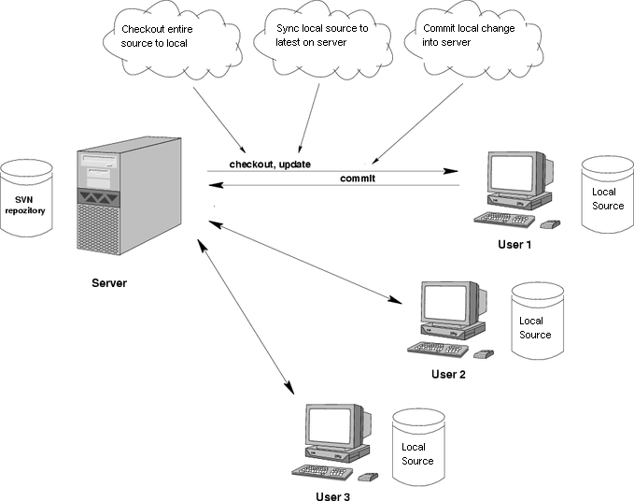
Teamwork

Slide 10
Advanced Actions
Branch: Create a separate copy of a file/folder for private use (bug fixing, testing, etc). Branch is both a verb (”branch the code”) and a noun (”Which branch is it in?”).
Diff/Change/Delta: Finding the differences between two files. Useful for seeing what changed between revisions.
Merge (or patch): Apply the changes from one file to another, to bring it up-to-date. For example, you can merge features from one branch into another.
Conflict: When pending changes to a file contradict each other (both changes cannot be applied).
Resolve: Fixing the changes that contradict each other and checking in the correct version.
Locking: “Taking control” of a file so nobody else can edit it until you unlock it. Some version control systems use this to avoid conflicts.
Breaking the lock: Forcibly unlocking a file so you can edit it. It may be needed if someone locks a file and goes on vacation (or “calls in sick” the day Halo 3 comes out).

Slide 11
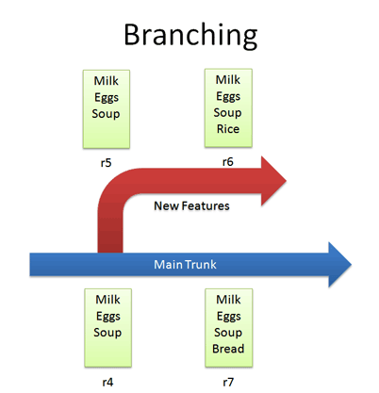
Branching

Slide 12
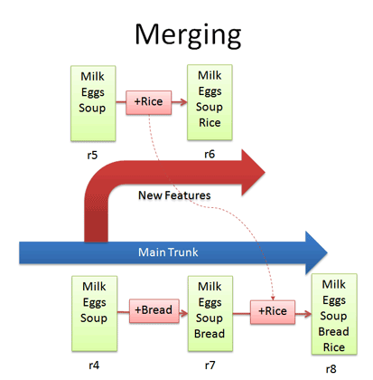
Merging

Slide 13
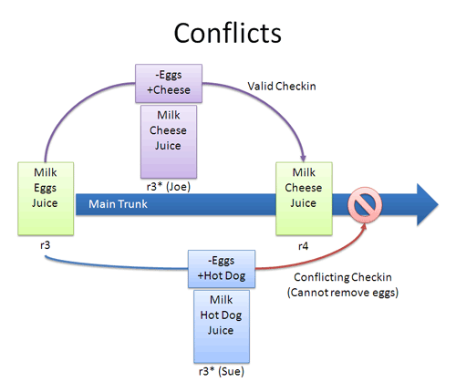
Conflicts

Slide 14
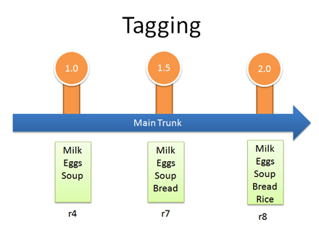
Tagging

Slide 15
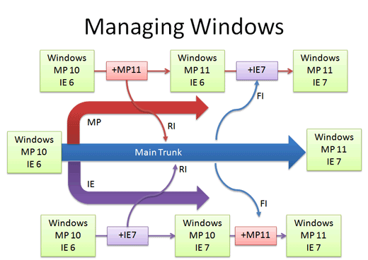
Real-life Example: Managing Windows Source Code
Notes:
We guessed that Windows was managed out of a shared folder, but it’s not the case. So how’s it done?
There’s a main line with stable builds of Windows.
Each group (Networking, User Interface, Media Player, etc.) has its own branch to develop new features. These are under development and less stable than main.
You develop new features in your branch and “Reverse Integrate (RI)” to get them into Main. Later, you “Forward Integrate” and to get the latest changes from Main into your branch:
Let’s say we’re at Media Player 10 and IE 6. The Media Player team makes version 11 in their own branch. When it’s ready and tested, there’s a patch from 10 – 11 which is applied to Main (just like the “Rice” example, but a tad more complicated). This a reverse integration, from the branch to the trunk. The IE team can do the same thing.
Later, the Media Player team can pick up the latest code from other teams, like IE. In this case, Media Player forward integrates and gets the latest patches from main into their branch. This is like pulling in the “Bread” feature into the experimental branch, but again, more complicated.
So it’s RI and FI. Aye aye. This arrangement lets changes percolate throughout the branches, while keeping new code out of the main line. Cool, eh?
In reality, there’s many layers of branches and sub-branches, along with quality metrics that determine when you get to RI. But you get the idea: branches help manage complexity. Now you know the basics of how one of the largest software projects is organized.

Slide 16
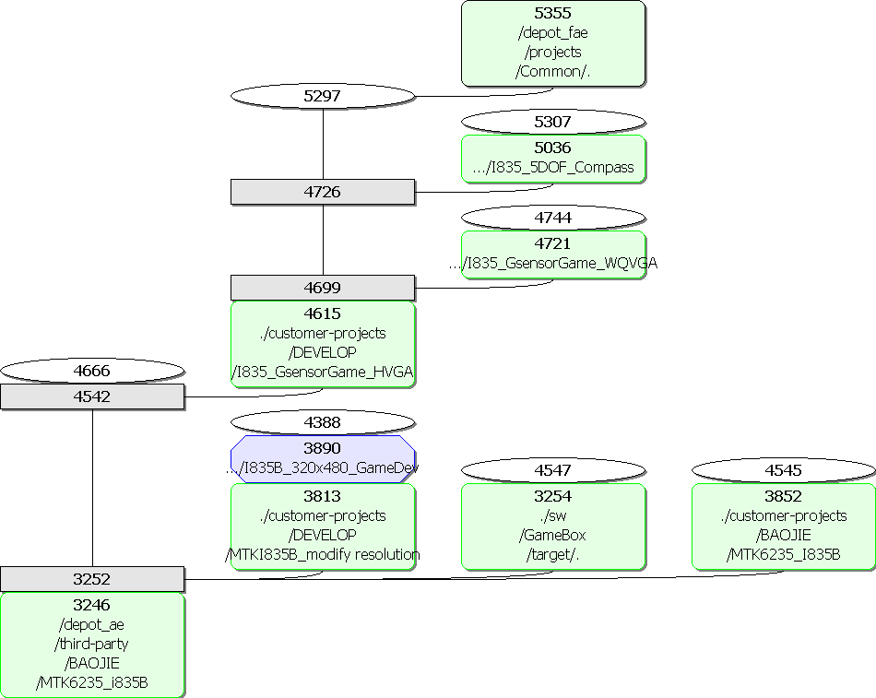
Relationships between Branches

Slide 17
Disciplines
Always work synchronized with server
All file operations by revision control tool (TortoiseSVN) – add, delete, copy, move, rename, branch, tag, …
Commit changes with log to describe the modification
Not check in generated files (.obj, .lib, etc)
Make sure committed change not block other team member
Atomic commit – one commit for one bug
Frequent check in

Slide 18
Q & A

Slide 19
Thank you!

