Slide 1
SVN Hands-on Training
Robbie Cao
May, 2010

Slide 2
Agenda
SVN Quick Start
  SVN Client Tool Setup
  Getting Started
  How to Connect and Browse SVN Repository
  How to Download (Checkout) a Working Copy
  How to Sync (Download Other’s Change) from SVN Repository
  How to Upload (Commit) Your Changes to Repository
  How to Add New Files and Directories
  How to Delete Files and Directories
  How to Rename/Move/Copy Files and Directories
  How to Undo Changes
  How to Showing Log/History
  Further Reading

Slide 3
SVN Quick Start
    Client Tool Setup
    Getting Started
    How to Connect and Browse SVN Repository
    How to Download (Checkout) a Working Copy
    How to Sync (Download Other’s Change) from SVN Repository
    How to Upload (Commit) Your Changes to Repository
    How to Add New Files and Directories
    How to Delete Files and Directories
    How to Rename/Move/Copy Files and Directories
    How to Undo Changes
    How to Showing Log/History
    Further Reading

Slide 4
SVN Client Tools
SVN (Subversion) Core Tools
  http://subversion.tigris.org/files/documents/15/46906/Setup-Subversion-1.6.6.msi
TortoiseSVN (Windows GUI)
  http://sourceforge.net/projects/tortoisesvn/files/Application/1.6.8/TortoiseSVN-1.6.8.19260-win32-svn-1.6.11.msi/download

Slide 5
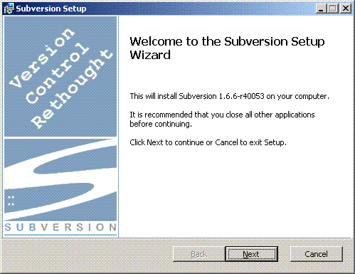
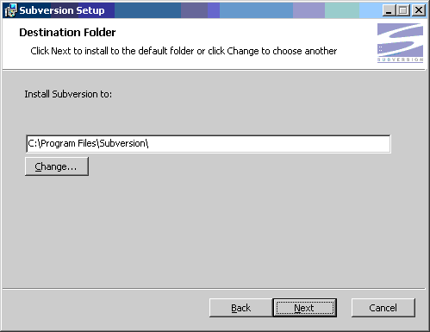
Install Subversion

Slide 6
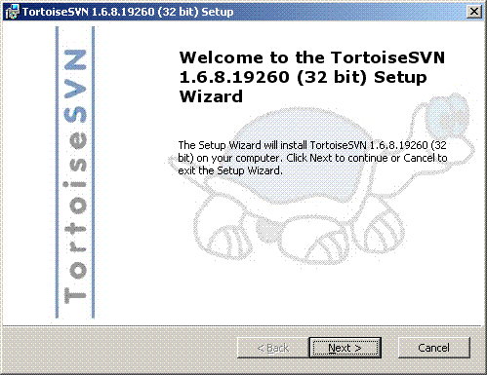
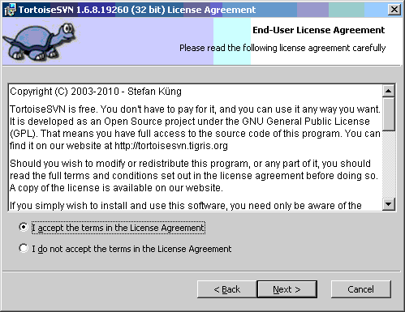
Install TortoiseSVN

Slide 7
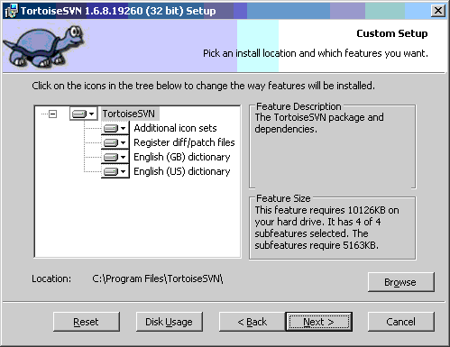
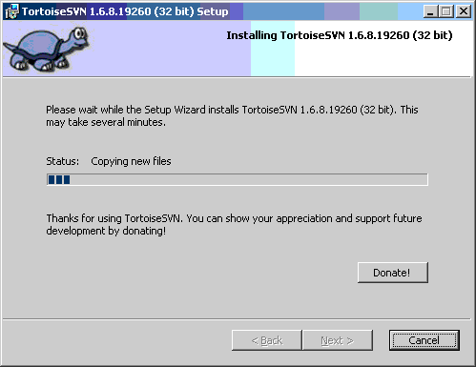
Install TortoiseSVN (cont.)

Slide 8
SVN Quick Start
    SVN Client Tool Setup
    Getting Started
    How to Connect and Browse SVN Repository
    How to Download (Checkout) a Working Copy
    How to Sync (Download Other’s Change) from SVN Repository
    How to Upload (Commit) Your Changes to Repository
    How to Add New Files and Directories
    How to Delete Files and Directories
    How to Rename/Move/Copy Files and Directories
    How to Undo Changes
    How to Showing Log/History
    Further Reading

Slide 9
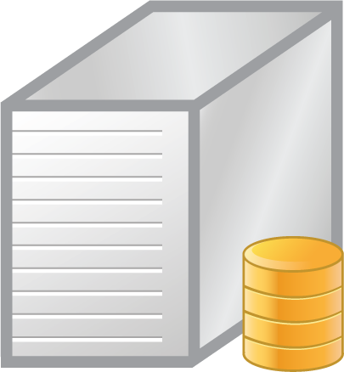






Typical Working Cycle
Repository Server
Connect to server and download/update a working copy.
Make changes. (modify, add new file, delete, rename/move/copy, etc)
Commit your changes.
1, Check out a working copy
3, Commit changes to repository
2, Make changes
The client machine

Slide 10
SVN Quick Start
    SVN Client Tool Setup
    Getting Started
    How to Connect and Browse SVN Repository
    How to Download (Checkout) a Working Copy
    How to Sync (Download Other’s Change) from SVN Repository
    How to Upload (Commit) Your Changes to Repository
    How to Add New Files and Directories
    How to Delete Files and Directories
    How to Rename/Move/Copy Files and Directories
    How to Undo Changes
    How to Showing Log/History
    Further Reading

Slide 11
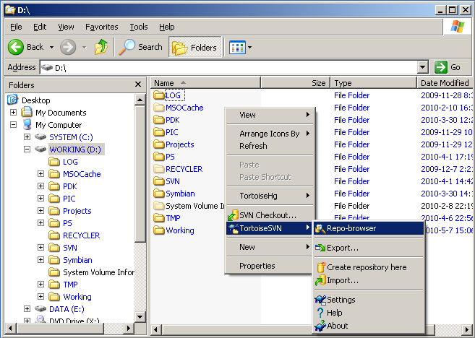
Step 1 - Starting in Windows Explorer
You can start in any directory of Windows explorer, such as desktop:
Right click to pop up the context menu.
Select the command TortoiseSVN -> Repo-browser, which brings up the dialog box as next page.

Slide 12
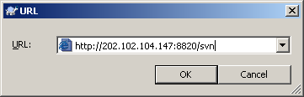
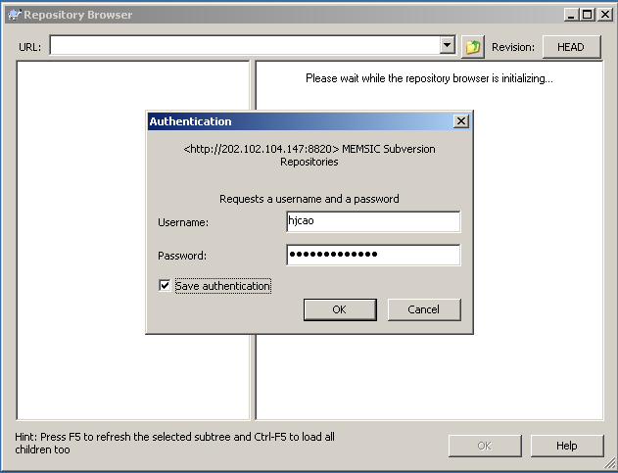
Step 2 - URL and Authentication
A dialog to show you input the SVN repository URL.
Input SVN portal address: http://202.102.104.147:8820/svn then click OK.
An authentication dialog will show up when you trying to access.
Enter your username and password. The checkbox will make TortoiseSVN store the credentials so that you don’t need re-enter username & password next time.

Slide 13
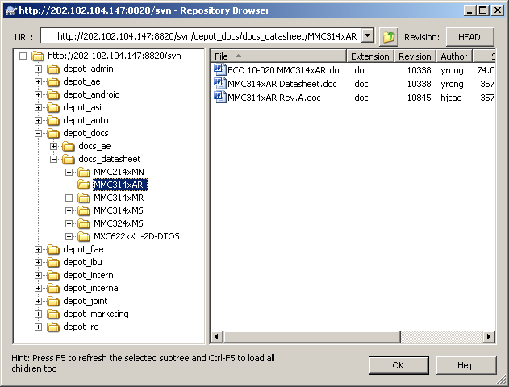
Step 3 - Navigate in Repository Browser
The repository browser looks very similar to the Windows explorer, except that it is showing the content of the repository than files on your computer.
In the left pane you can see a directory tree, and in the right pane are the contents of the selected directory.
You can navigate the repository to locate the path you will work on. Please remember this path, we will need it when we checkout a working copy.

Slide 14
SVN Quick Start
    SVN Client Tool Setup
    Getting Started
    How to Connect and Browse SVN Repository
    How to Download (Checkout) a Working Copy
    How to Sync (Download Other’s Change) from SVN Repository
    How to Upload (Commit) Your Changes to Repository
    How to Add New Files and Directories
    How to Delete Files and Directories
    How to Rename/Move/Copy Files and Directories
    How to Undo Changes
    How to Showing Log/History
    Further Reading

Slide 15
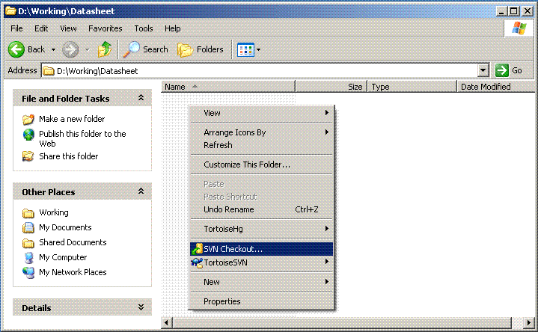
Step 1 - Initial Checkout via Context Menu
For the first time, you will start using a Subversion repository by doing a checkout of your project.
Select a directory in windows explorer where you want to place your working copy.
Right click to pop up the context menu.
Select the command SVN Checkout…, which brings up the dialog box as next page.

Slide 16
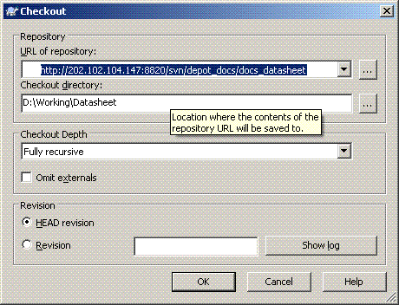
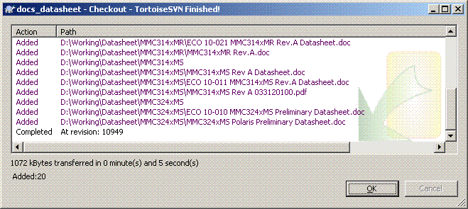
Step 2 - URL and Working Directory
Input the URL of repository you are working on.
Specify the local directory where the working copy will be saved to.
A check out will transfer the project’s content
from the repository server
to the client machine.

Slide 17
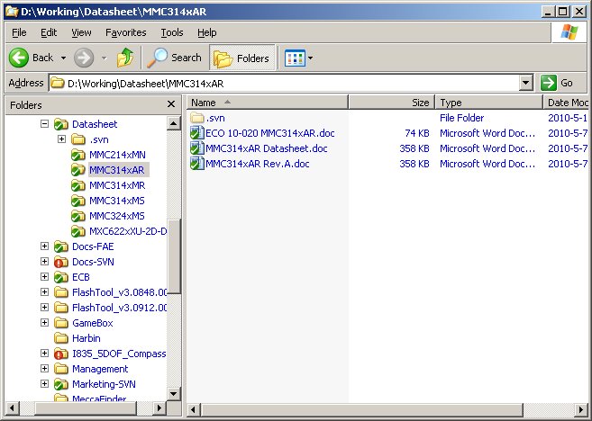
Step 3 - What’s Next
Now you have a working copy of SVN repository in your local directory with icon overlays as right image.
With a working copy, you are working synchronized with repository on server from now on.
You can make changes (modify, add new file, delete, rename/move/copy) as you need and then upload (commit) then changes to repository. See the following sections for detail.

Slide 18
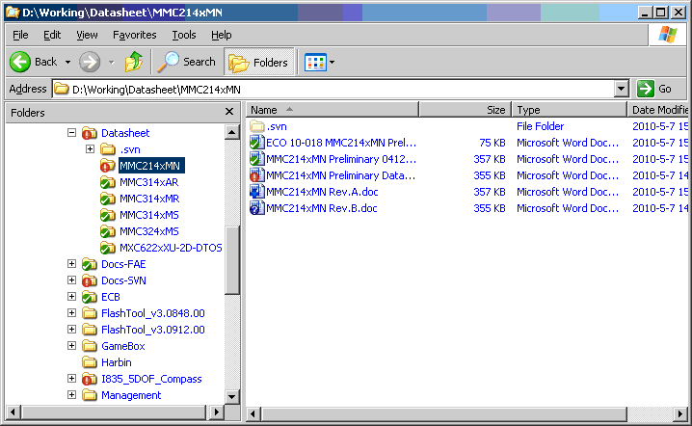
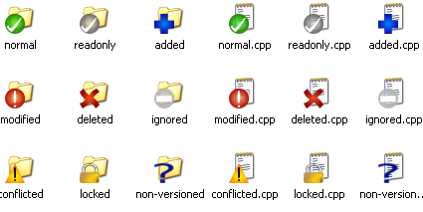
TortoiseSVN Icon Overlays
One of the most visible features of TortoiseSVN is the icon overlays which appear on files in your working copy.
These show you at a glance which of your files have been modified.

Slide 19
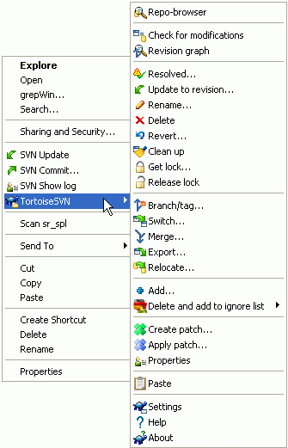
TortoiseSVN Context Menus
All TortoiseSVN commands are invoked from the context menu of the windows explorer.
Most are directly visible, when you right click on a file or folder.
The commands that are available depend on whether the file or folder or its parent folder is under version control or not.

Slide 20
SVN Quick Start
    SVN Client Tool Setup
    Getting Started
    How to Connect and Browse SVN Repository
    How to Download (Checkout) a Working Copy
    How to Sync (Download Other’s Change) from SVN Repository
    How to Upload (Commit) Your Changes to Repository
    How to Add New Files and Directories
    How to Delete Files and Directories
    How to Rename/Move/Copy Files and Directories
    How to Undo Changes
    How to Showing Log/History
    Further Reading

Slide 21
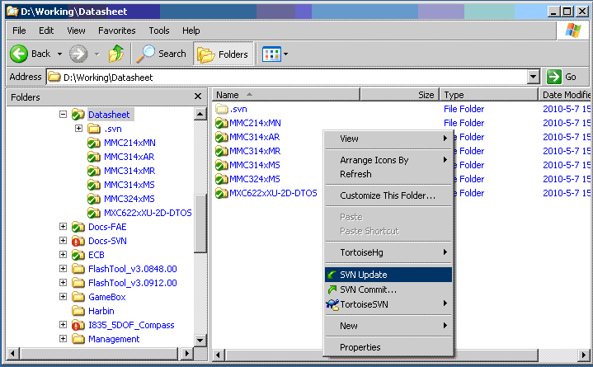
Update Working Copy via Context Menu
Periodically, you should ensure that changes done by others get incorporated in your local working copy. The process of getting changes from the server to your local copy is known as updating.
To update, in your working copy, select the files and/or directories you want, right click and select SVN Update in the explorer context menu.

Slide 22
SVN Quick Start
    SVN Client Tool Setup
    Getting Started
    How to Connect and Browse SVN Repository
    How to Download (Checkout) a Working Copy
    How to Sync (Download Other’s Change) from SVN Repository
    How to Upload (Commit) Your Changes to Repository
    How to Add New Files and Directories
    How to Delete Files and Directories
    How to Rename/Move/Copy Files and Directories
    How to Undo Changes
    How to Showing Log/History
    Further Reading

Slide 23
Step 1 - Update Working Copy
We assume you have a working copy of repository already, otherwise, please turn to the section of “How to Download (Checkout) a Working Copy”.
Before make any changes, you should ensure that changes done by others get incorporated in your local working copy.
To update, select the files and/or directories you want, right click and select SVN Update in the explorer context menu.

Slide 24
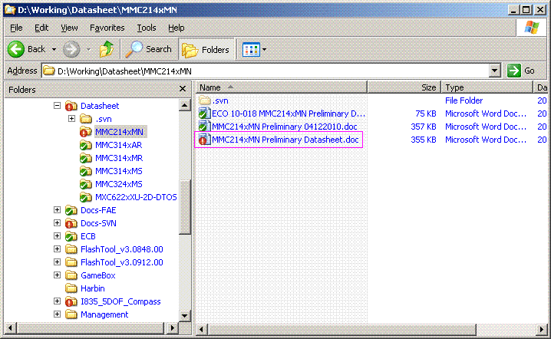
Step 2 - Modify the Files You Want
Edit the versioned files in your favorite editor.
Folder/files modification will be indicated with an excalmatory mark icon.

Slide 25
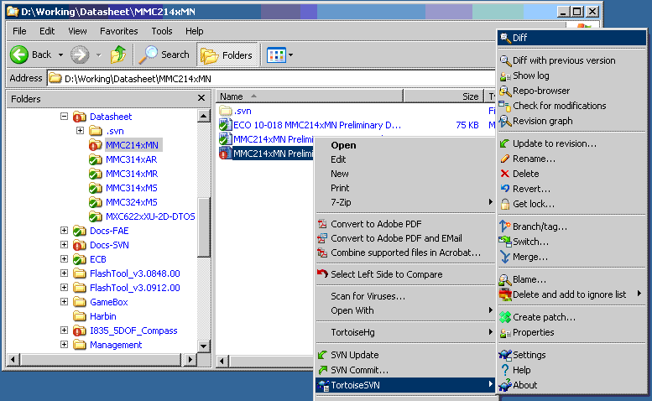
Step 3 - Checking Modifications (Optional)
Right click the modified file you are going to check modifications.
In context menu, select TortoiseSVN -> Diff.

Slide 26
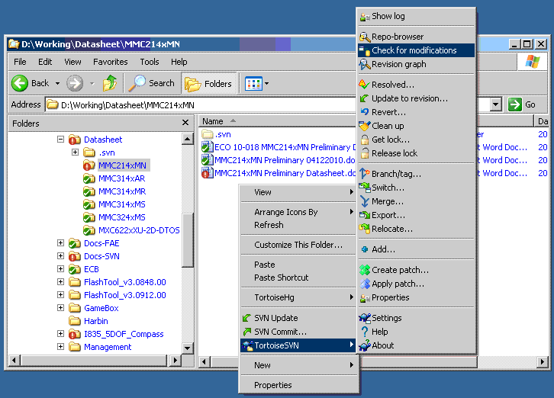
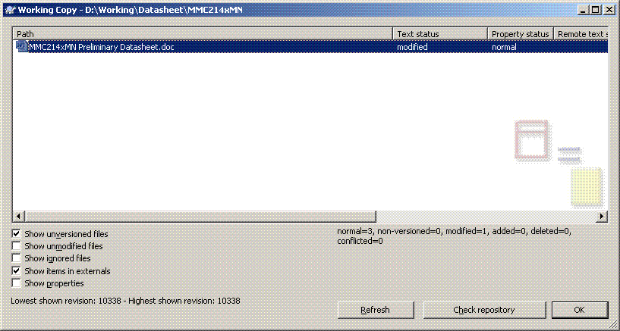
Step 3 - Checking Modifications (cont.)
Another Way
Right click in the working folder you are going to check modifications.
In context menu, select TortoiseSVN -> Check for modifications.
Double click the modified files to show difference.

Slide 27
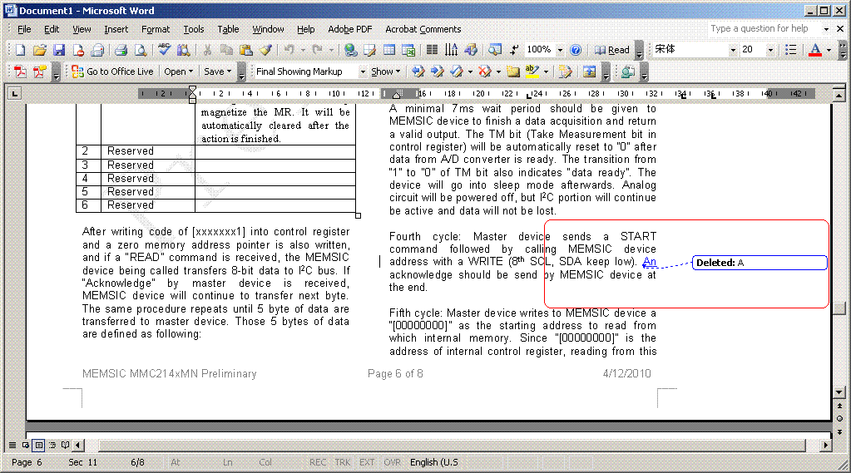
Step 3 - Checking Modifications (cont.)
Show Difference
The modifications will be shown in side by side difference for plain text and Track Changes mode in MS Word.

Slide 28
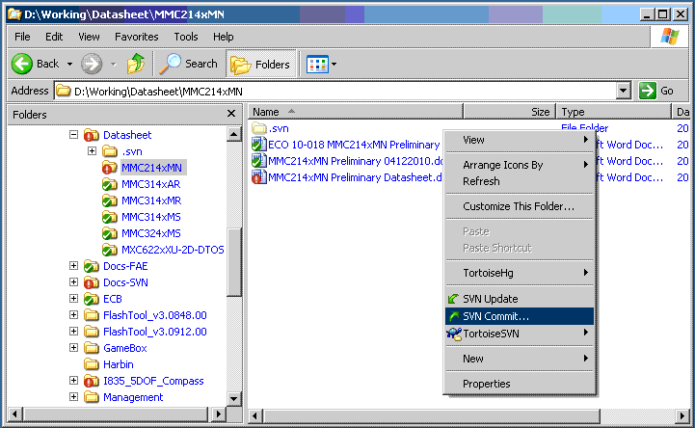
Step 4 - Commit Changes via Context Menu
Before you commit you have to make sure that your working copy is up to date. You can use context menu SVN Update to check. (See Step 1).
Now you are ready to commit your changes. Right click in your working directory.
In context menu, select SVN Commit…

Slide 29
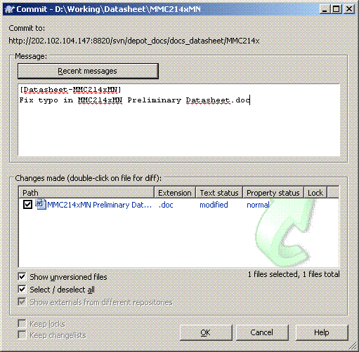
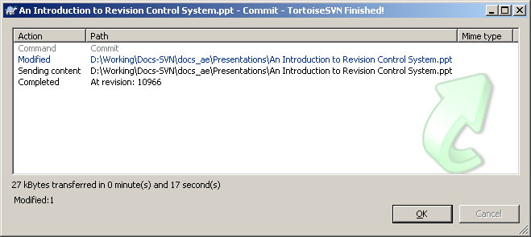
Step 5 – Commit Dialog
The commit dialog will show you every changed file.
If you don't want a changed file to be committed, just uncheck that file.
Input log to describe your change.
You are required to input at least 10 characters to describe your change, otherwise, the server will prevent your commit.
After pressing OK, a dialog appears displaying the progress of the commit.

Slide 30
SVN Quick Start
    SVN Client Tool Setup
    Getting Started
    How to Connect and Browse SVN Repository
    How to Download (Checkout) a Working Copy
    How to Sync (Download Other’s Change) from SVN Repository
    How to Upload (Commit) Your Changes to Repository
    How to Add New Files and Directories
    How to Delete Files and Directories
    How to Rename/Move/Copy Files and Directories
    How to Undo Changes
    How to Showing Log/History
    Further Reading

Slide 31
Step 1 - Update Working Copy
We assume you have a working copy of repository already, otherwise, please turn to the section of “How to Download (Checkout) a Working Copy”.
Before make any changes, you should ensure that changes done by others get incorporated in your local working copy.
To update, select the files and/or directories you want, right click and select SVN Update in the explorer context menu.

Slide 32
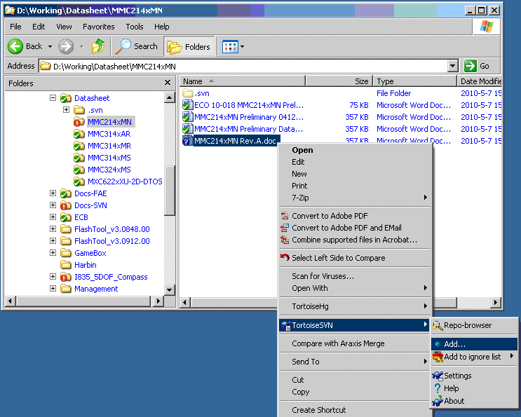

Step 2 - Adding Folder/Files via Context Menu
Create new folders/files or copy from other place.
Right click the new folders/files you are going to add.
In context menu, select TortoiseSVN -> Add.
After you added the files/directories to source control the file appears with a added icon overlay which means you first have to commit your working copy to make those files/directories available to other developers.

Slide 33
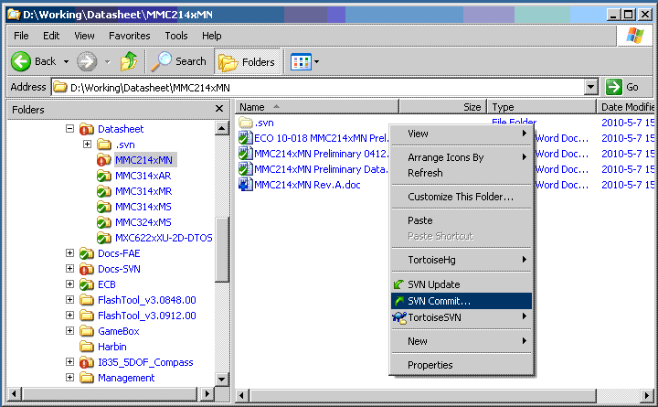
Step 3 - Commit Added Folder/Files via Context Menu
Right click in your working directory.
In context menu, select SVN Commit…

Slide 34
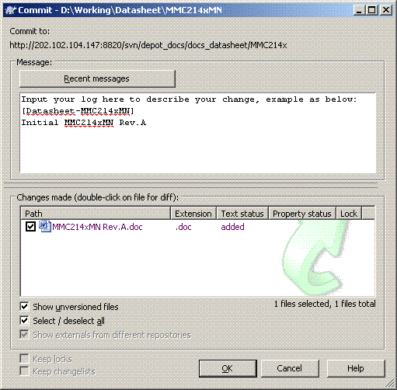
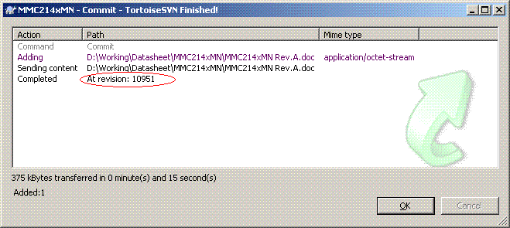
Step 4 - Commit Dialog
The commit dialog will show you every added file.
If you don't want a added file to be committed, just uncheck that file.
Input log to describe your added folder/file.
You are required to input at least 10 characters to describe your change, otherwise, the server will prevent your commit.
After pressing OK, a dialog appears displaying the progress of the commit.

Slide 35
SVN Quick Start
    SVN Client Tool Setup
    Getting Started
    How to Connect and Browse SVN Repository
    How to Download (Checkout) a Working Copy
    How to Sync (Download Other’s Change) from SVN Repository
    How to Upload (Commit) Your Changes to Repository
    How to Add New Files and Directories
    How to Delete Files and Directories
    How to Rename/Move/Copy Files and Directories
    How to Undo Changes
    How to Showing Log/History
    Further Reading

Slide 36
Step 1 - Update Working Copy
We assume you have a working copy of repository already, otherwise, please turn to the section of “How to Download (Checkout) a Working Copy”.
Before make any changes, you should ensure that changes done by others get incorporated in your local working copy.
To update, select the files and/or directories you want, right click and select SVN Update in the explorer context menu.

Slide 37
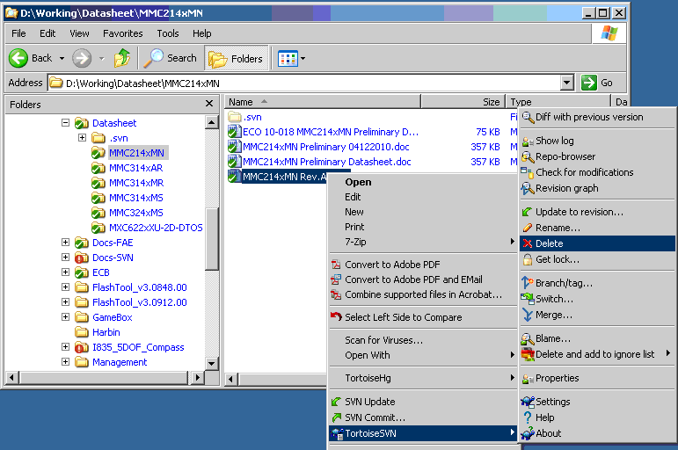
Step 2 - Deleting Folder/Files via Context Menu
Right click the versioned folders/files you are going to remove.
In context menu, select TortoiseSVN -> Delete.

Slide 38
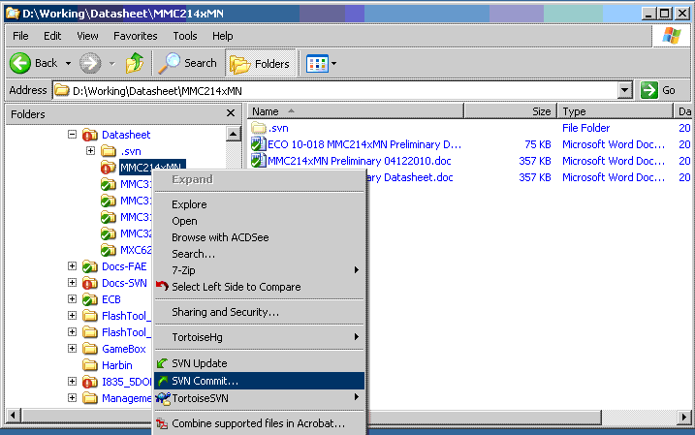
Step 3 - Commit Deleted Folder/Files
Right click in your working directory.
In context menu, select SVN Commit…

Slide 39
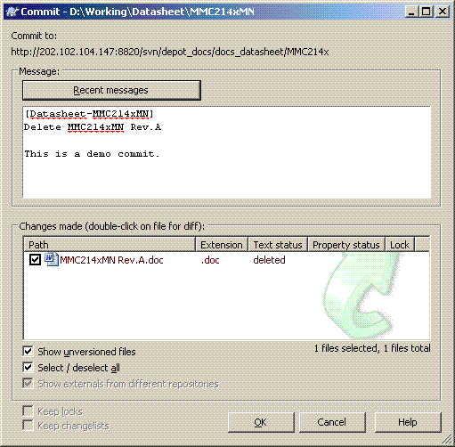
Step 4 - Commit Dialog
The commit dialog will show you every deleted file.
If you don't want a deleted file to be committed, just uncheck that file.
Input log to describe your deleted folder/file.
You are required to input at least 10 characters to describe your change, otherwise, the server will prevent your commit.
After pressing OK, a dialog appears displaying the progress of the commit.

Slide 40
SVN Quick Start
    SVN Client Tool Setup
    Getting Started
    How to Connect and Browse SVN Repository
    How to Download (Checkout) a Working Copy
    How to Sync (Download Other’s Change) from SVN Repository
    How to Upload (Commit) Your Changes to Repository
    How to Add New Files and Directories
    How to Delete Files and Directories
    How to Rename/Move/Copy Files and Directories
    How to Undo Changes
    How to Showing Log/History
    Further Reading

Slide 41
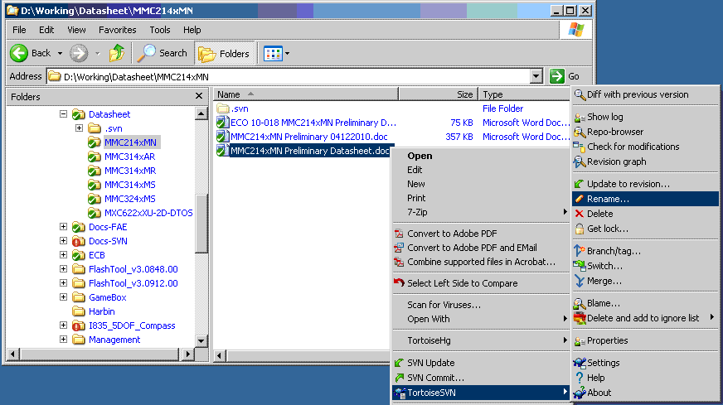
Renaming Folder/Files via Context Menu
The procedure to rename a file is same as add/delete a file. We need 4 steps: update, rename, commit, input log. Here we only mention step 2.
Right click the versioned folders/files you are going to rename.
In context menu, select TortoiseSVN -> Rename…

Slide 42
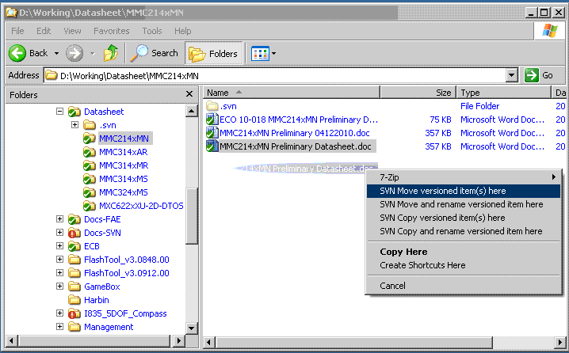

Moving/Copying Folder/Files via Context Menu
The procedure to rename a file is same as add/delete a file. We need 4 steps: update, move/copy, commit, input log. Here we only mention step 2.
Move or copy folder/files via dragging with right mouse button

Slide 43
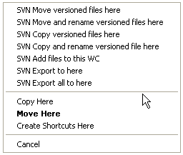
Drag and Drop
Right drag menu for a directory under version control as right image.
Other commands are available as drag handlers, when you right drag files or folders to a new location inside working copies or when you right drag a non-versioned file or folder into a directory which is under version control.

Slide 44
SVN Quick Start
    SVN Client Tool Setup
    Getting Started
    How to Connect and Browse SVN Repository
    How to Download (Checkout) a Working Copy
    How to Sync (Download Other’s Change) from SVN Repository
    How to Upload (Commit) Your Changes to Repository
    How to Add New Files and Directories
    How to Delete Files and Directories
    How to Rename/Move/Copy Files and Directories
    How to Undo Changes
    How to Showing Log/History
    Further Reading

Slide 45
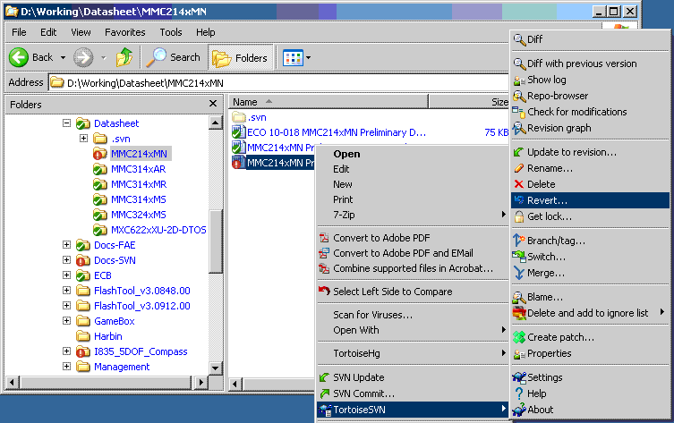
Undo Modifications - Step 1
If you want to discard some change since the latest update, you can revert it by:
Right click the modified file you are going to revert.
In context menu, select TortoiseSVN -> Revert… and click on OK.

Slide 46
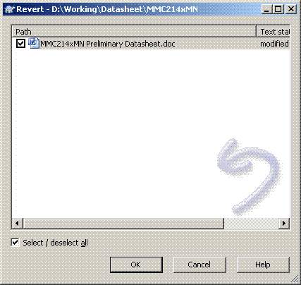
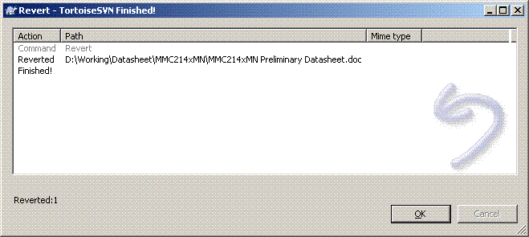
Undo Modifications - Step 2
The commit dialog will show you every added file.
If you don't want a added file to be committed, just uncheck that file.
Another dialog will show you the result after click OK.

Slide 47
Undo Deletion and Addition
If you want to undo a deletion or a rename, you need to use Revert on the parent folder as the deleted item does not exist for you to right-click on.
If you want to undo the addition of an item, this appears in the context menu as TortoiseSVN -> Undo add.... This is really a revert as well, but the name has been changed to make it more obvious.

Slide 48
SVN Quick Start
    SVN Client Tool Setup
    Getting Started
    How to Connect and Browse SVN Repository
    How to Download (Checkout) a Working Copy
    How to Sync (Download Other’s Change) from SVN Repository
    How to Upload (Commit) Your Changes to Repository
    How to Add New Files and Directories
    How to Delete Files and Directories
    How to Rename/Move/Copy Files and Directories
    How to Undo Changes
    How to Showing Log/History
    Further Reading
Notes:
Trac is a minimalistic approach to web-based management of software projects. Its goal is to simplify effective tracking and handling of software issues, enhancements and overall progress.
All aspects of Trac have been designed with the single goal to help developers write great software while staying out of the way and imposing as little as possible on a team's established process and culture.

Slide 49
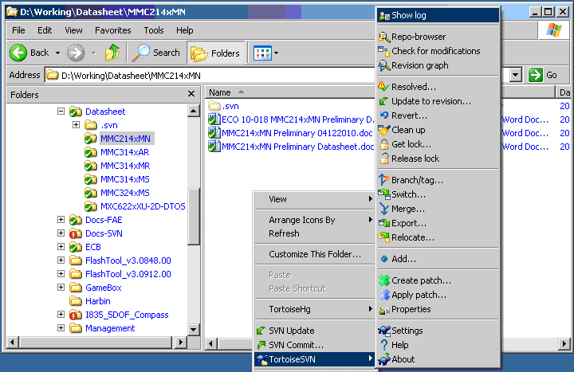
Show Log via Context Menu
You may want to track the change history, Show log will help you on that:
Right click the working folder/file you want to know its history.
In context menu, select TortoiseSVN -> Show log.

Slide 50
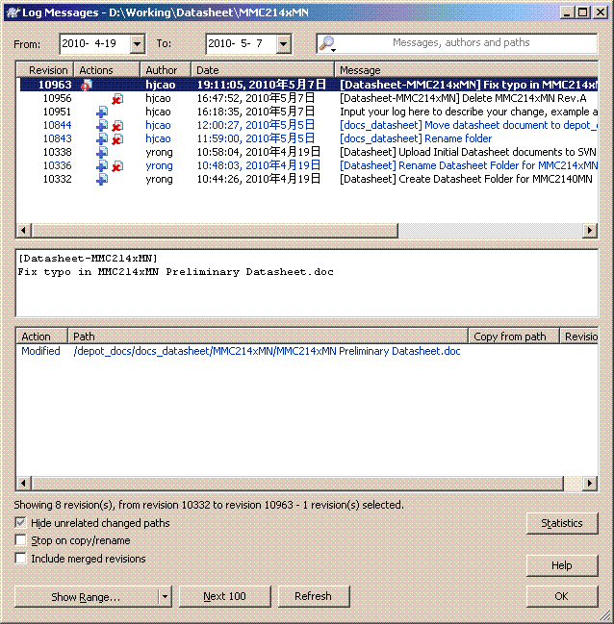
Full History
Full log as right image will show you all the changing history, ownership and file/folder evolution.

Slide 51
SVN Quick Start
    SVN Client Tool Setup
    Getting Started
    How to Connect and Browse SVN Repository
    How to Download (Checkout) a Working Copy
    How to Sync (Download Other’s Change) from SVN Repository
    How to Upload (Commit) Your Changes to Repository
    How to Add New Files and Directories
    How to Delete Files and Directories
    How to Rename/Move/Copy Files and Directories
    How to Undo Changes
    How to Showing Log/History
    Further Reading

Slide 52
Why We Need Version Control System
Backup and Restore
Synchronization
Short-term undo
Long-term undo
Track Changes
Track Ownership
Notes:
Backup and Restore. Files are saved as they are edited, and you can jump to any moment in time. Need that file as it was on Feb 23, 2007? No problem.
Synchronization. Lets people share files and stay up-to-date with the latest version.
Short-term undo. Monkeying with a file and messed it up? (That’s just like you, isn’t it?). Throw away your changes and go back to the “last known good” version in the database.
Long-term undo. Sometimes we mess up bad. Suppose you made a change a year ago, and it had a bug. Jump back to the old version, and see what change was made that day.
Track Changes. As files are updated, you can leave messages explaining why the change happened (stored in the VCS, not the file). This makes it easy to see how a file is evolving over time, and why.
Track Ownership. A VCS tags every change with the name of the person who made it. Helpful for blamestorming giving credit.
Sandboxing, or insurance against yourself. Making a big change? You can make temporary changes in an isolated area, test and work out the kinks before “checking in” your changes.
Branching and merging. A larger sandbox. You can branch a copy of your code into a separate area and modify it in isolation (tracking changes separately). Later, you can merge your work back into the common area.

Slide 53
Without a Version Control System
Source/docs missed with longer period
Source/docs easily “damaged” in isolated storage, PC lost, HD crash, delete by mistake…
Conflict when access to same code/project in teamwork development
Difficult to rollback to some historical status
Out of control to work outside MEMSIC facilities
Not easy to handover projects to the new developers
No change history, no change ownership
…

Slide 54









Teamwork Working Cycle with SVN
get content
Submit your changes
svn checkout
svn update
svn commit
106
100
Merge your changes
Resolve conflicts
Make changes
svn diff
svn resolved
svn add
svn move
svn delete
Subversion
Repository
105
See what was changed
in the repository in the meantime
Update your local copy
svn update
svn status -u

Slide 55
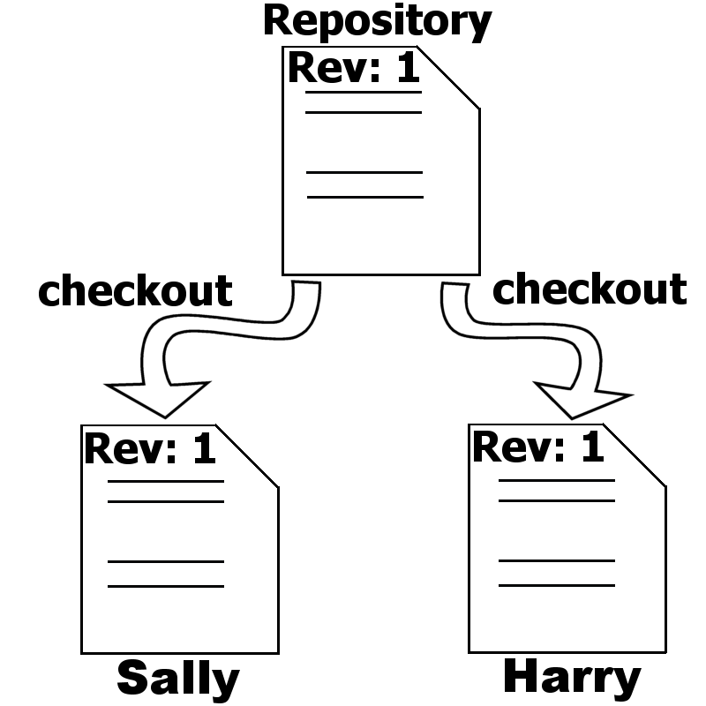
Teamwork 1/5
Harry and Sally both check out a directory in their repository.
Both get the same revision of this particular directory copied to their machine.
Their working copy.

Slide 56
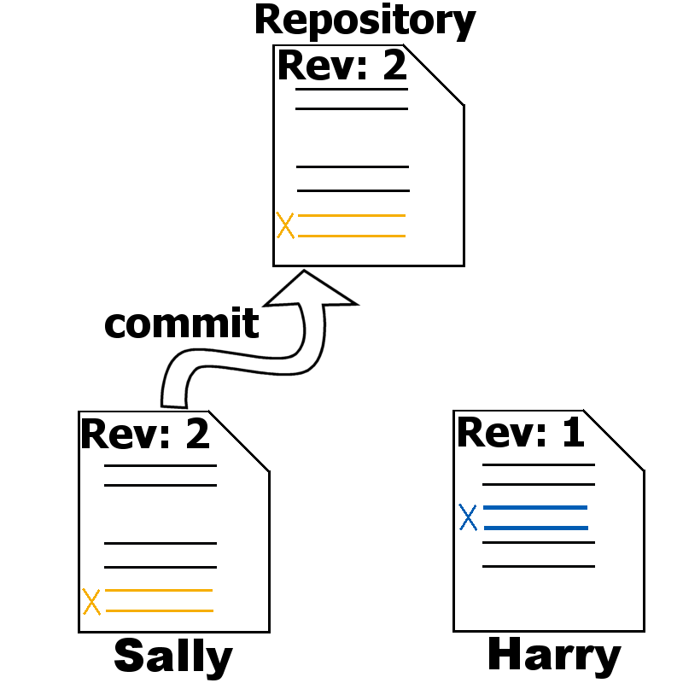
Teamwork 2/5
Harry and Sally change
different lines in the same file.
Sally commits first and
creates revision 2.

Slide 57
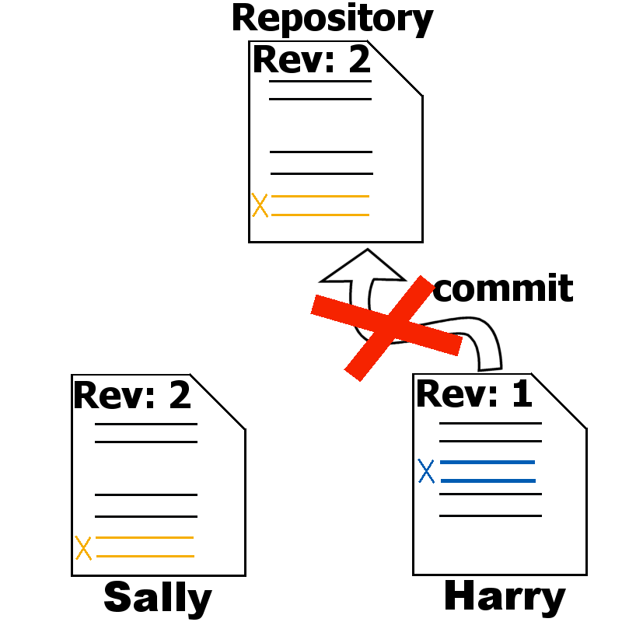
Teamwork 3/5
As Harry tries to commit his changes, her receives an error telling him that his working copy is probably out of date.
His commit fails.

Slide 58
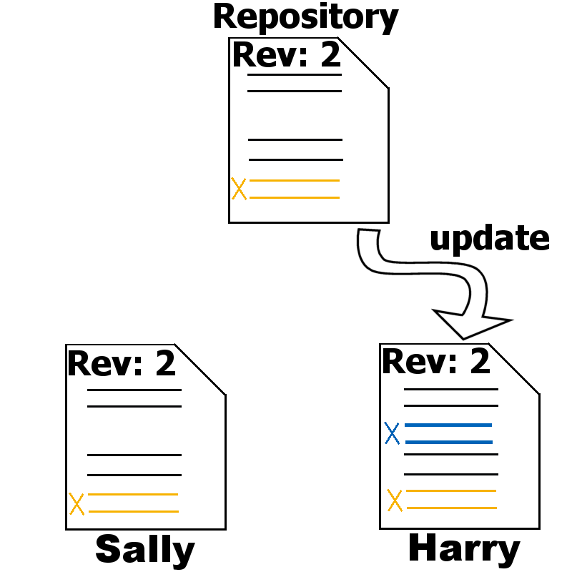
Teamwork 4/5
Harry has to update his working copy and SVN integrates Sallies changes into his working copy.

Slide 59
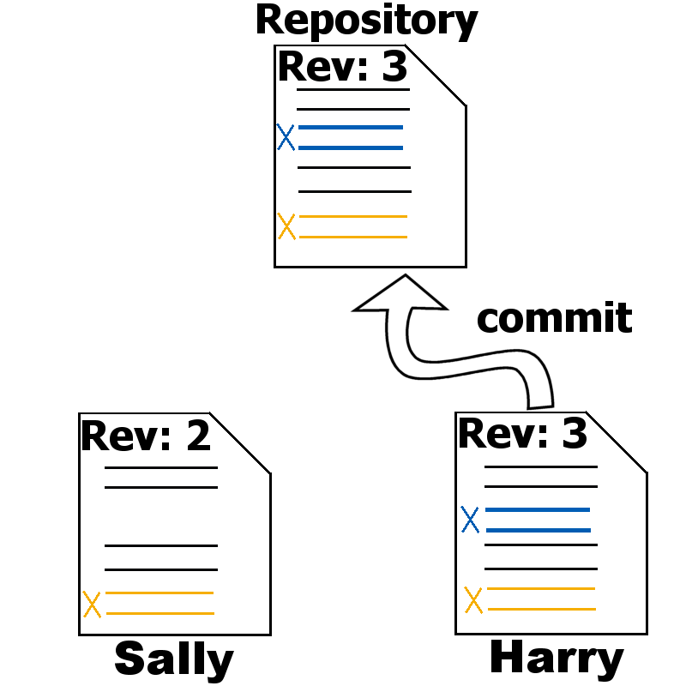
Teamwork 5/5
Now Harry is ready to
commit his changes.
He creates revision 3.

Slide 60
Misc.
Always work synchronized with server
All file operations by revision control tool (TortoiseSVN) – add, delete, copy, move, rename, …
Commit with log to describe the change
Not check in generated files
Frequent check in

Slide 61
Q & A

Slide 62
Thank you!

