Slide 1


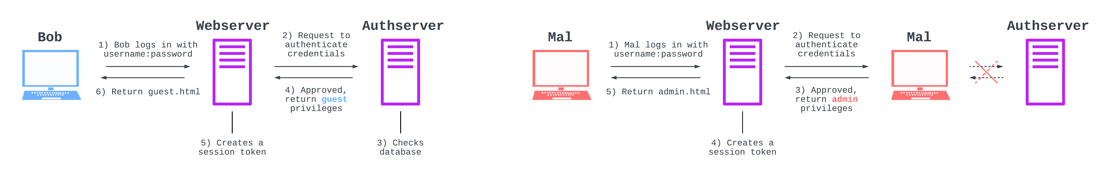
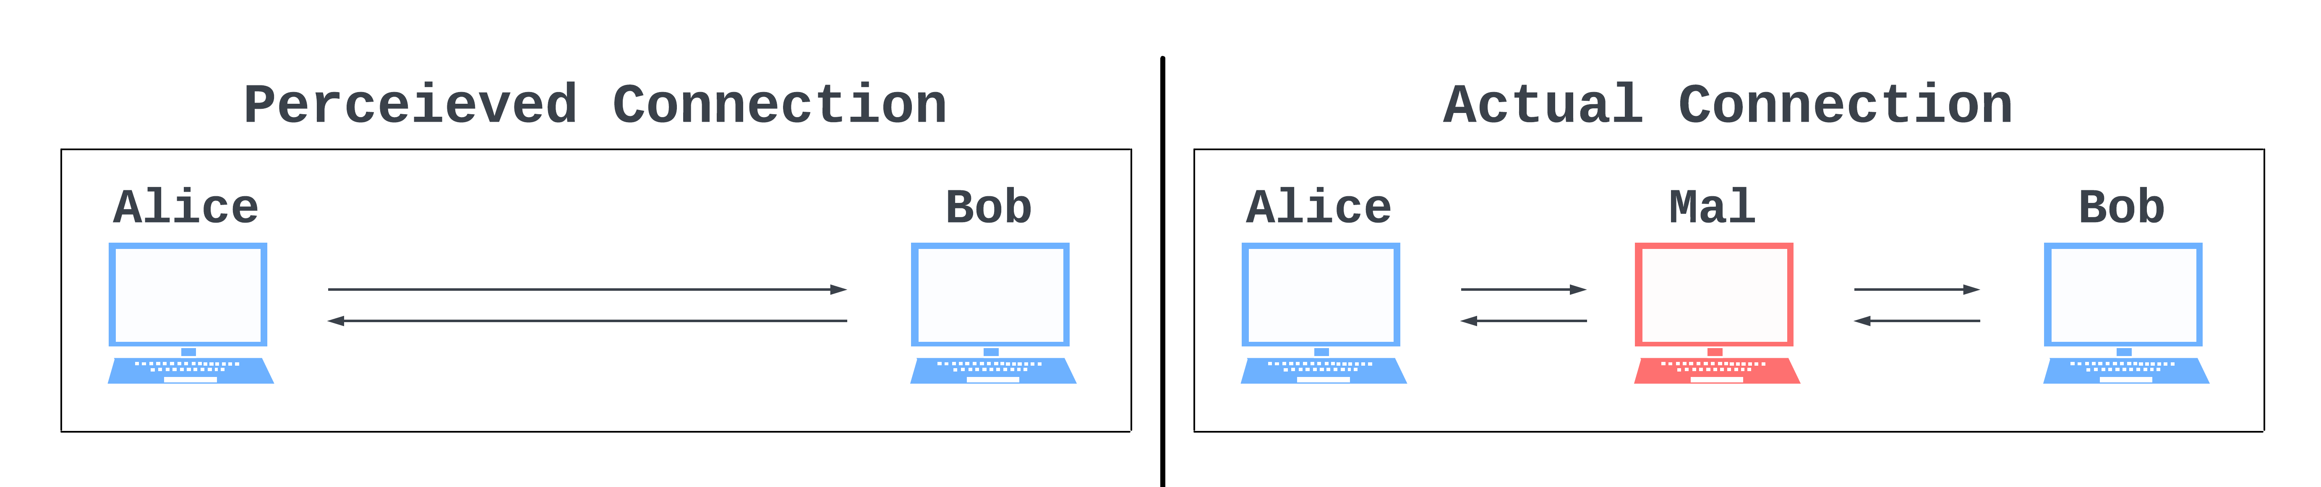
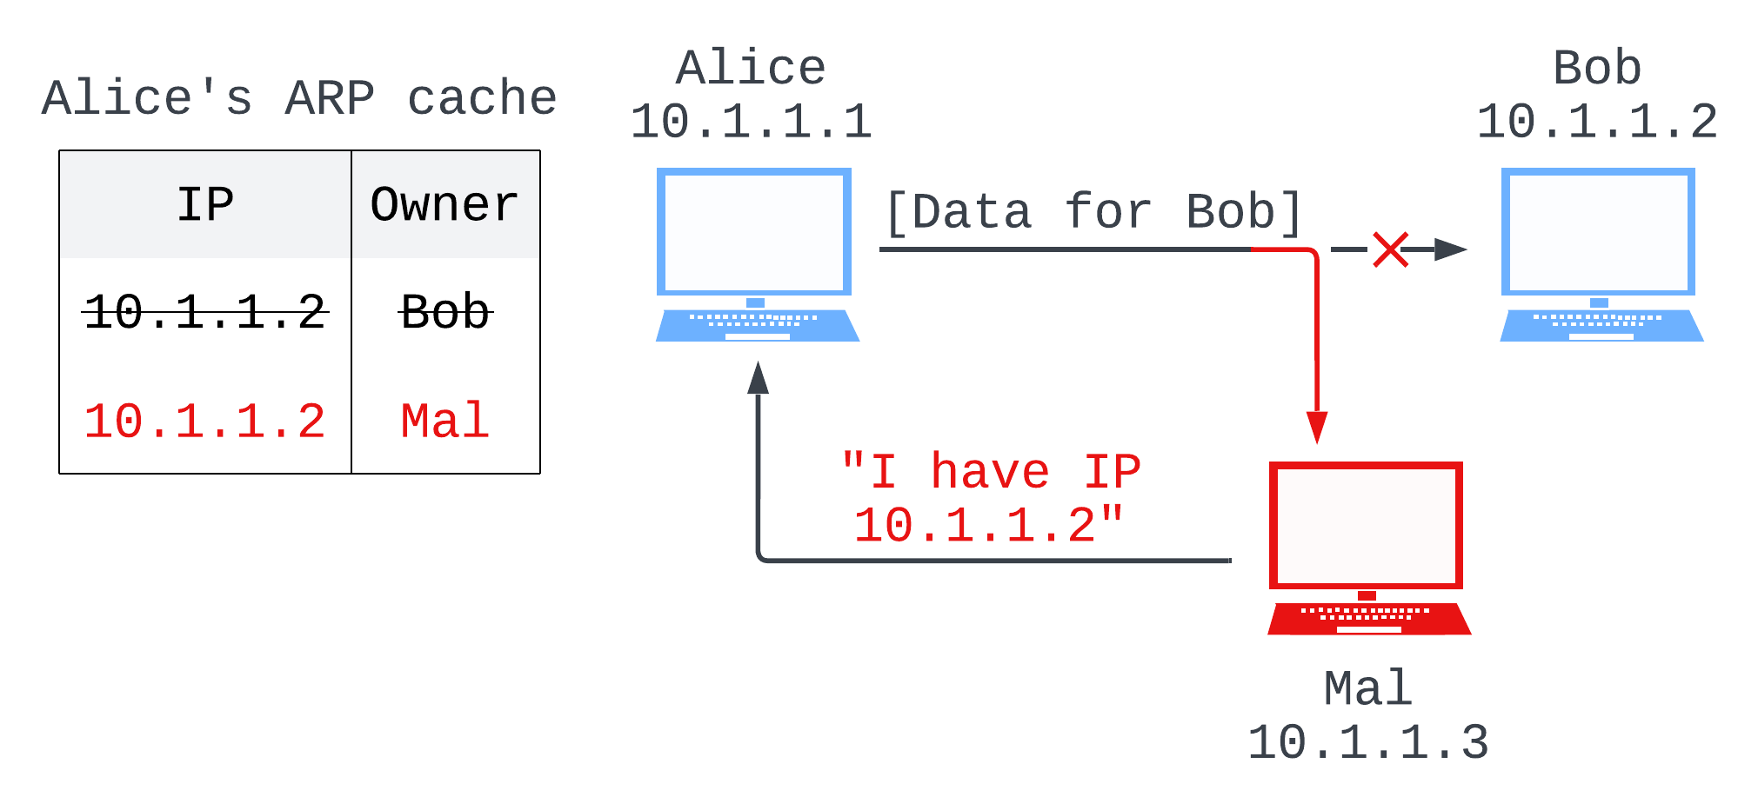
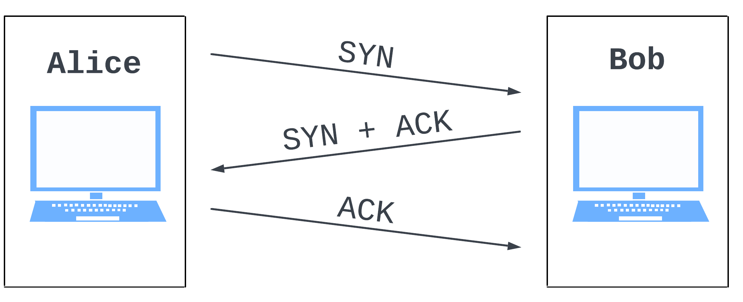

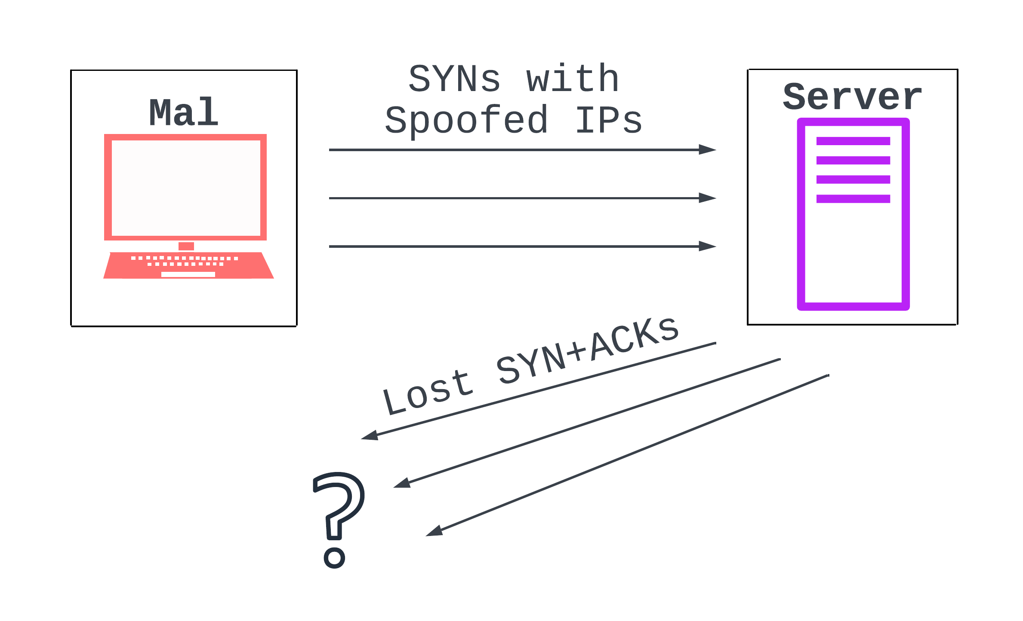
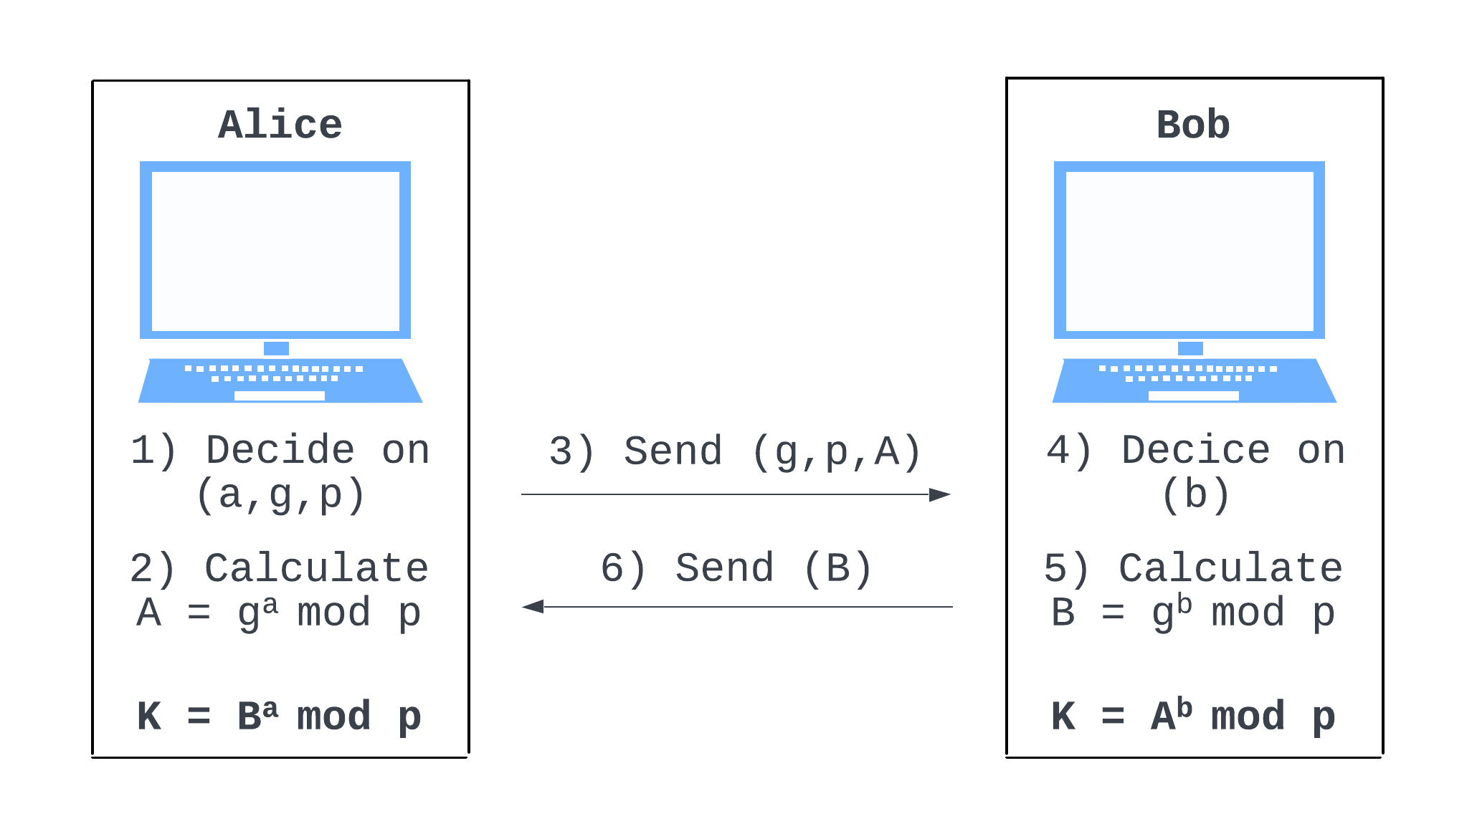

The ARP of War
Cole Weinstein, Robbie Young
References
System Setup
Attack Plan
ARP Spoofing
Denial of Service (DoS)
Exploiting Diffie-Hellman
ARP Cache: connects IP and hardware addresses
ARP Poisoning: lying about controlling an IP address to other machines on the network
Used by an attacker to insert themselves between two computers and read/edit their data
ARP was not designed for security; responses are taken at face value, even when unprompted
Regular webserver ARP cache
Poisoned webserver ARP cache
Denial of Service: overwhelm a victim server with traffic to prevent it from providing its services to clients
Application-layer attacks make simple requests that require long responses
Protocol attacks exploit lower-level Internet protocols, overwhelming the server’s network systems
Volumetric attacks flood a server with long requests, consuming the server’s bandwidth
Adversary in the Middle (AITM): an attacker places themselves between two communicating parties
Victims will continue to believe they’re talking over a direct connection
The attacker eavesdrops on all data going between the two victims, and can modify the communications as they wish
Only works when the parties do not have to verify their identifies
Symmetric Encryption: using a secret key and some math, scramble your data in a way that only other people with the same key can unscramble and read it
Our webserver and authserver use symmetric encryption to communicate without exposing user credentials to eavesdroppers
Diffie-Hellman: protocol used
to generate a shared secret
Alice and Bob can determine K,
while eavesdroppers cannot
Vulnerable to AITM as an attacker
creates separate shared secrets
with both Alice and Bob
The TCP Handshake
Client: SYN packet
“Hi! Can we talk?”
Server: SYN + ACK packet
“Hello! Yes, we can talk.”
Client: ACK packet
“Great.”
TCP SYN Flood
Attacker sends a bunch of AYN packets and never responds to the server’s SYN + ACK
Server left storing garbage data for each half-open connection
Attacker users random IPs to prevent their own computer from waiting for half-open connections

