Slide 1




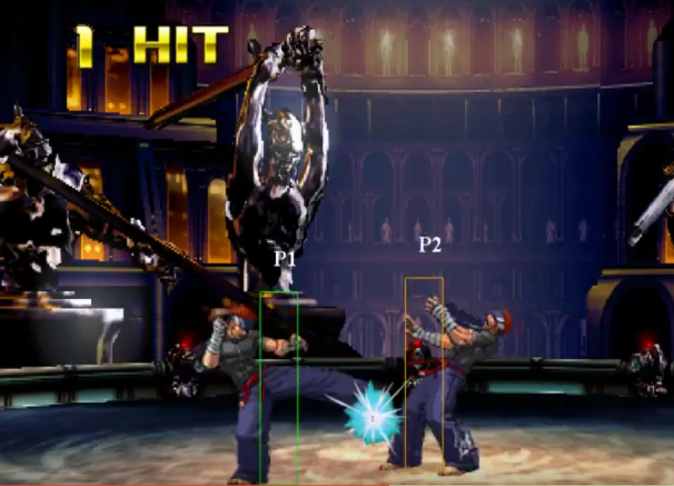
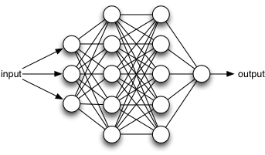
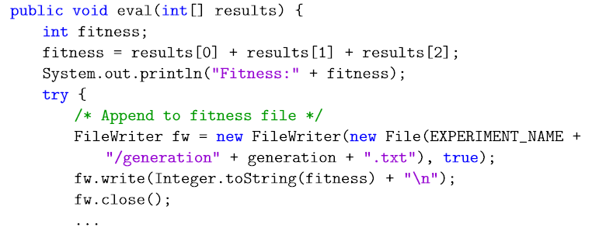
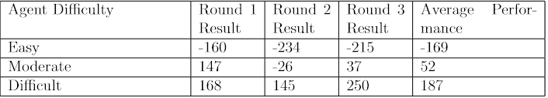
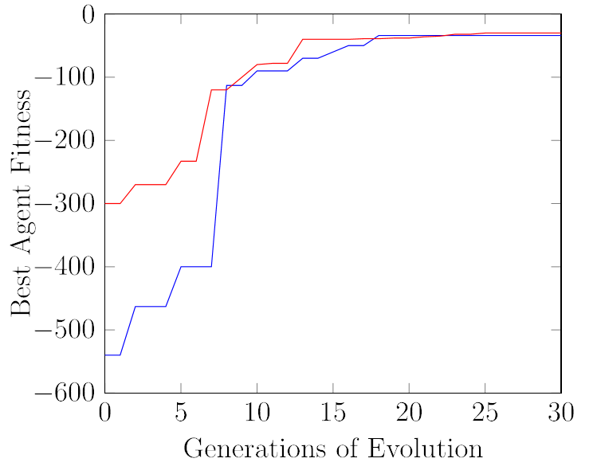



Robert John Dunn
BSc Computer Science
Supervisor: Dr Patricia A. Vargas
Co-Supervisor: Dr Fabrício Olivetti de França
Federal University of ABC, Brazil
SCHOOL OF MATHEMATICAL AND COMPUTER SCIENCES
Evolving a Learning Agent using Neuroevolution in the FightingICE Game Framework
Motivation
FightingICE
Artificial intelligence is the study of emulating intelligence in machines. [1]
One fundamental attribute of intelligence is the ability to learn.
The field of machine-learning aims to imitate this ability in machines. [2]
2-dimensional fighting video game.
Java based game framework organised and maintained by Ritsumeikan University, Japan. [3]
Two characters fight in an arena similar to popular games such as Tekken and Street Fighter.
Dissertation aims to implement the machine-learning method neuroevolution: evolutionary algorithms evolving an artificial neural network.
Agent implemented in the FightingICE framework.
Can the agent be evolved to a competitive level?
Will the introduction of an incremental learning environment benefit evolution rate?
Design
Prototype 1 : Agent controlled by artificial neural network perceiving and acting in environment.
Prototype 2 : Neuroevolution machine-learning method acting on weights of neural network.
Prototype 3 : Implement incremental learning environment.
https://github.com/robbiejdunn/FightingICENeuroevolution
https://youtu.be/EIxX_CfB4Q0
Results
Evaluate data from agent's evolution to determine effectiveness of evolution and incremental learning environment.
Evaluate performance versus human opponent.
Incremental learning environment
Learning agent implemented neuroevolution successfully.
Agent was evolved to point of being competitive versus a human opponent.
Incremental learning environment benefits rate of agent evolution.
Without
[1] Barto, S. (1998). Reinforcement Learning: An Introduction.
[3] FightingICE website - http://www.ice.ci.ritsumei.ac.jp/~ftgaic/index-2.html
[2] Michalski, R. (1983). Machine Learning: An Artificial Intelligence Approach.

