Slide 1
Light Penetration Through a Snow Depth Distribution over Sea Ice

Slide 2
Light Penetration Through a Snow Depth Distribution over Sea Ice

Slide 3
Light Loss in Stages
(1)
Reflection at Snow Surface
Attenuation in Snow Volume
Reflection at Ice Surface
Attenuation in Ice Volume
(2)
(3)
(4)

Slide 4
Light Loss in Stages: Assumptions
Loss after surface reflection
Beer-Lambert Attenuation
Ice is uniformly attenuating

Slide 5
Two-layer Beer-Lambert exponential decay in snow/ice system
T_s = 0.05
E_s = 14 m-1
T_i = 0.5
E_i = 1.2 m-1
Abraham et al., 2015
T_s
E_s
T_i
E_i

Slide 6
Light Loss Plot
Height
Downward Light Flux (log)

Slide 7
Light Loss Plot
Height
Downward Light Flux (log)

Slide 8
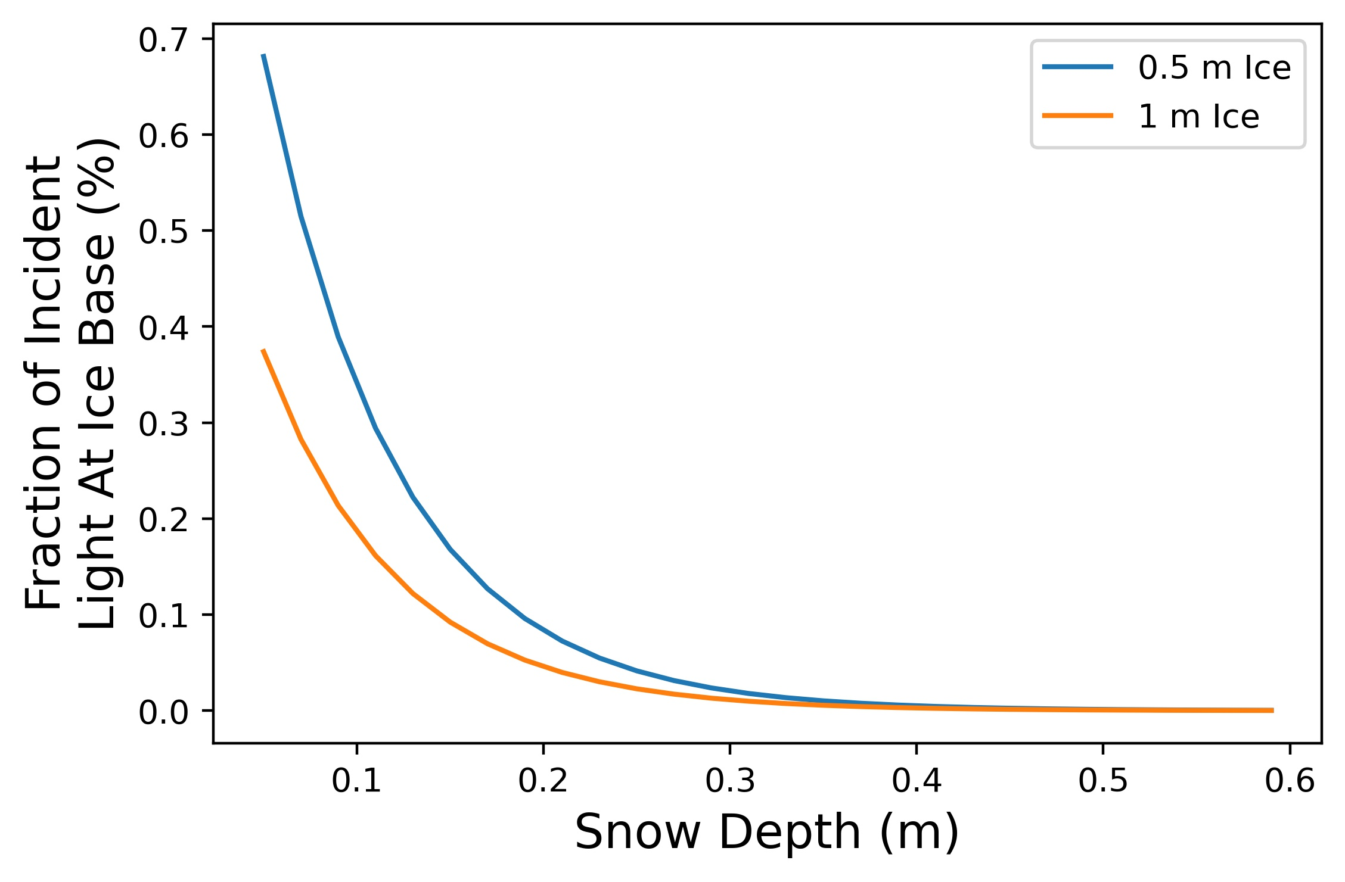
Light Loss Plot

Slide 9
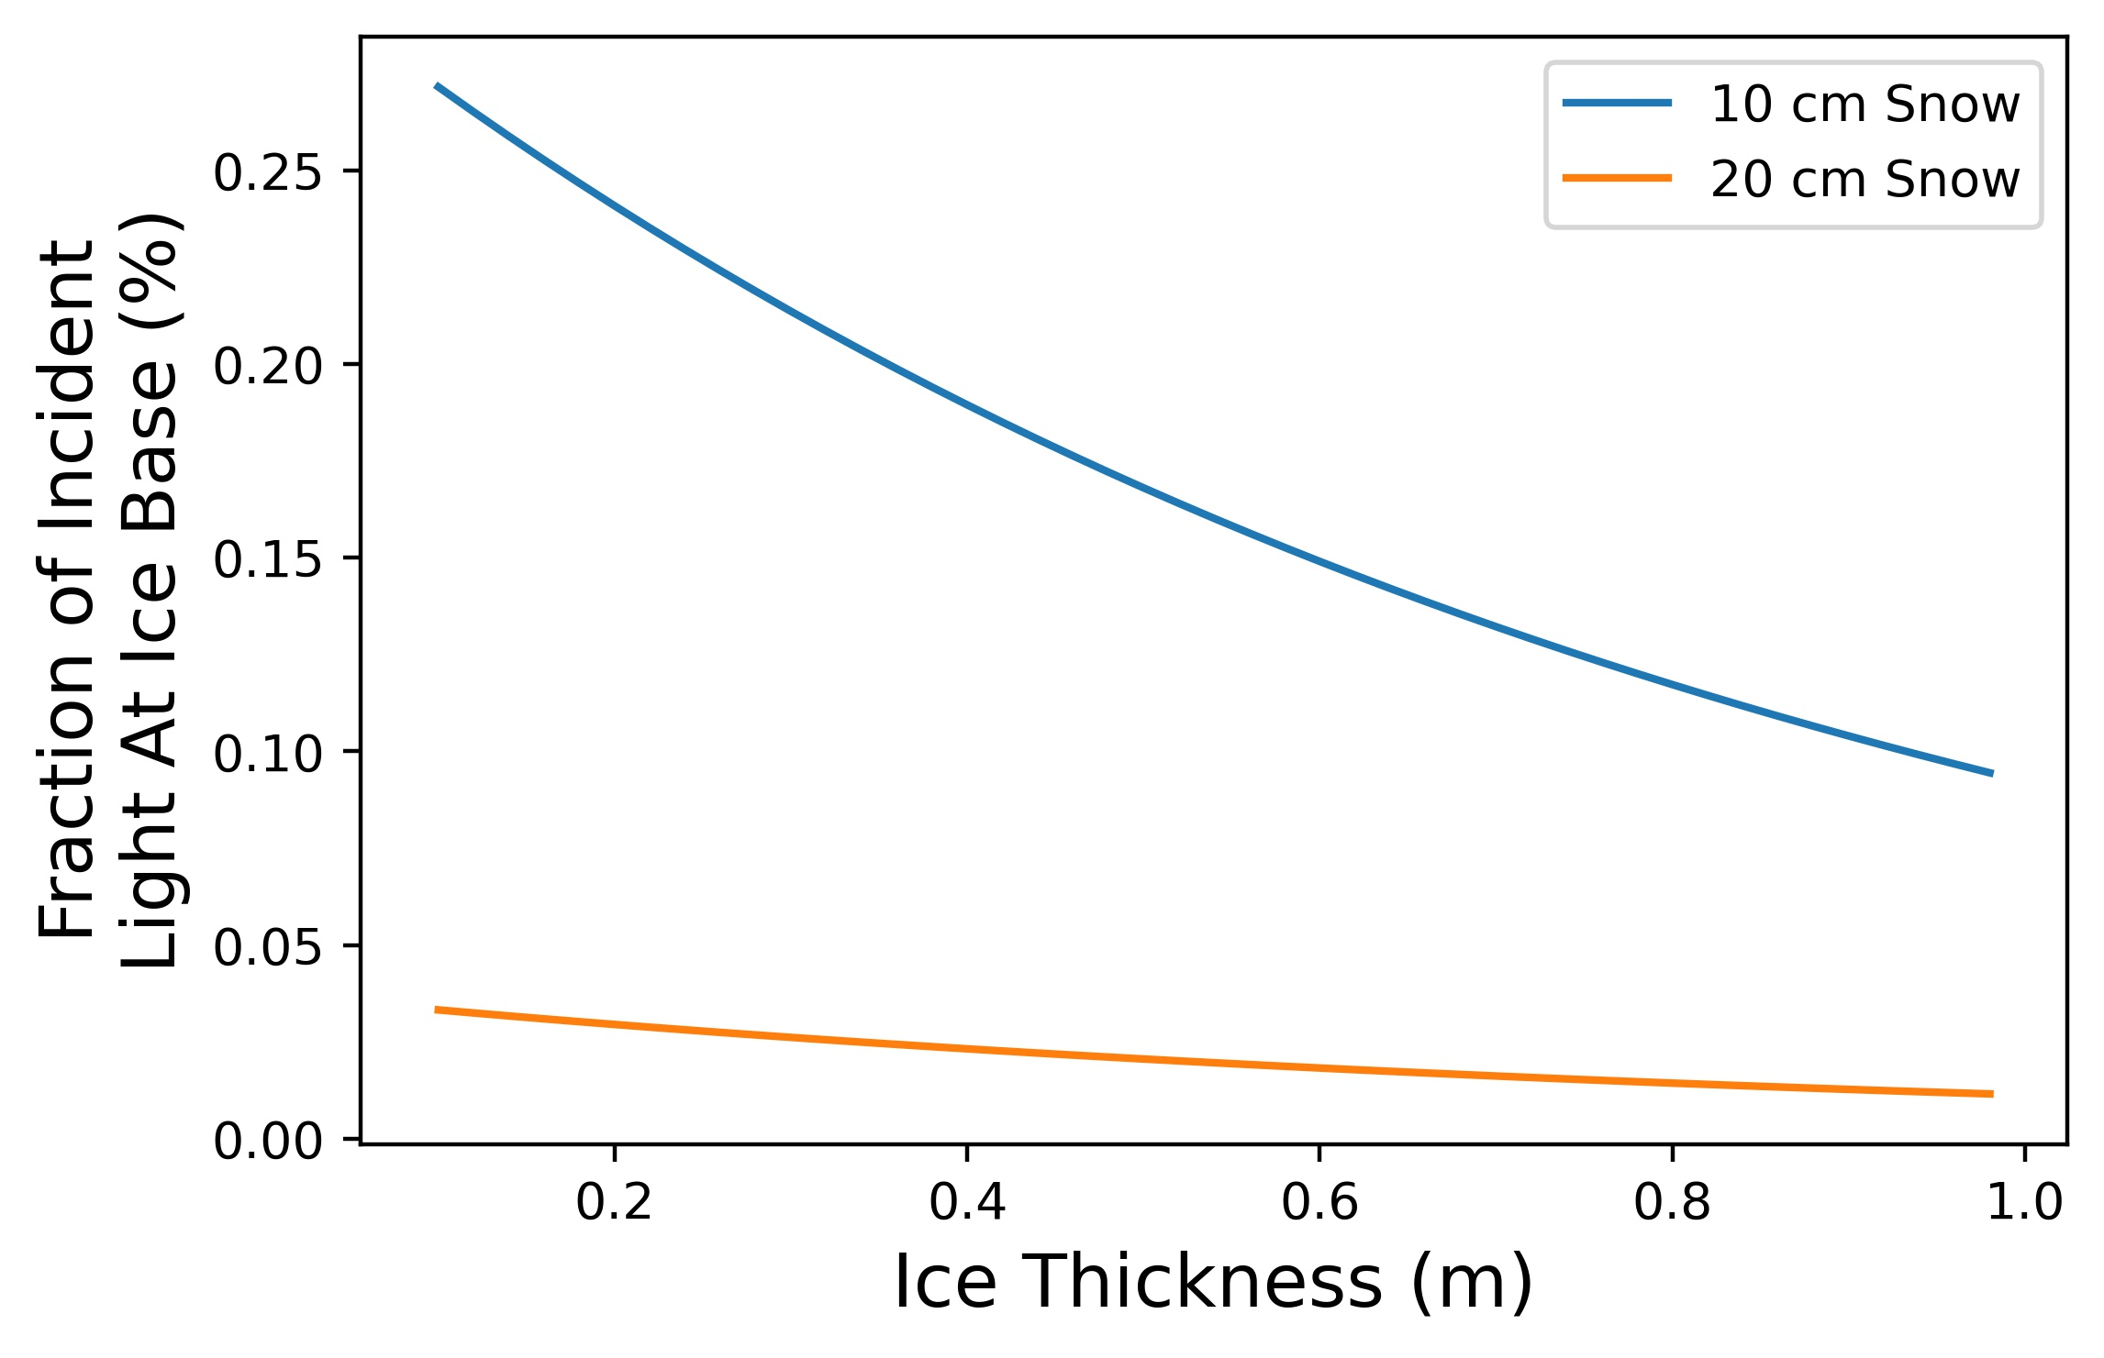
Light Loss Plot

Slide 10
Different Snow Depth Bins
Lots of Light!
Not Much Light!

Slide 11
Different Snow Depth Bins Cover Different Areas of the Floe
Lots of Light!
Not Much Light!

Slide 12
The Snow Depth Distribution Affects the ‘Window Area’
Window
Lots of Light!
Not Much Light!

Slide 13
The Snow Depth Distribution Affects the ‘Window Area’
Window
Lots of Light!
Not Much Light!

Slide 14
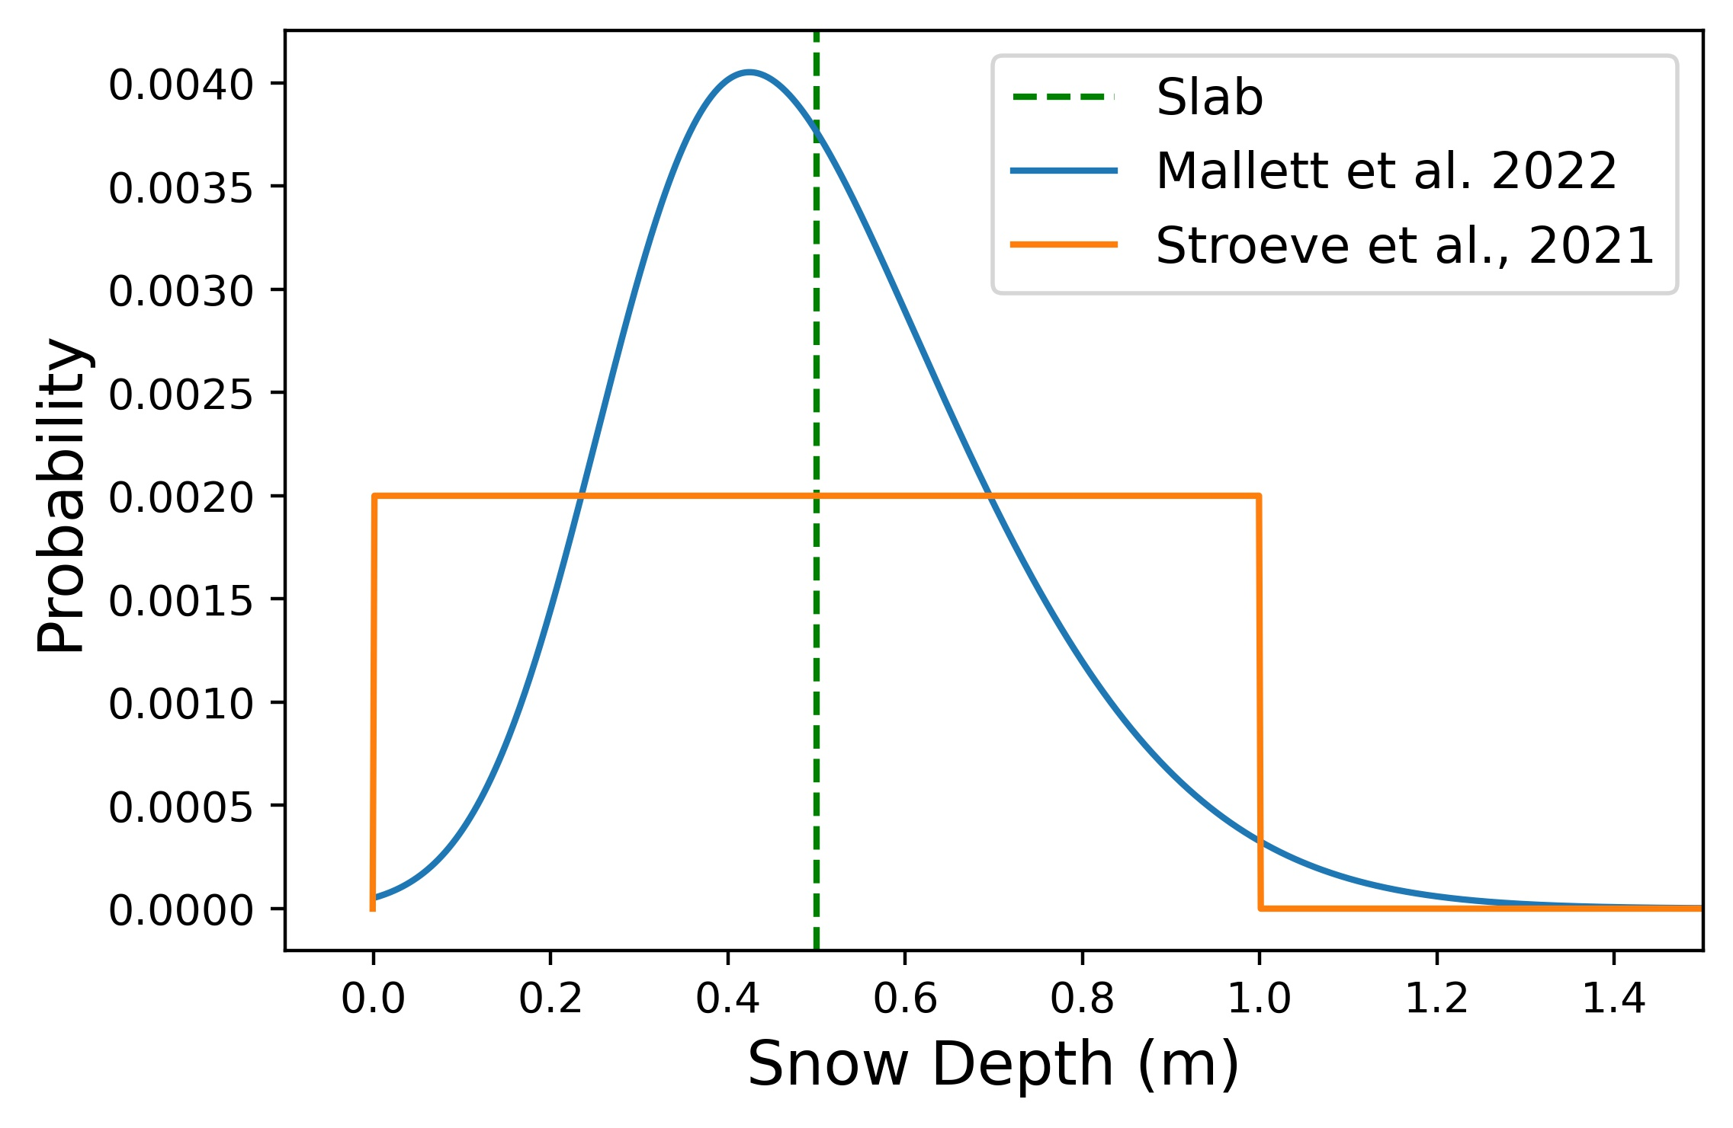
But what is the snow depth distribution?

Slide 15
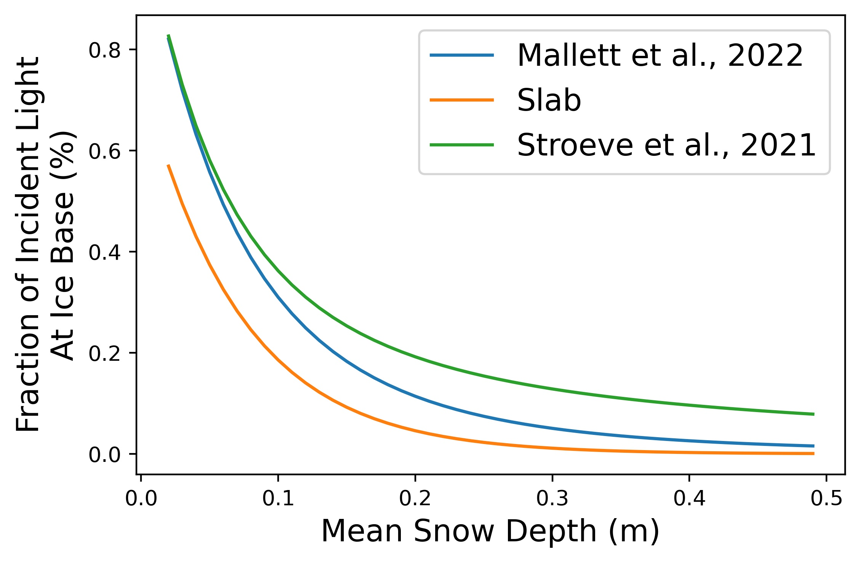
Results of Bin Integration

Slide 16
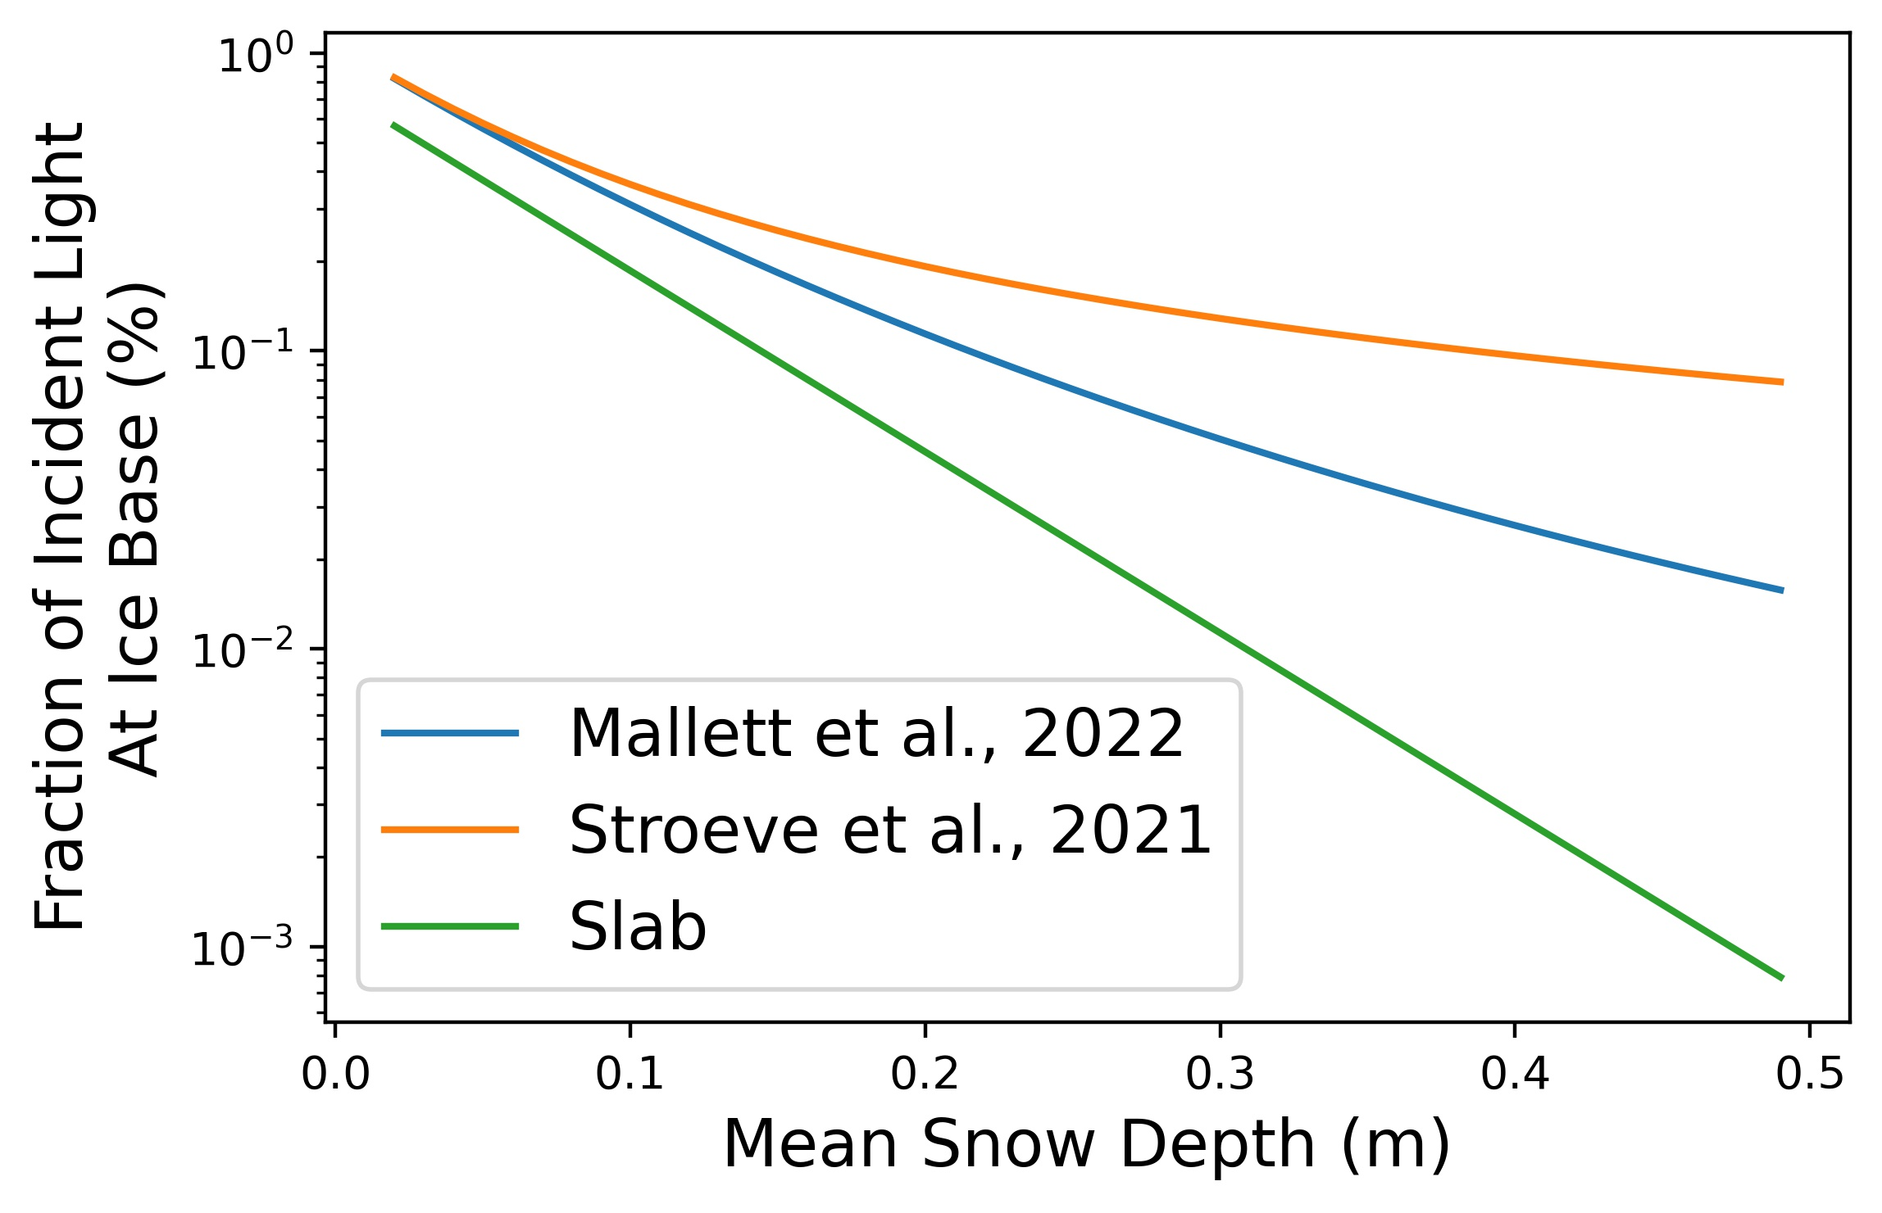
Results of Bin Integration

Slide 17
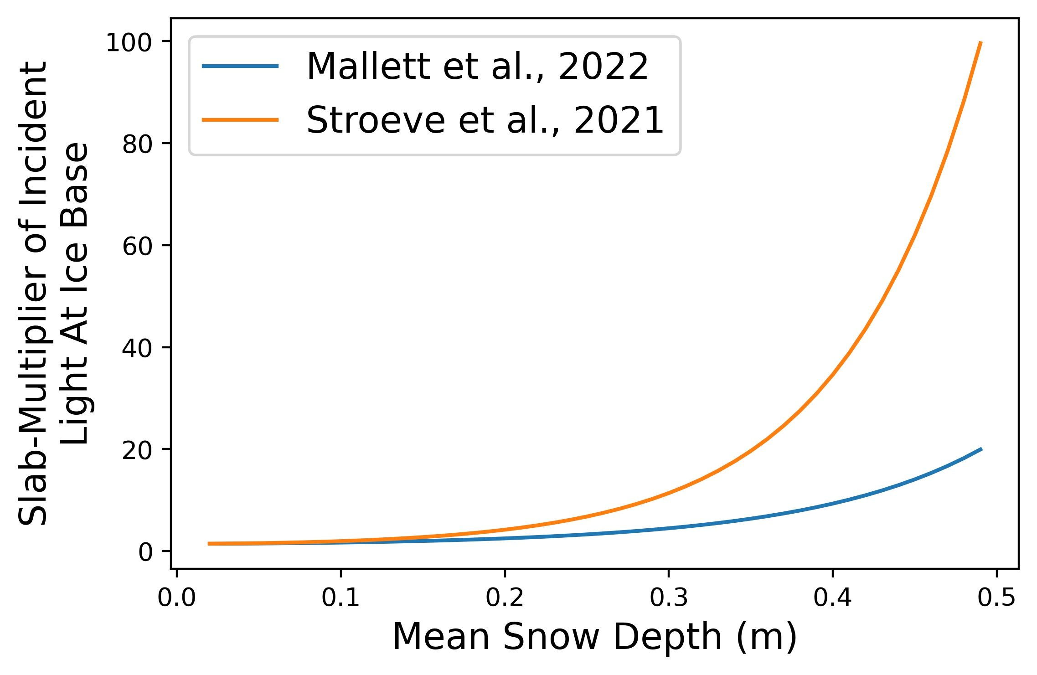
Results of Bin Integration

Slide 18
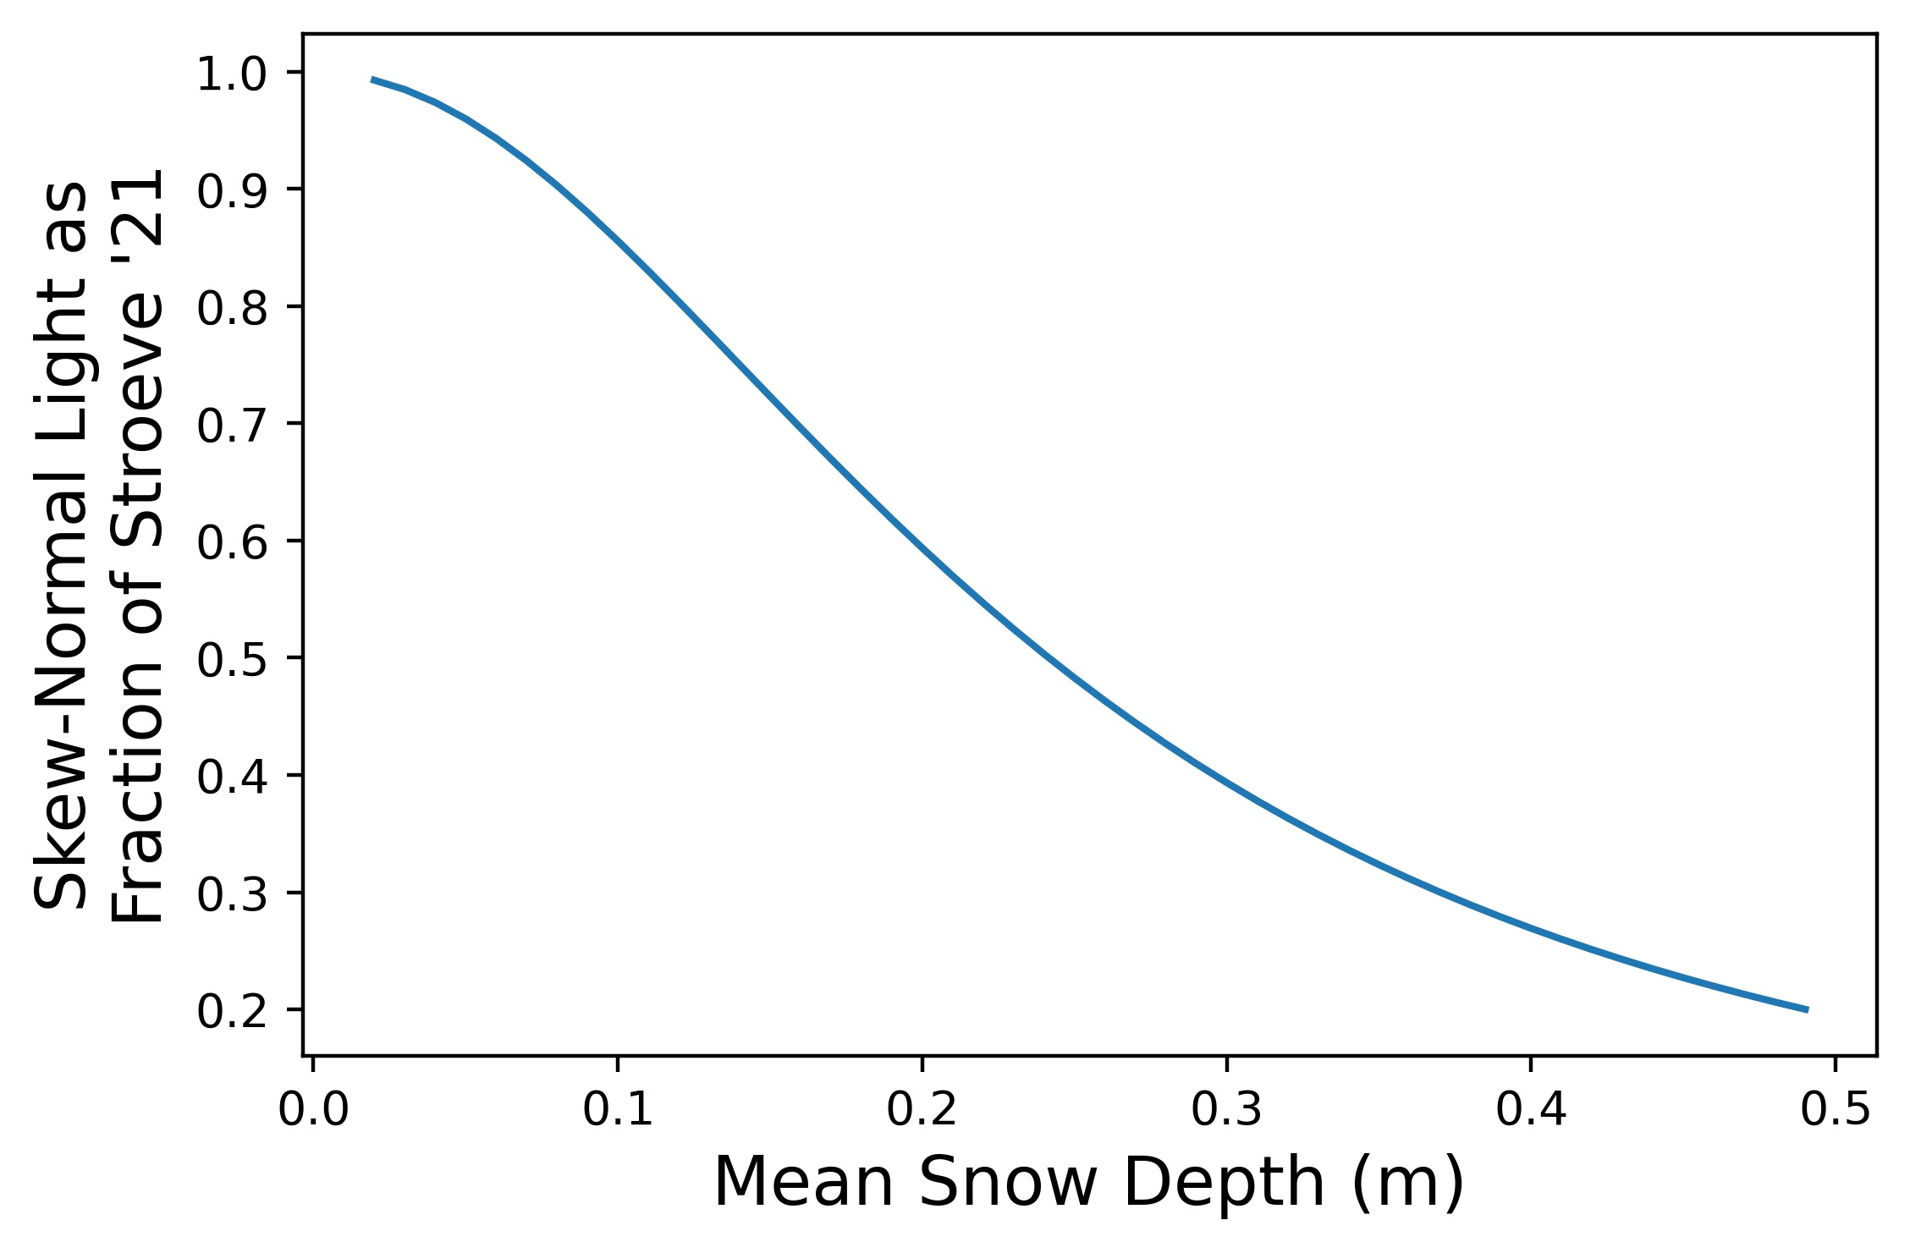
Results of Bin Integration

Slide 20
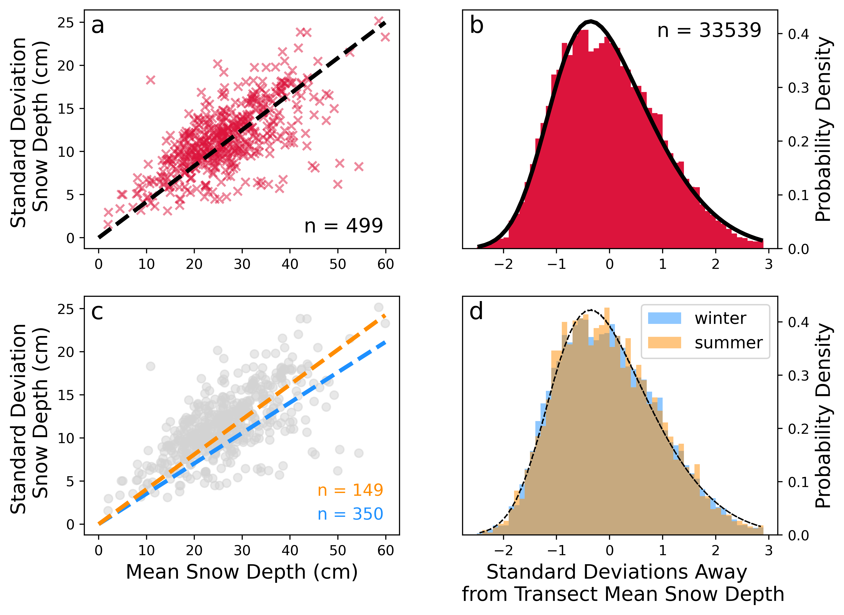
But what is the snow depth distribution?

