Slide 1
King County, WA Home Prices
Robbie Walsh
Notes:
I found a dataset of about 4,000 houses in King County WA
Information on selling price (assuming), which is to be predicted
Information on home, # bedrooms, # bathrooms, condition score, view score, year built, etc.
Information on where house is, address, zip code, waterfront indicator
Merged in data from UMichigan on zip code level median household income
Data from census on # of businesses operating in a zip code, more on that later
House price data is over 3 months in 2014, so relatively cross sectional

Slide 2
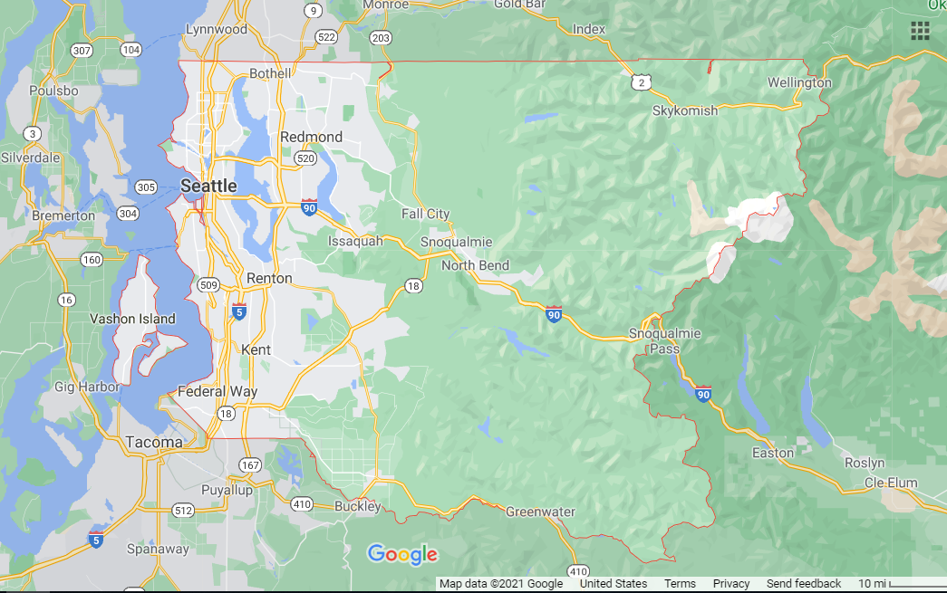
Where is King County?
Notes:
Western WA, contains Seattle, some northern/southern suburbs, eastern suburbs, rural/small towns to the east

Slide 3
Data Modifications
2 obs with 0 price, removed
2 obs with price > $10 million, not correct, removed
Transformations to variables
“Professional Services” variable, prof_biz
Notes:
Some prices clearly not correct
Lots of right-skewed variables, used log transform
Talk about variable from census data

Slide 4
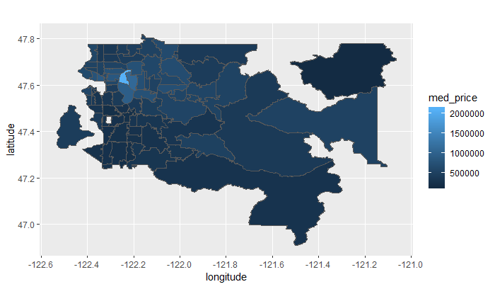
Median House Price by Zip Code
Notes:
Zip codes that appear in dataset
Based on 2010 zip codes, 2014 data, mostly the same for populated areas
Median house price in dataset is $465,000

Slide 5
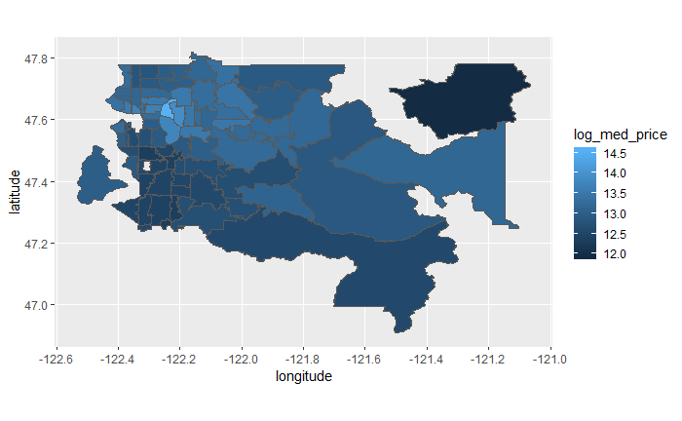
Log of Median Home Price by Zip Code
Notes:
Less interpretable but we can see general geographical distribution better
Eastern suburbs highest prices, southern lowest, everywhere else tends to be in the middle

Slide 6
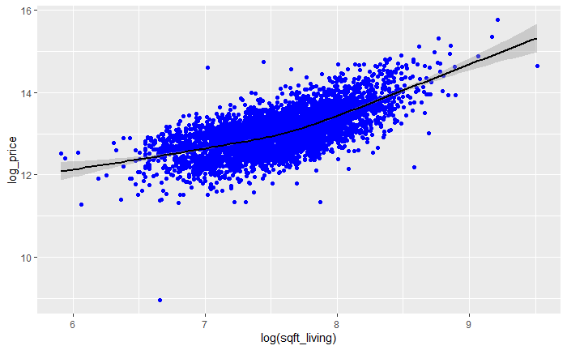
Clear Patterns, Lots of Variability
Notes:
House prices are notoriously difficult to model
Cross sectional makes it easier, even so the final model has an R-sq of 68%

Slide 7
Model Development
Lots of graphs
Boxcox for price’s log transform
Kitchen sink, manual backward selection
Check VIFs
Glinternet, L1/LASSO regularization with interactions
Notes:
Touch on some of this quickly
Wasn’t seeing much evidence for interactions in graphs
Glinternet considers all possible interactions, performs group LASSO
Need both base levels in model for interaction
Ran across a range of regularization parameters, chose a fairly strong one, gave two interactions
Considered both, dropped one due to high VIF

Slide 8
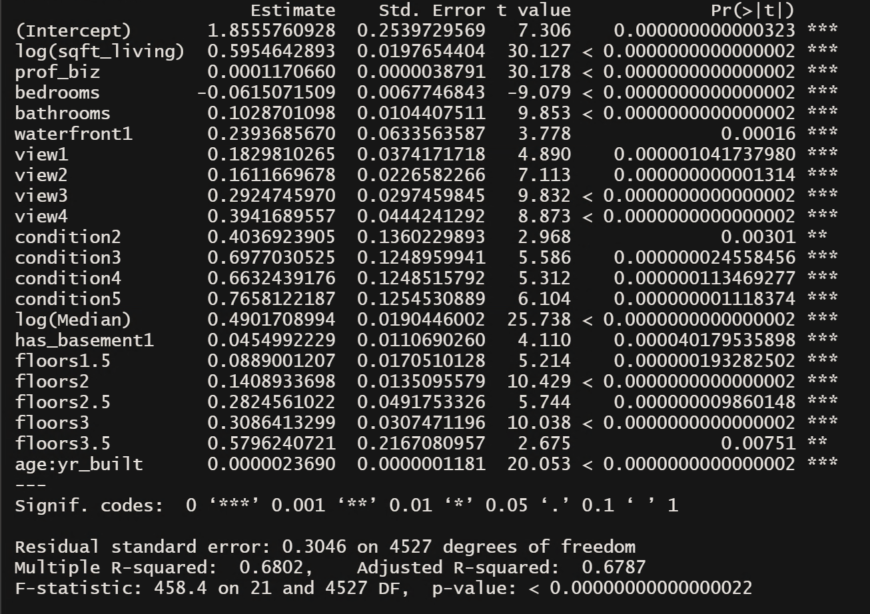
The Final Model
Notes:
Sqft living very important, log-log specification roughly translates to, if we increase sqft by 1% (all else equal), we expect price to increase by 0.59%
Location factors are important, prof_biz and median hhi are two of the strongest predictors
Bedrooms negative, once accounting for everything, wasting space on another bedroom is marginal negative
Waterfront and basement are interesting, gives you a “waterfront premium” and “basement premium”, which are about 27%, and 4.65%, respectively
Age x yr_built strange, from glinternet, not sure how to explain

Slide 9
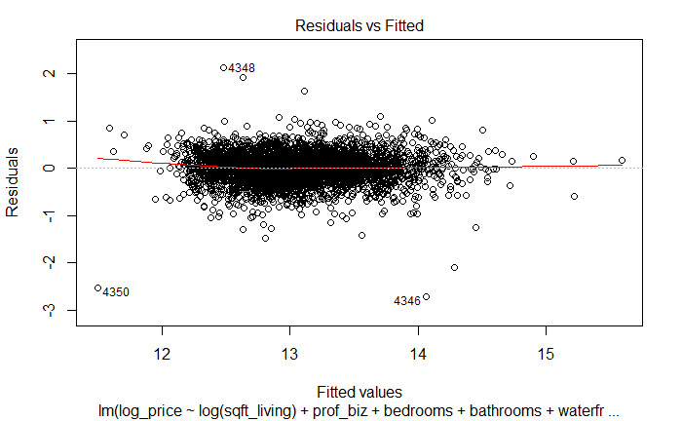
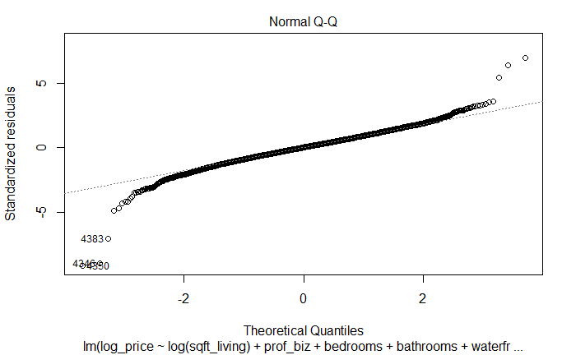
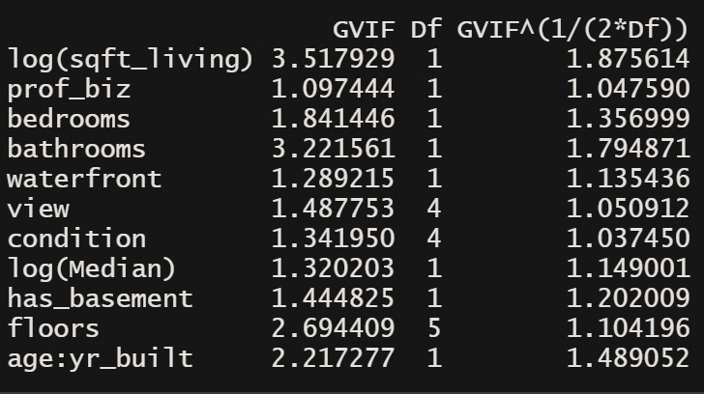
Assumptions
Notes:
Overall linearity seems ok, made lots of transformations to ensure this assumption met
Normality ok, tails are a bit fat, predictions aren’t as strong there
VIFs are low, were part of model dev
Independence not met, spatial autocorrelation, attempted to control for location but within zip code effects hard to get

Slide 10
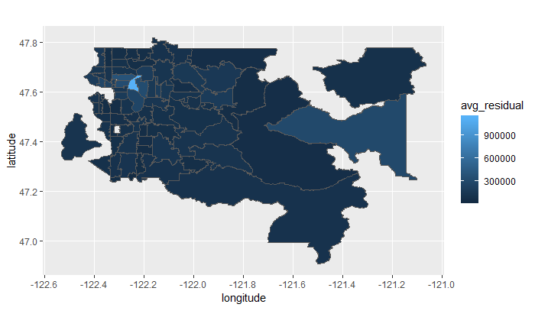
Average Absolute Residual for each Zip Code
Notes:
Did better than it looks, super high house price zip codes missed

Slide 11

Log of Average Absolute Residual
Notes:
Gives us a better look
Model tends to miss on more extreme observations, super high price, very high sqft, etc.

Slide 12
Improvements
Local models
Seattle 69% Rsq, not Seattle 76% Rsq
More data would allow for zip code dummies
Notes:
Local models, not only are Rsq different but coefficients different

Slide 13
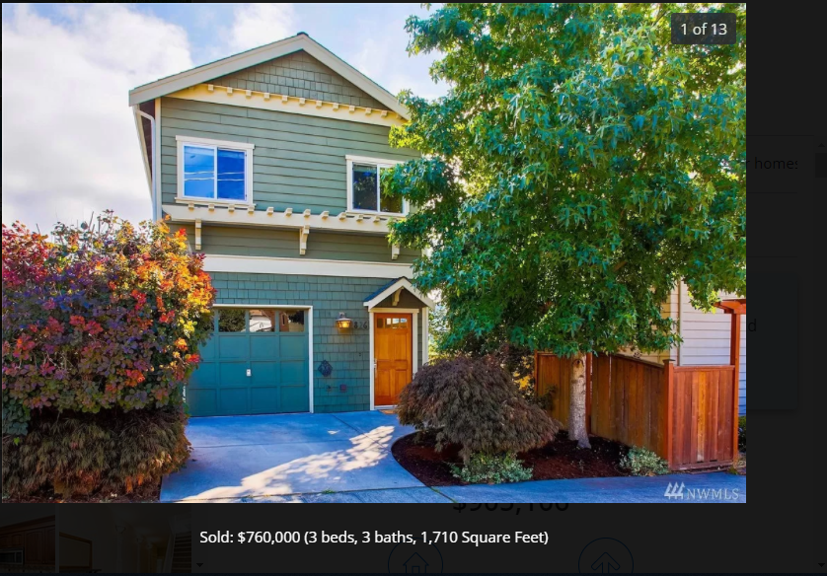
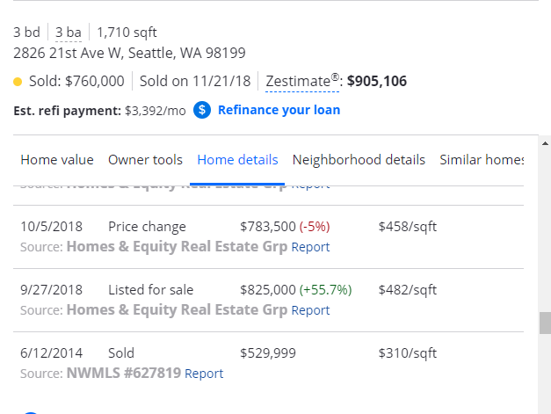
Incorrect Data?
3rd Largest Residual (absolute)
2821 21st Ave W, Seattle WA 98199
Dataset says 3 beds, 3 baths, 1710 sqft
Price is $2,560,498?
Prediction was $496,586

