Slide 1

REAL ESTATE PRICE FORECASTING USING REGRESSION MODELLING
GROUP 2

Slide 2

Introduction
The real estate industry is complex and dynamic
Multiple players like homeowners, buyers, and real estate agents face the challenge of establishing the fair market value of a house
Inaccurate pricing affects both buyers and sellers
Utilizing a multiple linear regression model can provide a data-driven solution to the challenge
We seek to provide a tool that assists stakeholders in determining house prices

Slide 3
Project Overview
The goal of this project is to develop a robust regression model for predicting house prices in a specific real estate market, thereby addressing the critical need for accurate and reliable property price estimations.
By leveraging advanced data analysis techniques and predictive modeling, this initiative aims to provide invaluable insights to various stakeholders, including prospective homebuyers, sellers, real estate agents, and property investors.

Slide 4
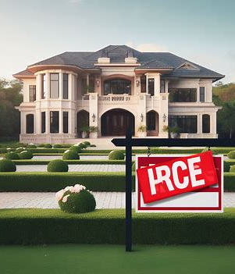
Business Understanding
Inadequate pricing models often lead to overpriced properties, resulting in extended time on the market.
Overpricing contributes to prolonged periods of property stagnation and limited buyer interest.
Prospective buyers encounter difficulties in identifying properties that align with their budgetary constraints.
A lack of robust pricing strategies hinders effective decision-making for both sellers and buyers.
Implementing an accurate and efficient housing pricing model can streamline the buying and selling process, enhancing market competitiveness and overall transaction efficiency.

Slide 5

Problem Statement
The real estate market demands accurate pricing for homes. Inaccurate pricing can lead to prolonged property listings and missed profit opportunities as well as harming both sellers and buyers.
Core problem: Accurate pricing of homes in the market. A data-driven solution is needed to provide precise price predictions, addressing real estate market challenges.

Slide 6
Objectives
a) Build a regression model that can predict suburban house prices with an accuracy of at least 75%, ensuring that the predictions are within a range of $75,000 from the actual prices.
b) Identify Key Factors Influencing House Prices in King County, California, to provide valuable insights for precise pricing strategies.
c) Analyze Model Performance using metrics such as mean squared error, R-squared values, and residual analysis to gauge the model's effectiveness.
d) Provide Actionable Recommendations to the Real Estate Agency for improving profitability and market presence, leveraging insights from the model.

Slide 7
Data Understanding
Data Source: The dataset used in this analysis was sourced from the King County, Washington real estate database, which compiles information on residential properties
Data Structure: Approximately 21,597 records,
Data Types: It has numerical and categorical data with minimal missing values or anomalies.

Slide 8
Data Understanding
Data Columns in the dataset include:
Date – Date house was sold
Price – Sale price(prediction target)
Bedrooms – Number of bedrooms
Bathrooms – Number of bathrooms
Sqft_living – Square footage of living space in the house
Sqft_lot – Square footage of the lot
Floors – Number of floors(levels) in the house
Sqft_above – Square footage of the house apart from the basement.
Sqft_basement – Square footage of the basement.
Yr_built – Year when house was built.
Yr_renovated – Year when house was renovated.
Lat – Latitude coordinate.
Long – Longitude coordinate.
Sqft_living15 – The square footage of interior housing living space for the nearest 15 neighbors.
Sqft_lot15 – The square footage of the land lots of the nearest 15 neighbors.

Slide 9
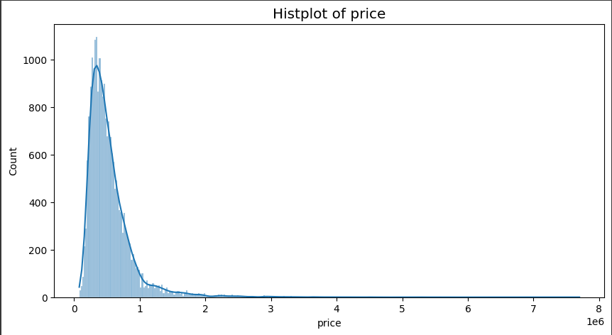
ANALYSIS
Distribution of Price
- Most houses are price between $100K and $1M

Slide 10
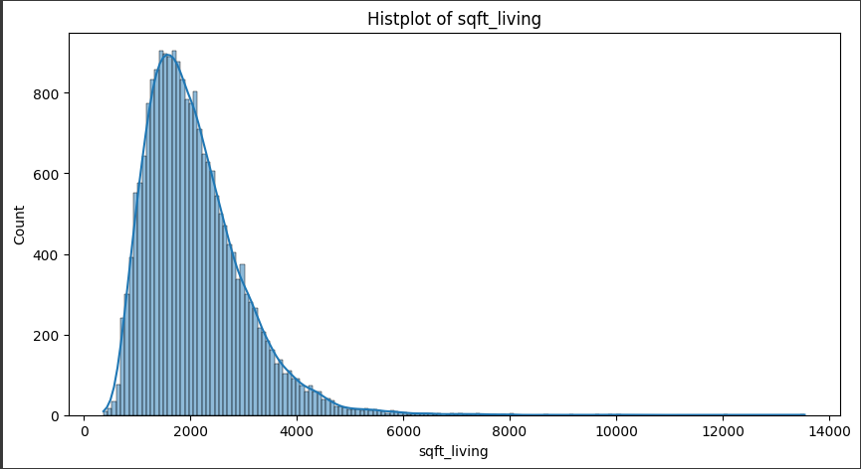
House Sizes
Most houses have between 700 and 5000 sqft of space
Some have as much as 12000 sqft

Slide 11
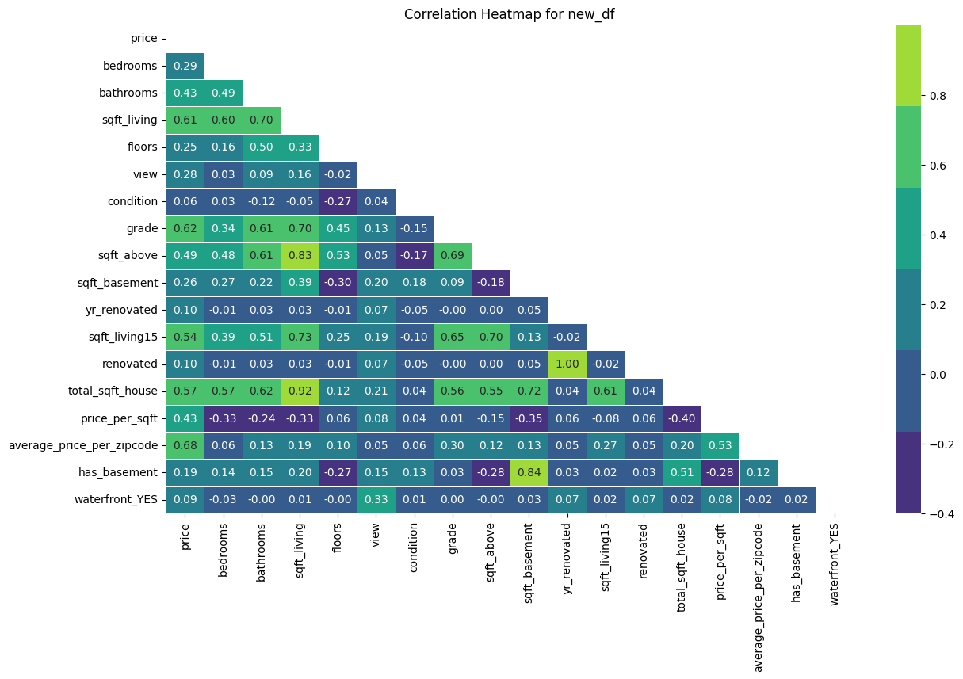
ho
Correlation between Price and Other Features

Slide 12
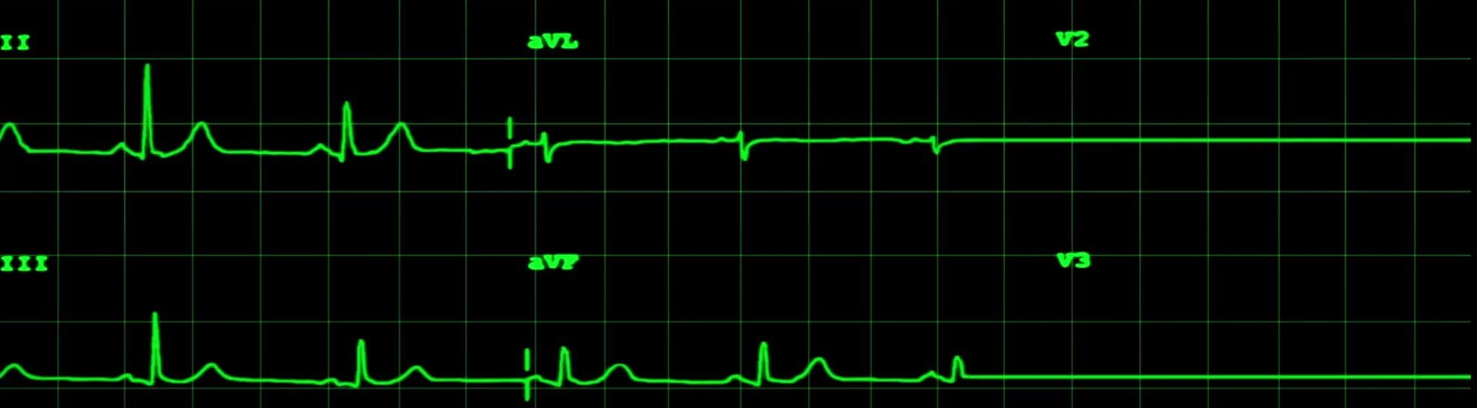
Regression Modeling
Model | R-Squared Value | RMSE | Observation
Baseline Model | 46.01% | $124,066 | This model has a weak predictive capability.
Multiple Linear regression | 81.4% | $71,295 | The model has a strong predictive capability.

Slide 13
Interpretation of the Model
Model Overview The model predicts property prices with an intercept of $491,419
Key Factors Affecting Price Living Space: $25,790 increase per square foot. Bedrooms: $6,716.56 increase per bedroom. Bathrooms: $5,756.37 increase per bathroom. Year Renovated: $1,116.40 increase per year renovated
Influential Features Neighborhood View: $25,444.25 increase per unit. Basement: $72,121.07 increase for properties with a basement. Waterfront: $ 62,300.17 increase for properties with waterfront

Slide 14
Challenges
The outcome can be affected by external factors such as market prices and economy as well as other policies that can disrupt the real estate industry.
Data on more expensive houses was relatively small hence the model may not be very accurate in predicting expensive houses > $2 million

Slide 15
Conclusion
The real estate market is dynamic and complex
There is a need for a robust model that predicts the prices of the houses
We developed a regression model to explain the relationship between house prices and other variables
The Real Estate Agency should consider investing in houses with a nice view, large basement, and waterfront

Slide 16
Recommendations
Emphasize Important Features: Highlight the importance of living space, bedrooms, and bathrooms in property listings to attract potential buyers.
Stress Renovation Potential: Promote the value of properties with recent renovations, as they tend to attract buyers looking for move-in-ready homes.
Consider Neighborhood View: Highlight properties with appealing views to capture the interest of potential buyers who value scenic surroundings.
Educate on Basement Benefits: Inform buyers about the advantages of properties with a basement, such as additional space for storage or living areas.
Market Waterfront Properties: Showcase properties with a waterfront location, emphasizing the premium value associated with such desirable features.
Price Competitively: Use the insights from the predictive model to set competitive prices for properties, considering the influence of various features on property prices

